Slide 1
Introduction to Business Studies
“International Class of Accounting Education”
ABDULLAH TAMAN, M.SI., Ak.
Lecturer of Accounting Education Department
Faculty of Economics
YOGYAKARTA STATE UNIVERSITY

Slide 2
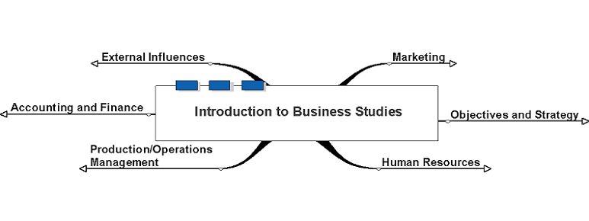
Introduction to Business Studies

Slide 3
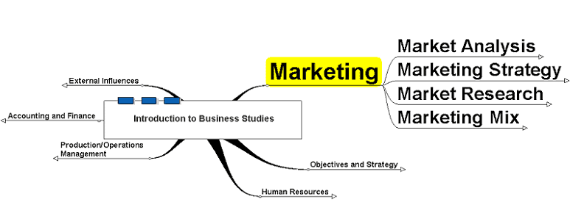
Marketing

Slide 4
Market Analysis
Size
Segments

Slide 5
Marketing Strategy
Objectives
Niche v Mass marketing
Portfolio analysis

Slide 6
Market Research
Primary
Secondary

Slide 7
Marketing Mix
The 7 Ps
Elasticity of Demand

Slide 8
Objectives and Strategy

Slide 9
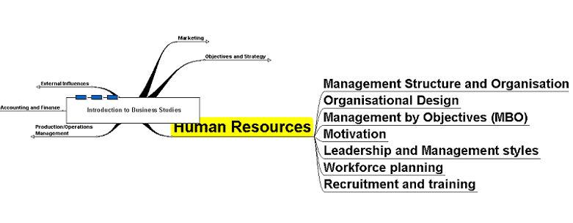
Human Resources

Slide 10
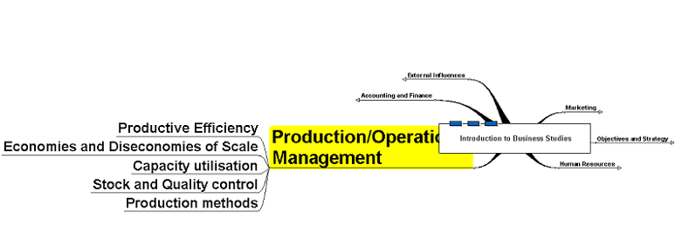
Production/Operations Management

Slide 11
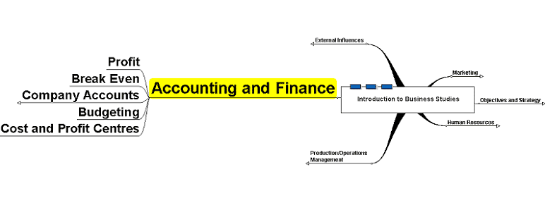
Accounting and Finance

Slide 12
Company Accounts
Profit and Loss Account
Balance Sheet

Slide 13
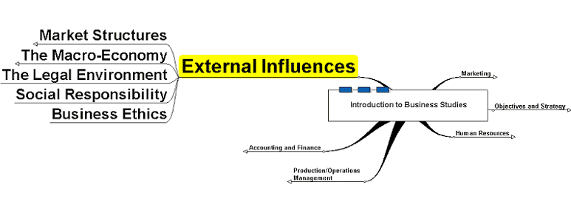
External Influences

Slide 14
Market Structures
Oligopoly
Monopoly
Perfect Competition
Imperfect Competition

Slide 15
The Macro-Economy
Business Cycles
Government Objectives
Government Policies

