Slide 1
BIOLOGY EDUCATION
Dr. Slamet Suyanto,M.Ed.
Biology- FMIPA - UNY

Slide 2
QUESTIONS
WHAT IS BIOLOGY?
WHAT ARE THE CHARACTERISTICS OF THE LEARNERS?
WHAT ARE THE CHARACTERISTICS OF A GOOD TEACHER?
HOW TO TEACH & LEARN BIOLOGY?
HOW TO MOTIVATE & OPTIMIZE STUDENTS’ LEARNING?
HOW TO ASSESS LEARNING PROGRESS?

Slide 3
BIOLOGY
BIOS + LOGOS
BIOS = LIVE
LOGOS = SCIENCE
BIOLOGY IS SCIENCE THAT STUDIES LIVING THINGS AND THE PROCESS OF LIFE

Slide 4
BIOLOGY AS A SCIENCE
IT HAS OBJECTS
IT HAS THEMES OR PROBLEM TO STUDY
IT HAS METHODS
IT HAS APPLICATIONS
IT HAS CAREERS IN SOCIETIES

Slide 5
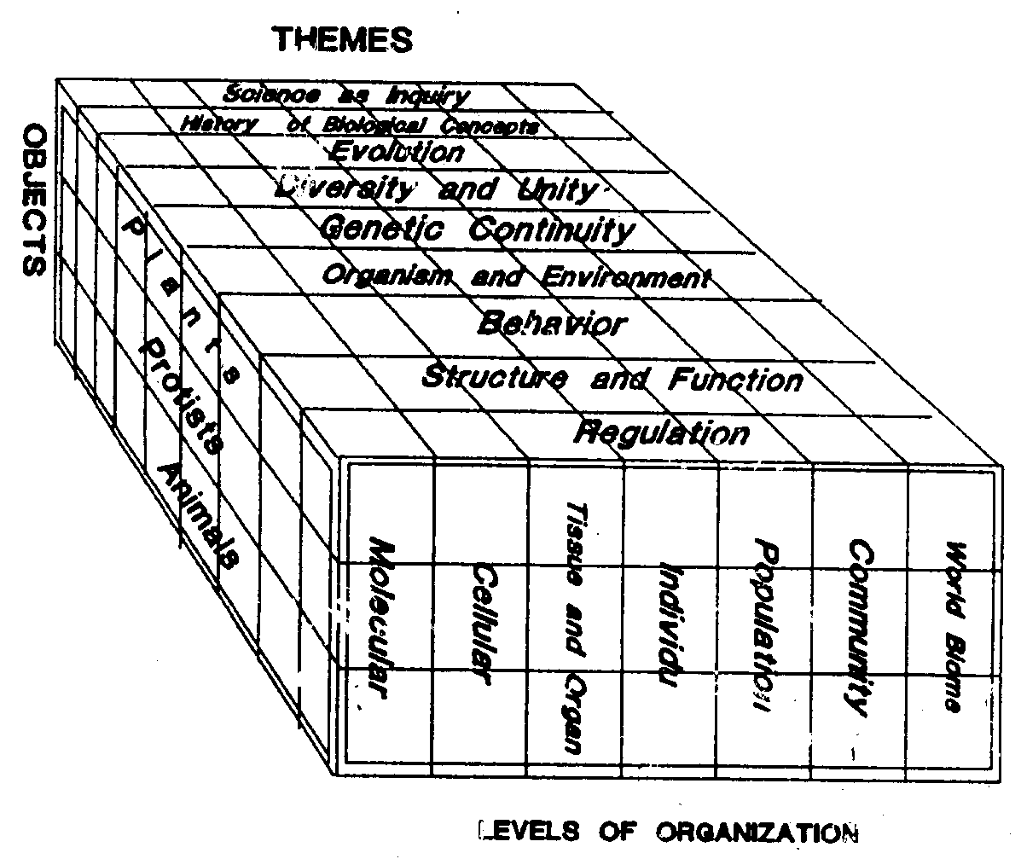
THE STRUCTURE OF BIOLOGY

Slide 6
Biology Education
Objects: Learning Biology
Problem: How to learn biology easier, faster, and better
Application: Biology Instruction in schools
Products: Book, curriculum, lesson plan, assessment instrument, etc.
Career: educator, teacher, professor

Slide 7
BIOLOGY AND BIOLOGY EDUCATION
 | Biology | Biology Education
Object | Living things | Learning
Problem/ Theme | 7 Themes of life | Curriculum, instruction, evaluation
Method | Scientific Method | Social Research
Product | Book, journal, goods on biology | Book, journal, on education
Career | Biology Expert | Educators
Application | Nature, Industries | Schools

Slide 8
THE CHARACTERISTICS OF THE LEARNERS

Slide 10
LEARNING STYLES

Slide 11
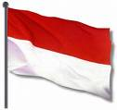
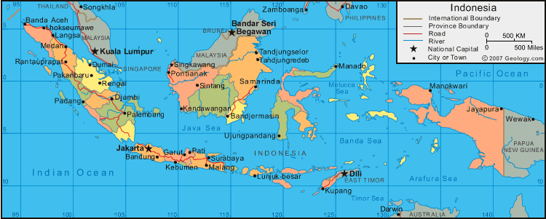
INDONESIAN tropical biology

Slide 12
AUSTRALASIA
Australasia is a region of Oceania: Australia, New Zealand, the island of New Guinea, and neighbouring islands in the Pacific Ocean. The term was coined by Charles de Brosses in Histoire des navigations aux terres australes (1756). He derived it from the Latin for "south ofAsia" and differentiated the area from Polynesia (to the east) and the southeast Pacific (Magellanica). It is also distinct from Micronesia (to the northeast).

Slide 13
PEOPLE & TRIBE
Australasia is sometimes used as a term for Australia and New Zealand together, in the absence of another word limited to those two countries. Sometimes the Island of New Guinea (including Papua New Guinea and the Indonesian part of the island) is encompassed by the term. There are many native tribes with similar appearence: aborigin, asmat, .

Slide 14
AUSTRALASIAN ZONE
The Australasian zone is an ecological region that is coincident, but not synonymous (by some definitions), with the geographic region ofAustralasia.^{[citation needed]} The ecozone includes Australia, the island of New Guinea (including Papua New Guinea and the Indonesian province ofPapua), and the eastern part of the Indonesian archipelago, including the island of Sulawesi, the Moluccan islands (the Indonesian provinces ofMaluku and North Maluku) and islands of Lombok, Sumbawa, Sumba, Flores, and Timor, often known as the Lesser Sundas. The Australasian ecozone also includes several Pacific island groups, including the Bismarck Archipelago, Vanuatu, the Solomon Islands, and New Caledonia.New Zealand and its surrounding islands are a distinctive sub-region of the Australasian ecozone. The rest of Indonesia is part of the Indomalayanecozone. ^{[1]}

Slide 15
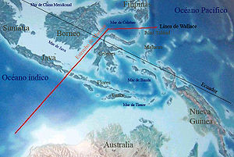
WALLACE LINE

Slide 16
WALLACE LINE
The Wallace Line (or Wallace's Line) is a boundary that separates the ecozones of Asia and Wallacea (which is a transitional zone between Asia and Australia). West of the line are found organisms related to Asiatic species; to the east, a mixture of species of Asian and Australian origin are present. The line is named after Alfred Russel Wallace, who noticed this clear dividing line during his travels through the East Indies in the 19th century. The line runs through Indonesia, between Borneo and Sulawesi(Celebes); and through the Lombok Strait between Bali (in the west) and Lombok (in the east). Antonio Pigafetta had also recorded the biological contrasts between the Philippines and the Maluku Islands (Spice Islands) (situated on opposite sides of the line) in 1521 during the continuation of the voyage of Ferdinand Magellan (after Magellan himself had been killed on Mactan)

Slide 17
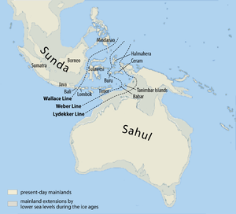
LYDEKKER LINE

Slide 18
Richard Lydekker (25 July 1849 – 16 April 1915) was an English naturalist, geologist and writer of numerous books on natural history.
Lydekker was born in London, and educated at Trinity College, Cambridge, where he took a first-class in the Natural Science tripos (1872).^{[1]} In 1874 he joined the Geological Survey of India and made studies of the vertebrate paleontology of northern India (especially Kashmir). He was responsible for the cataloguing of the fossil mammals, reptiles and birds in the Natural History Museum. His books included A Manual of Palaeontology (with Henry Alleyne Nicholson, 1889) and The Wild Animals of India, Burma, Malaya, and Tibet.

Slide 19
WALLACE, LYDEKKER, & WEBBER LINE
Australia is likewise connected via the shallow ocean over the Sahul Shelf to New Guinea, and the related biogeographic boundary known as Lydekker's Line, which separates the eastern edge of Wallacea and the Australian region, has a similar origin. During ice age glacial advances, when the ocean levels were up to 120 m lower, both Asia and Australia were united with what are now islands on their respective continental shelves as continuous land masses, but the deep water between those two large continental shelf areas was — for a period in excess of 50 million years — a barrier that kept the flora and fauna of Australia separated from that of Asia. Wallacea consists of islands that were never recently connected by dry land to either of the continental land masses, and thus was populated by organisms capable of crossing the straits between islands. "Weber's Line" runs through this transitional area (rather to the east of centre), at the tipping point between dominance by species of Asian vs. Australian origin.^{[1]}

Slide 20
WEBBER LINE
Max Carl Wilhelm Weber or Max Wilhelm Carl Weber (5 December 1852, Bonn – 7 February 1937 Eerbeek) was a German-Dutch zoologistand biogeographer.
Weber studied at the University of Bonn, then at the Humboldt University in Berlin with the zoologist Eduard Carl von Martens (1831-1904). He obtained his doctorate in 1877. Weber taught at the University of Utrecht then participated in an expedition to the Barents Sea. After this he became Professor of Zoology, Anatomy and Physiology at the University of Amsterdam (in 1883). In the same year he was naturalised Dutch.
He drew Weber's Line which encloses the region in which the mammalian fauna is exclusively Australasian. Weber's Line is an alternative toWallace Line.
Thus, for many invertebrates, and birds and butterflies, this interface is better represented by Weber’s Line than Wallace’s Line. ^{[1]}

Slide 21
INDONESIAN BIOLOGY
70% OF WORLD SPECIES IS HERE
VERY HIGH IN DIVERSITY
GREAT OF TROPICAL RAIN FOREST
HUGE NUMBER OF LIANA & EPIPHYTES
WIDHEST RICE FIELD
MORE THAN 100 SPECIES OF BANANA
HUGE SPECIES OF ORCHIDS
STABIL TEMPERATURE & CLIMATE

Slide 22
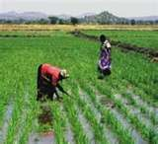
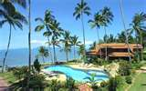
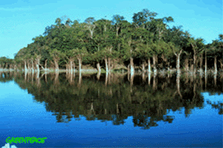
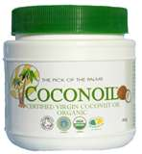
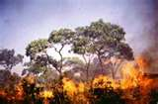
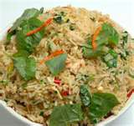
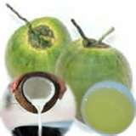
TROPICAL BIOLOGY SPECIES

Slide 23
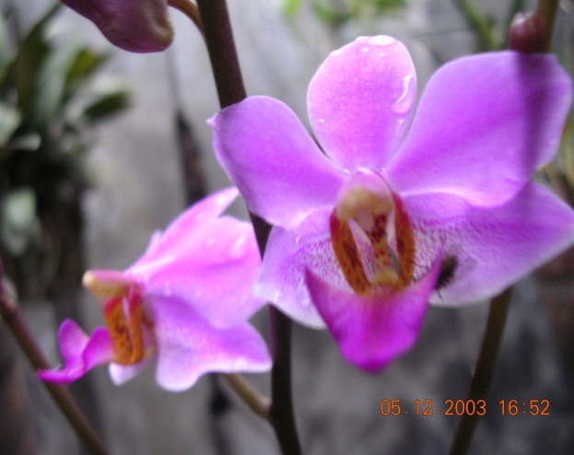
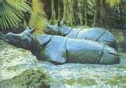
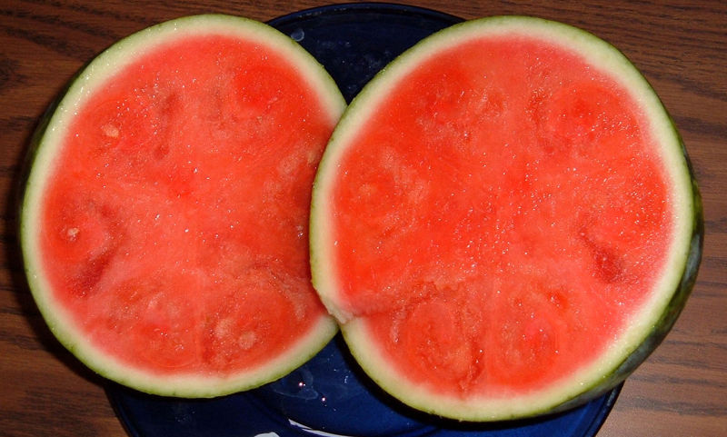
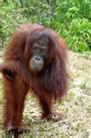
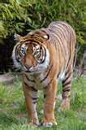
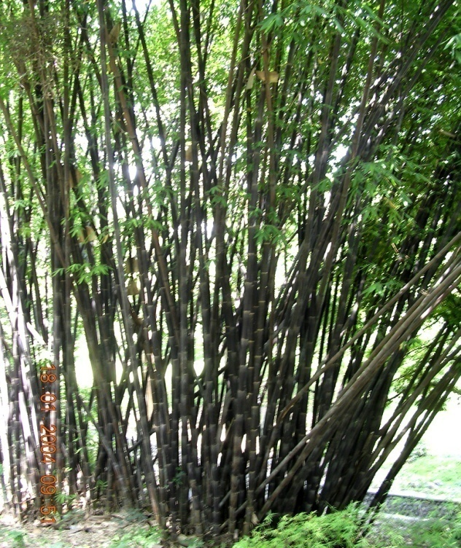
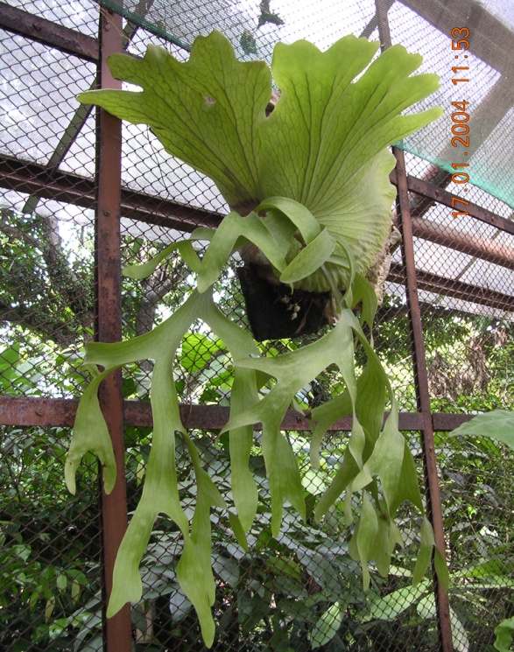
THE MOST DIVERS SPECIES

Slide 24
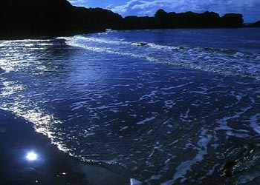
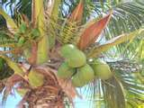
LOCAL POTENCIES

Slide 25
CURRICULUM FRAMEWORK

Slide 26
LEARNING DOMAINS

Slide 27
SYLLABI SINGAPORE

Slide 28
TUJUAN PENDIDIKAN:
PENGEMBANGAN SISWA SEUTUHNYA
Daya Fikir
Daya Qolbu
Daya
Spiritual
Daya Fisik

Slide 29
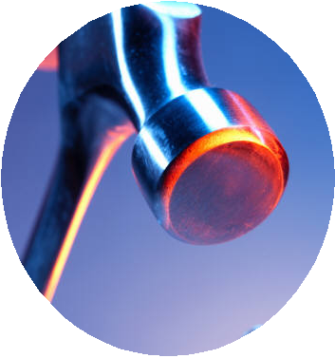
Basic skills
Technology skills
Problem solving
skills
UNESCO
Communi-
cation skills
Multicultural/
multilingual
literacy
21ST CENTURY SKILLS
AND LITERACY
Critical and creative
thinking skills
Information /digital
literacy
Interpersonal
skills
Inquiry /reasoning
skills

Slide 30
LEARNING

Slide 31
KIMBLE & OLSON
LEARNING IS A RELATIVELY PERMANENT CHANGE IN BEHAVIOR OR IN BEHAVIORAL POTENTIALS THAT RESULTS FROM EXPERIENCE AND CANNOT BE ATTRIBUTED TO TEMPORARY BODY STATES SUCH AS THOSE INDUCE BY ILLNESS, FATIGUE, OR DRUGS

Slide 32
LEARNING THEORY
BEHAVIORISM
COGNITIVISM
SOCIAL COGNITIVE
HUMANISM

Slide 33
BEHAVIORISM
CLASSICAL CONDITIONING
OPERANT CONDITIONING

Slide 34
COGNITIVISM
BELAJAR MELIBATKAN PROSES DI OTAK (KOGNISI)
BELAJAR MELIBATKAN MODALITAS BELAJAR
BELAJAR MENYANGKUT SEMANTIK DAN SEMI0TIK
BELAJAR MELIBATKAN INDERA
BELAJAR MELIBATKAN WORKING MEMORY, SHORT-TERM & LONGTERM MEMORY
BELAJAR MENYANGKUT HUKUM ORGANISASI PENGETAHUAN DI OTAK

Slide 35
COGNITIVISM
PIAGET -- KONSTRUKTIVISME
NEO-PIAGETIAN
INFORMATION PROCESSING THEORY
TEORI GESTALT/KOFFKA
BRUNER: LEARNING BY DOING
GAGNE:ENACTIC-ICONIC-SYMBOLIC
AUSUBLE: MEANINGFUL LEARNING

Slide 36
PIAGET
REVISE
SCHEM
ASISMILATION
EXITING SCHEM
NEW INFORMATION
NEW
SCHEM
ACOMMODATION
DISEQULIBRIUM
EQUILIBRIUM

Slide 37
INFORMATION PROCESSING
Input,
Pola ingatan, encoding, Persepsi
Short-term Memory atau Working Memory (Memori Jangka Pendek),
Long-term Memory (Memory Jangka Panjang),,
Organisasi Informasi, Menyimpan dan Mengingat informasi, dan
Merespon/menggunakan memori.

Slide 38
INFORMATION PROCESSING

Slide 39
EVALUATION AND ASSESSMENT

Slide 40
INSTRUCTIONAL MATERIAL
SYLLABUS
RPP
PLANNING
ASSESSING
POWERPOINT
SW & TEST
IMPLEMENTING
?
EVALUATING

Slide 41
EVALUATION & ASSESSMENT
TO EVALUATE THE SUCCESS OF THE INSTRUCTIONAL PROGRAM
EVALUATION
EFFECTIVITY
EFFICIENCY
RESOURCES
TO KNOW LEARNERS’ DEVELOPMENT
ASSESSMENT
EXCELLENT STUDENT
COMMON STUDENTS
SLOW LEARNERS

Slide 42
EVALUATION PROCESS
MEASUREMENT
VALID & RELIABEL
DATA
EVALUATION
UJI VALIDITAS
UJI RELIABILITAS
DECISION

