Slide 1
PNEUMATICS
Oleh : Totok Heru TM., M.Pd.

Slide 2
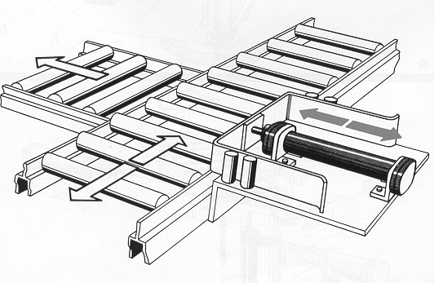
Actuators used in Pushing

Slide 3
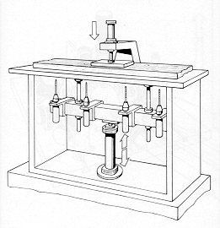
Actuators used in Machining - Drilling

Slide 4
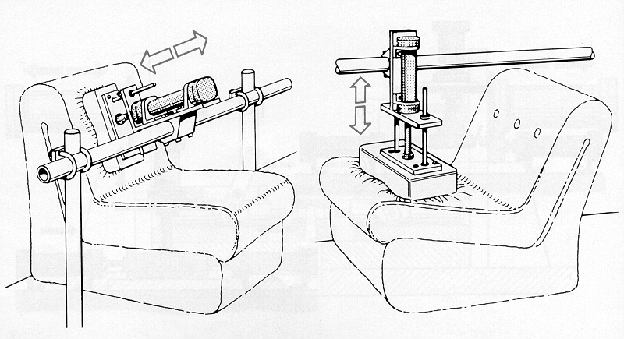
Actuators used in Testing and Quality Control

Slide 5
Piston Compressor

Slide 6
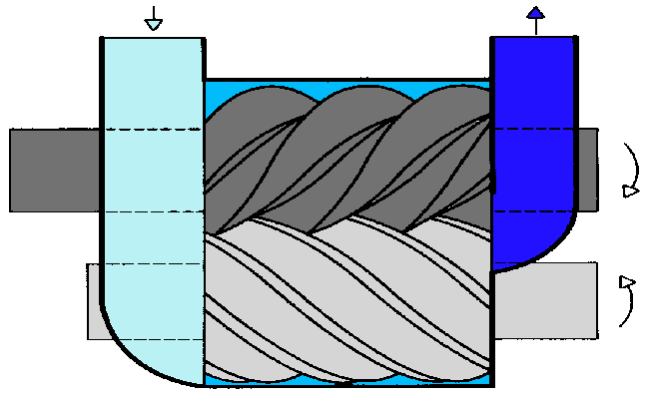
Screw Compressor

Slide 7
Axial Compressor

Slide 8
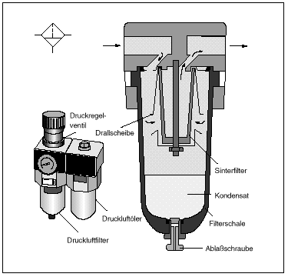
Air Filter
Pressure
regulator
Baffle
Filter
Condensate
Lubricator
Filter bowl
Filter unit
Drain screw

Slide 9
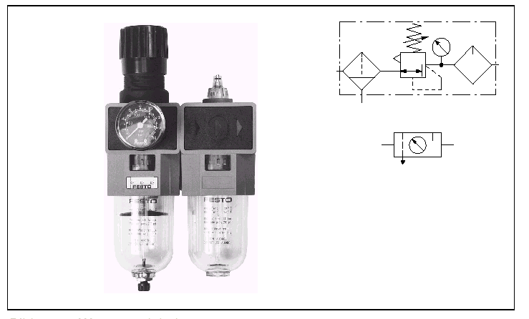
Air Service Unit
(Unit Pelayanan Udara)

Slide 10
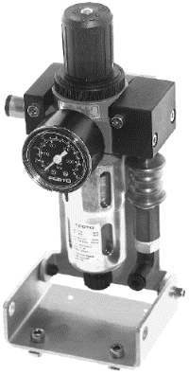

Air Service Unit

Slide 11
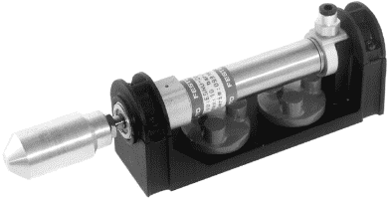
Single Acting Cylinder

Slide 12
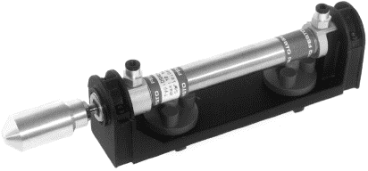
Double Acting Cylinder

Slide 13
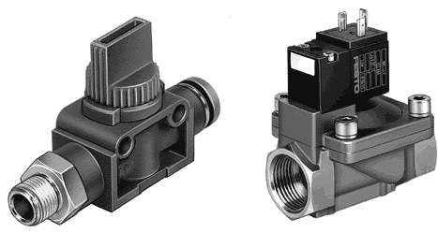

Katup pneumatik 2/2

Slide 14
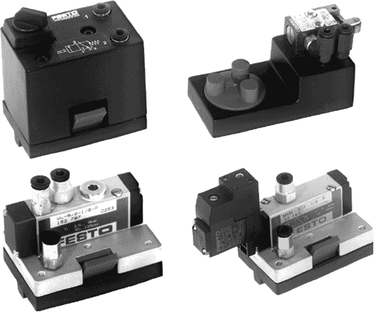

Katup pneumatik 3/2
MACAM-MACAM KATUP PNEUMATIK

Slide 15
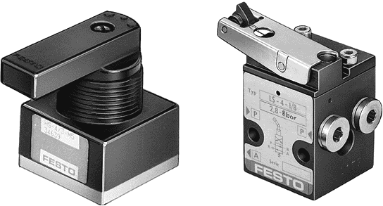


Katup pneumatik 4/2
MACAM-MACAM KATUP PNEUMATIK

Slide 16
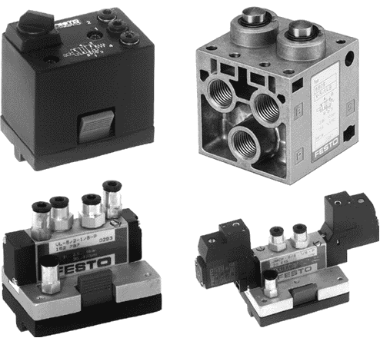

Katup pneumatik 5/2

Slide 17
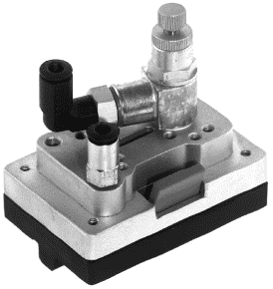

Throtle Valve

Slide 18
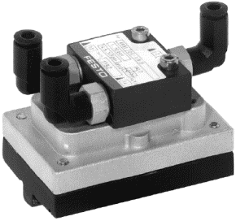

Shuttle Valve (OR Valve)
MACAM-MACAM KATUP PNEUMATIK

Slide 19
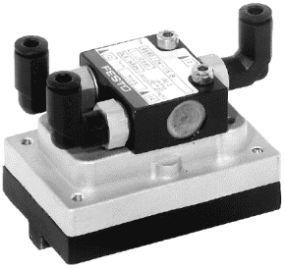

Two Pressure Valve (AND Valve)

Slide 20
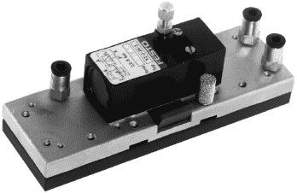
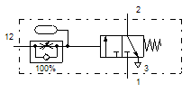
Time Delay Valve

Slide 21
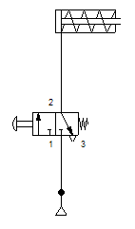
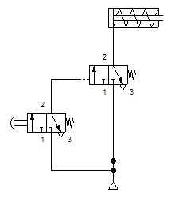
Gambar Rangkaian Pengontrolan Pneumatik
Gb a. Langsung
Gb b.Tak Langsung

Slide 22
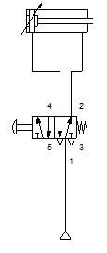
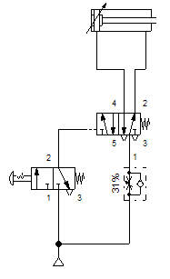
Gambar Rangkaian Pengontrolan Pneumatik
Langsung
Tak Langsung

