Slide 1
INTEGRAL CALCULUS
BY
SUWARDI

Slide 2
2.1 INTRODUCTION
TWO MAJOR APPROACHES
ANTIDERIVATIVES – to mathematically generate integrals
INTEGRATION – to assign a physical meaning to the integral
The other approach:
To consider the integral as the sum of many similar, infinitesimal elements
The process of taking integration, as the inverse of differentiation

Slide 3
In this chapter we shall consider the reverse process. Knowing the effect of individual changes, we wish to determine the overall effect of adding together these changes such that sum equals a finite change
Before considering the physical significance and the application of integral calculus, let us briefly review the general and special methods of integration

Slide 4
2.2 INTEGRAL AS ANTIDERIVATIVE
Function y = f(x), differentiation of this function, symbolized by the equation
Where f’(x) denotes the first derivative of the function f(x) with respect to x

Slide 5
In this chapter we shall pose the following question: What function f(x), when differentiated, yields the function f’(x)?
For example, what function f(x) when differentiated, yields the function f’(x) = 2x?
Substituting f’(x) = 2x into equation gives

Slide 6
This function, f(x), for which we are looking is called the integral of the differential and symbolized by the equation
∫ : the integral sign; f’(x): the integrand

Slide 7
If f’(x) = 2x, then f(x) = x². f(x) = x² is not the complete solution but f(x) = x² + C is the complete solution.
C is the constant of integration, and this constant always is included as part of the answer to any integration. Thus,

Slide 8
2.3 GENERAL METHODS OF INTEGRATION
Let us consider several general methods of integration

Slide 9
Examples:

Slide 11
2.4 SPECIAL METHODS OF INTEGRATION
Many of the functions encountered in physical chemistry are not in one of the general forms given above
Special methods of integration:
Algebraic Substitution
Trigonometric Transformation
Partial Fractions

Slide 12
Algebraic Substitution
The mathematical functions can be transformed into one of the general forms in section 2.3 or into one of the forms found in table of integral by some form of algebraic substitution
Examples

Slide 13
Let us attempt to transform this integral into the form
Let u = (1 – x²), Then du = -2x dx. Hence,

Slide 15
Let u = V – nb. Then du = dv. Hence,

Slide 16
Let u = sin x. Then du = cos x dx. Hence

Slide 17
Trigonometric Transformation
Many trigonometric integrals can be transformed into a proper form for integration by making some form of trigonometric transformation using trigonometric identities.
For example, to evaluate the integral we must make use of the identity

Slide 18
Thus,
Integrating each term separatly gives,

Slide 19
Again, integration of integral of this type are more parctically done by using the Table of Integrals
Example:
Integration of this function can be accomplished using integral from the Table of Integral. Here, a = 2 and b = 0

Slide 20
Partial Fractions
Consider an integral of the type
This type of integral can be trasformed into simpler integral by the following method. Let A = (a – x) and B = (b –x). Then

Slide 21
Therefore,
Which can be integrated to give,

Slide 22
2.5 The Integral as a summation of infinitesimally
In the previous sections we have considered integration as the purely mathematical operation of finding antiderivatives.
Let us now turn to the more physical aspects of integration in order to understand the physical importance of the integral

Slide 23
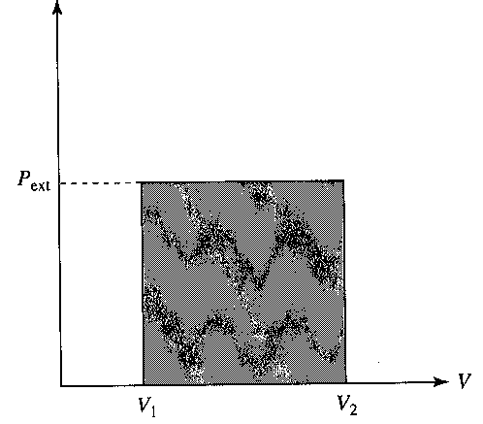
Consider, as an example:
The expansion of an ideal gas from a volume of V₁ to a volume V₂ against a constant external pressure P_{ext},
The plot seen in the indicator diagram is not a graph of P_{ext} as a function of V.
There is no functional dependence between the external pressure on the gas and the volume of the gas

Slide 24
The diagram shows what the external pressure is doing on one axis and what the volum is doing on the other axis
Both can vary independently
The work done by the gas does depend on both the external prssure and the volume change
For expansion, the work is w = - P_{ext}(V₂ – V₁)
W is just the negative of the area under the P_{ext} versus V diagram

Slide 25
The external prssure changes, in some fashion, as the volume changes
The external pressure is not changing as a function of volume
To emphasize this point, let us assume that the external prsessure actually goes up as the volumes changes (see indicator diagram )
A gas could be expanding against atmospheric pressure which perhaps is increasing over the period of time that the expansion take place

Slide 26
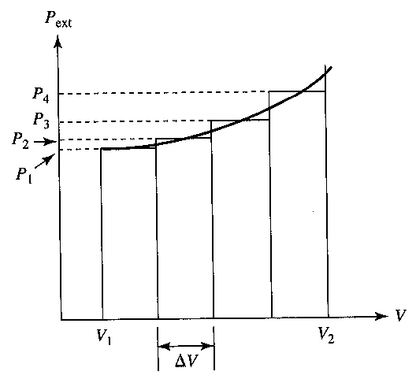
Indicator diagram showing PV work done by a gas expanding against a variable external pressure

Slide 27
The approximate area under the curve, then, is just the sum of the four rectangles
If we extend this process-that is if we divide the area under the curve into more and more rectangles of smaller and smaller ΔV-the sum approaches a fixed value as N approaches infinity

Slide 28
Hence, we can write
However, since as N approaches infinity, ΔV approaches zero, we also can write
But, by definition

Slide 29
Where the symbol is read “the integral from V₁ to V₂”, and V₁ and V₂ are called the limits of integration. Hence,
This integral is called a definite integral

Slide 30
2.6 Line Integral
Integral of the general type
Are called line integral, because such integral represent the area under the specific curve (path) connecting x₁ to x₂

Slide 31
Such integral can be evaluated analytically (i.e., by finding the antiderivative) only if an equation, the path, y = f(x) is known, since under these circumstances the integral
contains only one variable

Slide 32
If y is not a function of x (as in the case of P_{ext} versus V), or
if y is a function of x, but the equation relating y and x is not known or can not be integrated (as in the case ), or

Slide 33
if y is a function of more than one variable that changes with x,
then the line integral cannot be evaluated analytically, and one must resort to a graphical or numeric method of integration in order to evaluate the integral.

Slide 34
The integral in below can be evaluated analytically if we assume that P_{ext} is a constant, hence, it can be brought out of the integral
work = -A = - P_{ext} (V₂ - V₁)

Slide 35
A second way to evaluate the above integral is found in the concept of reversibility. If the expansion of the gas is reversible, then for all practical purposes the external is equal to the gas pressure, P_{ext} = P_{gas.} This gives
It can be integrated if P is a function of V only so T must be constant (isothermal condition)

Slide 36
We can write

Slide 37
Example
The change in enthalpy as a function of temperature is given by the equation
Find the change in enthalpy for one mole of real gas when the temperature of the gas is increased from, say, 298.2 K to 500.0 K

Slide 38
Solution
We first recognize that the above integral is a line integral. This integral cannot be evaluated unless C_{P} as a function of T is known
We could assume that C_{P} is a constant and evaluate the integral that way, but over such a large temperature range the approximation would be poor
Another approach would be to determine the integral numerically

Slide 39
One analytical approach is to expand C_{P} as a power series in temperature
C_{P} = a + bT + cT²
The constant a, b, and c are known for many common gases. Substituting this into the ΔH equation gives

Slide 40
2.7 Double and Triple Integrals
Functions could be differentited more than once
How about the determination of multiple integrals
Example,
The volume of cylinder is a function of both the radius and the height of the cylinder. That is, V = f(r, h)

Slide 41
Let us suppose that we allow the height of the cylinder, h, to change while holding the radius, r, constant
The integral from h = 0 to h = h, then, could be expressed as

Slide 42
But the value of this line integral depends on the value of the radius, r, and hence the integral could be considered to be a function of r.
If we allow r to vary from r = 0 to r = r and integrate over the change, we can write

Slide 43
To evaluate the above double integral, we integrate first while holding r a constant, which gives us g(r).
Then we integrate next while holding h constant. Such a process is known as successive partial integration

Slide 44
For example, let us evaluate
First,
Next, we integrate
That is the volume of a cylinder

Slide 45
The above argument can be extended to the triple integral. For example, let us evaluate the triple
First, evaluate
Substituting this back into the above equation gives

Slide 46
Next, evaluate
Substituting this back into the above equation gives
Integrating this gives
Which is the volume of a rectangular box x by y by z

Slide 47
Problem. The differential volume element in spherical polar coordinates is dV = r²sinθ dφ dθ dr. Given that φ goes from 0 to 2π, and r goes from 0 to r, evaluate the triple integral
Solution

Slide 48
PROBLEMS
Evaluate the following integral (consider all uppercase letters to be constant):

Slide 49
Evaluate the following integrals using the Table of Integral (consider all uppercase letters to be constant):

Slide 50
Evaluate the following definite integrals using the Table of indefinite and definite interals, as needed

Slide 52
Consider the ideal gas law equation P = nRT/V, where in the case n, R, and T are assumed to be constant. Prepare a graph of P versus V, choosing suitable coordinates, for n = 1 mole, R = 0,0821 liter atm/mol K and T = 298 K from a volume of V = 1.00 liters to a volume of V = 10.0 liters. Consider now the area under the P versus V curve from V = 2.00 liters to V = 6.00 liters. Determine the approximate area graphically by breaking up the area into four rectangles of equal width ΔV; compare your answer to that found by analytically integrating the function between these limits of integration

Slide 53
Evaluate the following multiple integrals using the Table of Integrals, as needed

Slide 54
The equation of a straight line passing through the origin of a cartesian coordinate system is y = mx, where m is the slope of the line. Show that the area of a triangle made up of this line and the x axis between x = 0 and x = a is A = ½ ay.

Slide 55
The Kirchoff equation for a chemical reaction relating the variation of ΔH of a reaction with absolute temperature is where ΔC_{P} as a power series in T, ∆C_{P} = a + bT + cT². Derive an equation for ΔH as a function of temperature. (Hint: Write the above derivative in differential form)

Slide 56
The Gibbs-Helmholtz equation for a chemical reaction is
Where ΔG is the Gibbs free energy change attending the reaction, and T is absolute temperature. Expressing ΔH in a power series in T, ∆H = a + bT + cT². where a, b, and c are experimentally determined constants, derive an expression for ΔG as a function of temperature

Slide 57
Find the probability of finding a particle confined to e field-free one-dimensional box in the state n = 1 at x = L/2 in a range L/2 ± 0.05 L, where L is the width of box, given

Slide 58
Find the probability of finding an electron in the 1s-state of the hydrogen atom at r = a₀ in a range a₀ ± 0.005a₀, where a₀ is the Bohr radius, given

Slide 59
Find the expectation value <x> for an electron in the 1s-state of the hydrogen atom, given that
The differential volume element in cylindrical coordinates is dV = r dθ dr dz. Show that if r goes from 0 to r, θ from 0 to 2π, and z from 0 to h, the volume of a cylinder is V = π r² h

