Slide 1
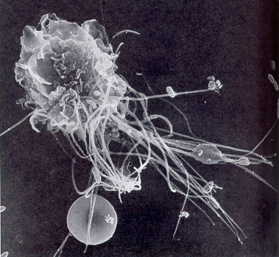
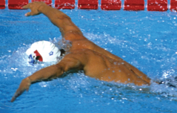
EXERCISE & IMMUNE SYSTEM
BU DINI

Slide 2
Bagaimana Sistem Imun Bekerja
Peran sistem imun adalah melindungi tubuh dari mikroorganisme lain seperti virus, bakteri, jamur, dan parasit.
Sistem pertahanan lini pertama dari sistem imun adalah pembentukan barrier (penghalang), sebagai contoh, kulit menghasilkan substansi antibakteri, hidung mengeluarkan lendir, mulut menghasilkan saliva, dan mata mengeluarkan air mata.

Slide 3
Sistem pertahanan lini pertama
Mrp sistem pertahanan pertama.
Ada 3 penghalang utama (barrier) yg mencegah masuknya mikroba ke dalam tubuh, yaitu:
Kulit
Saluran pernafasan
Saluran pencernaan

Slide 4
lanjutan
Ketiga barrier tersebut mempunyai lapisan sel epitel yg mencegah masuknya mikroba & mengeluarkan sekret yg membunuh atau menghambat mikroba.
Saluran pernafasan bagian atas mpy sel goblet, yg mengeluarkan lendir yg dpt menangkap mikroba & kmd dikeluarkan dg cara disapu oleh rambut-rambut halus di saluran pernafasan atas, & dg batuk atau bersin.

Slide 5
Bagaimana Sistem Imun Bekerja
Jika mikroorganisme berhasil masuk tubuh, mereka dapat dikeluarkan oleh mekanisme spesifik, seperti bersin atau batuk, atau dihancurkan oleh sel-sel dalam sistem imun sebelum mereka memperbanyak diri dan menyebabkan infeksi.
Penyakit terjadi saat sistem imun tidak berfungsi sebagaimana mestinya.

Slide 6
Sistem Imun
Sistem organ yg mencegah patogen masuk ke tubuh & mengidentifikasi serta membunuh patogen yg masuk ke dalam tubuh.
Ada 2 jenis sistem imun:
Sistem imun bawaan (innate immune system)
Sistem imun yg didapat (aquired /adaptive immune system)

Slide 7
Organ-organ sistem imun
1. Sum-sum tulang
Sum-sum tulang menghasilkan sel-sel sistem imun, jadi merupakan organ esensial dari pertahanan tubuh.
2. Thymus
Thymus terletak di rongga dada, antara tulang dada dan jantung. Thymus menghasilkan sel T. Thymus berperan penting dalam sistem imun bayi dan anak-anak

Slide 8
Organ-organ berikut membantu kerja sistem imun:
1. Limpa
Limpa berlokasi di sisi kiri atas rongga perut, berperan untuk menyaring darah dari organisme asing.
2. Kelenjar getah bening
Ditemukan di sepanjang tubuh, seperti di axilla, selangkangan, leher, usus, abdomen, dan dada.
menyaring cairan limfe dari mikroorganisme.
Jika terjadi respons imun yang dipicu oleh serangan mikroorganisme, kelenjar getah bening akan membengkak.
3. Tonsil (amandel)

Slide 9
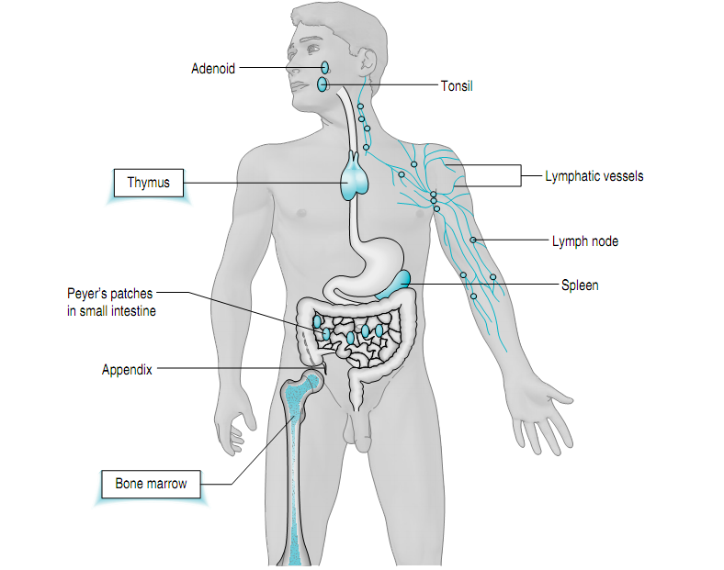

Slide 10
SEL-SEL SISTEM IMUN
Sel darah putih berasal dari sum-sum tulang sebagai stem cells. Mereka adalah pasukan penjaga sistem imun.
Jumlahnya meningkat jika ada invasi mikroorganisme.
Semua sel darah putih mengandung molekul yang memungkinkan mereka mengenali anggotanya dan dapat mendeteksi substansi asing.

Slide 11
lanjutan
Hal ini penting karena sistem ini mencegah sel-sel sistem imun untuk menyerang sel-sel sehat pada tubuh.
Sel-sel darah putih mempunyai kemampuan untuk mengingat musuh-musuhnya dan mengetahui bagaimana harus menetralisirnya.
Stem cells bertransformasi menjadi berbagai tipe sel.

Slide 12
lanjutan
Masing-masing tipe sel mempunyai tugas spesifik: mereka bertindak, baik dengan menyerang secara langsung substansi asing atau dengan berkomunikasi dengan sel-sel lain untuk melakukan respons imun.
Ada 5 kelompok utama lekosit, yaitu limfosit, monosit, neutrofil, eosinofil, dan basofil.

Slide 13
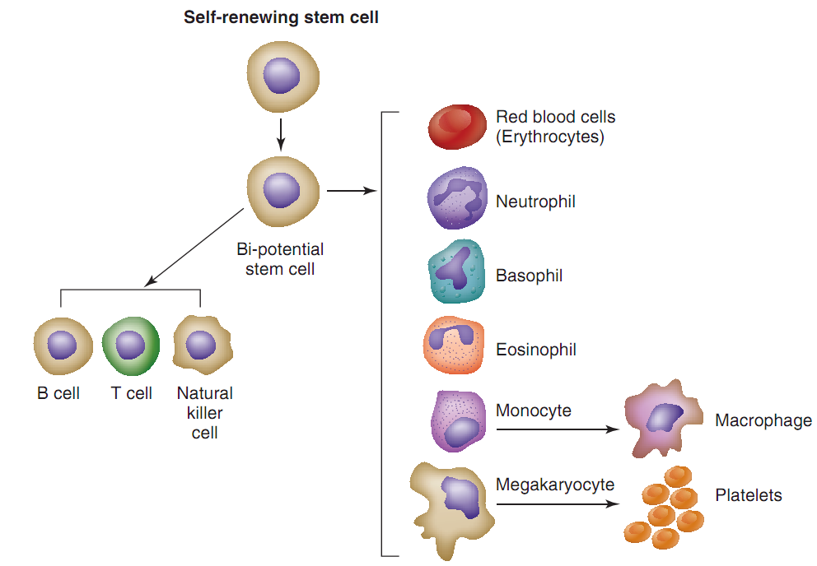
Pembentukan sel darah

Slide 14
Summary: Cells of the Immune System
Leukocytes (white blood cells)
Composed of:
1.) Lymphocytes (20%): have receptors for antigens
a.) T cells: develop in thymus
b.) B cells: develop in bone marrow
c.) Natural Killer Cells (NK Cells)
2.) Monocytes (10%): produce cytokines (stimulate inflammatory response)
3.) Granulocytes (70%): part of initial response to foreign pathogens (PHAGOCYTOSIS)
a.) Neutrophils: attracted to sites of infection/injury
b.) Eosinophils: parasitic infection
c.) Basophils & Mast Cells: allergies and inflammatory reactions

Slide 15
Lymphocytes
Comprised of T cells, B cells, and NK Cells
each have separate function
T cells/B cells: major effectors of adaptive immunity
NK Cells: innate immunity capability
Part of initial immune system
Responsible for:
1.) produce cytokines
2.) producing antibodies
3.) cytotoxicity
4.) memories of previous infections

Slide 16
Limfosit
Limfosit meliputi 20-40% sel darah putih. Ada 2 tipe sel, yaitu sel B dan sel T dan dapat ditemukan di jaringan limfoid.
Masing-masing sel B dan sel T spesifik untuk organisme dan antigen tertentu.

Slide 17
Sel T
Disebut sel T karena mereka matang di dalam Thymus.
Sel T terutama terlibat dalam memerangi mikroorganisme. Ada 3 jenis sel T, yaitu T helper, cytotoxic cells, dan suppressor T cells.

Slide 18
T Helper cells (CD⁴+ T cells)
CD4⁺ T helper tidak menyerang mikroorganisme,
mereka mengatur sistem imun dengan membantu mengatur mekanisme respons imun dan mengoordinasi kerja sel-sel lain sehingga bisa efektif.
Mereka diperlukan untuk mengaktivasi banyak sel-sel imun, termasuk sel B, yang mereka stimulasi untuk menghasilkan antibody atau cytotoxic cells.

Slide 19
T Helper cells (CD⁴+ T cells)
sel T helper diaktivasi oleh makrofag , melepaskan cytokines (suatu messengers kimia yang memungkinkan sel darah putih lain untuk berkomunikasi di antara mereka).
CD4⁺ T cells berperan penting dalam mencegah pertumbuhan sel abnormal seperti sel kanker.

Slide 20
The cytotoxic cells (CD8+ T cells)
Tipe sel T ini menyerang mikroorganisme secara langsung.
Masing-masing T killer cells membawa reseptor untuk satu tipe antigen. Jika mereka kontak dengan sel yang dikenali sebagai antigen, CD8+ T cells akan terikat pada antigen tersebut dan menghancurkannya.
CD8+T cells diperlukan untuk membunuh sel-sel tumor tertentu, sel yang terinfeksi virus dan kadang-kadang parasit, tetapi sayangnya mereka juga bertanggung jawab untuk menolak jaringan atau organ yang ditransplantasikan karena mereka kenali sebagai sel asing.

Slide 21
Suppressor T cells.
Sel-sel ini mematikan respons sel-sel B dan cytotoxic T cells saat antigen dihancurkan.
Jadi mencegah sel darah putih menyerang sel-sel sehat.

Slide 22
Natural Killer cells (NK cells)
Berperan menghancurkan tumor tertentu dan sel-sel yang terinfeksi virus.
Seperti CD8+Tcells, mereka membunuh saat kontak.
Perbedaannya adalah bahwa NK cells menyerang tanpa harus mengenali mikroorganisme sebagai antigen.

Slide 23
Sel B
Sel B diproduksi di sum-sum tulang dan matang di dalam sum-sum tulang atau berjalan ke thymus dan menjadi sel T.
Sel B menghasilkan antibodi dengan bantuan sel T.
Antibodi adalah protein khusus yang diprogram untuk mengenali semua tipe antigen karena mereka mempunyai reseptor yang sesuai dan mengatasi antigen.

Slide 24
Sel B
Saat sel B mengenali antigen, mereka menghasilkan antibodi yang akan terikat dengan antigen, menelan, dan mencernanya.
Mereka juga memberi tanda adanya serangan pada sel lain sehingga mereka dapat membantu.
Antibodi terdiri atas 5 immunoglobulin, yaitu Ig A, Ig E, Ig D, Ig G, dan Ig M.

Slide 25
Immunoglobulin (Antibodies)
Glycoproteins found in All bodily fluids
All antibodies → immunoglobins
But not vice-versa
Combat infections through direct & indirect means
DIRECT: bind to antigens on microorganisms to prevent it from entering host
INDIRECT: stimulate other phagocytic cells that kill organism (more prevalent)

Slide 26
Immunoglobin Classes
Immunoglobin | % of total pool | Function
IgG | 70-75% | Major antibody of secondary immune response
IgA | 15-20% | In saliva & mucous membranes and acts against infections entering through mucous
IgM | 10% | In mucosal secretions and seen early in immune response
IgD | <1% | On membrane of circulating B cells
IgE | trace | Associated with immediate sensitivity to asthma and hay fever

Slide 27
Monosit
5-8% lekosit adalah monosit. Mereka berubah menjadi makrofag, yang menghancurkan mikroorganisme.
Mereka menampilkan kepingan antigen di permukaannya dan memaparkan kepada sel B dan sel T.
Dengan cara ini, mereka mengaktifkan sel-sel ini untuk menghaslkan antibodi atau menampilkan tugas-tugas tertentu.
Makrofag juga bertanggung jawab membersihkan sel-sel virus mati

Slide 28
Neutrofil
45-70% lekosit adalah neutrofil.
Mereka menyerang mikroorganisme, mengelilingi, dan mencernanya.

Slide 29
Eosinofil
1-3% lekosit adalah eosinofil, membunuh parasit dengan melepaskan enzim.
Eosinofil juga mengontrol proses inflamasi.

Slide 30
Basofil
0-0,5% lekosit.
Jika mereka kontak dengan antigen, mereka melepaskan histamine.

Slide 31
Lekosit | Fungsi | Sistem Imun
Neutrophils | 1. Phagocytosis 2. Release chemicals involved in inﬂammation (vasodilators, chemotaxins, etc.) | innate
Basophils | Release chemicals (e.g., histamine) involved in inﬂ ammation | Innate
Eosinophils | 1. Destroy multicellular parasites 2. Involved in hypersensitivity reactions | innate
Monocytes | Precursors of macrophages— Macrophages are important phagocytes involved in innate immunity. | innate

Slide 32
Lekosit | Fungsi | Sistem Imun
B cell (B lymphocyte) | 1. Initiate antibody mediated reactions 2. Precursors of plasma cells—mature plasma cells secrete antibodies | Aquired
T cell (T lymphocyte) | Several different types of T cells exist collectively, these cells participate in cell mediated responses of the acquired immune system | Aquired
Natural killer cells | 1. Bind directly to virus-infected cells and cancer cells to kill them 2. Function as killer cells in antibody dependent immune response | Innate

Slide 33
What is phagocytosis?
Phagocytic cells brought to sites of infection and inflammation
Have surface receptors → increases affinity to variety of microorganisms
After attachment → phagocytes engulf and destroy microorganism

Slide 34
Sistem Imun
Sistem imun yang kuat akan menjaga tubuh bebas dari infeksi.
Namun demikian, banyak faktor yang dapat menurunkan efektivitas sistem imun,

Slide 35
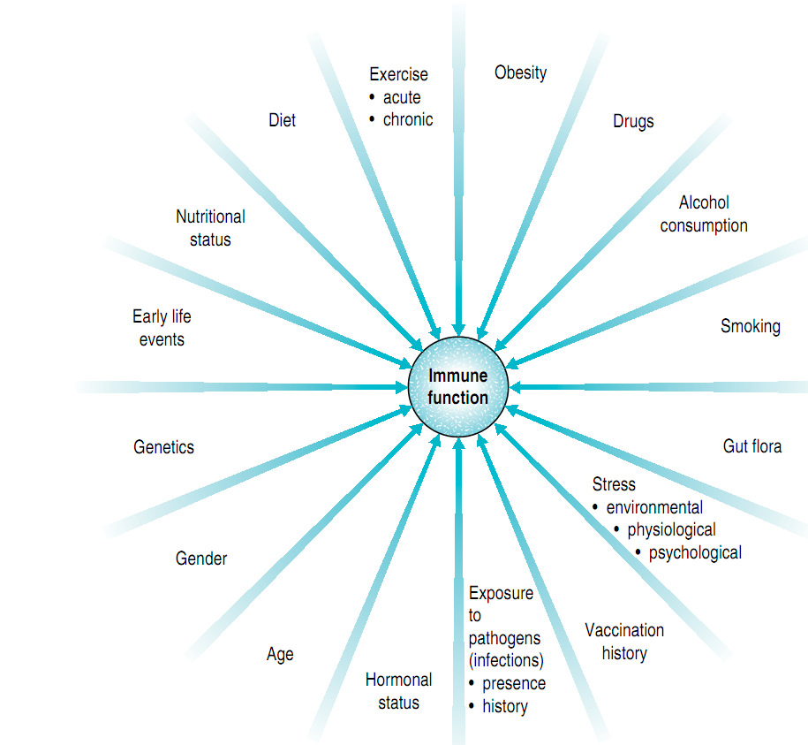
Faktor yg mempengaruhi sistem imun

Slide 36
Kekebalan Tubuh
Innate immunity (kekebalan alami)
Kemampuan segera sel-sel sistem imun untuk melindungi melawan penyakit karena respons imun dipicu secara otomatis saat substansi asing masuk ke dalam tubuh. Sel darah putih tidak perlu mengenali mikroorganisme atau terekspos sebelumnya dengan mikroorgansime tersebut.
Acquired or adaptive immunity
Saat substansi asing masuk ke dalam tubuh, sistem imun butuh beberapa hari untuk menyiapkan respons. Awalnya sel darah putih mengingat kontak pertama dengan mikroorganisme dan kemudian mereka menyerangnya.

Slide 37
Innate immune system
The innate system provides the ﬁrst line of defense against foreign invaders.
It is composed of three major components:
Physical barriers such as the skin and the mucous membranes that line our respiratory, digestive, and genitourinary tracts;
specialized cells (e.g., phagocytes and natural killer cells) designed to destroy invaders;
a group of proteins called the complement system

Slide 38
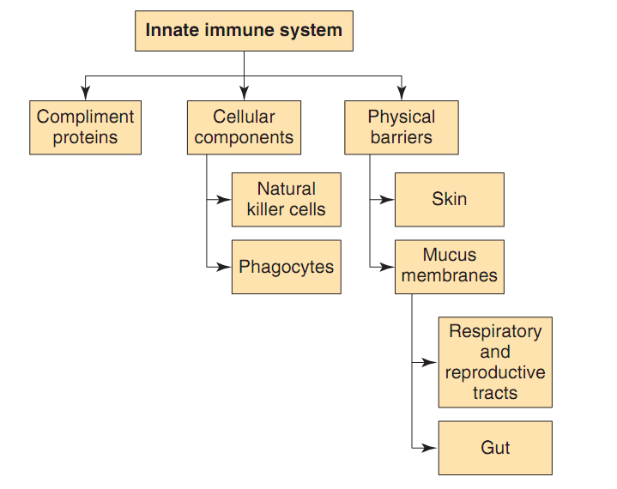
Komponen Utama Innate Immunity

Slide 39
Cytokines
Regulate growth factors
Involved with immediate inflammatory response
Soluble (in plasma)
Commonly types
Interleukien (IL)
Inflammatory mediation
Enhance phagocytic function
Stimulate further cytokine function
IL-6: increased substantially following muscle damaging activity
IL-1β: elevated levels in brain following a fatiguing downhill run in mice (Carmichael et al., 2005).

Slide 40
Complement System
Group of proteins found in blood
Primary Function: initiate and amplify inflammatory response
Biological Functions:
1.) recruit macrophages and neutrophils to site of injury
2.) lysis of bacteria
3.) opsonization of pathogens
Opsonization = process that alters bacteria by adding an antibody (C3b-component),
this increases the likelihood that they will be engulfed by phagocyte

Slide 41
Aquired Immune system
The acquired immune system adapts to protect against almost any type of invading pathogen.
The primary purpose of the acquired immune system is to provide protection against viruses that the innate immune system cannot provide.

Slide 42
Sistem imun yg didapat
Lebih lambat daripada sistem imun bawaan
Butuh waktu bbrp minggu atau bulan sblm berfungsi penuh.
Sel-sel utama:
Limfosit B
Limfosit T

Slide 43
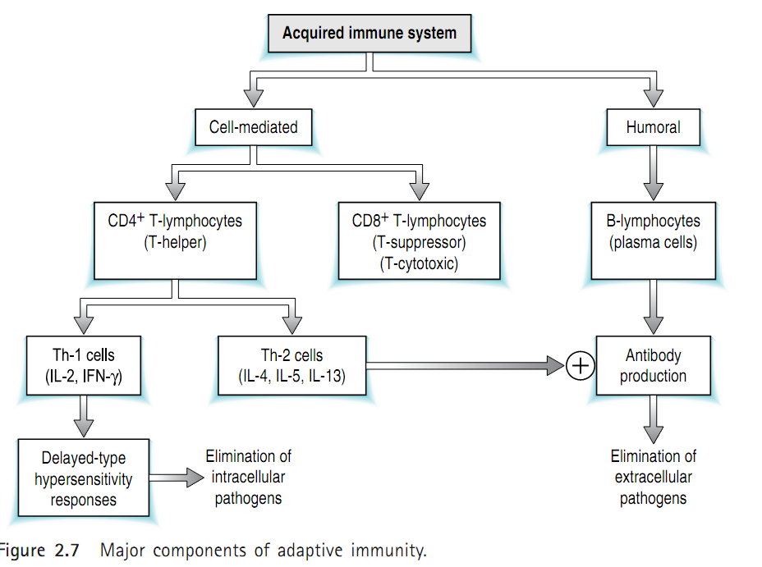

Slide 44
Functional Immune Divisions
INNATE
1.) body’s natural response
2.) first line of defense against infectious agents
3.) does not get better from exposure (it is what it is)
ADAPTIVE
1.) used if innate system unable to destroy infectious agent
2.) infectious-specific reaction
3.) has a memory
4.) antibodies produced to quickly & efficiently respond to infectious threats
COMPLEMENT
1.) also part of innate system response
2.) includes:
a.) lysozymes
b.) phagocytes
c.) natural killer (NK) cells

Slide 45
EXERCISE & IMMUNE SYSTEM

Slide 46
Exercise Immunology
“Exercise can be employed as a model of temporary immunosuppression that occurs after severe physical stress. Furthermore, exercise that is associated with muscle damage may represent a model of the acute-phase response to local injury”
Pedersen & Nieman (1998)

Slide 47
Two Sides of the “Immune” Coin
Immunological System & Exercise
1.) regular moderate exercise is beneficial to a person’s health by stimulating the immuno-response
2.) intense training may increase the athlete’s susceptibility to infection (i.e. upper respiratory infection)
Research focused on the effect of exercise volume and intensity on the immune response!

Slide 48
Exercise Induced Changes
Leukocyte (including lymphocytes) Response
A. Acute Exercise
B. Long Term
Phagocytic Cell Function
Cytokines & Complement System
Immunoglobulins
Athlete Immune Response

Slide 49
Leukocyte Effect of Acute Exercise
Circulating leukocyte ↑ after an acute bout of exercise
Most notable within neutrophils but also within monocytes and lymphocytes
Magnitude of change dependent on both DURATION and INTENSITY
Positive relationship
Short-duration, high intensity
150-180% above resting values
Decline begins 30-60min post-exercise
Can remain elevated up to 2hrs depending on exercise dose

Slide 50
Leukocyte Effect of Acute Exercise (continued)
Endurance Exercise
Circulating levels may increase 2-3 fold during exercise
May remain elevated up to 6hr post-exercise
Lymphocyte Response
Consistent increase during and immediately after exercise
After prolonged or intense workouts NK Cells levels may be decreased below resting levels for several hours or even days post-exercise

Slide 51
Leukocyte Effect of Long-Term Training
Research studies (cross sectional design) have shown no differences in athletes vs. non-athletes
BUT leukocyte values may be affected during periods of heavy training volume as opposed to smaller training volume

Slide 52
Leukocyte Effect of Long-Term Training (continued)
Training Volume ↑ → ↓ Leukocyte count
Increased susceptibility to infectious attack
Training Intensity ↑ → no change in leukocyte count
Response also sensitive to type of exercise (aerobic vs anaerobic)

Slide 53
Phagocytic Cell Function (con’t)
What is the significance of decreased phagocytic cell activity in endurance athletes?
More susceptible to infection
OR
Smith et al. (1990) argues that lower sensitivity of neutrophil function indicates a good adaptation that limits inflammatory response to chronic tissue damage

Slide 54
Cytokines & Complement System
Reminder: these are mediators of the INNATE immune system
Effect on Complement System from acute exercise
Contradictory results
MacKinnon (1999): complement system levels may remain elevated for several hours post-exercise and are responsible for cleaning proteolytic fragments released from muscles

Slide 55
Immunoglobins
Important for the adaptive immune system
For athletes (runners, cyclists) serum levels of immunoglobin did not alter much during or after exercise.
However, response was elevated up to 1.5 hrs following exercise for overweight females
Resting salivary IgA levels reduced in athletes involved high-intensity training programs
Suppressed immunoglobin levels may indicate greater chance of upper respiratory tract infection (URTI) in athletes
40-60% ↓ of IgA following an acute exercise bout (can remained lower for up to 24 hrs - IMPLICATIONS)

Slide 56
URTI

Slide 57
Exercise & sistem imun
Latihan intensitas sedang dapat mengurangi risiko infeksi saluran pernafasan bagian atas.
Pd latihan fisik intensitas tinggi, ada perubahan jumlah lekosit. Segera sesudah latihan, tjd peningkatan jml neutrofil melalui pengaruh hormonal (adrenalin dan kortisol).
Latihan fisik intensitas tinggi dapat menekan sistem imun, memungkinkan patogen menginfeksi.

Slide 58
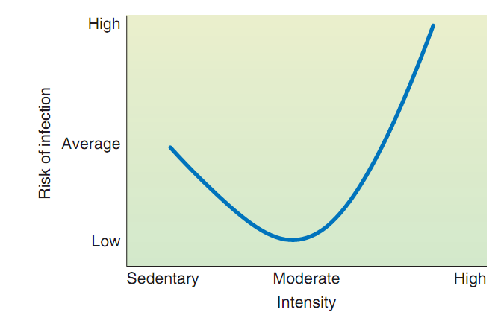
Exercise & Immunity

Slide 59
Moderate intensity exercise
Regular aerobic exercise can reduce the risk of infection in several ways.
An acute bout of moderate exercise increases blood levels of antibodies, natural killer cells, and neutrophils that provide a positive boost to the immune system.

Slide 60
High intensity-long duration
High-intensity/long-duration exercise has been shown to have a temporary depressive effect on the immune system.
This acute immune suppression following an intense exercise session provides an “open window” during which viruses and bacteria can grow, resulting in an infection.

Slide 61
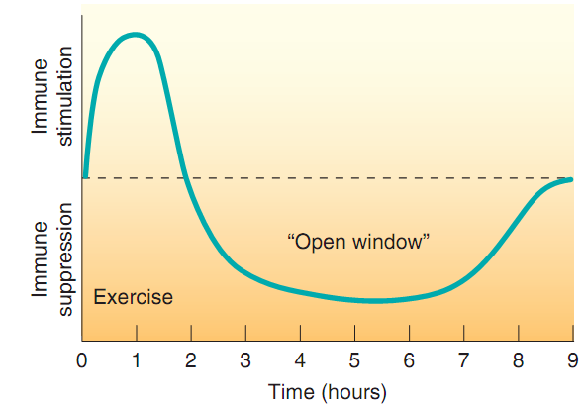
The “open window theory”

Slide 62
High-intensity and long-duration exercise promotes an increased risk of infection
Decreased blood levels of B cells, T cells, and natural killer cells
Decreases in natural killer cell activity and T-cell function
Decreases in nasal neutrophil phagocytosis
Decreases in nasal and salivary IgA levels
Increases in pro- and anti-inﬂ ammatory cytokines

Slide 63
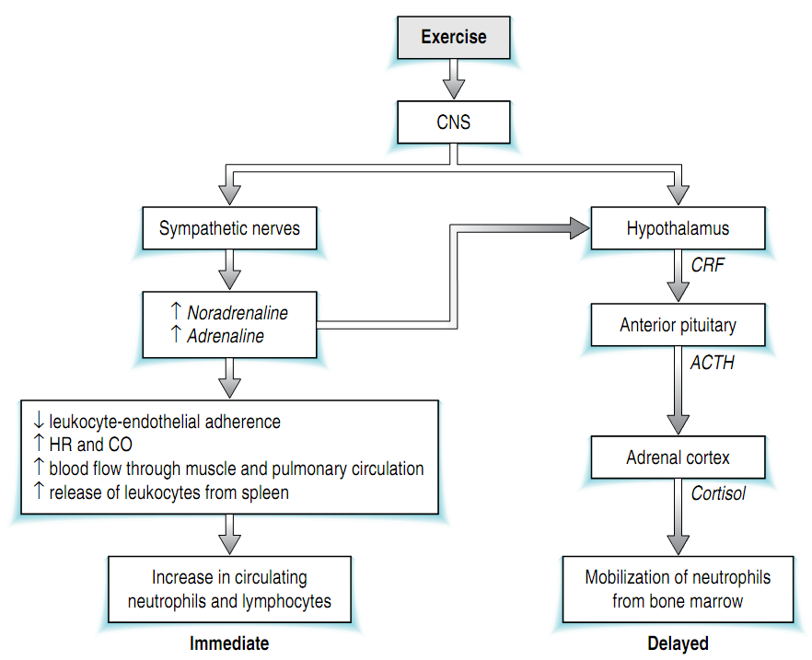
Acute exercise-innate immune system

Slide 64
Acute exercise and acquired immune function
The lymphocytopenia observed during recovery from exercise appears to be due to a decrease in the percentage of type 1 T cells in the circulation at this time.
Acute exercise appears to result in changes in T cell function that are proportional to exercise intensity and duration.

Slide 65
Acute exercise and acquired immune function
The underlying mechanism for the lymphocytosis is thought to be catecholamine mediated through re-distribution of blood flow, an increase in cardiac output and the associated mechanical shear stress and via their effect on lymphocyte adhesion molecules.

Slide 66
Acute exercise and acquired immune function
Acute exercise increases the expression of a number of markers of T cell activation; this may be due to an increase in the recruitment of activated cells into the circulation and/or an effect on the state of activation of individual cells themselves.

Slide 67
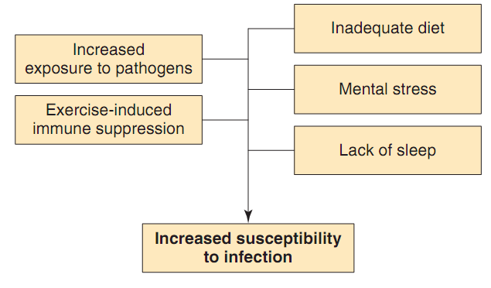
Factors affecting susceptibility to infection in athletes

Slide 68
Overtraining
Periods of intensified training (over-reaching) in already well trained athletes can result in a depression of immunity in the resting state.
Overtraining is associated with recurrent infections and immunodepression is common, but immune functions do not seem to be reliable markers of impending overtraining.

Slide 69
Immune responses to intensified training and overtraining
There are several possible causes of the diminution of immune function associated with periods of heavy training. One mechanism may simply be the cumulative effects of repeated bouts of intense exercise (with or without tissue damage) with the consequent elevation of stress hormones, particularly glucocorticoids such as cortisol, causing temporary inhibition of Th1 cytokines with a relative dampening of the cell-mediated response.
When exercise is repeated frequently there may not be sufficient time for the immune system to recover fully.

Slide 70
Exercise, nutrition and immune function
Nutrient availability has the potential to affect almost all aspects of the immune system because macronutrients are involved in immune cell metabolism and protein synthesis and micronutrients are involved in immune cell replication and antioxidant defences.
Decreased nutrient availability during prolonged high-intensity exercise, and poor dietary practices during training, may be involved in the etiology of exercise induced immune depression.

Slide 71
Exercise, nutrition and immune function
To maintain immune function, athletes are advised to eat a well balanced diet with sufficient energy intake to maintain energy balance. This should also ensure an adequate intake of protein (1.6g/kg body mass per day).
Athletes are advised to consume sufficient fluids during exercise and recovery to limit the potential detrimental effects of dehydration an hypohydration on immune function.

Slide 72
Exercise, nutrition and immune function
Athletes with CHO intake below the recommended 8–10 g CHO/kg body mass per day will not only jeopardize athletic performance by limiting muscle and liver glycogen availability but may also place themselves at risk from the known immunosuppressive effects of cortisol.
Consumption of CHO (30-60 g CHO/h) during prolonged exercise delays fatigue and attenuates the cortisol and catecholamine response which in turn reduces the degree of exercise-induced immunosuppression.

Slide 73
Exercise, nutrition and immune function
Increased dietary fatty acid intake may decrease immune function by altering immune cell membrane fluidity (‘direct effect’) and increasing eicosanoid formation (‘indirect effect’), particularly prostaglandins which are known to have immunosuppressive effects.
Given that immune function may be compromised on low- and high-fat diets, athletes are currently advised to follow the recommendation that approximately 20% of daily energy intake should come from fat.

Slide 74
Mencegah underperformance syndrome (UPS)
Sufficient rest following a bout of excessive exercise to minimize cumulative tissue trauma.
Sufficient recovery time between training sessions. When athletes train twice in one day, IL-6 concentrations in the second training session are lower when there is a longer period of recovery between sessions (Ronsen et al 2001).

Slide 75
Mencegah underperformance syndrome (UPS)
Adequate dietary carbohydrate prior to and during exercise. Carbohydrate ingestion during prolonged exercise and high carbohydrate diets prior to exercise reduce the plasma IL-6 response to exercise.
Supplementation of the diet with antioxidants (e.g. vitamins C and E) reduces the plasma IL-6 and cortisol response to exercise.

