Slide 1
PLANTING THE RELIGIOUS HUMANIST VALUES IN SOCIAL STUDIES OF TEACHING AND LEARNING IN JUNIOR HIGH SCHOOL
Supardi
Yogyakarta State University

Slide 2
Globalization

Slide 4
Rate of abortion (abortion) is illegal in Indonesia: 2.5 million cases each year (Suara Merdeka, 18 April 2012).
WHO : from 1000 there are 28 pregnant women that an abortion (http://www.bbc.co.uk/ indonesia).

Slide 5
Humanism?
Religious Humanists regard the universe as self-existing and not created. Second: Humanism Believes that man is a part of nature and that he has emerged as the result of a continuous process
Thought humanism much conflict with religious thought, which puts religion as a way of life.

Slide 7
Religious Humanist Values
The values are based on the individual's independence but still be based on religious values that is called religious humanist values.

Slide 8
Planting Religious Humanist Values in the Social Studies Learning ?

Slide 9
Social Studies
"The Social Studies are comprissed of those aspests of history, geography, and pilosophy roomates in practice are selected for instructional purposes in schools and collegs".

Slide 10
Values of education can be done by :
Inculcation
Exemplary
Facilitation
Development of academic skills.

Slide 11
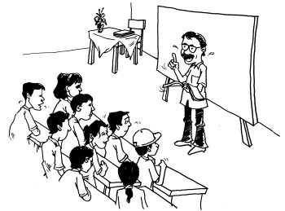

Slide 12
Strategies???
Development of teaching materials
Learning Method. Learning methods, is an important key in instilling religious humanist education in schools
Learning Assessment. Development of assessment in learning to inculcate religious humanist values, emphasizes assessment process rather than outcomes.

Slide 13
Conclusion
Planting religious humanist values can also be done by developing a strategy that includes the development of social studies teaching materials, teaching methods, and assessment of learning. Modeling and habituation in school is an important key to a humanist religious character familiarize the students.

