Slide 1
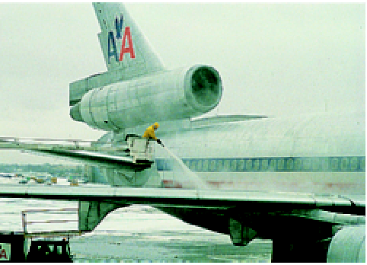
SIFAT FISIKA LARUTAN

Slide 2
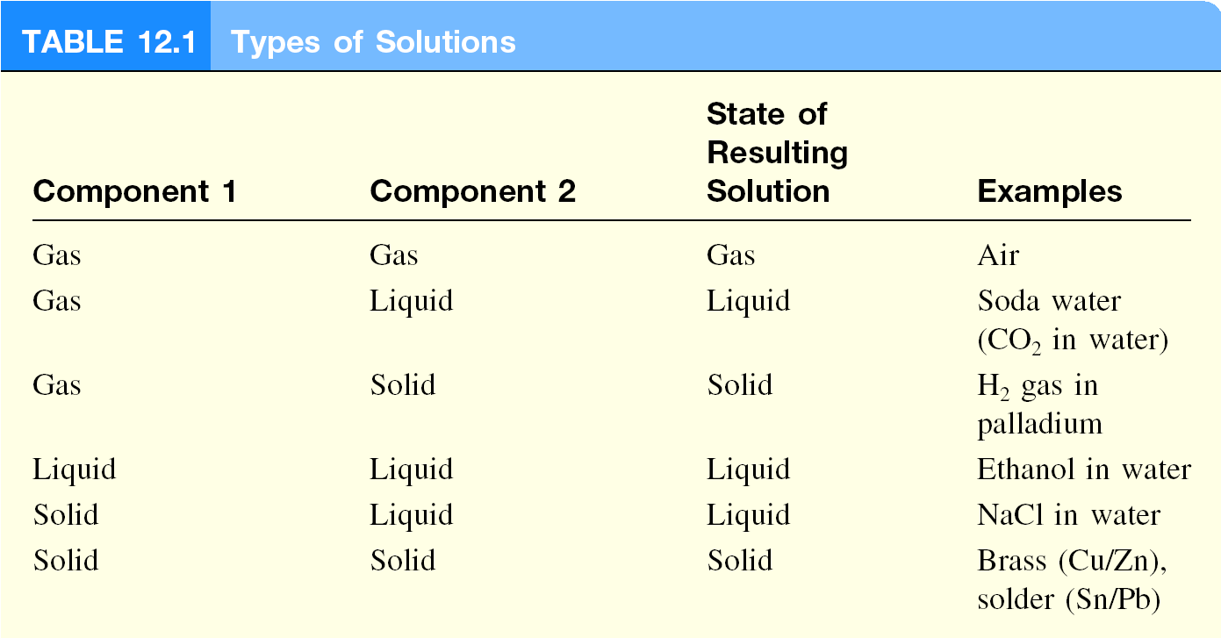
Larutan : campuran homogen dari dua senyawa atau lebih
Zarut : senyawa yang jumlahnya lebih sedikit (solute)
Pelarut : Senyawa yang jumlahnya lebih besar (solvent)

Slide 3
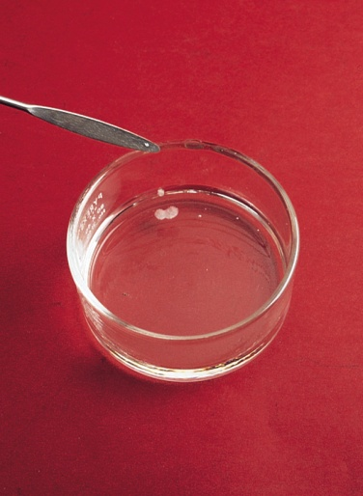
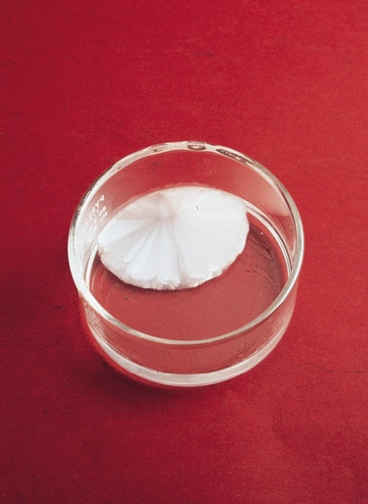
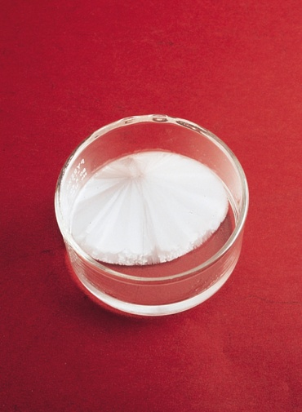
Larutan jenuh mengandung jumlah maksimum zarut yang dapat terlarut dalam jumlah pelarut tertentu pada temperatur spesifik
Larutaan tidak jenuh mengandung jumlah zarut yang lebih kecil dari kapasitas pelarut pada temperatur spesifik
Larutan super jenuh mengandung jumlah zarut yang lebih besar dari larutan jenuh pada temperatur spesifik
Kristal CH₃COONa sangat cepat terbentuk pada larutan
super jenuh

Slide 4
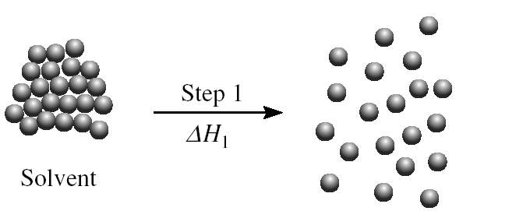
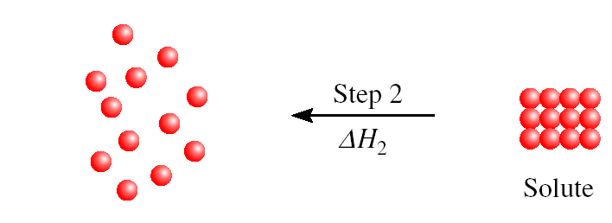
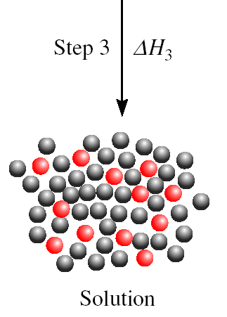
Tiga tipe interaksi dalam proses pelarutan:
Interaksi solven-solven
Interaksi zarut-zarut
Interaksi solven-zarut
Mekanisme pembentukan larutan:
ΔH_{soln} = ΔH₁ + ΔH₂ + ΔH₃

Slide 5
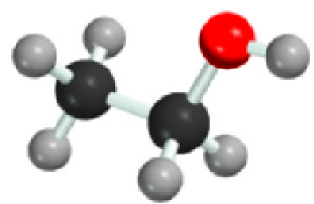
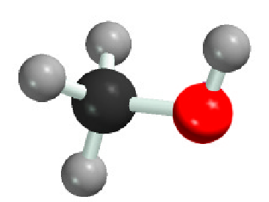
“like dissolves like”
Dua senyawa dengan gaya intermolekuler yang serupa akan melarutkan satu sama lain
Molekul non-polar larut dalam pelarut non-polar
CCl₄ dalam C₆H₆
Molekular polar larut dalam pelarut polar
C₂H₅OH dalam H₂O
Senyawa ionik lebih larut dalam pelarut polar
NaCl dalam H₂O atau NH₃ (l)

Slide 6
Konsentrasi
Konsentrasi suatu larutan : jumlah zarut yang ada dalam jumlah tertentu pelarut atau larutan
Persen Massa
massa zarut
% massa =
x 100%
massa zarut + massa pelarut
massa zarut
=
x 100%
massa larutan
Fraksi Mol (X)
mol A
X_{A} =
Jumlah mol seluruh komponen

Slide 7
Molaritas (M)
mol zarut
M =
volum larutan (L)
Molalitas (m)
mol zarut
m =
massa pelarut(kg)

Slide 8
Berapa molalitas 5.86 M larutan (C₂H₅OH) yang memiliki densitas 0.927 g/mL?
mol zarut
mol zarut
m =
M =
massa pelarut (kg)
Volum larutan (L)
Asumsi 1 L larutan:
5.86 mol etanol = 270 g etanol
927 g larutan (1000 mL x 0.927 g/mL)
massa pelarut = massa larutan – massa zarut
= 927 g – 270 g = 657 g = 0.657 kg
mol zarut
5.86 mol C₂H₅OH
m =
=
= 8.92 m
massa pelarut (kg)
0.657 kg pelarut

Slide 9
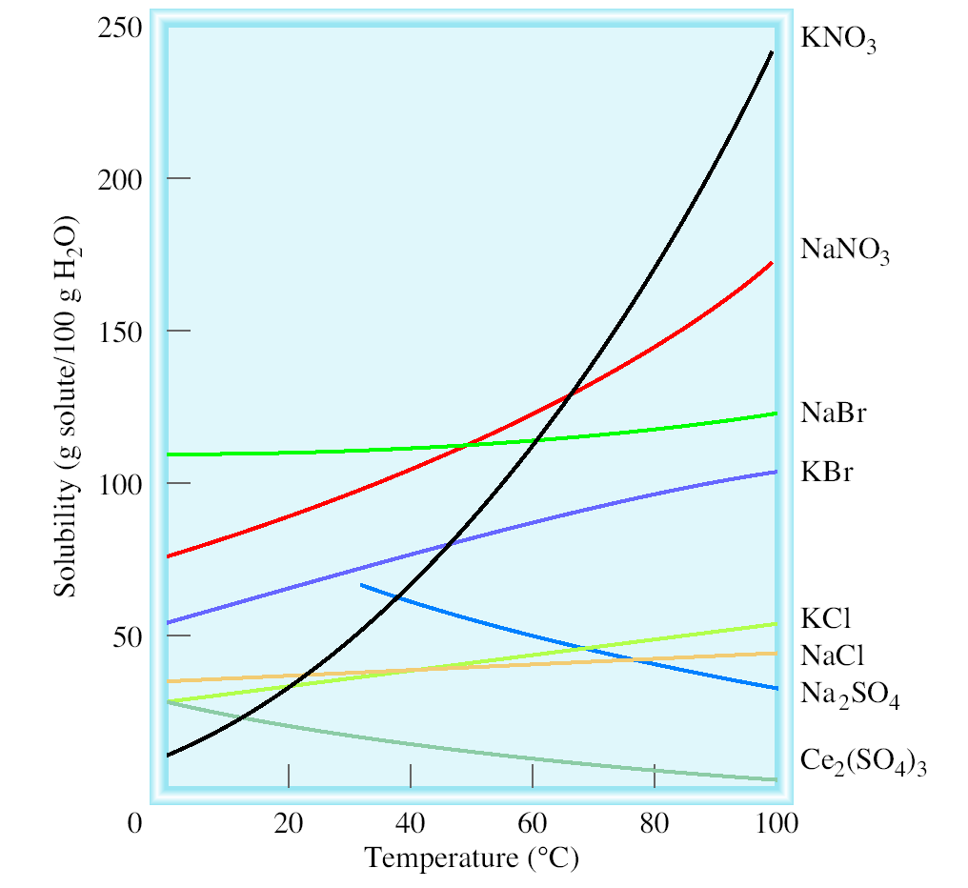
Temperatur and Kelarutan
Kelarutan padatan and temperatur
Kelarutan meningkat seiring peningkatan temperatur
Kelarutan menurun seiring peningkata temperatur

Slide 10
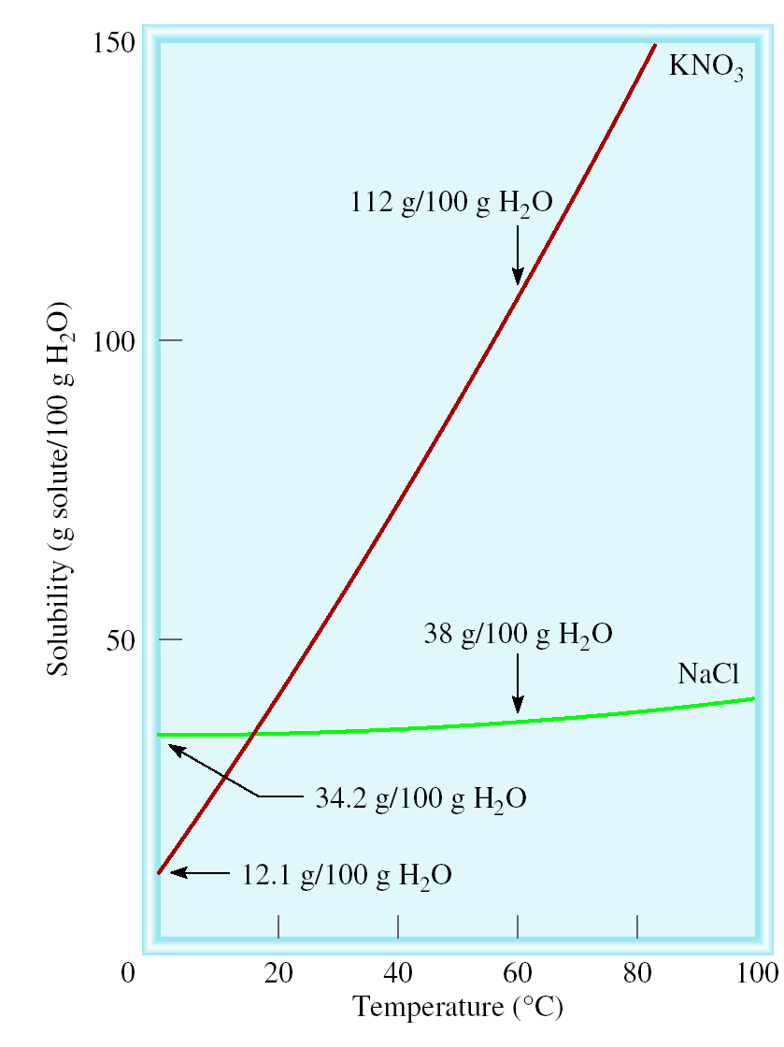
Kristalisasi fraksional : pemisahan campuran senyawa menjadi senyawa murni berdasarkan perbedaan kelarutan
Contoh: 90 g KNO₃ terkontaminasi oleh 10 g NaCl.
Kristalisasi fraksional:
Larutkan sampel dalam 100 g air pada 60⁰C
Dinginkan larutan hingga 0⁰C
Seluruh NaCl akan tertinggal dalam larutan (s = 34.2g/100g)
78 g KNO₃ murni akan mengendap (s = 12 g/100g). 90 g – 12 g = 78 g

Slide 11
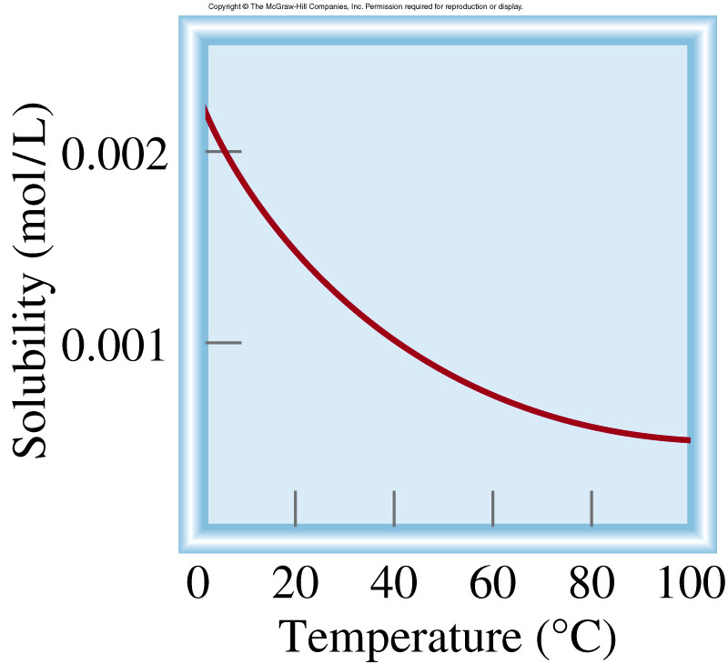
Temperatur dan Kelarutan
Kelarutan gas O₂ dan temperatur
Kelarutan biasanya menurun dengan peningkatan temperatur

Slide 12
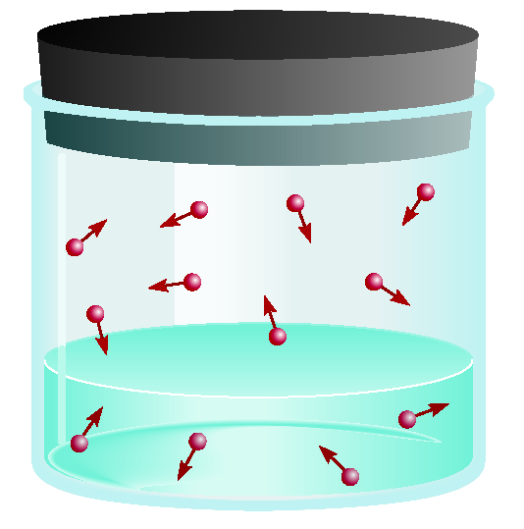
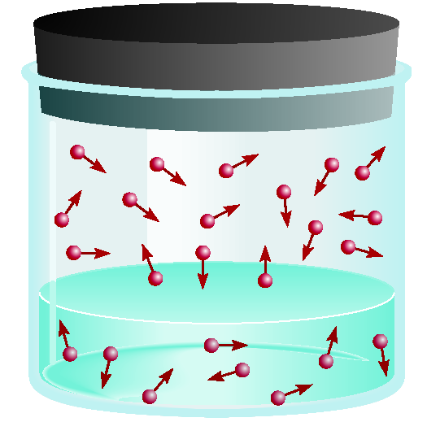
Tekanan dan Kelarutan Gas
Kelarutan gas dalam cairan proporsional terhadap tekanan gas pada larutan (Henry’s law).
c : konsentrasi (M) gas terlarut
c = kP
P : tekanan gas dalam larutan
k : konstanta setiap gas (mol/L•atm) yang tergantung hanya pada temperatur
low P
high P
low c
high c

Slide 13
Chemistry In Action: The Killer Lake
21/08/86
Awan CO₂ dilepaskan
1700 korban
Penyebab?
Gempa bumi
Tanah longsor
Angin kencang
Lake Nyos, West Africa

Slide 14
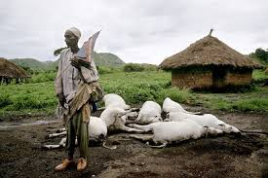
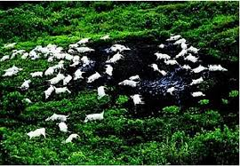
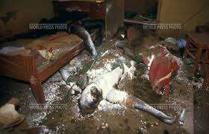
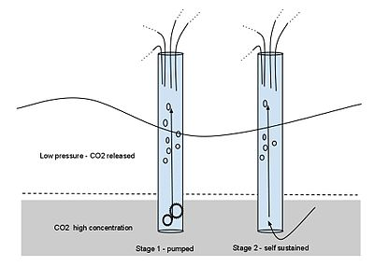
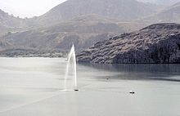

Slide 15
Colligative Properties of Nonelectrolyte Solutions
Colligative properties are properties that depend only on the number of solute particles in solution and not on the nature of the solute particles.
Vapor-Pressure Lowering
0
0
P ₁
= vapor pressure of pure solvent
P₁ = X₁ P ₁
Raoult’s law
X₁ = mole fraction of the solvent
If the solution contains only one solute:
X₁ = 1 – X₂
0
- P₁ = ΔP = X₂
0
X₂ = mole fraction of the solute
P ₁
P ₁

Slide 16
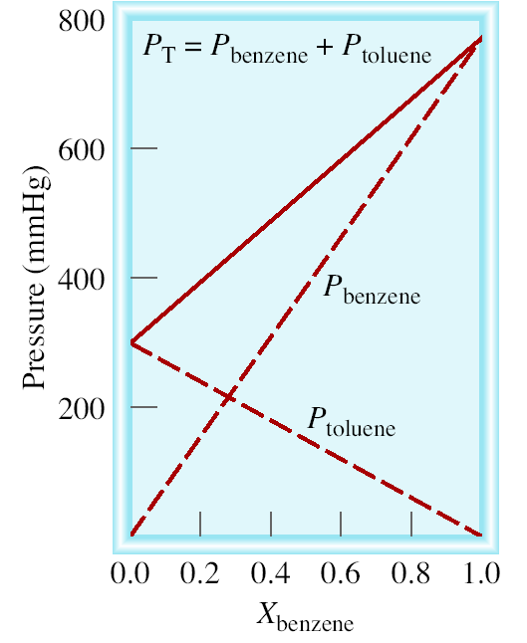
0
P_{A} = X_{A} P _{A}
Ideal Solution
0
P_{B} = X_{B} P _{B}
P_{T} = P_{A} + P_{B}
0
0
P_{T} = X_{A} P _{A}
+ X_{B} P _{B}

Slide 17
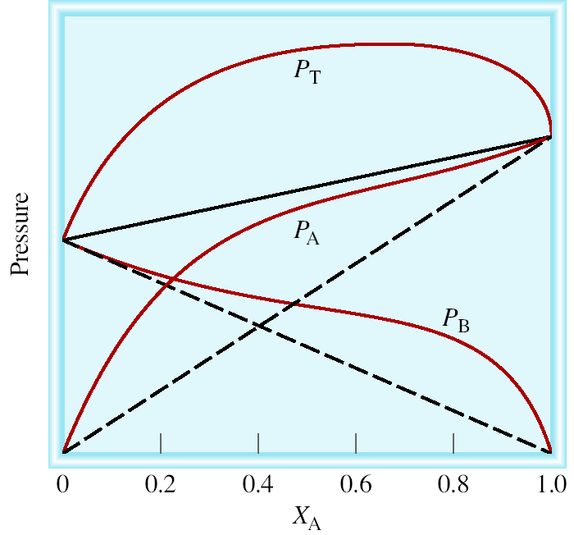
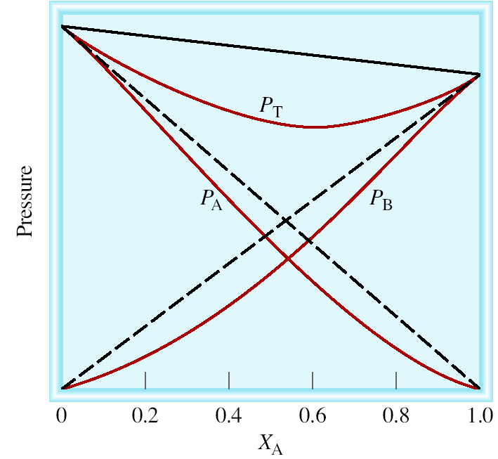
P_{T} is greater than
predicted by Raoults’s law
P_{T} is less than
predicted by Raoults’s law
Force
A-B
Force
A-A
Force
B-B
Force
A-B
Force
A-A
Force
B-B
<
&
>
&

Slide 18
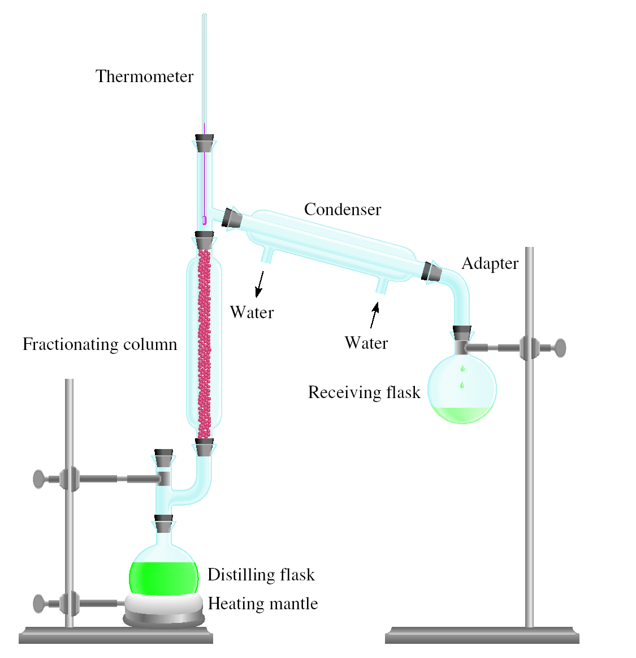
Fractional Distillation Apparatus

Slide 19
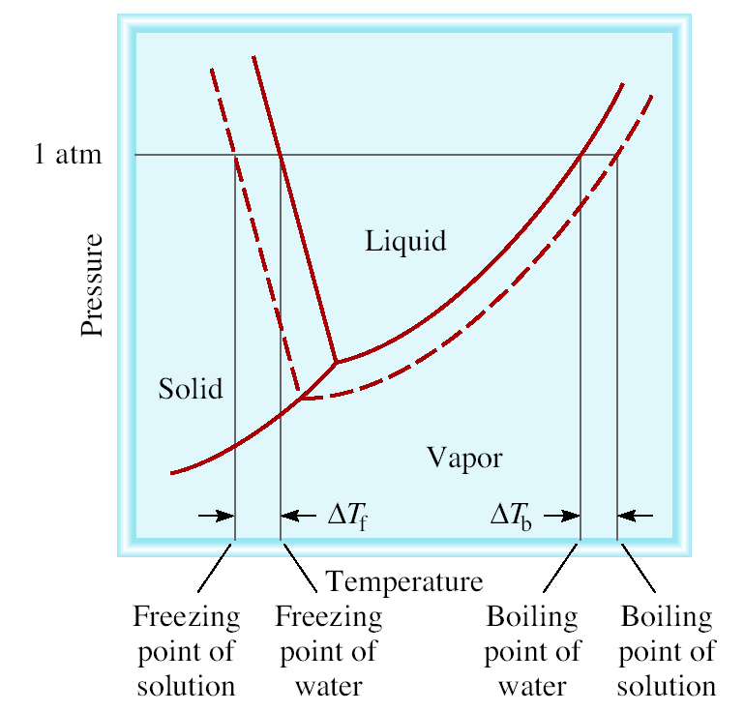
Boiling-Point Elevation
0
ΔT_{b} = T_{b} – T _{b}
0
T _{b} is the boiling point of
the pure solvent
T _{b} is the boiling point of
the solution
0
ΔT_{b} > 0
T_{b} > T _{b}
ΔT_{b} = K_{b} m
m is the molality of the solution
K_{b} is the molal boiling-point
elevation constant (⁰C/m)
for a given solvent

Slide 20
Freezing-Point Depression
0
ΔT_{f} = T _{f} – T_{f}
0
T _{f} is the freezing point of
the pure solvent
T _{f} is the freezing point of
the solution
0
ΔT_{f} > 0
T _{f} > T_{f}
ΔT_{f} = K_{f} m
m is the molality of the solution
K_{f} is the molal freezing-point
depression constant (⁰C/m)
for a given solvent

Slide 21
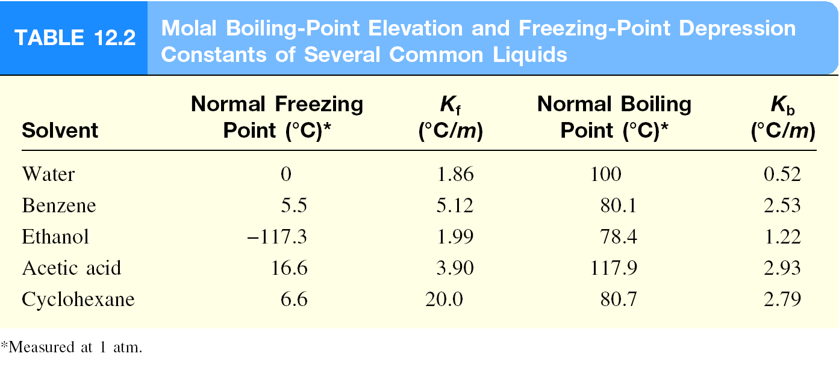

Slide 22
What is the freezing point of a solution containing 478 g of ethylene glycol (antifreeze) in 3202 g of water? The molar mass of ethylene glycol is 62.01 g.
ΔT_{f} = K_{f} m
K_{f} water = 1.86 ºC/m
1 mol
478 g x
moles of solute
62.01 g
m =
=
= 2.41 m
mass of solvent (kg)
3.202 kg solvent
ΔT_{f} = K_{f} m
= 1.86 ºC/m x 2.41 m = 4.48 ºC
0
ΔT_{f} = T _{f} – T_{f}
0
= 0.00 ºC – 4.48 ºC = -4.48 ºC
T_{f} = T _{f} – ΔT_{f}

Slide 23
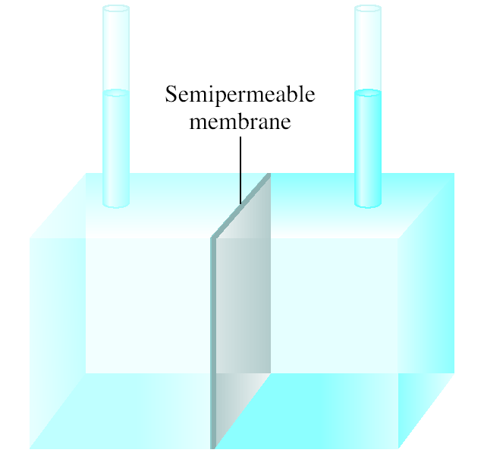
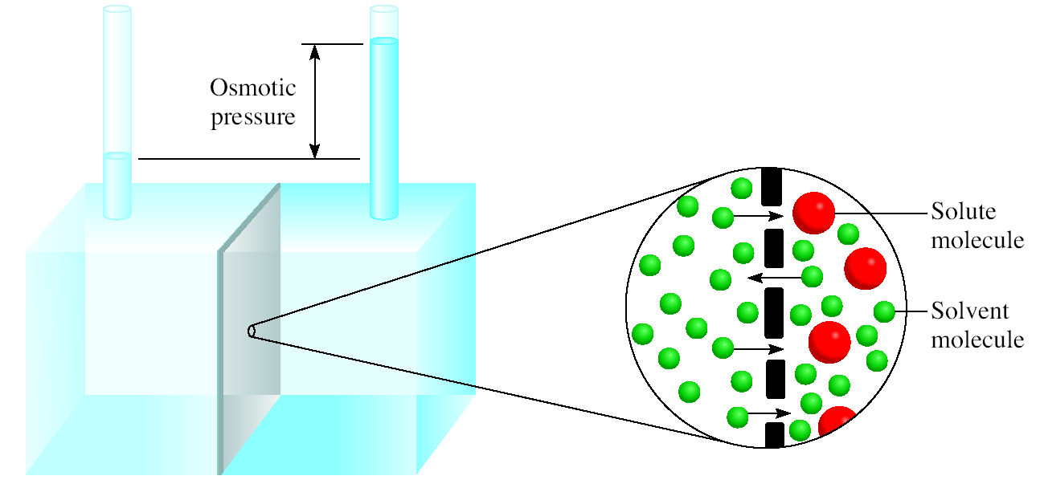
Osmotic Pressure (π)
Osmosis is the selective passage of solvent molecules through a porous membrane from a dilute solution to a more concentrated one.
A semipermeable membrane allows the passage of solvent molecules but blocks the passage of solute molecules.
Osmotic pressure (π) is the pressure required to stop osmosis.
more
concentrated
dilute

Slide 24
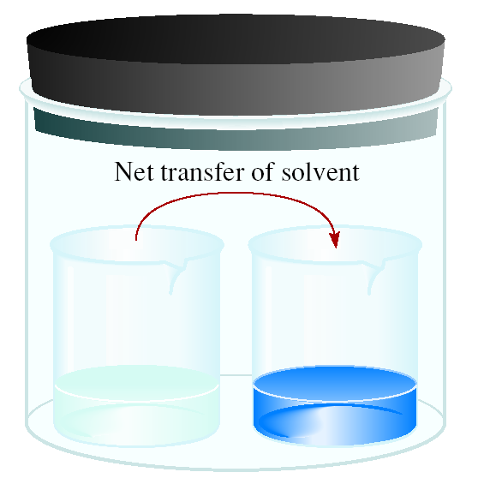
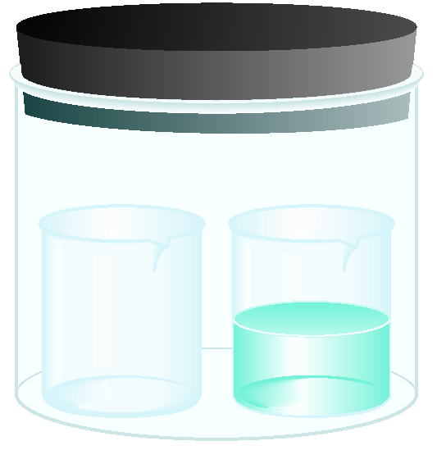
Osmotic Pressure (π)
time
solvent
solution
High
P
Low
P
π = MRT
M is the molarity of the solution
R is the gas constant
T is the temperature (in K)

Slide 25
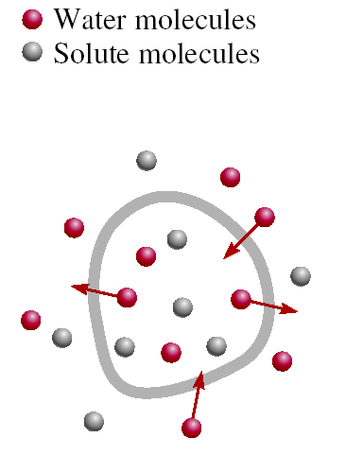
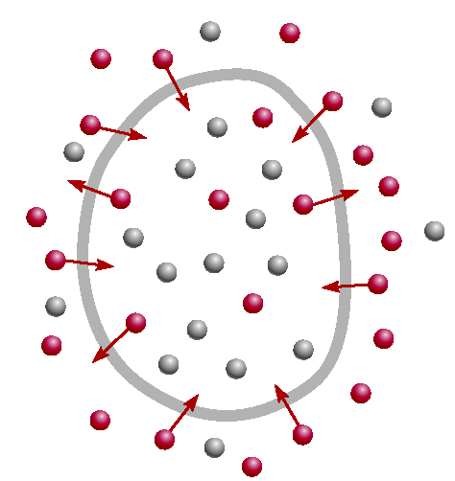
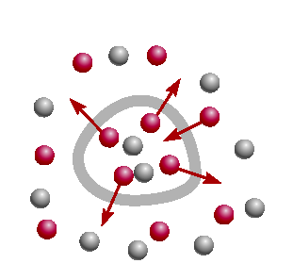
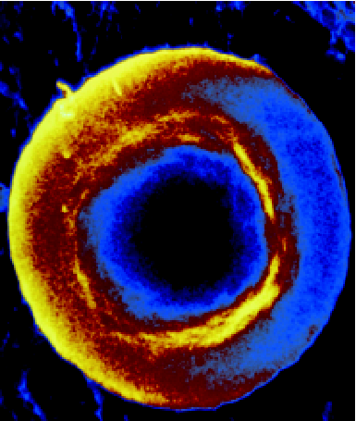
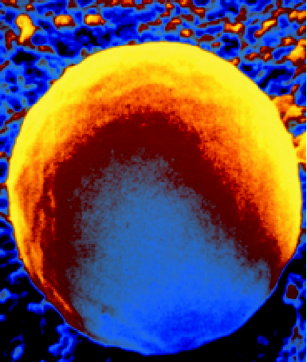
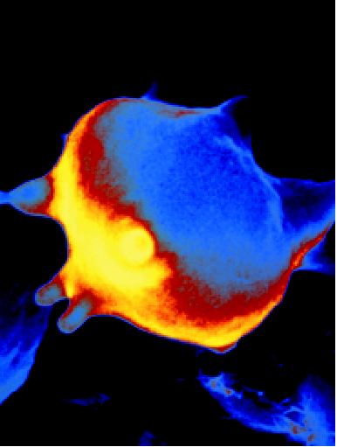
A cell in an:
isotonic
solution
hypotonic
solution
hypertonic
solution

Slide 26
Colligative Properties of Nonelectrolyte Solutions
Colligative properties are properties that depend only on the number of solute particles in solution and not on the nature of the solute particles.
0
Vapor-Pressure Lowering
P₁ = X₁ P ₁
Boiling-Point Elevation
ΔT_{b} = K_{b} m
Freezing-Point Depression
ΔT_{f} = K_{f} m
Osmotic Pressure (π)
π = MRT

Slide 27
Colligative Properties of Electrolyte Solutions
0.1 m NaCl solution
0.1 m Na⁺ ions & 0.1 m Cl⁻ ions
Colligative properties are properties that depend only on the number of solute particles in solution and not on the nature of the solute particles.
0.1 m NaCl solution
0.2 m ions in solution
actual number of particles in soln after dissociation
van’t Hoff factor (i) =
number of formula units initially dissolved in soln
i should be
nonelectrolytes
1
NaCl
2
CaCl₂
3

Slide 28
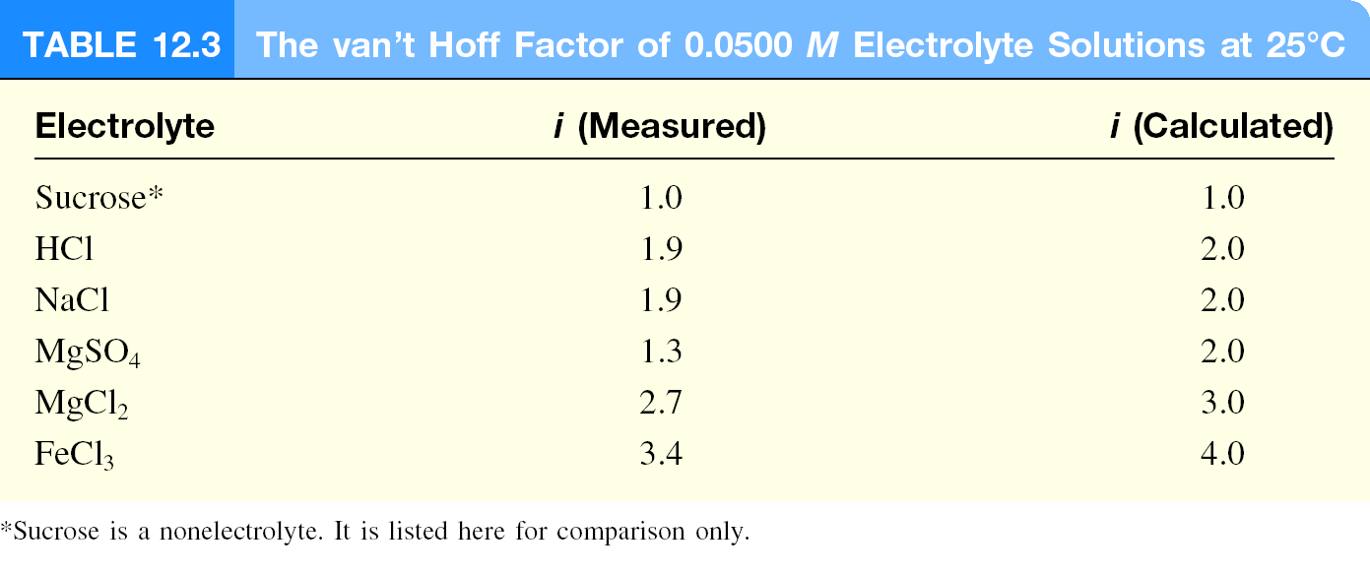
Colligative Properties of Electrolyte Solutions
Boiling-Point Elevation
ΔT_{b} = i K_{b} m
Freezing-Point Depression
ΔT_{f} = i K_{f} m
Osmotic Pressure (π)
π = iMRT

Slide 29
A colloid is a dispersion of particles of one substance throughout a dispersing medium of another substance.
Colloid versus solution
collodial particles are much larger than solute molecules
collodial suspension is not as homogeneous as a solution
colloids exhibit the Tyndall effect

Slide 30
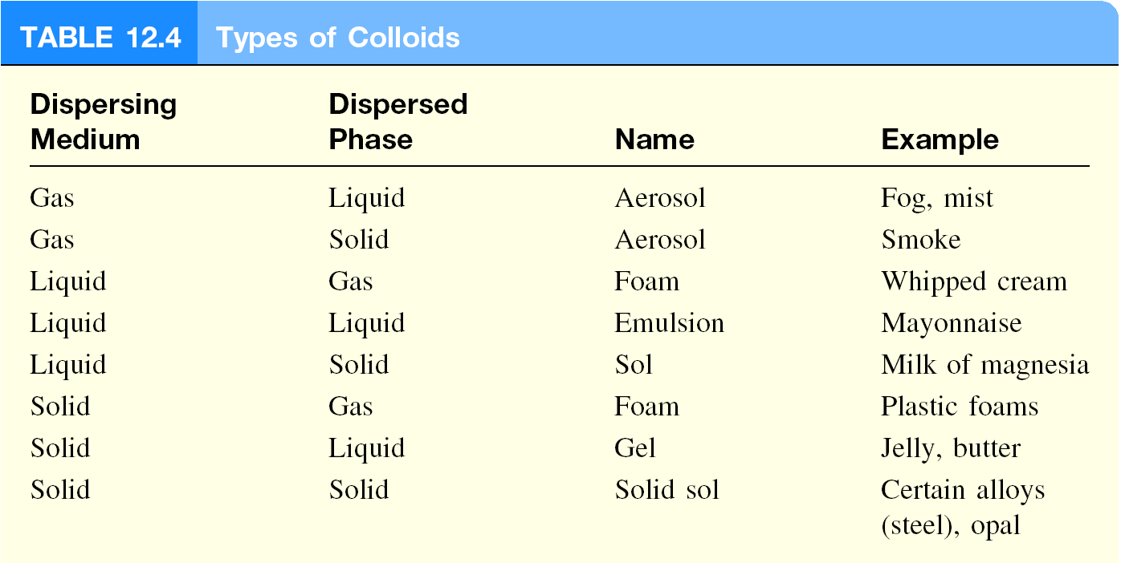

Slide 31
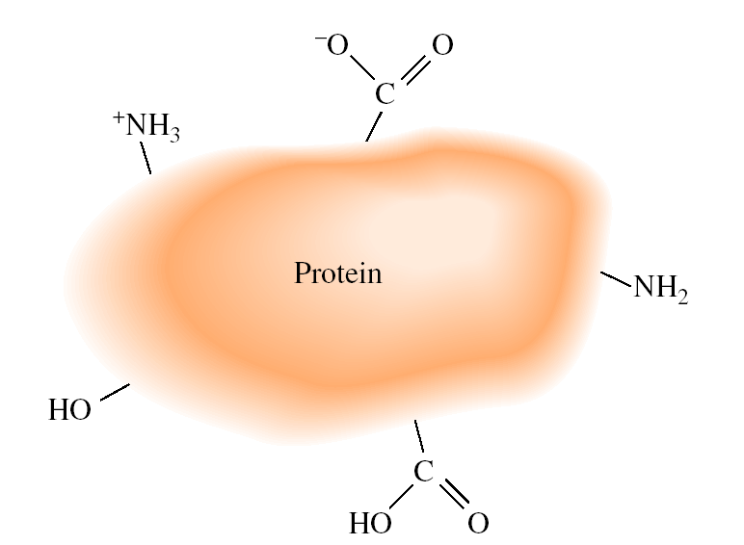
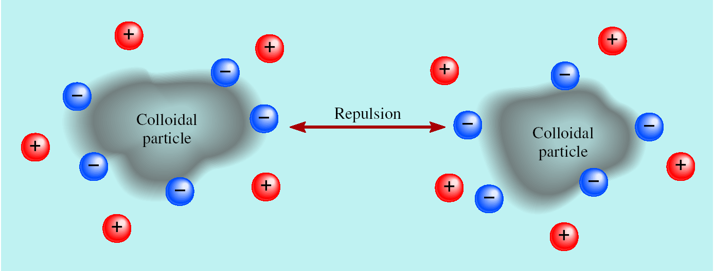
Hydrophilic and Hydrophobic Colloids
Hydrophilic: water-loving
Hydrophobic: water-fearing
Stabilization of a hydrophobic colloid

Slide 32
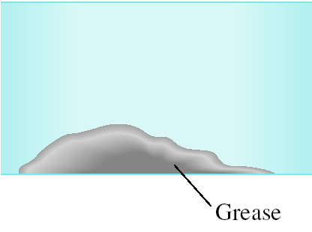
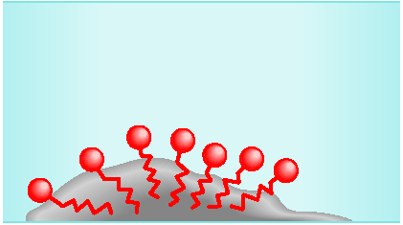
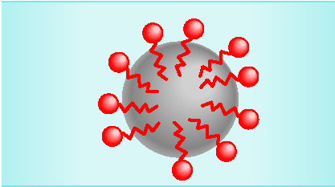
The Cleansing Action of Soap

Slide 33
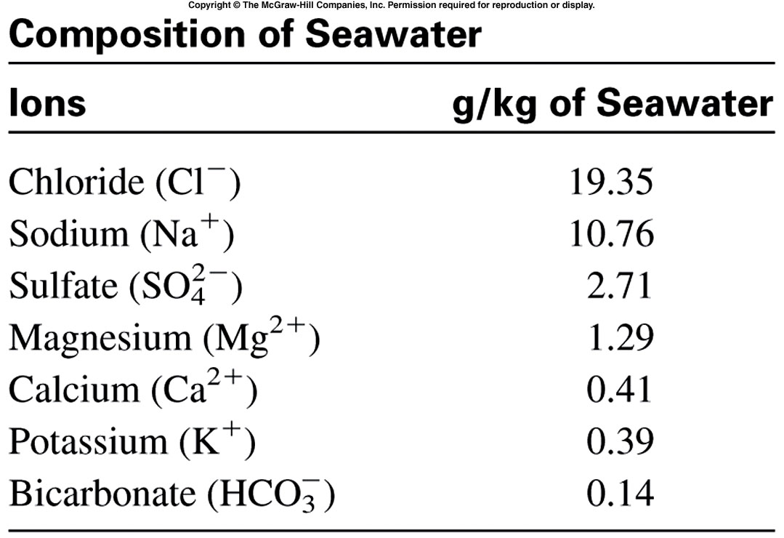
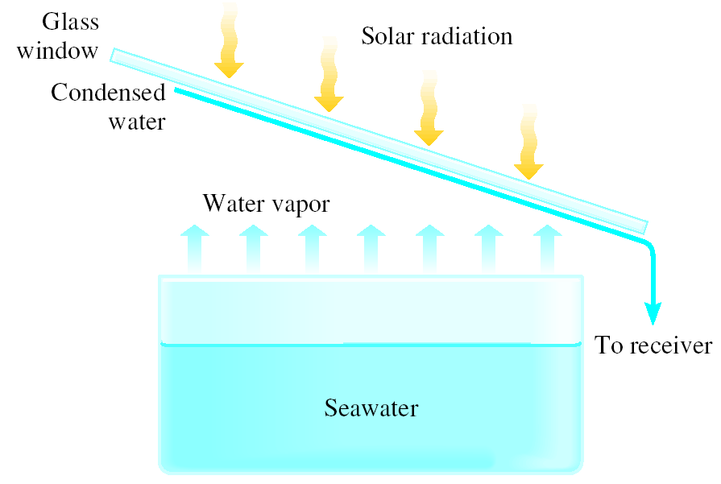
Chemistry In Action:
Desalination

Slide 34
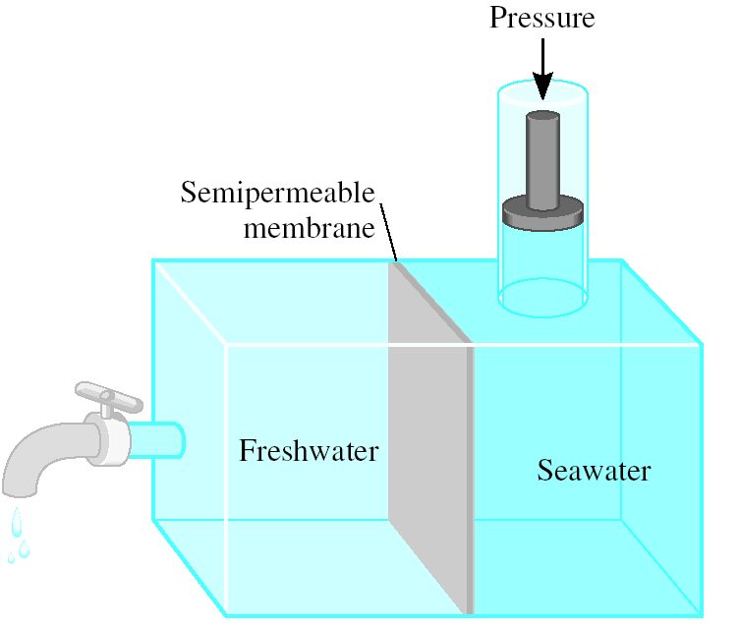
Chemistry In Action:
Reverse Osmosis

