Slide 1
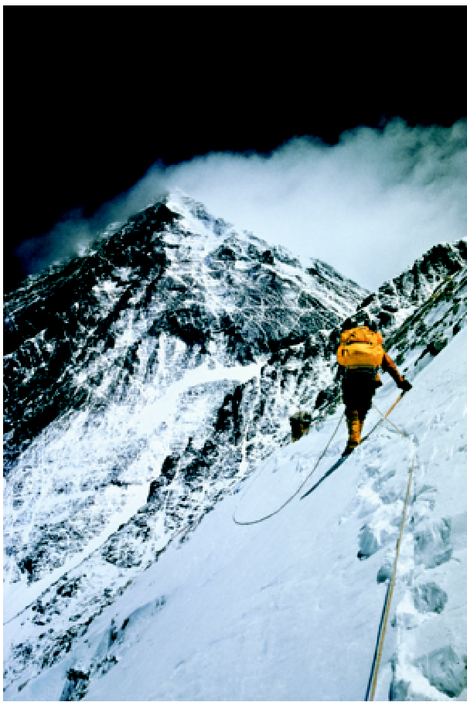
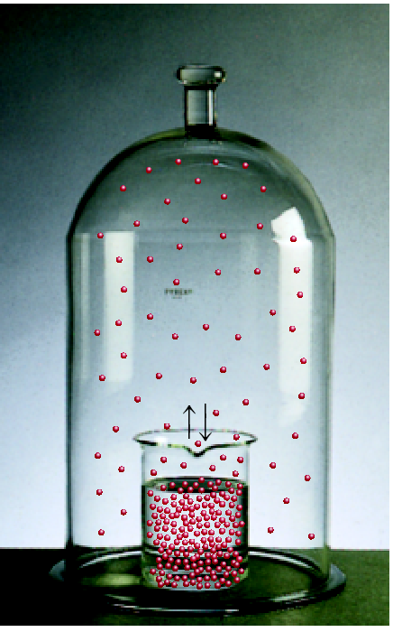
Chemical Equilibrium
Chapter 14
Copyright © The McGraw-Hill Companies, Inc. Permission required for reproduction or display.

Slide 2
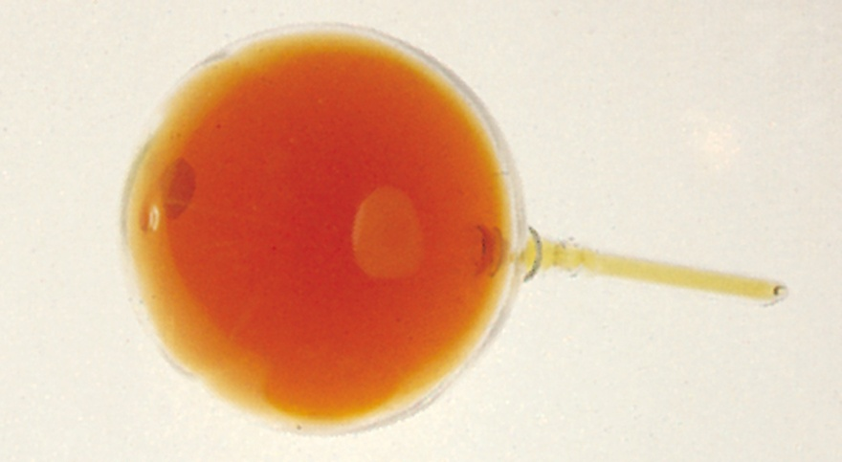
Equilibrium is a state in which there are no observable changes as time goes by.
Chemical equilibrium is achieved when:
the rates of the forward and reverse reactions are equal and
the concentrations of the reactants and products remain constant
Physical equilibrium
H₂O (l)
H₂O (g)
NO₂
Chemical equilibrium
N₂O₄ (g)
2NO₂ (g)

Slide 3
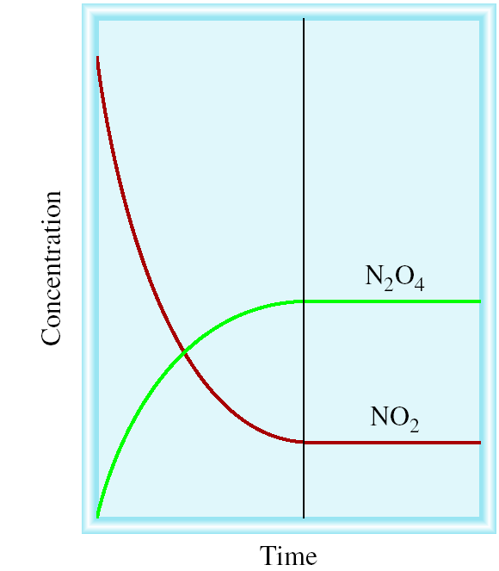
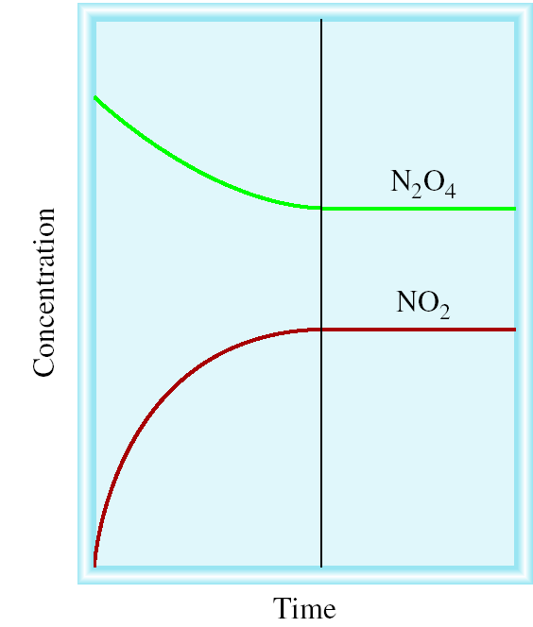
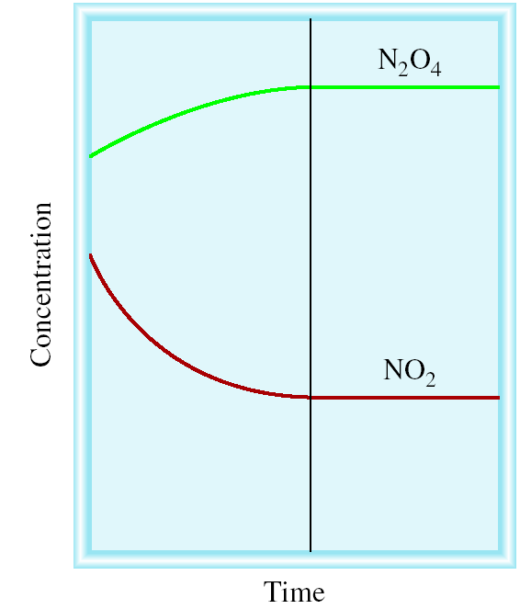
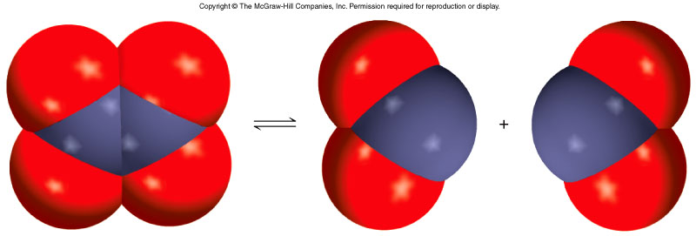
N₂O₄ (g) 2NO₂ (g)
equilibrium
equilibrium
equilibrium
Start with NO₂
Start with N₂O₄
Start with NO₂ & N₂O₄

Slide 4
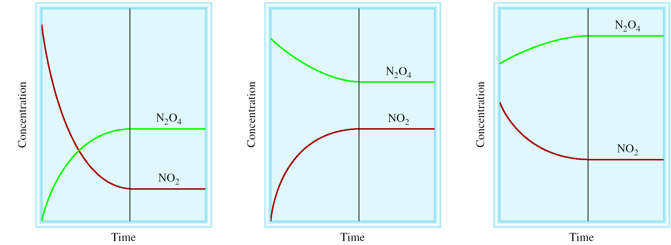
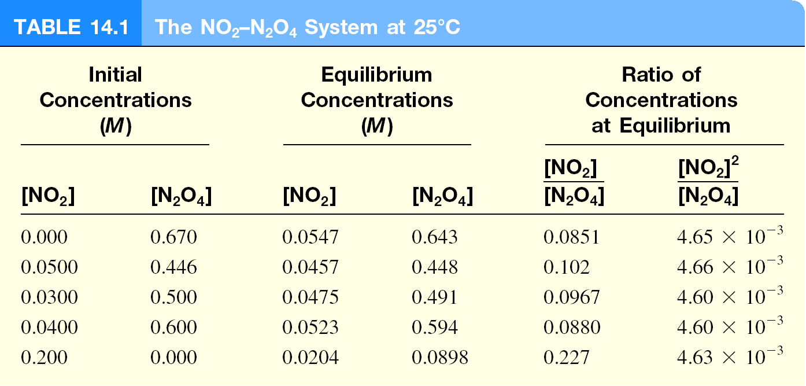
constant

Slide 5
N₂O₄ (g) 2NO₂ (g)
[NO₂]²
K =
= 4.63 x 10⁻³
[N₂O₄]
aA + bB cC + dD
[C]^{c}[D]^{d}
K =
Law of Mass Action
[A]ª[B]^{b}

Slide 6
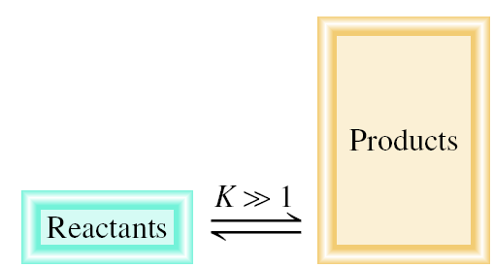
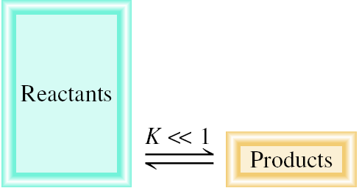
[C]^{c}[D]^{d}
K =
aA + bB cC + dD
[A]ª[B]^{b}
Equilibrium Will
K >> 1
Lie to the right
Favor products
K << 1
Lie to the left
Favor reactants

Slide 7
Homogenous equilibrium applies to reactions in which all reacting species are in the same phase.
N₂O₄ (g) 2NO₂ (g)
[NO₂]²
P ²
K_{c} =
NO₂
K_{p} =
[N₂O₄]
P
N₂O₄
In most cases
K_{c} ≠ K_{p}
aA (g) + bB (g) cC (g) + dD (g)
K_{p} = K_{c}(RT)^{Δn}
Δn = moles of gaseous products – moles of gaseous reactants
= (c + d) – (a + b)

Slide 8
Homogeneous Equilibrium
CH₃COOH (aq) + H₂O (l) CH₃COO⁻ (aq) + H₃O⁺ (aq)
′
[CH₃COO⁻][H₃O⁺]
K_{c} =
[H₂O] = constant
[CH₃COOH][H₂O]
[CH₃COO⁻][H₃O⁺]
=
′
K_{c} =
K_{c} [H₂O]
[CH₃COOH]
General practice not to include units for the equilibrium constant.

Slide 9
The equilibrium concentrations for the reaction between carbon monoxide and molecular chlorine to form COCl₂ (g) at 74⁰C are [CO] = 0.012 M, [Cl₂] = 0.054 M, and [COCl₂] = 0.14 M. Calculate the equilibrium constants K_{c} and K_{p}.
CO (g) + Cl₂ (g) COCl₂ (g)
[COCl₂]
0.14
K_{c} =
=
= 220
[CO][Cl₂]
0.012 x 0.054
K_{p} = K_{c}(RT)^{Δn}
Δn = 1 – 2 = -1
R = 0.0821
T = 273 + 74 = 347 K
K_{p} = 220 x (0.0821 x 347)⁻¹ = 7.7

Slide 10
The equilibrium constant K_{p} for the reaction
is 158 at 1000K. What is the equilibrium pressure of O₂ if the P_{NO} = 0.400 atm and P_{NO} = 0.270 atm?
2NO₂ (g) 2NO (g) + O₂ (g)
2
2
P_{NO} P_{O}
K_{p} =
2
2
P_{NO}
2
2
P_{NO}
P_{O}
= K_{p}
2
2
2
P_{NO}
P_{O}
= 158 x (0.400)²/(0.270)²
= 347 atm
2

Slide 11
Heterogenous equilibrium applies to reactions in which reactants and products are in different phases.
CaCO₃ (s) CaO (s) + CO₂ (g)
[CaO][CO₂]
′
[CaCO₃] = constant
[CaO] = constant
K_{c} =
[CaCO₃]
[CaCO₃]
′
K_{c} = [CO₂] =
K_{c} x
K_{p} = P_{CO}
[CaO]
2
The concentration of solids and pure liquids are not included in the expression for the equilibrium constant.

Slide 12
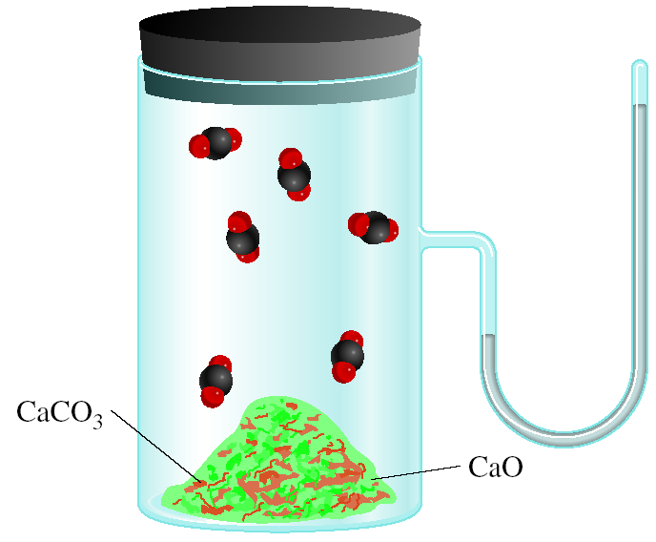
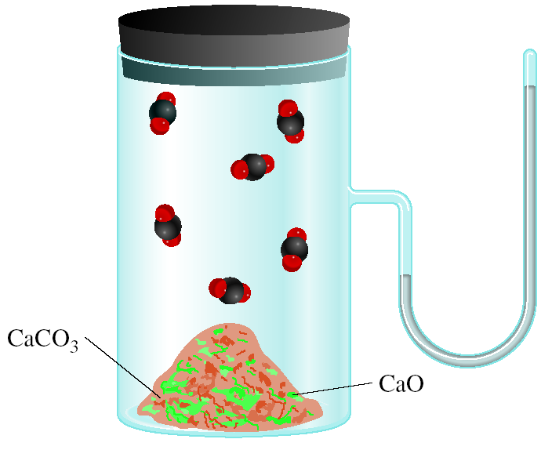
CaCO₃ (s) CaO (s) + CO₂ (g)
P_{CO}
= K_{p}
2
P_{CO}
does not depend on the amount of CaCO₃ or CaO
2

Slide 13
Consider the following equilibrium at 295 K:
The partial pressure of each gas is 0.265 atm. Calculate K_{p} and K_{c} for the reaction?
NH₄HS (s) NH₃ (g) + H₂S (g)
K_{p} = P
P
= 0.265 x 0.265 = 0.0702
NH₃
H₂S
K_{p} = K_{c}(RT)^{Δn}
K_{c} = K_{p}(RT)^{-Δn}
Δn = 2 – 0 = 2
T = 295 K
K_{c} = 0.0702 x (0.0821 x 295)⁻² = 1.20 x 10⁻⁴

Slide 14
[C][D]
[E][F]
′
′
′
′
A + B C + D
K_{c}
K_{c} =
K_{c} =
[A][B]
[C][D]
C + D E + F
K_{c}
′′
[E][F]
A + B E + F
K_{c}
K_{c} =
[A][B]
′
′′
K_{c} =
K_{c}
x
K_{c}
If a reaction can be expressed as the sum of two or more reactions, the equilibrium constant for the overall reaction is given by the product of the equilibrium constants of the individual reactions.

Slide 15
N₂O₄ (g) 2NO₂ (g)
2NO₂ (g) N₂O₄ (g)
[NO₂]²
[N₂O₄]
1
K =
= 4.63 x 10⁻³
′
= 216
K =
=
[N₂O₄]
[NO₂]²
K
When the equation for a reversible reaction is written in the opposite direction, the equilibrium constant becomes the reciprocal of the original equilibrium constant.

Slide 16
Writing Equilibrium Constant Expressions
The concentrations of the reacting species in the condensed phase are expressed in M. In the gaseous phase, the concentrations can be expressed in M or in atm.
The concentrations of pure solids, pure liquids and solvents do not appear in the equilibrium constant expressions.
The equilibrium constant is a dimensionless quantity.
In quoting a value for the equilibrium constant, you must specify the balanced equation and the temperature.
If a reaction can be expressed as a sum of two or more reactions, the equilibrium constant for the overall reaction is given by the product of the equilibrium constants of the individual reactions.

Slide 17
Chemical Kinetics and Chemical Equilibrium
k_{f}
rate_{f} = k_{f} [A][B]²
A + 2B AB₂
k_{r}
rate_{r} = k_{r} [AB₂]
Equilibrium
rate_{f} = rate_{r}
k_{f} [A][B]² = k_{r} [AB₂]
k_{f}
[AB₂]
=
K_{c} =
k_{r}
[A][B]²

Slide 18
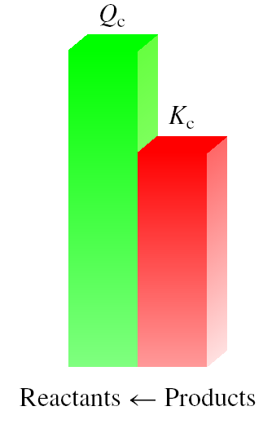
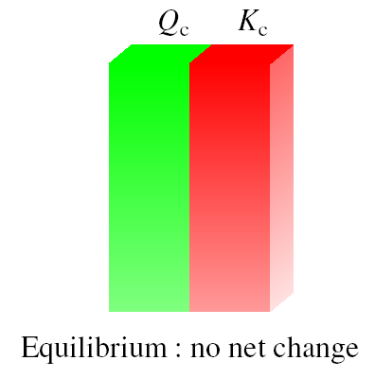
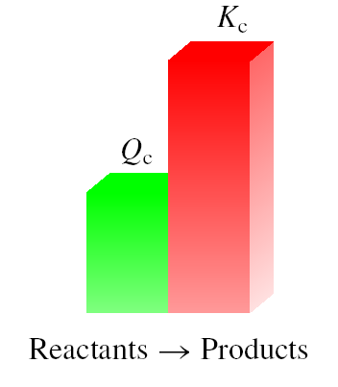
The reaction quotient (Q_{c}) is calculated by substituting the initial concentrations of the reactants and products into the equilibrium constant (K_{c}) expression.
IF
Q_{c} > K_{c} system proceeds from right to left to reach equilibrium
Q_{c} = K_{c} the system is at equilibrium
Q_{c} < K_{c} system proceeds from left to right to reach equilibrium

Slide 19
Calculating Equilibrium Concentrations
Express the equilibrium concentrations of all species in terms of the initial concentrations and a single unknown x, which represents the change in concentration.
Write the equilibrium constant expression in terms of the equilibrium concentrations. Knowing the value of the equilibrium constant, solve for x.
Having solved for x, calculate the equilibrium concentrations of all species.

Slide 20
At 1280ºC the equilibrium constant (K_{c}) for the reaction
Is 1.1 x 10⁻³. If the initial concentrations are [Br₂] = 0.063 M and [Br] = 0.012 M, calculate the concentrations of these species at equilibrium.
Br₂ (g) 2Br (g)
Let x be the change in concentration of Br₂
Br₂ (g) 2Br (g)
Initial (M)
0.063
0.012
ICE
Change (M)
-x
+2x
Equilibrium (M)
0.063 - x
0.012 + 2x
[Br]²
(0.012 + 2x)²
K_{c} =
K_{c} =
= 1.1 x 10⁻³
Solve for x
[Br₂]
0.063 - x

Slide 21
(0.012 + 2x)²
K_{c} =
= 1.1 x 10⁻³
0.063 - x
4x² + 0.048x + 0.000144 = 0.0000693 – 0.0011x
4x² + 0.0491x + 0.0000747 = 0
√
-b ± b² – 4ac
ax² + bx + c =0
x =
2a
x = -0.0105
x = -0.00178
Br₂ (g) 2Br (g)
Initial (M)
0.063
0.012
Change (M)
-x
+2x
Equilibrium (M)
0.063 - x
0.012 + 2x
At equilibrium, [Br] = 0.012 + 2x = -0.009 M
or 0.00844 M
At equilibrium, [Br₂] = 0.062 – x = 0.0648 M

Slide 22
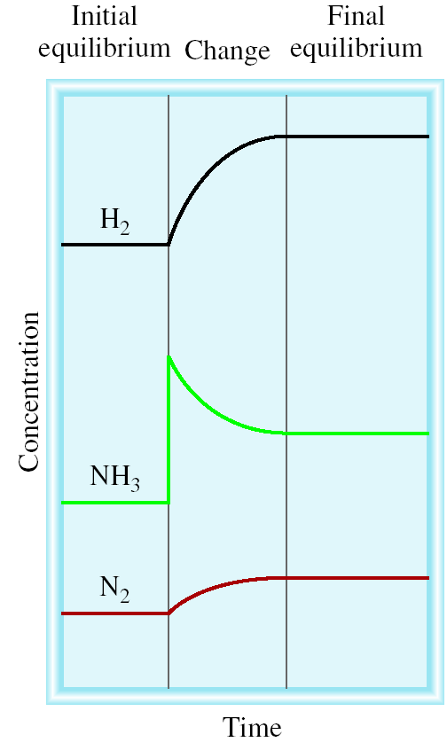
Le Châtelier’s Principle
If an external stress is applied to a system at equilibrium, the system adjusts in such a way that the stress is partially offset as the system reaches a new equilibrium position.
Changes in Concentration
N₂ (g) + 3H₂ (g) 2NH₃ (g)
Equilibrium shifts left to offset stress
Add
NH₃

Slide 23
Le Châtelier’s Principle
Changes in Concentration continued
Remove
Remove
Add
Add
aA + bB cC + dD
Change
Shifts the Equilibrium
Increase concentration of product(s)
left
Decrease concentration of product(s)
right
Increase concentration of reactant(s)
right
Decrease concentration of reactant(s)
left

Slide 24
Le Châtelier’s Principle
Changes in Volume and Pressure
A (g) + B (g) C (g)
Change
Shifts the Equilibrium
Increase pressure
Side with fewest moles of gas
Decrease pressure
Side with most moles of gas
Increase volume
Side with most moles of gas
Decrease volume
Side with fewest moles of gas

Slide 25
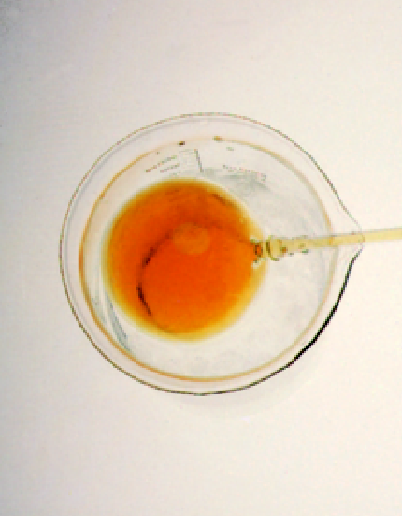
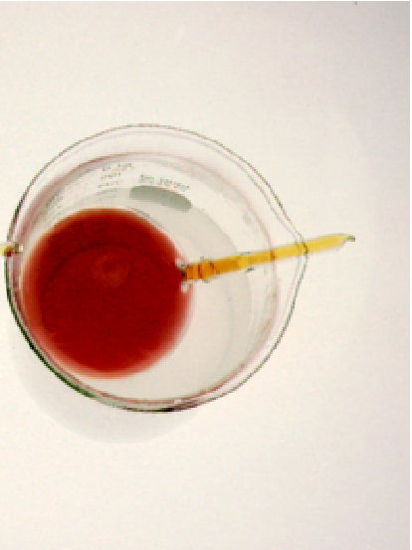
Le Châtelier’s Principle
Changes in Temperature
Change
Exothermic Rx
Endothermic Rx
Increase temperature
K decreases
K increases
Decrease temperature
K increases
K decreases
N₂O₄ (g) 2NO₂ (g)
colder
hotter

Slide 26
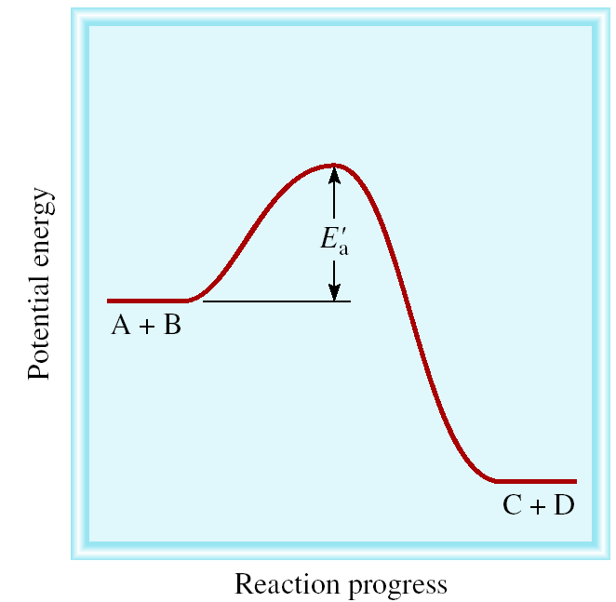
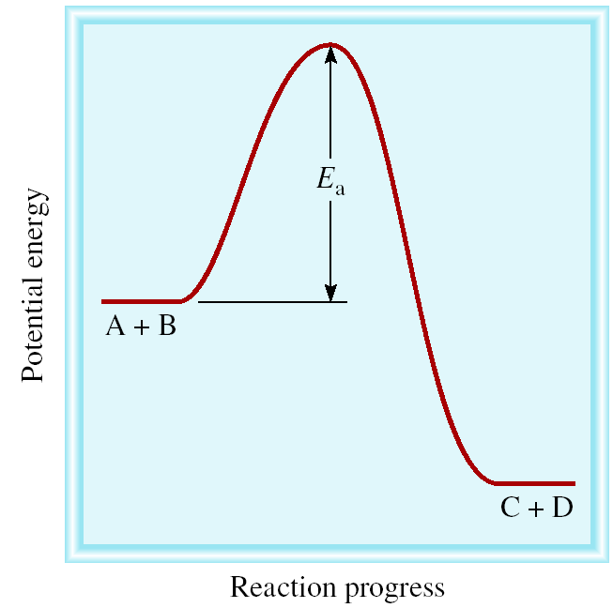
Le Châtelier’s Principle
Adding a Catalyst
does not change K
does not shift the position of an equilibrium system
system will reach equilibrium sooner
Catalyst lowers E_{a} for both forward and reverse reactions.
Catalyst does not change equilibrium constant or shift equilibrium.

Slide 27
Chemistry In Action
Life at High Altitudes and Hemoglobin Production
Hb (aq) + O₂ (aq) HbO₂ (aq)
[HbO₂]
K_{c} =
[Hb][O₂]

Slide 28
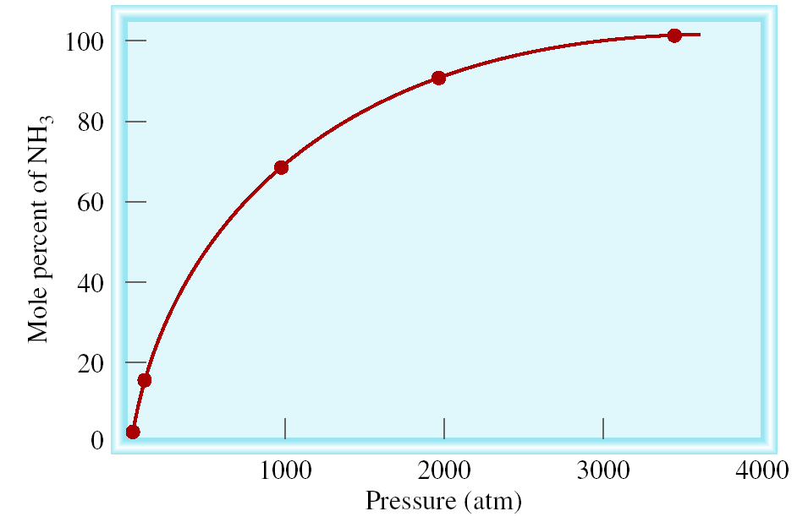
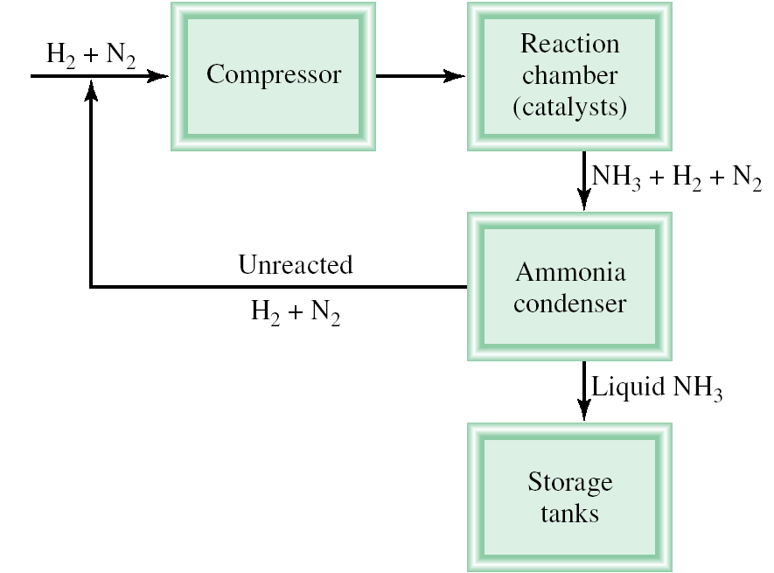
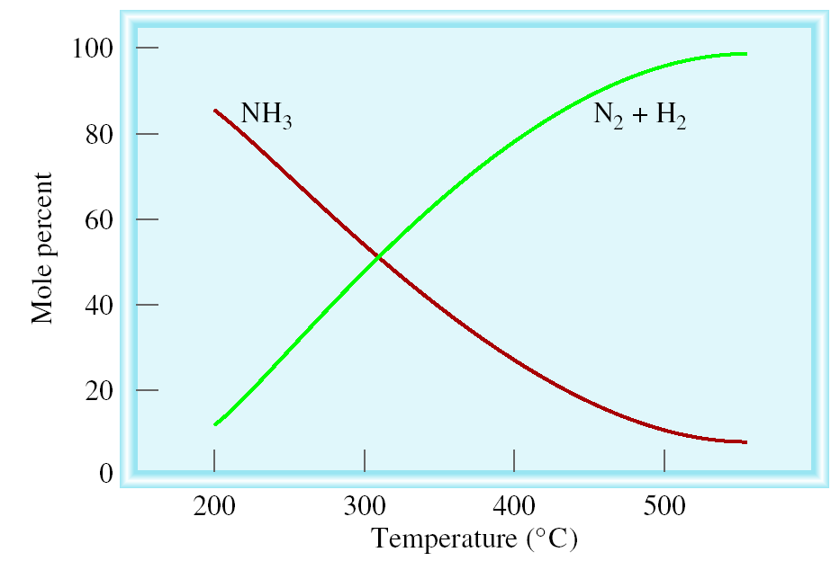
Chemistry In Action: The Haber Process
N₂ (g) + 3H₂ (g) 2NH₃ (g) ΔH⁰ = -92.6 kJ/mol

Slide 29
Le Châtelier’s Principle - Summary
Change Equilibrium
Constant
Change
Shift Equilibrium
Concentration
yes
no
Pressure
yes*
no
Volume
yes*
no
Temperature
yes
yes
Catalyst
no
no
*Dependent on relative moles of gaseous reactants and products

