Slide 1
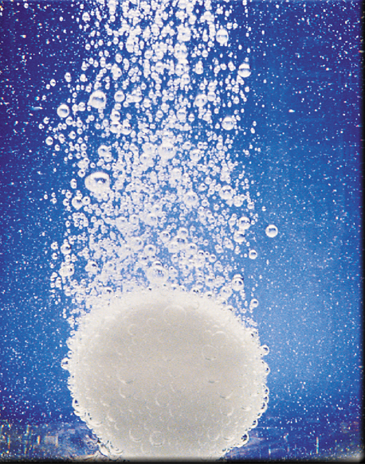
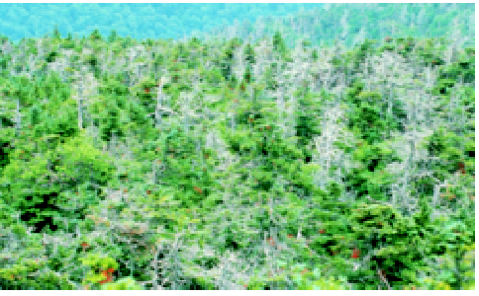
Acids and Bases

Slide 2
Acids
Have a sour taste. Vinegar owes its taste to acetic acid. Citrus
fruits contain citric acid.
React with certain metals to produce hydrogen gas.
React with carbonates and bicarbonates to produce carbon
dioxide gas
Bases
Have a bitter taste.
Feel slippery. Many soaps contain bases.

Slide 3
A Brønsted acid is a proton donor
A Brønsted base is a proton acceptor
base
acid
acid
base
conjugate acid
conjugate base
base
acid

Slide 4
Acid-Base Properties of Water
H₂O (l) H⁺ (aq) + OH⁻ (aq)
autoionization of water
-
[
]
+
H
O
+
H
O
H
O
H
+
H
O
H
H
H
conjugate acid
base
H₂O + H₂O H₃O⁺ + OH⁻
acid
conjugate base

Slide 5
The Ion Product of Water
[H⁺][OH⁻]
H₂O (l) H⁺ (aq) + OH⁻ (aq)
K_{c} =
[H₂O] = constant
[H₂O]
K_{c}[H₂O] = K_{w} = [H⁺][OH⁻]
The ion-product constant (K_{w}) is the product of the molar concentrations of H⁺ and OH⁻ ions at a particular temperature.
Solution Is
[H⁺] = [OH⁻]
neutral
At 25⁰C
K_{w} = [H⁺][OH⁻] = 1.0 x 10⁻¹⁴
[H⁺] > [OH⁻]
acidic
[H⁺] < [OH⁻]
basic

Slide 6
What is the concentration of OH⁻ ions in a HCl solution whose hydrogen ion concentration is 1.3 M?
K_{w} = [H⁺][OH⁻] = 1.0 x 10⁻¹⁴
[H⁺] = 1.3 M
K_{w}
1 x 10⁻¹⁴
[OH⁻] =
=
= 7.7 x 10⁻¹⁵ M
[H⁺]
1.3

Slide 7
pH – A Measure of Acidity
pH = -log [H⁺]
Solution Is
At 25⁰C
neutral
[H⁺] = [OH⁻]
[H⁺] = 1 x 10⁻⁷
pH = 7
acidic
[H⁺] > [OH⁻]
[H⁺] > 1 x 10⁻⁷
pH < 7
basic
[H⁺] < [OH⁻]
[H⁺] < 1 x 10⁻⁷
pH > 7
pH
[H⁺]

Slide 8
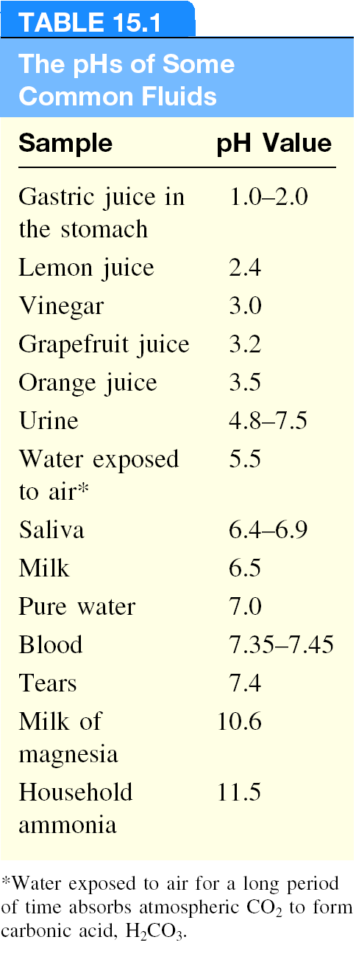
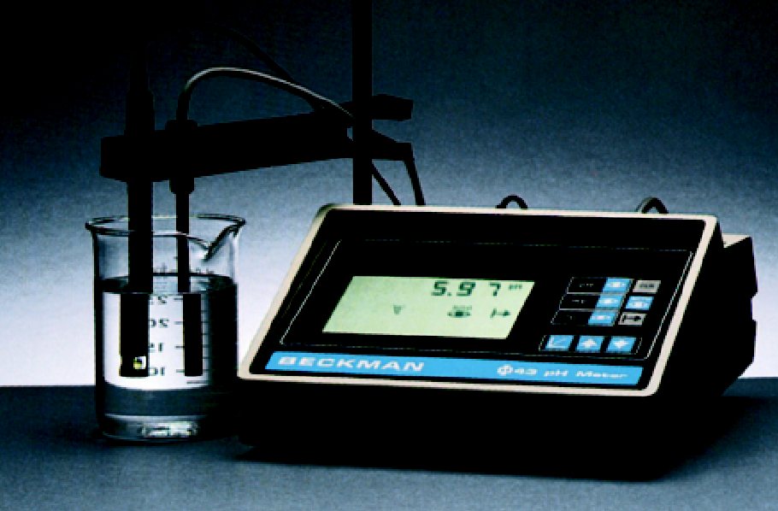
Other important relationships
pOH = -log [OH⁻]
[H⁺][OH⁻] = K_{w} = 1.0 x 10⁻¹⁴
-log [H⁺] – log [OH⁻] = 14.00
pH + pOH = 14.00
pH Meter

Slide 9
The pH of rainwater collected in a certain region of the northeastern United States on a particular day was 4.82. What is the H⁺ ion concentration of the rainwater?
pH = -log [H⁺]
[H⁺] = 10^{-pH}
= 10^{-4.82}
= 1.5 x 10⁻⁵ M
The OH⁻ ion concentration of a blood sample is 2.5 x 10⁻⁷ M. What is the pH of the blood?
pH + pOH = 14.00
pOH = -log [OH⁻]
= -log (2.5 x 10⁻⁷)
= 6.60
pH = 14.00 – pOH = 14.00 – 6.60 = 7.40

Slide 10
Strong Electrolyte – 100% dissociation
H₂O
NaCl (s) Na⁺ (aq) + Cl⁻ (aq)
Weak Electrolyte – not completely dissociated
CH₃COOH CH₃COO⁻ (aq) + H⁺ (aq)
Strong Acids are strong electrolytes
HCl (aq) + H₂O (l) H₃O⁺ (aq) + Cl⁻ (aq)
HNO₃ (aq) + H₂O (l) H₃O⁺ (aq) + NO₃⁻ (aq)
HClO₄ (aq) + H₂O (l) H₃O⁺ (aq) + ClO₄⁻ (aq)
H₂SO₄ (aq) + H₂O (l) H₃O⁺ (aq) + HSO₄⁻ (aq)

Slide 11
Weak Acids are weak electrolytes
HF (aq) + H₂O (l) H₃O⁺ (aq) + F⁻ (aq)
HNO₂ (aq) + H₂O (l) H₃O⁺ (aq) + NO₂⁻ (aq)
HSO₄⁻ (aq) + H₂O (l) H₃O⁺ (aq) + SO₄²⁻ (aq)
H₂O (l) + H₂O (l) H₃O⁺ (aq) + OH⁻ (aq)
Strong Bases are strong electrolytes
H₂O
NaOH (s) Na⁺ (aq) + OH⁻ (aq)
H₂O
KOH (s) K⁺ (aq) + OH⁻ (aq)
H₂O
Ba(OH)₂ (s) Ba²⁺ (aq) + 2OH⁻ (aq)

Slide 12
Weak Bases are weak electrolytes
F⁻ (aq) + H₂O (l) OH⁻ (aq) + HF (aq)
NO₂⁻ (aq) + H₂O (l) OH⁻ (aq) + HNO₂ (aq)
Conjugate acid-base pairs:
The conjugate base of a strong acid has no measurable strength.
H₃O⁺ is the strongest acid that can exist in aqueous solution.
The OH⁻ ion is the strongest base that can exist in aqeous solution.

Slide 13
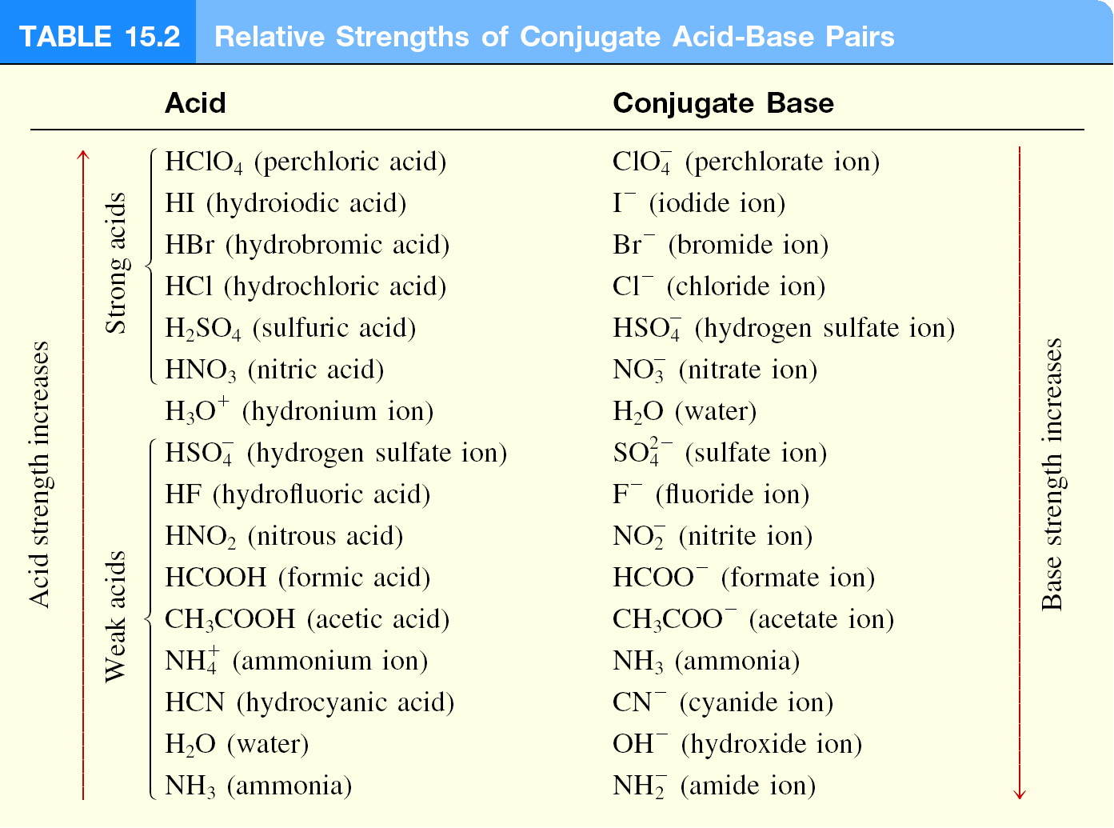

Slide 14
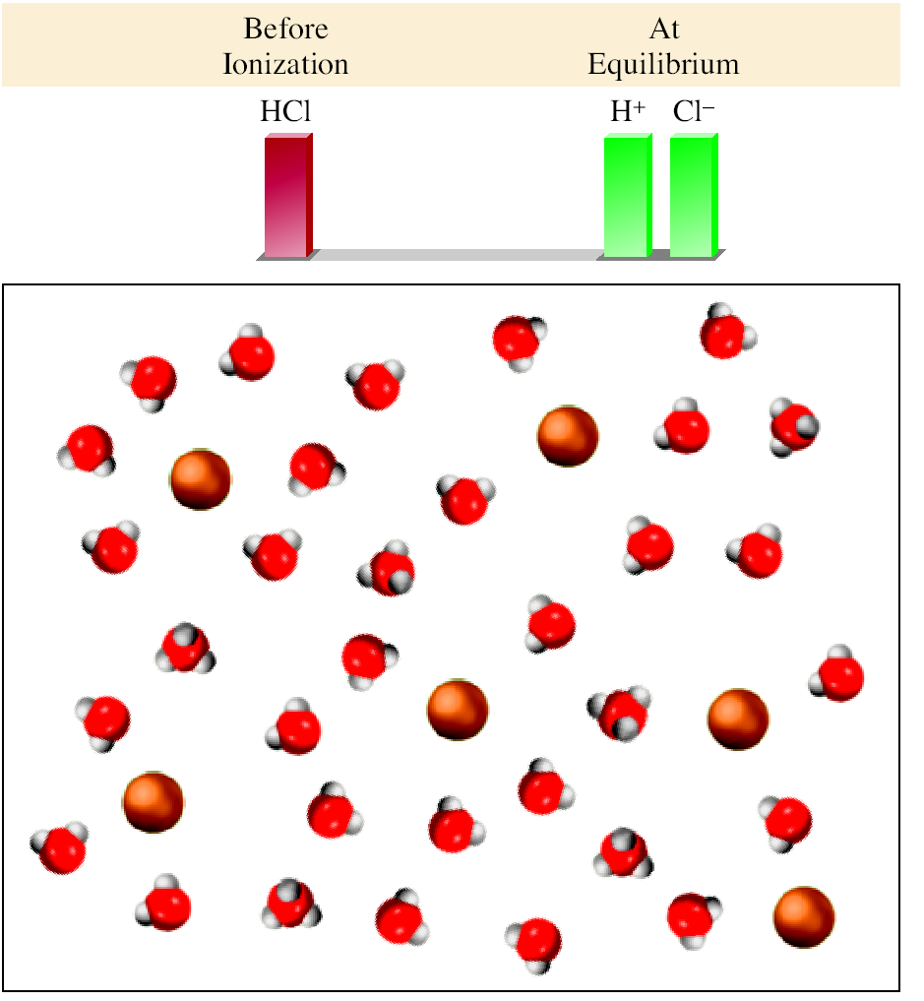
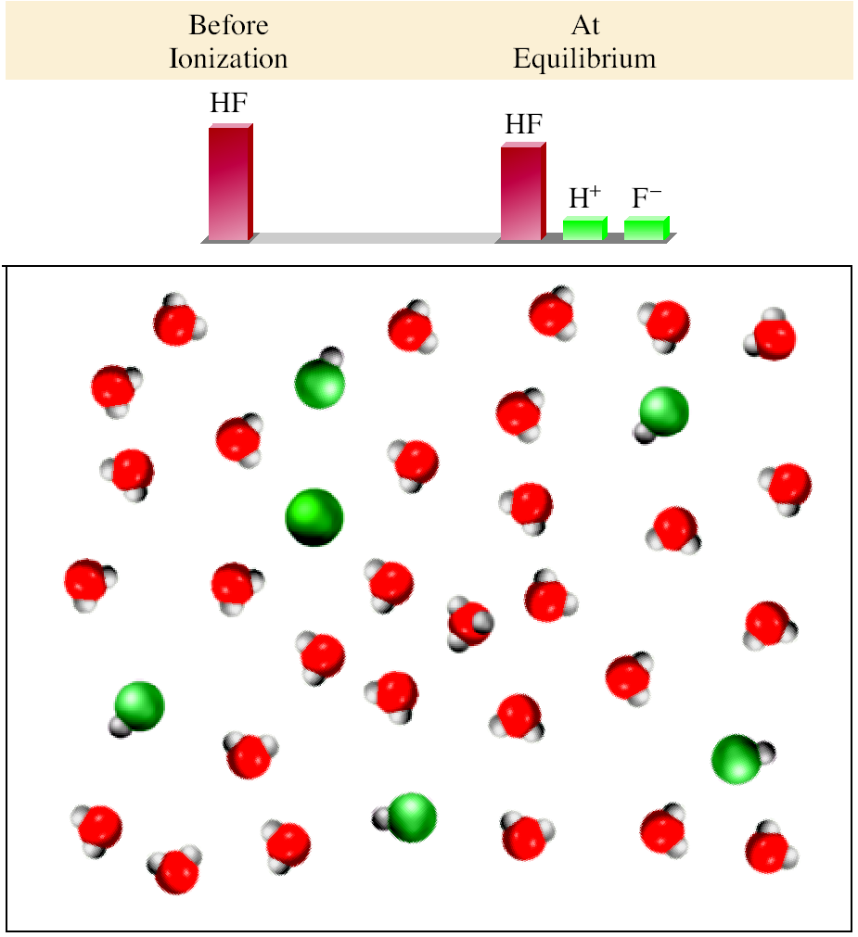
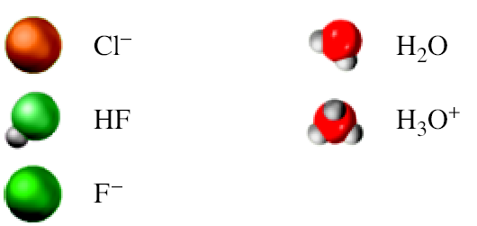
Strong Acid (HCl)
Weak Acid (HF)

Slide 15
What is the pH of a 2 x 10⁻³ M HNO₃ solution?
HNO₃ is a strong acid – 100% dissociation.
Start
0.002 M
0.0 M
0.0 M
HNO₃ (aq) + H₂O (l) H₃O⁺ (aq) + NO₃⁻ (aq)
End
0.0 M
0.002 M
0.002 M
pH = -log [H⁺] = -log [H₃O⁺] = -log(0.002) = 2.7
What is the pH of a 1.8 x 10⁻² M Ba(OH)₂ solution?
Ba(OH)₂ is a strong base – 100% dissociation.
Start
0.018 M
0.0 M
0.0 M
Ba(OH)₂ (s) Ba²⁺ (aq) + 2OH⁻ (aq)
End
0.0 M
0.018 M
0.036 M
pH = 14.00 – pOH = 14.00 + log(0.036) = 12.6

Slide 16
Weak Acids (HA) and Acid Ionization Constants
HA (aq) + H₂O (l) H₃O⁺ (aq) + A⁻ (aq)
HA (aq) H⁺ (aq) + A⁻ (aq)
[H⁺][A⁻]
K_{a} =
[HA]
K_{a} is the acid ionization constant
weak acid
strength
K_{a}

Slide 17
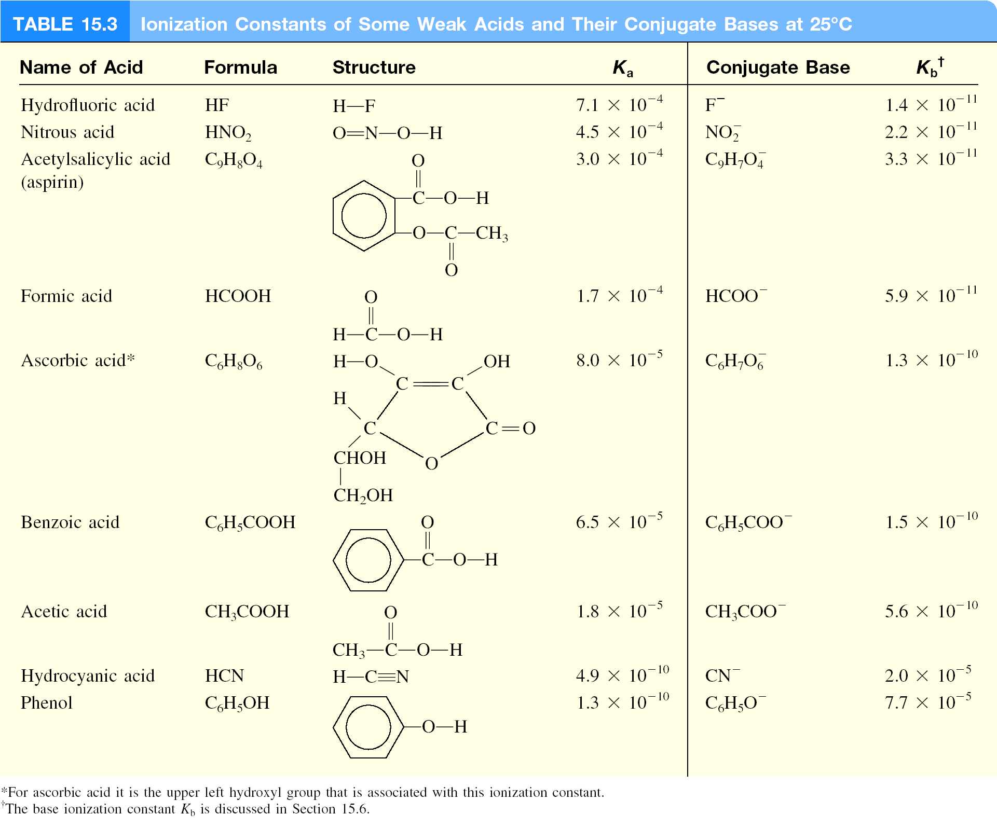

Slide 18
What is the pH of a 0.5 M HF solution (at 25⁰C)?
[H⁺][F⁻]
HF (aq) H⁺ (aq) + F⁻ (aq)
K_{a} =
= 7.1 x 10⁻⁴
[HF]
HF (aq) H⁺ (aq) + F⁻ (aq)
Initial (M)
0.50
0.00
0.00
Change (M)
-x
+x
+x
Equilibrium (M)
0.50 - x
x
x
x²
K_{a} =
= 7.1 x 10⁻⁴
K_{a} << 1
0.50 – x ≈ 0.50
0.50 - x
x²
K_{a} ≈
= 7.1 x 10⁻⁴
x² = 3.55 x 10⁻⁴
x = 0.019 M
0.50
[H⁺] = [F⁻] = 0.019 M
pH = -log [H⁺] = 1.72
[HF] = 0.50 – x = 0.48 M

Slide 19
When can I use the approximation?
K_{a} << 1
0.50 – x ≈ 0.50
When x is less than 5% of the value from which it is subtracted.
0.019 M
Less than 5%
Approximation ok.
x = 0.019
x 100% = 3.8%
0.50 M
What is the pH of a 0.05 M HF solution (at 25⁰C)?
x²
K_{a} ≈
= 7.1 x 10⁻⁴
x = 0.006 M
0.05
0.006 M
More than 5%
Approximation not ok.
x 100% = 12%
0.05 M
Must solve for x exactly using quadratic equation or method of successive approximations.

Slide 20
Solving weak acid ionization problems:
Identify the major species that can affect the pH.
In most cases, you can ignore the autoionization of water.
Ignore [OH⁻] because it is determined by [H⁺].
Use ICE to express the equilibrium concentrations in terms of single unknown x.
Write K_{a} in terms of equilibrium concentrations. Solve for x by the approximation method. If approximation is not valid, solve for x exactly.
Calculate concentrations of all species and/or pH of the solution.

Slide 21
What is the pH of a 0.122 M monoprotic acid whose
K_{a} is 5.7 x 10⁻⁴?
HA (aq) H⁺ (aq) + A⁻ (aq)
Initial (M)
0.122
0.00
0.00
Change (M)
-x
+x
+x
Equilibrium (M)
0.122 - x
x
x
x²
K_{a} =
= 5.7 x 10⁻⁴
K_{a} << 1
0.122 – x ≈ 0.122
0.122 - x
x²
K_{a} ≈
= 5.7 x 10⁻⁴
x² = 6.95 x 10⁻⁵
x = 0.0083 M
0.122
0.0083 M
More than 5%
Approximation not ok.
x 100% = 6.8%
0.122 M

Slide 22
x²
K_{a} =
= 5.7 x 10⁻⁴
x² + 0.00057x – 6.95 x 10⁻⁵ = 0
0.122 - x
√
-b ± b² – 4ac
ax² + bx + c =0
x =
2a
x = 0.0081
x = - 0.0081
HA (aq) H⁺ (aq) + A⁻ (aq)
Initial (M)
0.122
0.00
0.00
Change (M)
-x
+x
+x
Equilibrium (M)
0.122 - x
x
x
[H⁺] = x = 0.0081 M
pH = -log[H⁺] = 2.09

Slide 23
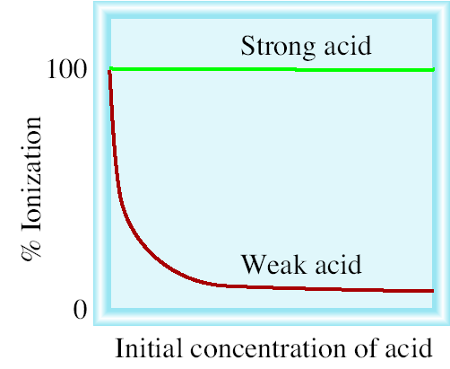
Ionized acid concentration at equilibrium
percent ionization =
x 100%
Initial concentration of acid
For a monoprotic acid HA
[H⁺]
Percent ionization =
x 100%
[HA]₀ = initial concentration
[HA]₀

Slide 24
Weak Bases and Base Ionization Constants
NH₃ (aq) + H₂O (l) NH₄⁺ (aq) + OH⁻ (aq)
[NH₄⁺][OH⁻]
K_{b} =
[NH₃]
K_{b} is the base ionization constant
weak base
strength
K_{b}
Solve weak base problems like weak acids except solve for [OH-] instead of [H⁺].

Slide 25
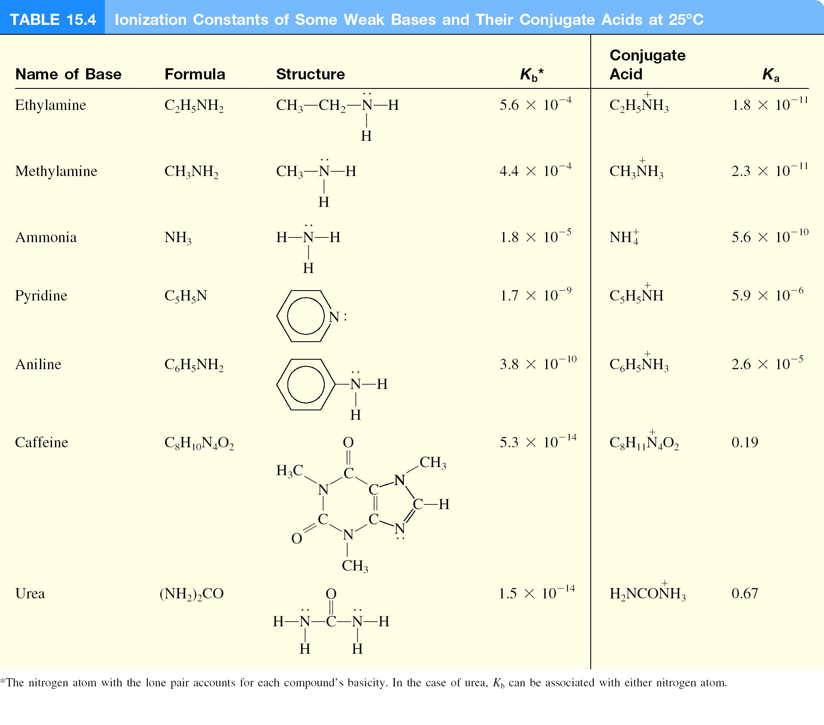

Slide 26
Ionization Constants of Conjugate Acid-Base Pairs
HA (aq) H⁺ (aq) + A⁻ (aq)
K_{a}
A⁻ (aq) + H₂O (l) OH⁻ (aq) + HA (aq)
K_{b}
H₂O (l) H⁺ (aq) + OH⁻ (aq)
K_{w}
K_{a}K_{b} = K_{w}
Weak Acid and Its Conjugate Base
K_{w}
K_{w}
K_{a} =
K_{b} =
K_{b}
K_{a}

Slide 27
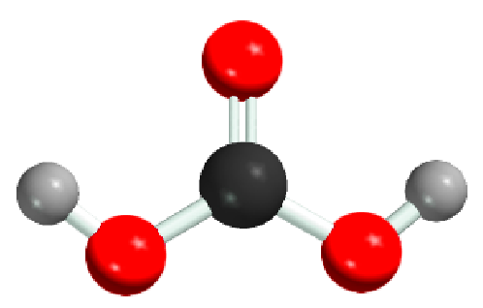
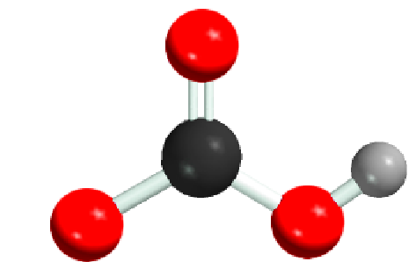
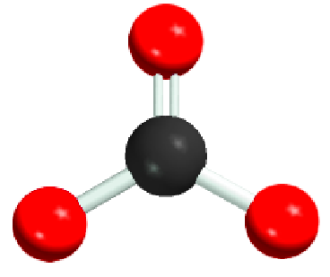
Diprotic and Triprotic Acids
May yield more than one hydrogen ion per molecule.
Ionize in a stepwise manner; that is, they lose one proton at
a time.
An ionization constant expression can be written for each
ionization stage.
Consequently, two or more equilibrium constant expressions
must often be used to calculate the concentrations of
species in the acid solution.

Slide 28
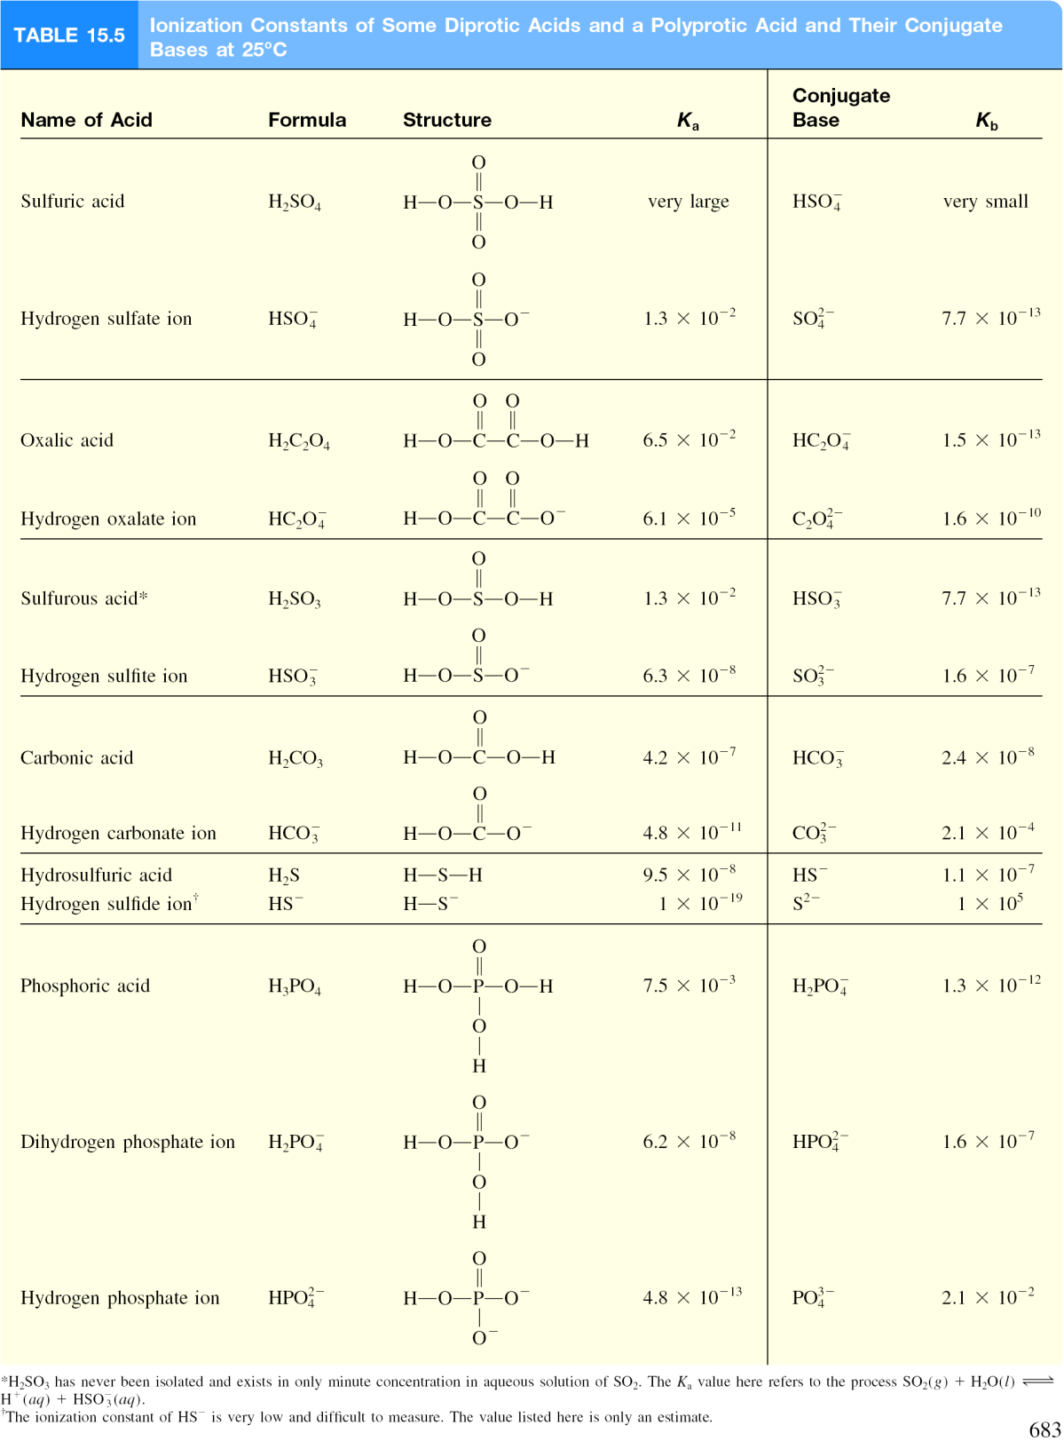

Slide 29
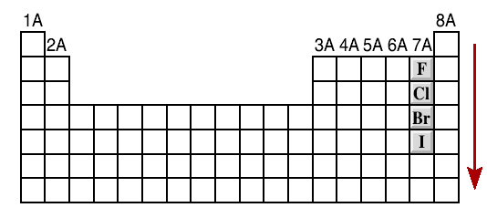
Molecular Structure and Acid Strength
H X
H⁺ + X⁻
The stronger the bond
The weaker the acid
HF << HCl < HBr < HI
acidity
increases

Slide 31
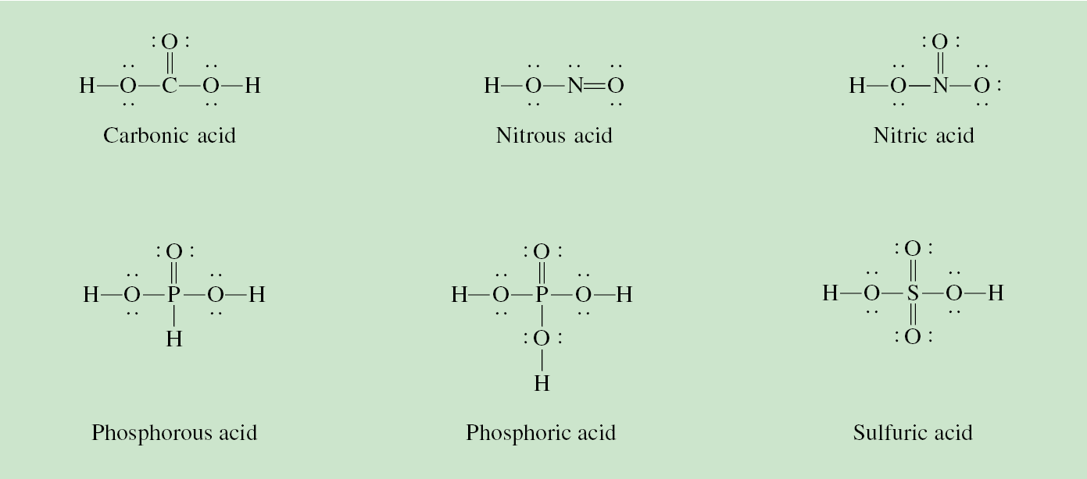
Molecular Structure and Oxoacid Strength
δ⁻
δ⁺
Z
O
H
Z
O⁻
+ H⁺
The O-H bond will be more polar and easier to break if:
Z is very electronegative or
Z is in a high oxidation state

Slide 32
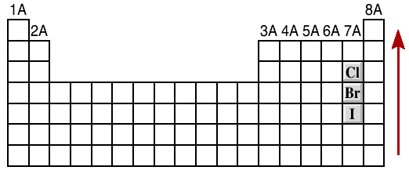
Molecular Structure and Oxoacid Strength
1. Oxoacids having different central atoms (Z) that are from the same group and that have the same oxidation number.
Acid strength increases with increasing electronegativity of Z
•
•
•
•
•
•
•
•
•
•
•
•
O
O
•
•
•
•
•
•
•
•
•
•
•
•
H O Cl O
H O Br O
•
•
•
•
•
•
•
•
•
•
•
•
Cl is more electronegative than Br
acidity
increases
HClO₃ > HBrO₃

Slide 33
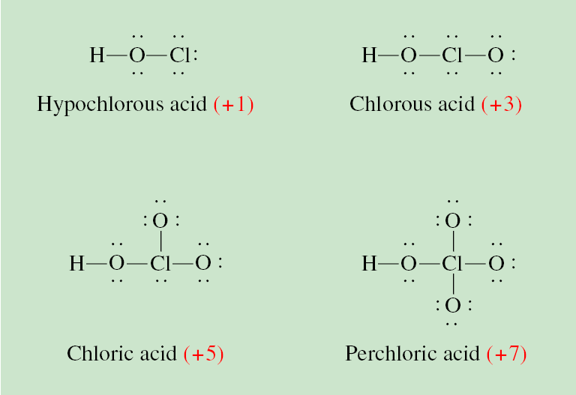
Molecular Structure and Acid Strength
2. Oxoacids having the same central atom (Z) but different numbers of attached groups.
Acid strength increases as the oxidation number of Z increases.
HClO₄ > HClO₃ > HClO₂ > HClO

Slide 34
Acid-Base Properties of Salts
Neutral Solutions:
Salts containing an alkali metal or alkaline earth metal ion (except Be²⁺) and the conjugate base of a strong acid (e.g. Cl⁻, Br⁻, and NO₃⁻).
H₂O
NaCl (s) Na⁺ (aq) + Cl⁻ (aq)
Basic Solutions:
Salts derived from a strong base and a weak acid.
H₂O
NaCH₃COOH (s) Na⁺ (aq) + CH₃COO⁻ (aq)
CH₃COO⁻ (aq) + H₂O (l) CH₃COOH (aq) + OH⁻ (aq)

Slide 35
Acid-Base Properties of Salts
Acid Solutions:
Salts derived from a strong acid and a weak base.
H₂O
NH₄Cl (s) NH₄⁺ (aq) + Cl⁻ (aq)
NH₄⁺ (aq) NH₃ (aq) + H⁺ (aq)
Salts with small, highly charged metal cations (e.g. Al³⁺, Cr³⁺, and Be²⁺) and the conjugate base of a strong acid.
3+
2+
Al(H₂O)₆ (aq) Al(OH)(H₂O)₅ (aq) + H⁺ (aq)

Slide 36
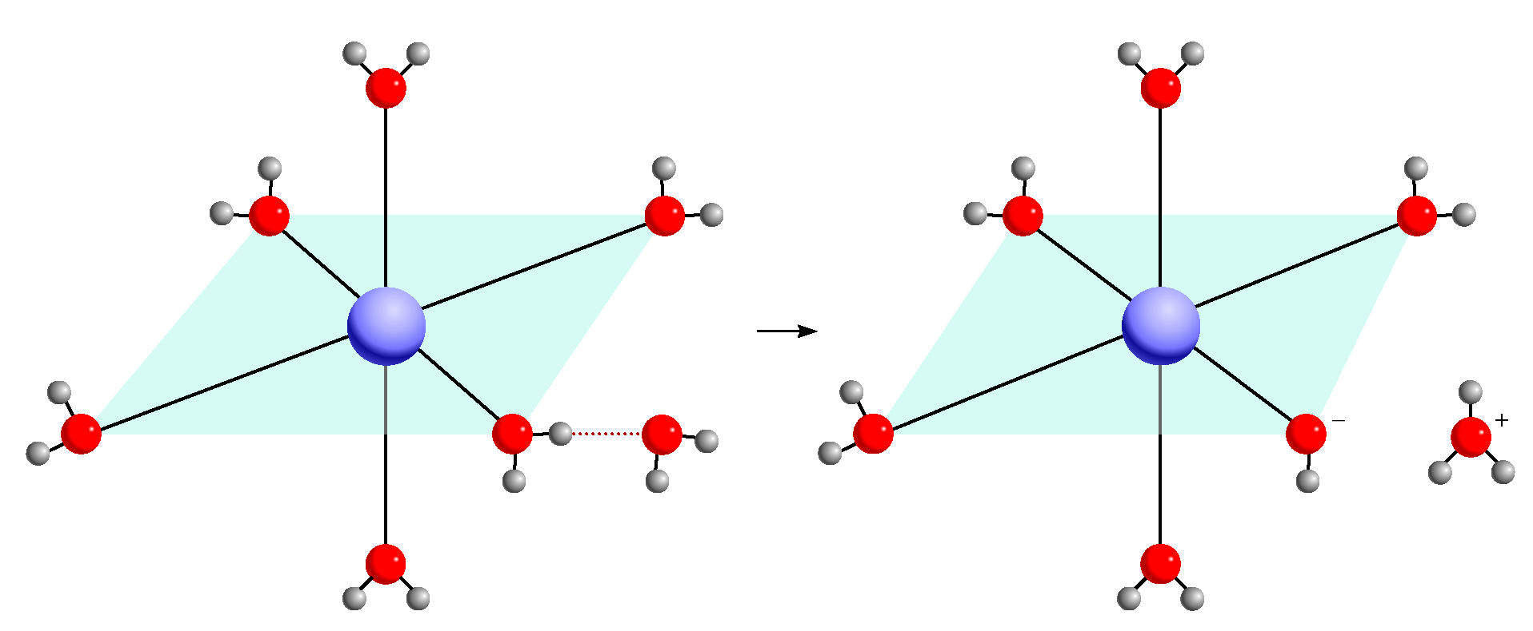
Acid Hydrolysis of Al³⁺

Slide 37
Acid-Base Properties of Salts
Solutions in which both the cation and the anion hydrolyze:
K_{b} for the anion > K_{a} for the cation, solution will be basic
K_{b} for the anion < K_{a} for the cation, solution will be acidic
K_{b} for the anion ≈ K_{a} for the cation, solution will be neutral

Slide 38
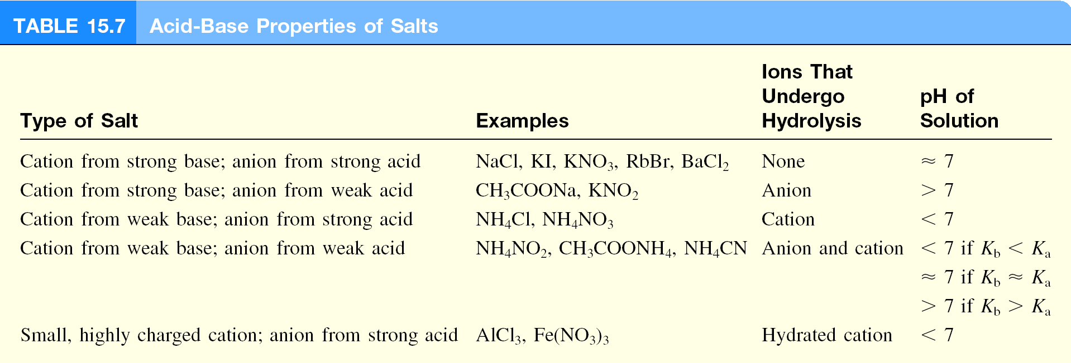

Slide 39
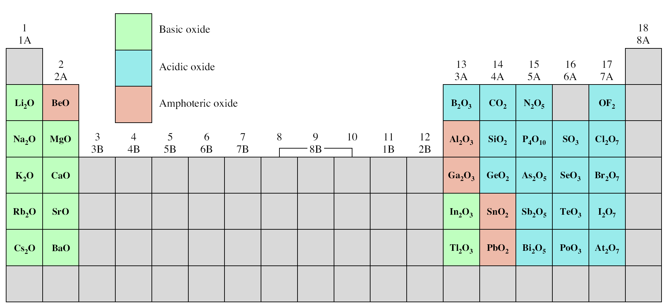
Oxides of the Representative Elements
In Their Highest Oxidation States
Na₂O (s) + H₂O (l) 2NaOH (aq)
CO₂ (g) + H₂O (l) H₂CO₃ (aq)
N₂O₅ (g) + H₂O (l) 2HNO₃ (aq)

Slide 40
Definition of An Acid
Arrhenius acid is a substance that produces H⁺ (H₃O⁺) in water
A Brønsted acid is a proton donor
A Lewis acid is a substance that can accept a pair of electrons
A Lewis base is a substance that can donate a pair of electrons
•
•
•
+ OH⁻
•
H⁺
•
•
H O H
•
•
•
•
acid
base
H
H
+
H⁺
+
N H
H
N H
•
•
H
H
acid
base

Slide 41
Lewis Acids and Bases
F
H
F
H
F B
+
N H
F B
N H
•
•
F
H
F
H
acid
base
No protons donated or accepted!

Slide 42
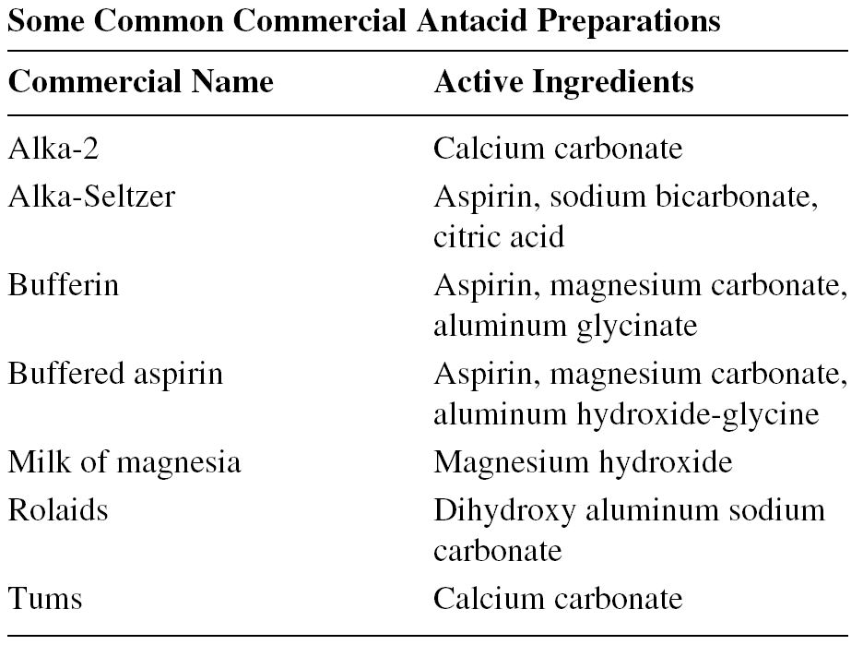
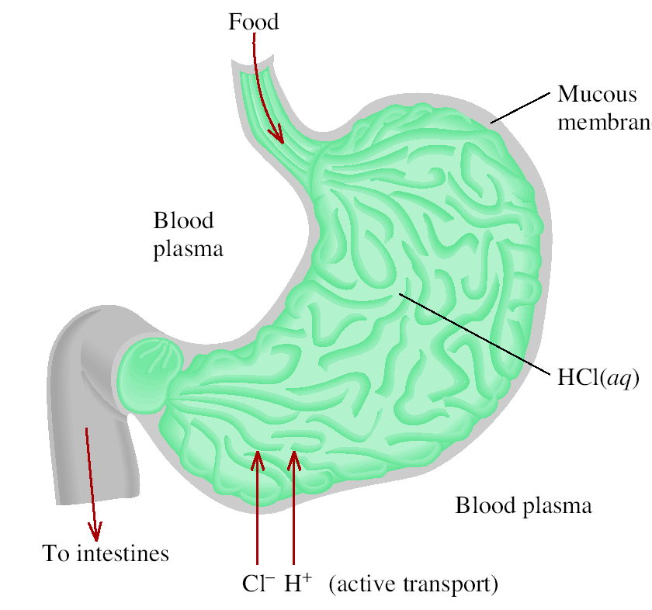
Chemistry In Action: Antacids and the Stomach pH Balance
NaHCO₃ (aq) + HCl (aq)
NaCl (aq) + H₂O (l) + CO₂ (g)
Mg(OH)₂ (s) + 2HCl (aq)
MgCl₂ (aq) + 2H₂O (l)

