Slide 1
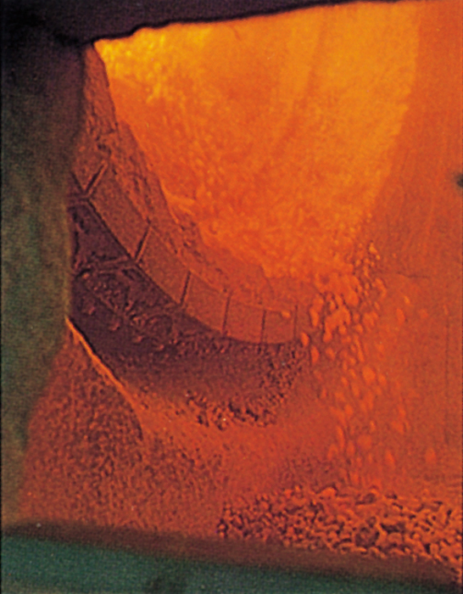
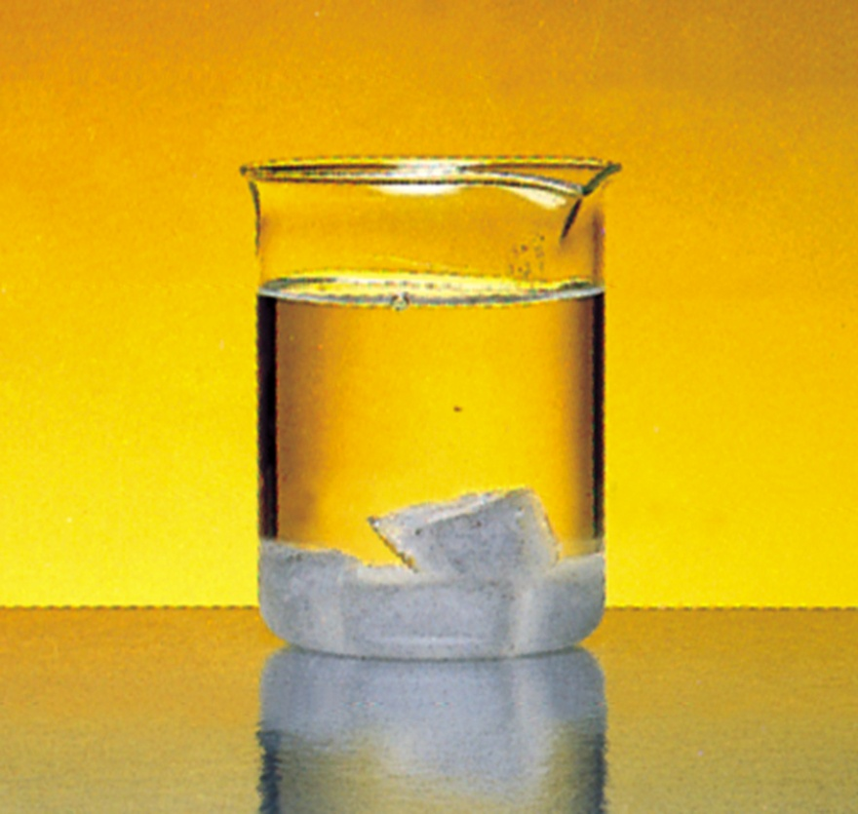
Entropy, Free Energy, and Equilibrium
Chapter 18
Copyright © The McGraw-Hill Companies, Inc. Permission required for reproduction or display.

Slide 2
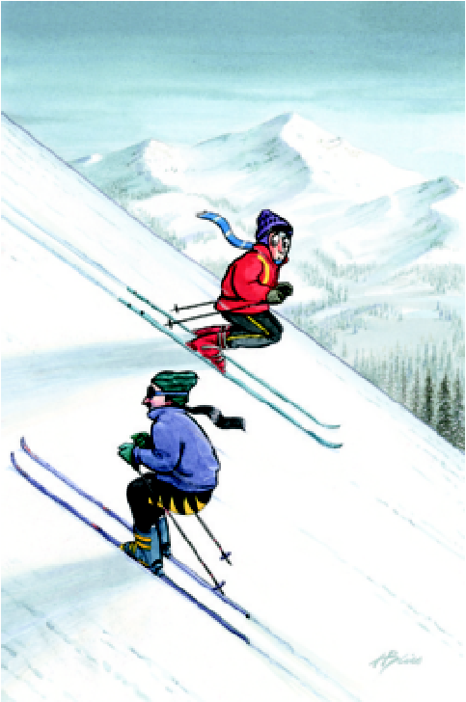
Spontaneous Physical and Chemical Processes
A waterfall runs downhill
A lump of sugar dissolves in a cup of coffee
At 1 atm, water freezes below 0 ºC and ice melts above 0 ºC
Heat flows from a hotter object to a colder object
A gas expands in an evacuated bulb
Iron exposed to oxygen and
water forms rust
spontaneous
nonspontaneous

Slide 3
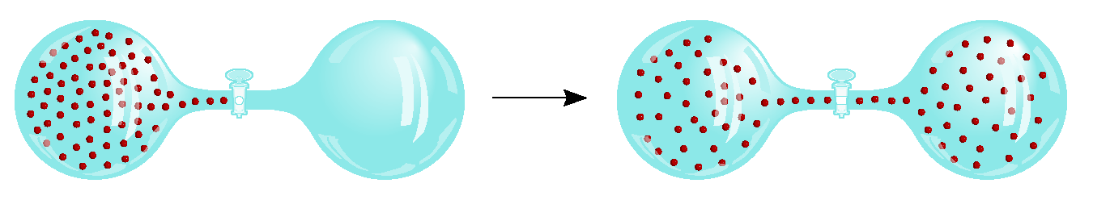
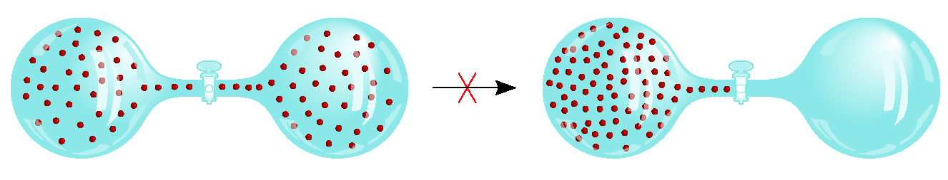
spontaneous
nonspontaneous

Slide 4
Does a decrease in enthalpy mean a reaction proceeds spontaneously?
Spontaneous reactions
CH₄ (g) + 2O₂ (g) CO₂ (g) + 2H₂O (l) ΔH⁰ = -890.4 kJ/mol
H⁺ (aq) + OH⁻ (aq) H₂O (l) ΔH⁰ = -56.2 kJ/mol
H₂O (s) H₂O (l) ΔH⁰ = 6.01 kJ/mol
H₂O
NH₄NO₃ (s) NH₄⁺(aq) + NO₃⁻ (aq) ΔH⁰ = 25 kJ/mol

Slide 5
Entropy (S) is a measure of the randomness or disorder of a system.
order
S
disorder
S
ΔS = S_{f} - S_{i}
If the change from initial to final results in an increase in randomness
S_{f} > S_{i}
ΔS > 0
For any substance, the solid state is more ordered than the liquid state and the liquid state is more ordered than gas state
S_{solid} < S_{liquid} << S_{gas}
H₂O (s) H₂O (l)
ΔS > 0

Slide 6
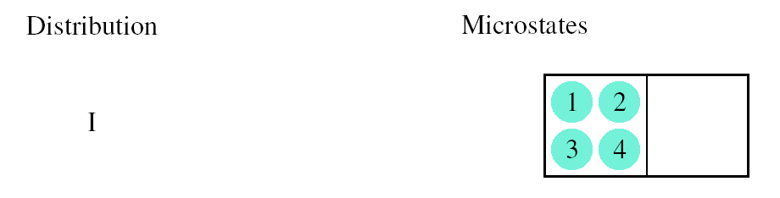
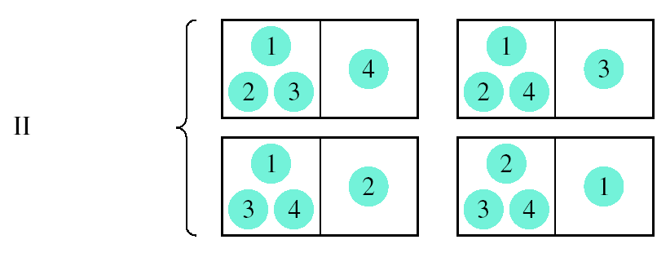
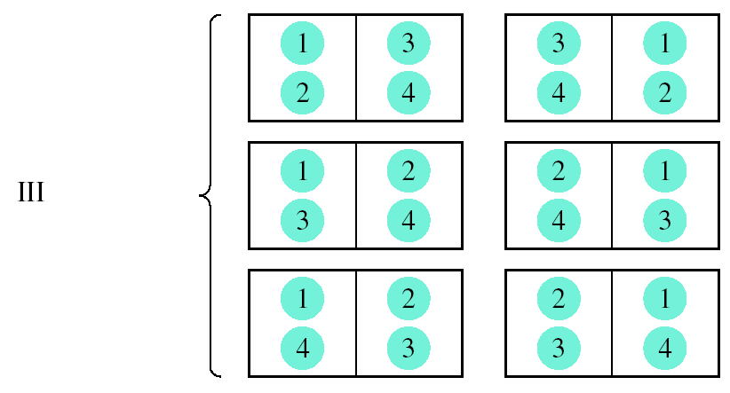
Entropy
W = number of microstates
S = k ln W
ΔS = S_{f} - S_{i}
W_{f}
ΔS = k ln
W_{i}
W_{f} > W_{i} then ΔS > 0
W_{f} < W_{i} then ΔS < 0

Slide 7
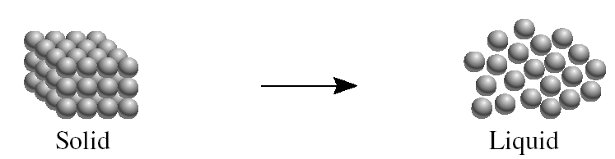
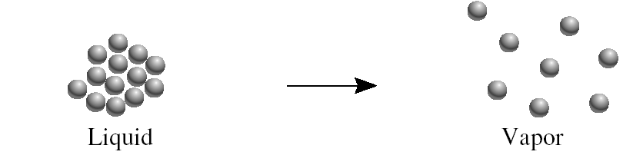
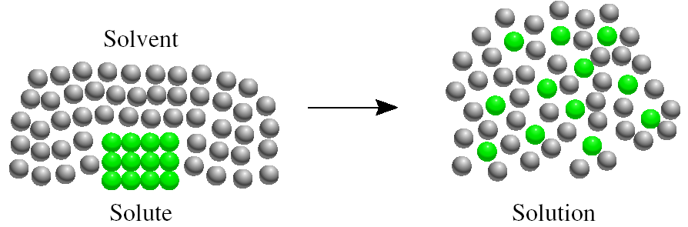
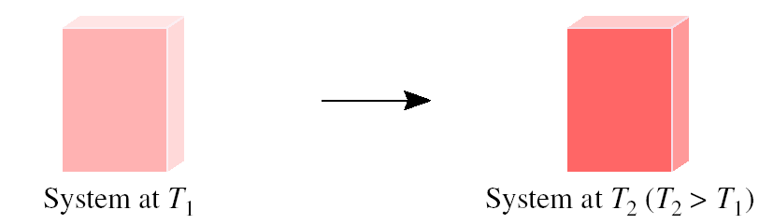
Processes that lead to an increase in entropy (ΔS > 0)

Slide 8
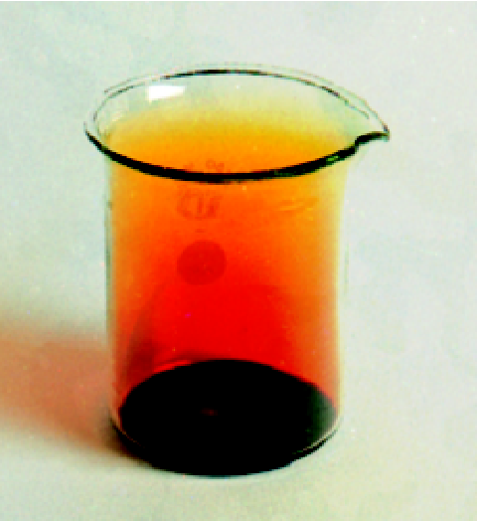
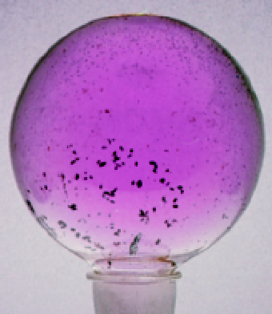
Example: Br₂(l) Br₂(g)
Example: I₂(s) I₂(g)
ΔS > 0
ΔS > 0

Slide 9
How does the entropy of a system change for each of the following processes?
(a) Condensing water vapor
Randomness decreases
Entropy decreases (ΔS < 0)
(b) Forming sucrose crystals from a supersaturated solution
Randomness decreases
Entropy decreases (ΔS < 0)
(c) Heating hydrogen gas from 60⁰C to 80⁰C
Randomness increases
Entropy increases (ΔS > 0)
(d) Subliming dry ice
Randomness increases
Entropy increases (ΔS > 0)

Slide 10
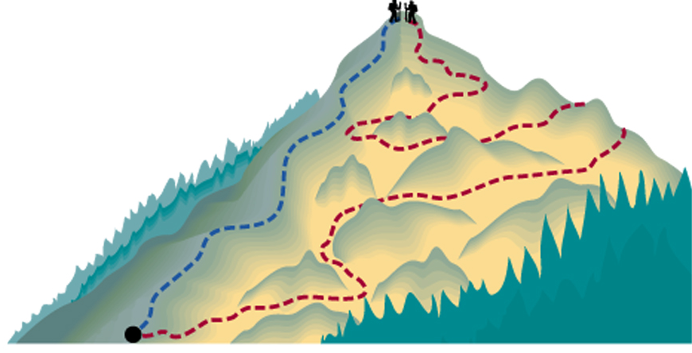
Entropy
State functions are properties that are determined by the state of the system, regardless of how that condition was achieved.
Examples:
energy, enthalpy, pressure, volume, temperature
, entropy
Review
Potential energy of hiker 1 and hiker 2 is the same even though they took different paths.

Slide 11
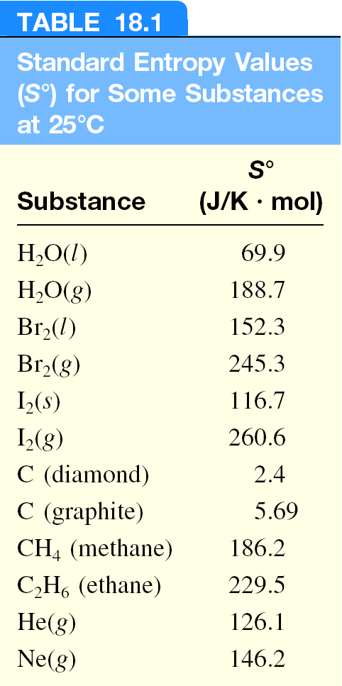

Slide 12
First Law of Thermodynamics
Energy can be converted from one form to another but energy cannot be created or destroyed.
Second Law of Thermodynamics
The entropy of the universe increases in a spontaneous process and remains unchanged in an equilibrium process.
Spontaneous process:
ΔS_{univ} = ΔS_{sys} + ΔS_{surr} > 0
Equilibrium process:
ΔS_{univ} = ΔS_{sys} + ΔS_{surr} = 0

Slide 13
Entropy Changes in the System (ΔS_{sys})
The standard entropy of reaction (ΔS⁰ ) is the entropy change for a reaction carried out at 1 atm and 25⁰C.
rxn
aA + bB cC + dD
ΔS⁰
-
[
aS⁰(A)
+
bS⁰(B)
=
[
cS⁰(C)
+
dS⁰(D)
]
]
rxn
ΔS⁰
=
Σ
nS⁰(products)
-
Σ
mS⁰(reactants)
rxn
What is the standard entropy change for the following reaction at 25⁰C? 2CO (g) + O₂ (g) 2CO₂ (g)
S⁰(CO) = 197.9 J/K•mol
S⁰(CO₂) = 213.6 J/K•mol
S⁰(O₂) = 205.0 J/K•mol
ΔS⁰
= 2 x S⁰(CO₂) – [2 x S⁰(CO) + S⁰ (O₂)]
rxn
ΔS⁰
= 427.2 – [395.8 + 205.0] = -173.6 J/K•mol
rxn

Slide 14
Entropy Changes in the System (ΔS_{sys})
When gases are produced (or consumed)
If a reaction produces more gas molecules than it consumes, ΔS⁰ > 0.
If the total number of gas molecules diminishes, ΔS⁰ < 0.
If there is no net change in the total number of gas molecules, then ΔS⁰ may be positive or negative BUT ΔS⁰ will be a small number.
What is the sign of the entropy change for the following reaction? 2Zn (s) + O₂ (g) 2ZnO (s)
The total number of gas molecules goes down, ΔS is negative.

Slide 15
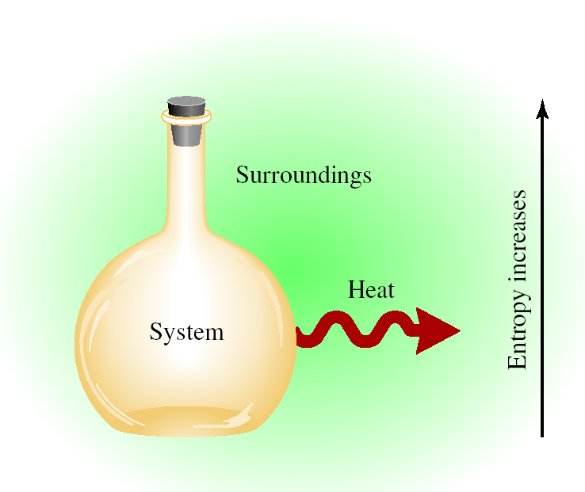
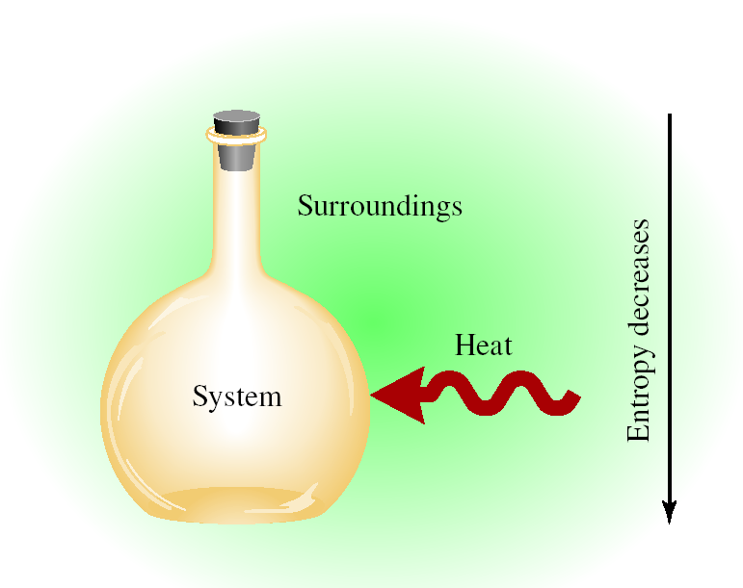
Entropy Changes in the Surroundings (ΔS_{surr})
Exothermic Process
ΔS_{surr} > 0
Endothermic Process
ΔS_{surr} < 0

Slide 16
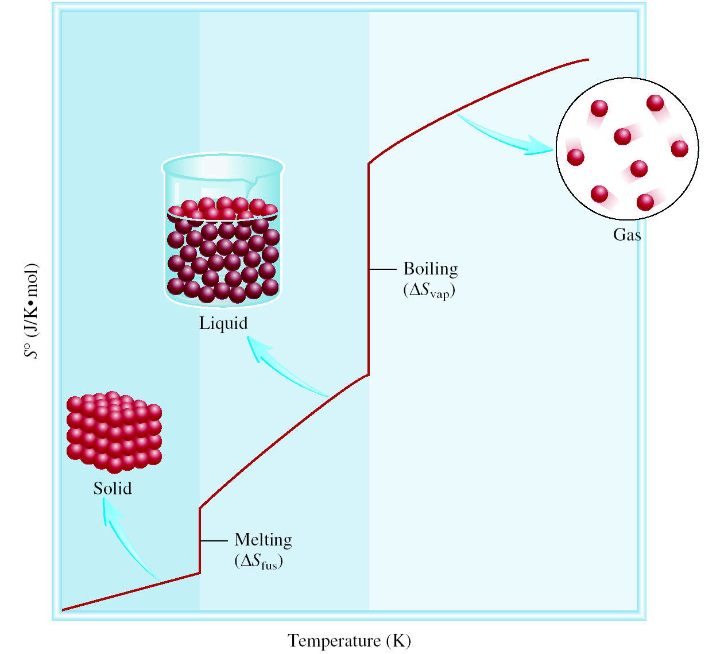
Third Law of Thermodynamics
The entropy of a perfect crystalline substance is zero at the absolute zero of temperature.
S = k ln W
W = 1
S = 0

Slide 17
Gibbs Free Energy
Spontaneous process:
ΔS_{univ} = ΔS_{sys} + ΔS_{surr} > 0
Equilibrium process:
ΔS_{univ} = ΔS_{sys} + ΔS_{surr} = 0
For a constant temperature and constant pressure process:
Gibbs free energy (G)
ΔG = ΔH_{sys} -TΔS_{sys}
ΔG < 0 The reaction is spontaneous in the forward direction.
ΔG > 0 The reaction is nonspontaneous as written. The
reaction is spontaneous in the reverse direction.
ΔG = 0 The reaction is at equilibrium.

Slide 18
The standard free-energy of reaction (ΔG⁰ ) is the free-energy change for a reaction when it occurs under standard-state conditions.
rxn
aA + bB cC + dD
ΔG⁰
cΔG⁰ (C)
dΔG⁰ (D)
-
aΔG⁰ (A)
bΔG⁰ (B)
=
[
+
]
[
+
]
rxn
f
f
f
f
ΔG⁰
=
Σ
nΔG⁰ (products)
-
Σ
mΔG⁰ (reactants)
rxn
f
f
Standard free energy of formation (ΔG⁰) is the free-energy change that occurs when 1 mole of the compound is formed from its elements in their standard states.
f
ΔG⁰ of any element in its stable form is zero.
f

Slide 19
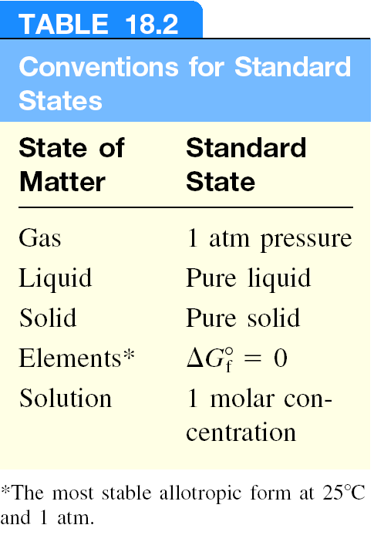

Slide 20
What is the standard free-energy change for the following reaction at 25 ⁰C?
2C₆H₆ (l) + 15O₂ (g) 12CO₂ (g) + 6H₂O (l)
ΔG⁰
=
Σ
nΔG⁰ (products)
-
Σ
mΔG⁰ (reactants)
rxn
f
f
ΔG⁰
12ΔG⁰ (CO₂)
6ΔG⁰ (H₂O)
-
[
2ΔG⁰ (C₆H₆)
=
[
+
]
]
rxn
f
f
f
ΔG⁰
=
[ 12x–394.4 + 6x–237.2 ] – [ 2x124.5 ] = -6405 kJ/mol
rxn
Is the reaction spontaneous at 25 ⁰C?
ΔG⁰ = -6405 kJ/mol
< 0
spontaneous

Slide 21
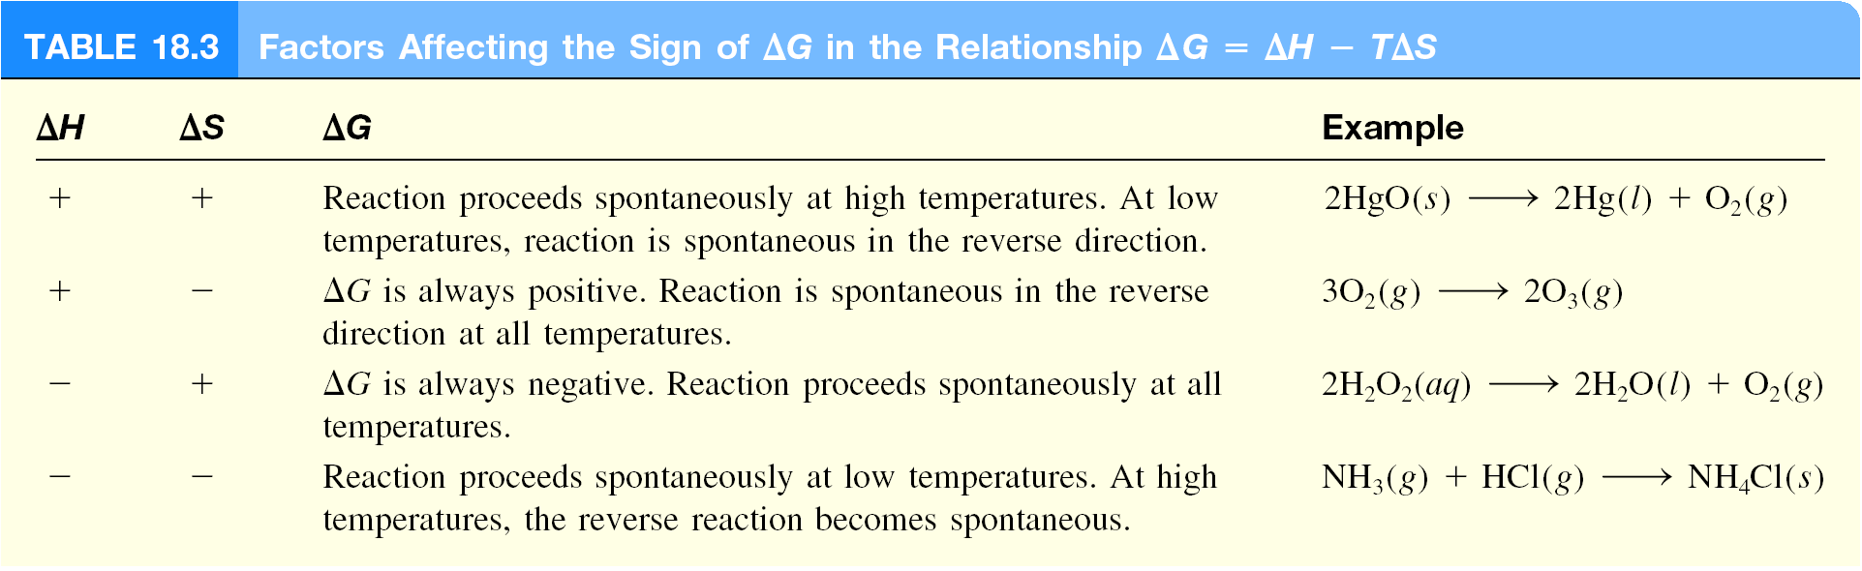
ΔG = ΔH - TΔS

Slide 22
Temperature and Spontaneity of Chemical Reactions
CaCO₃ (s) CaO (s) + CO₂ (g)
Equilibrium Pressure of CO₂
ΔH⁰ = 177.8 kJ/mol
ΔS⁰ = 160.5 J/K·mol
ΔG⁰ = ΔH⁰ – TΔS⁰
At 25 ºC, ΔG⁰ = 130.0 kJ/mol
ΔG⁰ = 0 at 835 ºC

Slide 23
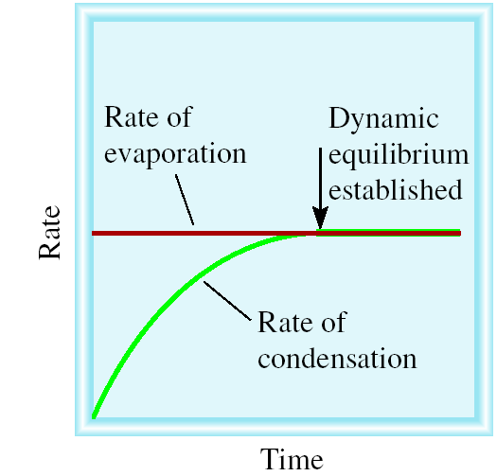
Gibbs Free Energy and Phase Transitions
ΔG⁰ = 0
= ΔH⁰ – TΔS⁰
H₂O (l) H₂O (g)
ΔH
40.79 kJ/mol
ΔS =
=
T
373 K
= 1.09 x 10⁻¹ kJ/K·mol
= 109 J/K·mol

Slide 24
Chemistry In Action: The Efficiency of Heat Engines
T_{h} - T_{c}
Efficiency =
X 100%
T_{h}

Slide 25
Gibbs Free Energy and Chemical Equilibrium
ΔG = ΔG⁰ + RT lnQ
R is the gas constant (8.314 J/K•mol)
T is the absolute temperature (K)
Q is the reaction quotient
At Equilibrium
ΔG = 0
Q = K
0 = ΔG⁰ + RT lnK
ΔG⁰ = − RT lnK

Slide 26
Free Energy Versus Extent of Reaction
ΔG⁰ < 0
ΔG⁰ > 0

Slide 27
ΔG⁰ = − RT lnK

Slide 28
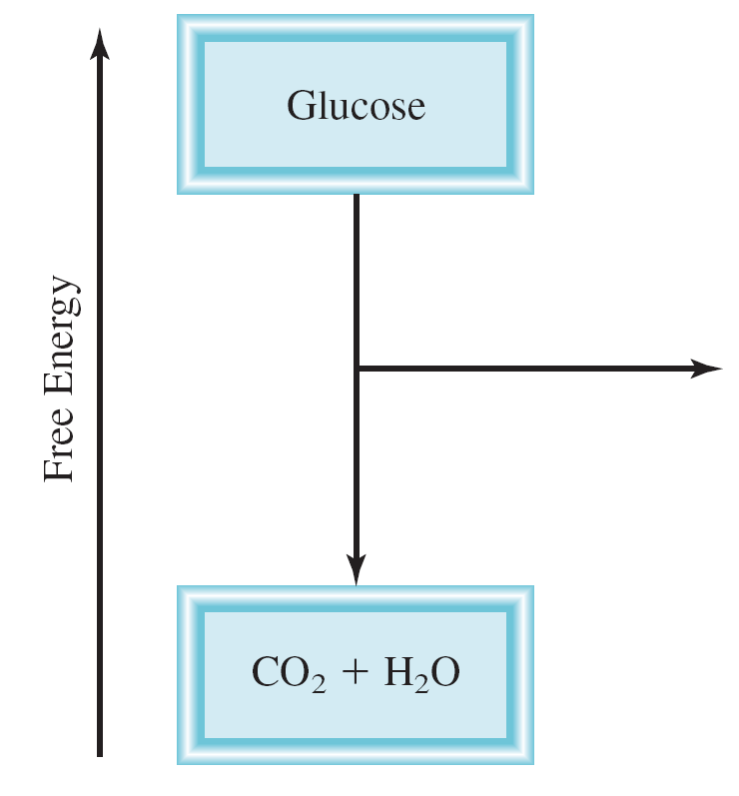
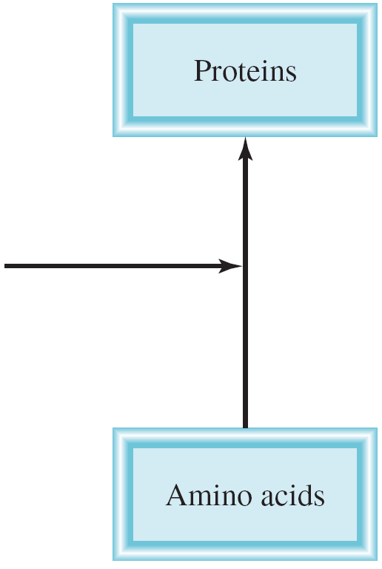
Coupled Reactions
Example:
Alanine + Glycine Alanylglycine
ΔG⁰ = +29 kJ
K < 1
ATP + H₂O + Alanine + Glycine ADP + H₃PO₄ + Alanylglycine
ΔG⁰ = -2 kJ
K > 1

Slide 29
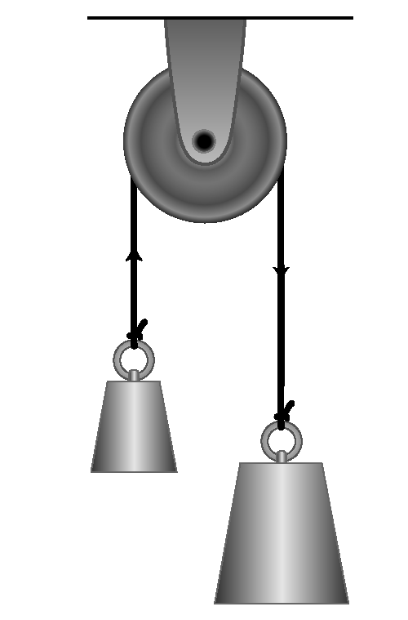
Mechanical Analog of Couple Reactions
Make the smaller weight move upward (a nonspontaneous process) by coupling it with the falling of a larger weight.

Slide 30
The Structure of ATP and ADP in Ionized Forms

Slide 31
Chemistry In Action: The Thermodynamics of a Rubber Band
TΔS = ΔH - ΔG
High Entropy
Low Entropy

