Slide 1
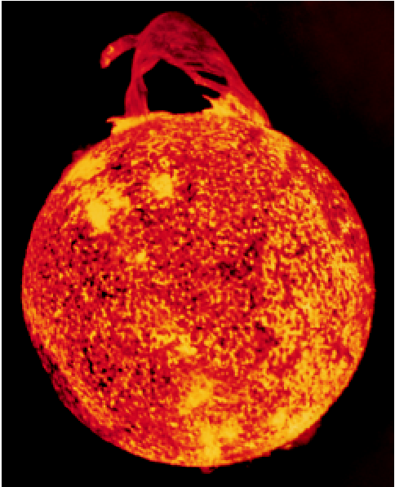
Nuclear Chemistry
Chapter 23
Copyright © The McGraw-Hill Companies, Inc. Permission required for reproduction or display.

Slide 2
Review
Atomic number (Z) = number of protons in nucleus
Mass number (A) = number of protons + number of neutrons
= atomic number (Z) + number of neutrons
Mass Number
A
X
Z
Element Symbol
Atomic Number
proton
neutron
electron
positron
α particle
¹p
or
¹H
¹n
⁰e
or
⁰β
⁰e
or
⁰β
⁴He
or
⁴α
1
1
0
-1
-1
+1
+1
2
2
A
1
1
0
0
4
Z
1
0
-1
+1
2

Slide 3
Balancing Nuclear Equations
Conserve mass number (A).
The sum of protons plus neutrons in the products must equal the sum of protons plus neutrons in the reactants.
235
U
+
¹n
138
Cs
+
96
Rb
+ 2
¹n
92
0
55
37
0
235 + 1 = 138 + 96 + 2x1
Conserve atomic number (Z) or nuclear charge.
The sum of nuclear charges in the products must equal the sum of nuclear charges in the reactants.
235
U
+
¹n
138
Cs
+
96
Rb
+ 2
¹n
92
0
55
37
0
92 + 0 = 55 + 37 + 2x0

Slide 4
²¹²Po decays by alpha emission. Write the balanced nuclear equation for the decay of ²¹²Po.
alpha particle -
⁴He
or
⁴α
2
2
²¹²Po ⁴He + ^{A}X
84
2
Z
212 = 4 + A
A = 208
84 = 2 + Z
Z = 82
²¹²Po ⁴He + ²⁰⁸Pb
84
2
82

Slide 6
Nuclear Stability and Radioactive Decay
Beta decay
¹⁴C ¹⁴N + ⁰β
Decrease # of neutrons by 1
6
7
-1
⁴⁰K ⁴⁰Ca + ⁰β
Increase # of protons by 1
19
20
-1
¹n ¹p + ⁰β
0
1
-1
Positron decay
¹¹C ¹¹B + ⁰β
Increase # of neutrons by 1
6
5
+1
³⁸K ³⁸Ar + ⁰β
Decrease # of protons by 1
19
18
+1
¹p ¹n + ⁰β
1
0
+1

Slide 7
Nuclear Stability and Radioactive Decay
Electron capture decay
³⁷Ar + ⁰e ³⁷Cl
Increase number of neutrons by 1
18
-1
17
⁵⁵Fe + ⁰e ⁵⁵Mn
Decrease number of protons by 1
26
-1
25
¹p + ⁰e ¹n
1
-1
0
Alpha decay
Decrease number of neutrons by 2
²¹²Po ⁴He + ²⁰⁸Pb
84
2
82
Decrease number of protons by 2
Spontaneous fission
²⁵²Cf 2¹²⁵In + 2¹n
98
49
0

Slide 8
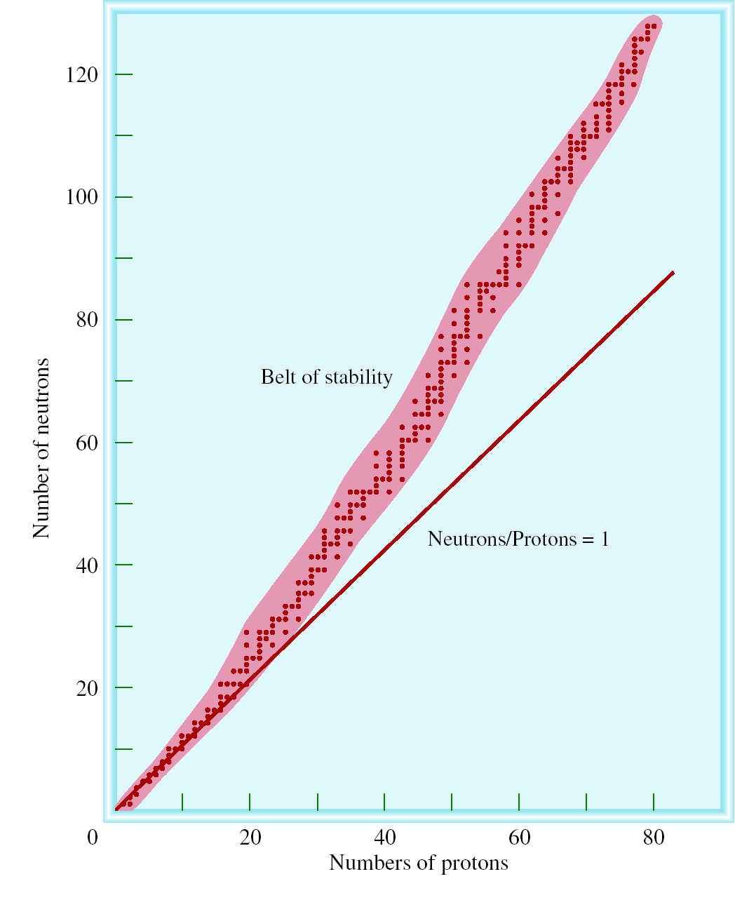
n/p too large
beta decay
X
Y
n/p too small
positron decay or electron capture

Slide 9
Nuclear Stability
Certain numbers of neutrons and protons are extra stable
n or p = 2, 8, 20, 50, 82 and 126
Like extra stable numbers of electrons in noble gases (e⁻ = 2, 10, 18, 36, 54 and 86)
Nuclei with even numbers of both protons and neutrons are more stable than those with odd numbers of neutron and protons
All isotopes of the elements with atomic numbers higher than 83 are radioactive
All isotopes of Tc and Pm are radioactive

Slide 11
Nuclear binding energy is the energy required to break up a nucleus into its component protons and neutrons.
Nuclear binding energy + ¹⁹F 9¹p + 10¹n
9
1
0
ΔE = (Δm)c²
Δm = 9 x (p mass) + 10 x (n mass) – ¹⁹F mass
Δm= 9 x 1.007825 + 10 x 1.008665 – 18.9984
Δm = 0.1587 amu
ΔE = 0.1587 amu x (3.00 x 10⁸ m/s)²
= -1.43 x 10¹⁶ amu m²/s²
Using conversion factors:
1 kg = 6.022 x 10²⁶ amu
1 J = kg m²/s²
ΔE = 2.37 x 10⁻¹¹J

Slide 12
ΔE = (2.37 x 10⁻¹¹J) x (6.022 x 10²³/mol)
ΔE = -1.43 x 10¹³J/mol
ΔE = -1.43 x 10¹⁰kJ/mol
Nuclear binding energy = 1.43 x 10¹⁰kJ/mol
binding energy
binding energy per nucleon =
number of nucleons
2.37 x 10⁻¹¹ J
=
19 nucleons
= 1.25 x 10⁻¹² J/nucleon

Slide 13
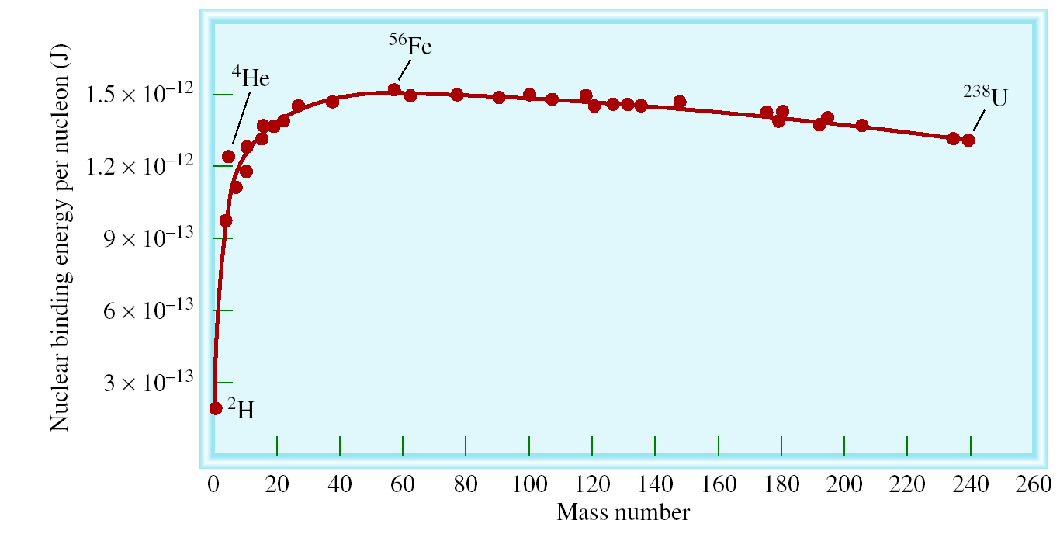
Nuclear binding energy per nucleon vs mass number
nuclear binding energy
nucleon
nuclear stability

Slide 14
Kinetics of Radioactive Decay
N daughter
rate = λN
N_{t}
ln
=
−λt
N₀
N = the number of atoms at time t
N₀ = the number of atoms at time t = 0
λ is the decay constant
0.693
t_{½}
=
λ

Slide 15
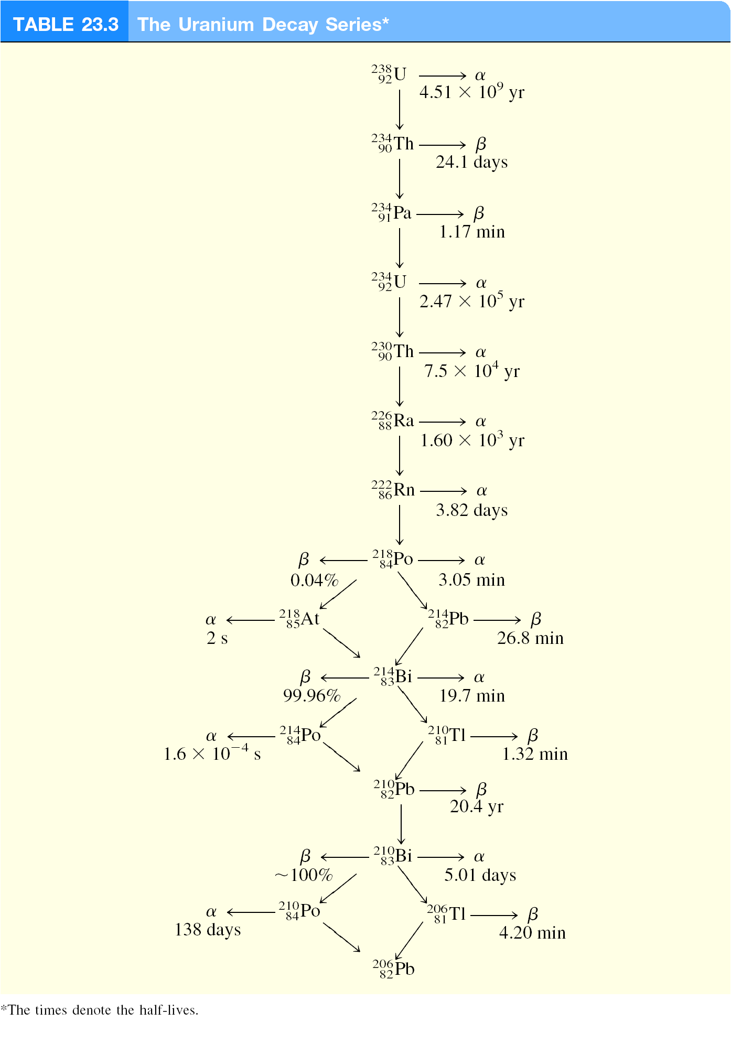

Slide 16
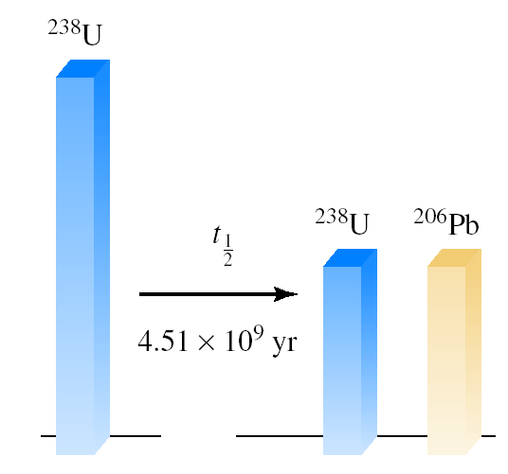
Radiocarbon Dating
¹⁴N + ¹n ¹⁴C + ¹H
7
0
6
1
¹⁴C ¹⁴N + ⁰β + ν
t_{½} = 5730 years
6
7
-1
Uranium-238 Dating
²³⁸U ²⁰⁶Pb + 8 ⁴α + 6 ⁰β
t_{½} = 4.51 x 10⁹ years
92
82
2
-1

Slide 17
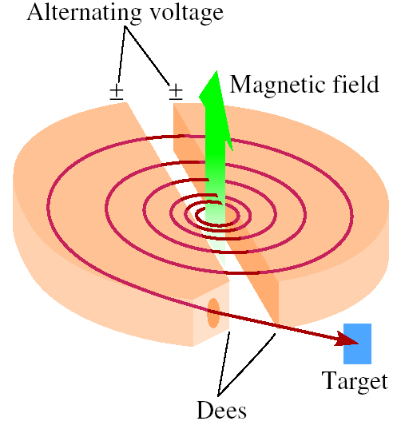
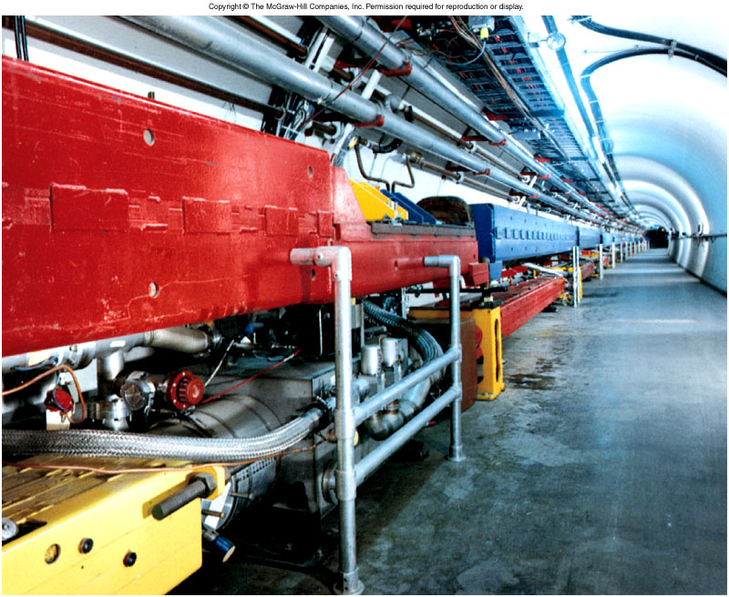
Nuclear Transmutation
¹⁴N + ⁴α ¹⁷O + ¹p
7
2
8
1
²⁷Al + ⁴α ³⁰P + ¹n
13
2
15
0
¹⁴N + ¹p ¹¹C + ⁴α
7
1
6
2

Slide 18
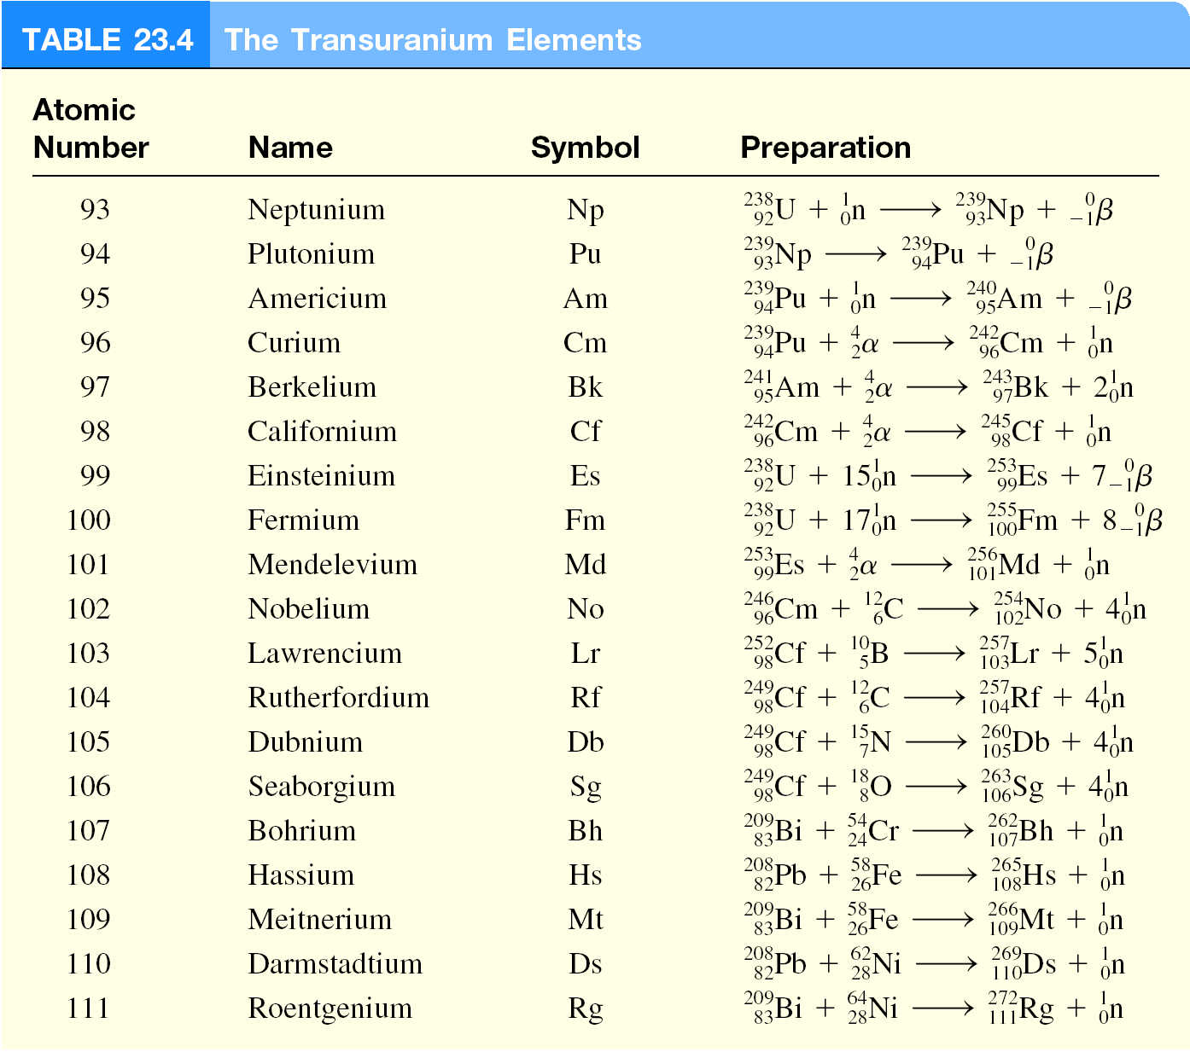
Nuclear Transmutation

Slide 19
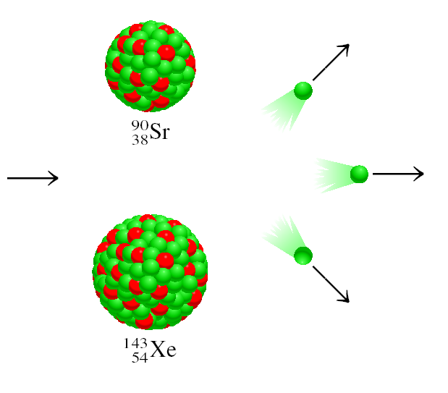
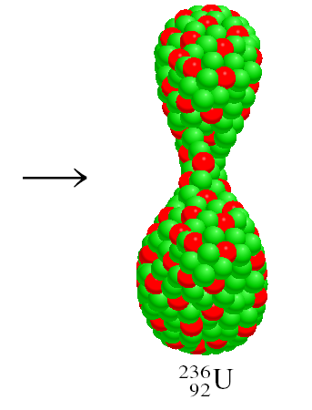
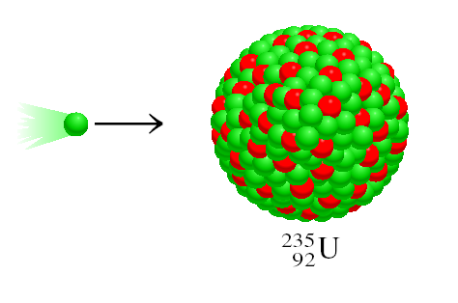
Nuclear Fission
²³⁵U + ¹n ⁹⁰Sr + ¹⁴³Xe + 3¹n + Energy
92
0
38
54
0
Energy = [mass ²³⁵U + mass n – (mass ⁹⁰Sr + mass ¹⁴³Xe + 3 x mass n )] x c²
Energy = 3.3 x 10⁻¹¹J per ²³⁵U
= 2.0 x 10¹³ J per mole ²³⁵U
Combustion of 1 ton of coal = 5 x 10⁷ J

Slide 20
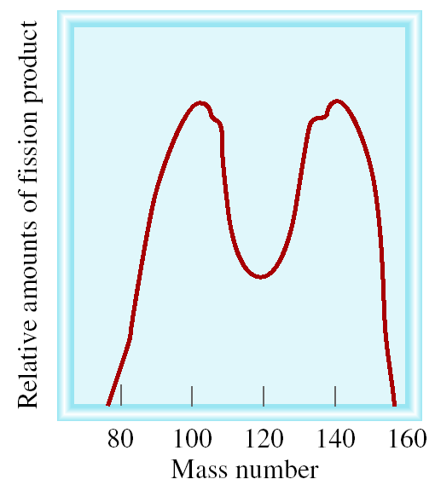
Nuclear Fission
Representative fission reaction
²³⁵U + ¹n ⁹⁰Sr + ¹⁴³Xe + 3¹n + Energy
92
0
38
54
0

Slide 21
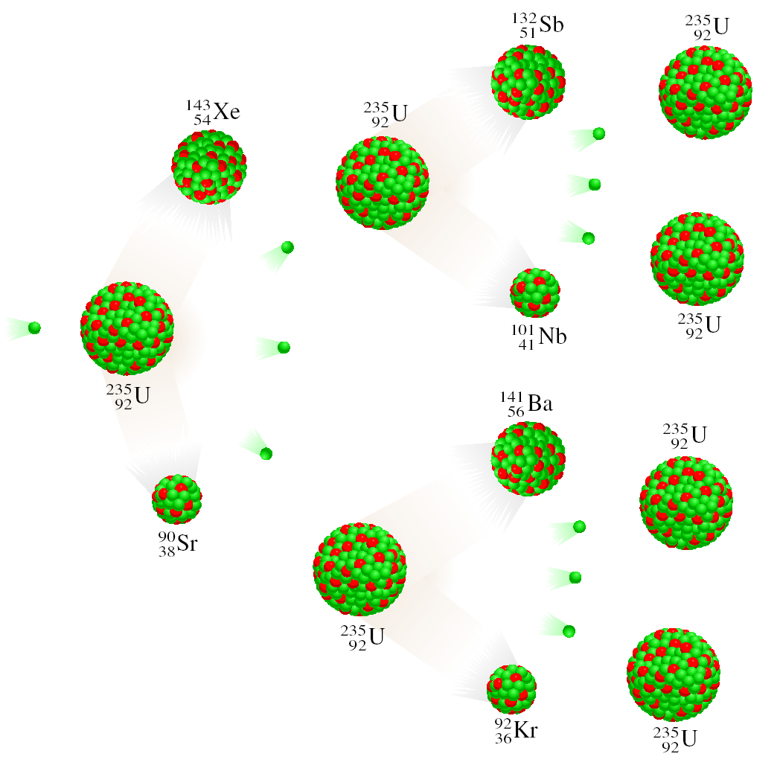
Nuclear Fission
Nuclear chain reaction is a self-sustaining sequence of nuclear fission reactions.
The minimum mass of fissionable material required to generate a self-sustaining nuclear chain reaction is the critical mass.

Slide 22
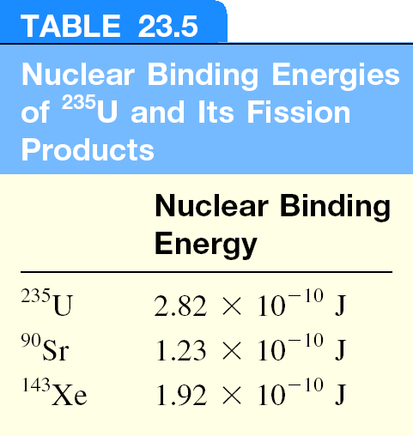

Slide 23
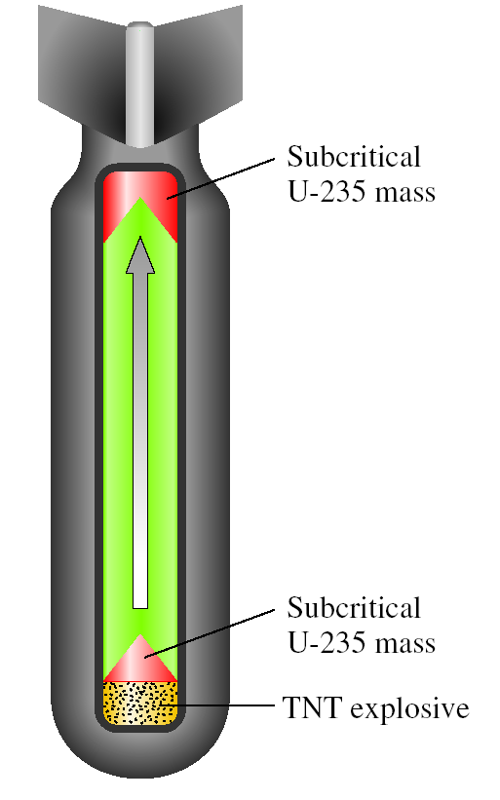
Schematic of an Atomic Bomb

Slide 24
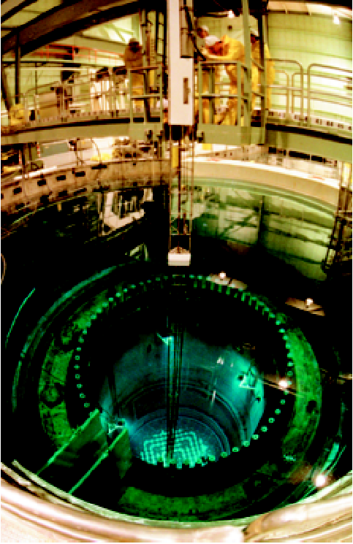
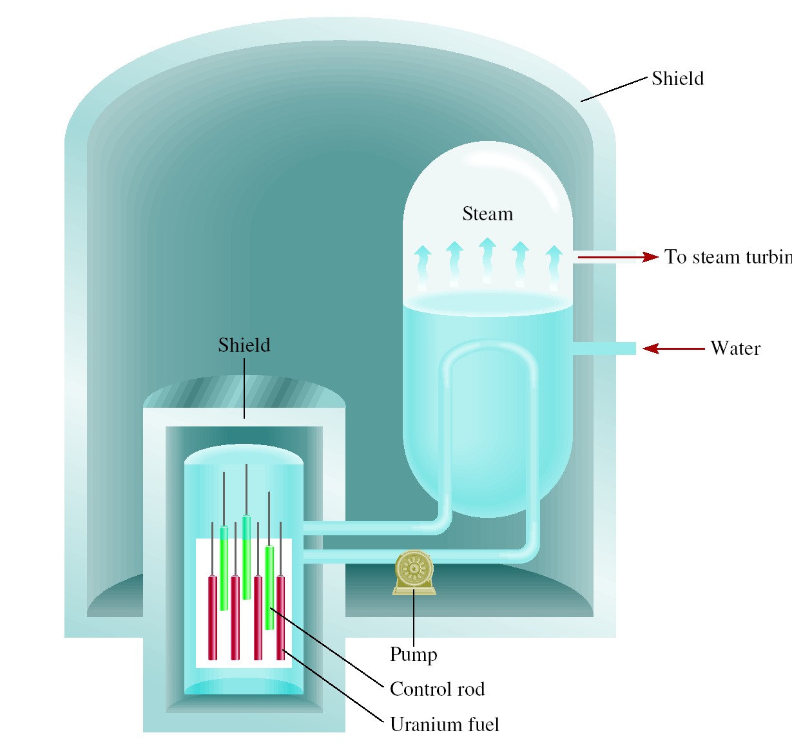
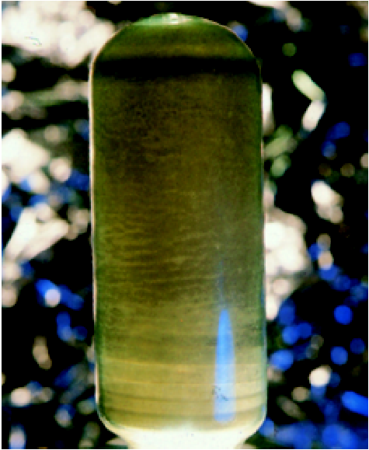
Schematic Diagram of a Nuclear Reactor
refueling
U₃O₈

Slide 25
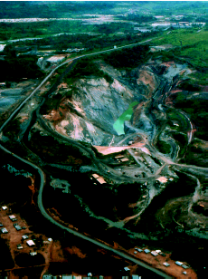
Chemistry In Action: Nature’s Own Fission Reactor
Natural Uranium
0.7202 % U-235 99.2798% U-238
Measured at Oklo
0.7171 % U-235

Slide 26
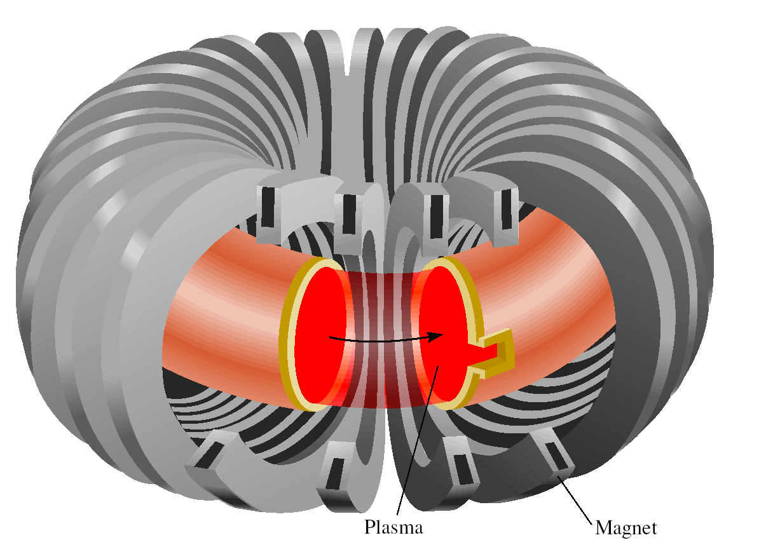
Nuclear Fusion
Fusion Reaction
Energy Released
²H + ²H ³H + ¹H
6.3 x 10⁻¹³ J
1
1
1
1
²H + ³H ⁴He + ¹n
2.8 x 10⁻¹² J
1
1
2
0
⁶Li + ²H 2 ⁴He
3.6 x 10⁻¹² J
3
1
2
solar fusion
Tokamak magnetic plasma confinement

Slide 27
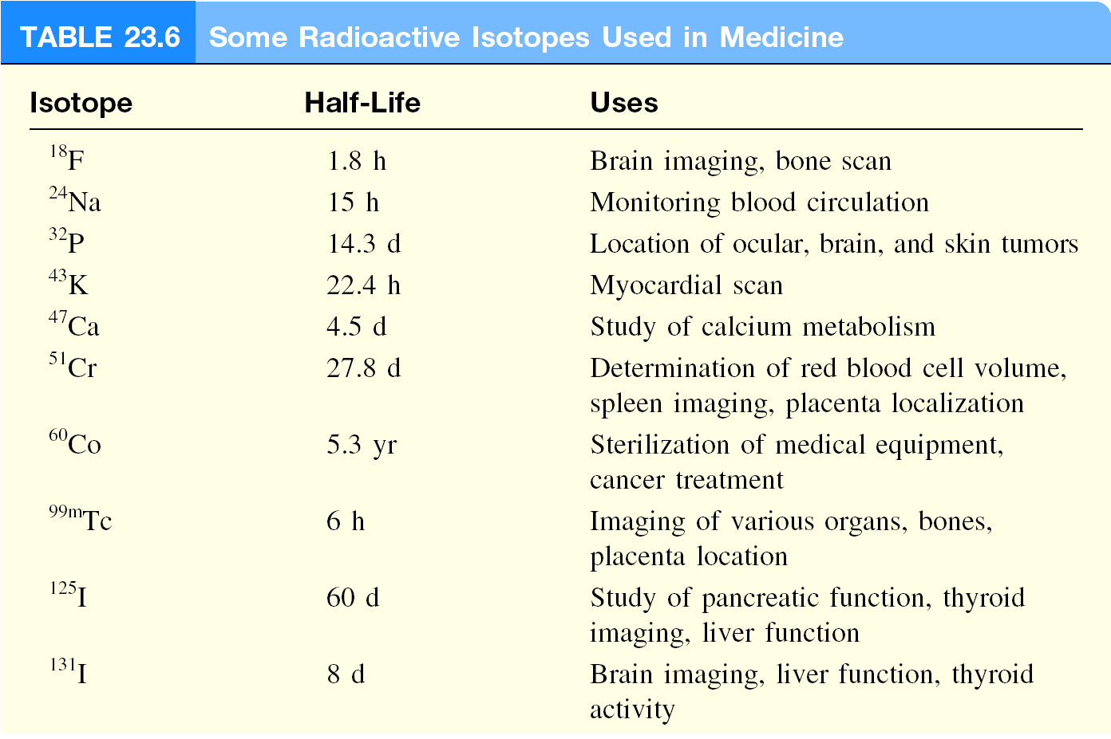
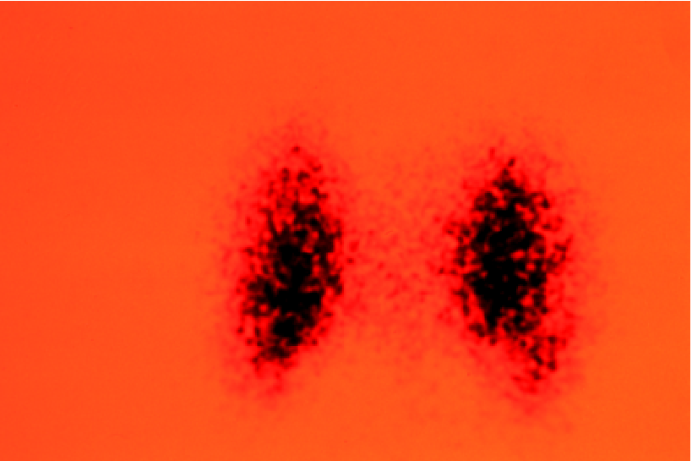
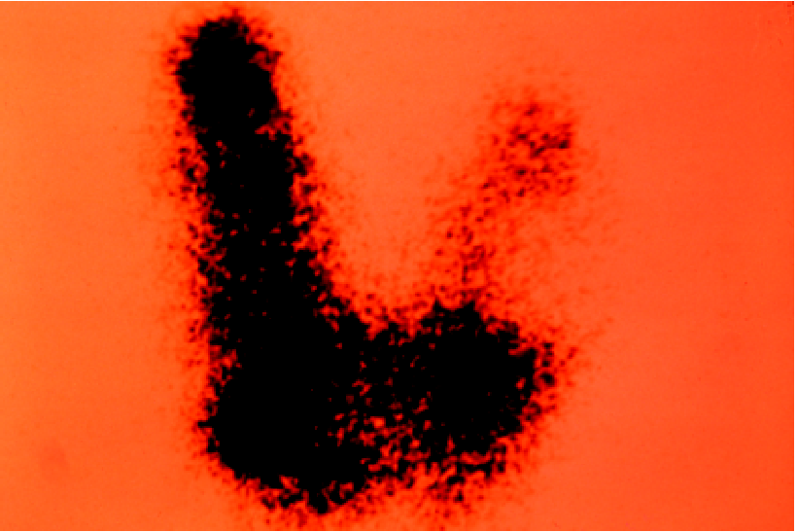
normal
enlarged
Thyroid images with ¹²⁵I-labeled compound

Slide 28
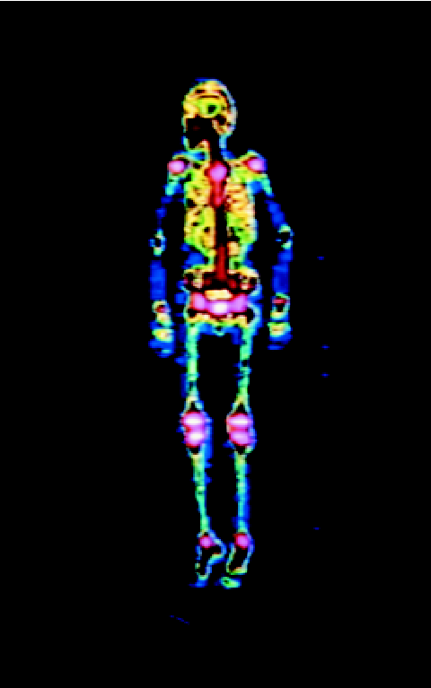
Radioisotopes in Medicine
Research production of ⁹⁹Mo
⁹⁸Mo + ¹n ⁹⁹Mo
42
0
42
Commercial production of ⁹⁹Mo
²³⁵U + ¹n ⁹⁹Mo + other fission products
92
0
42
Bone Scan with ^{99m}Tc
⁹⁹Mo ^{99m}Tc + ⁰β
t_{½} = 66 hours
42
43
-1
^{99m}Tc ⁹⁹Tc + γ-ray
t_{½} = 6 hours
43
43

Slide 29
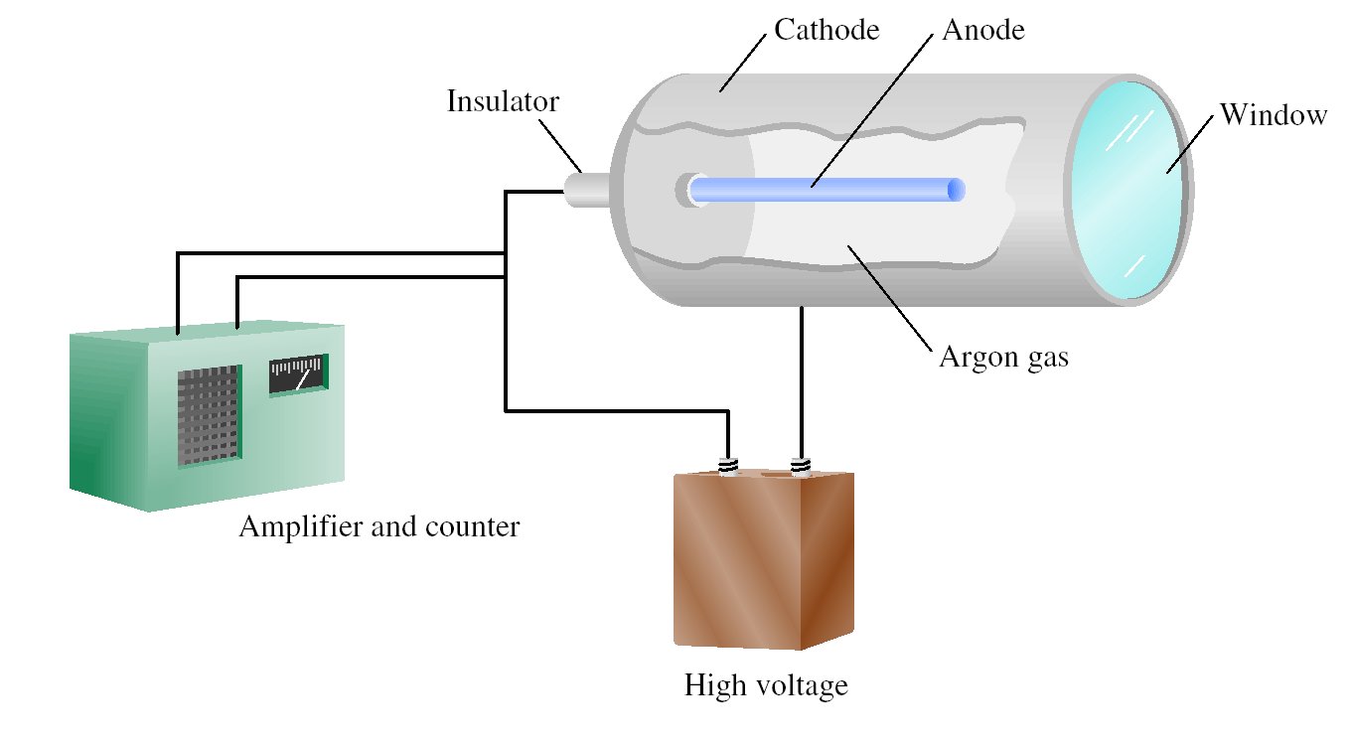
Geiger-Müller Counter

Slide 30
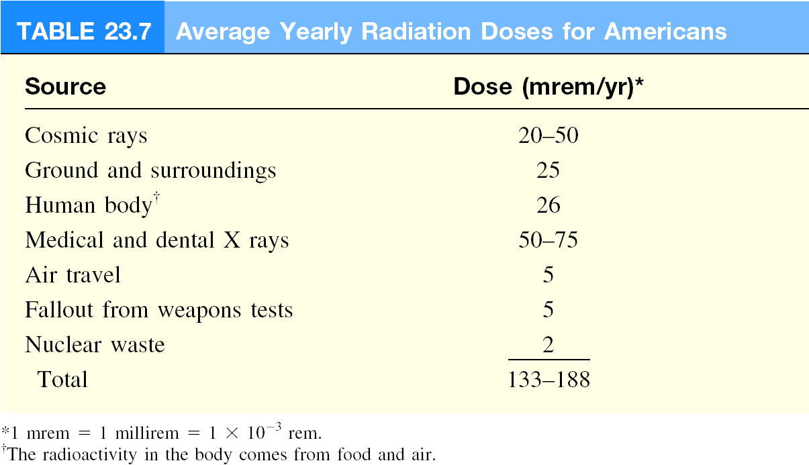
Biological Effects of Radiation
Radiation absorbed dose (rad)
1 rad = 1 x 10⁻⁵ J/g of material
Roentgen equivalent for man (rem)
1 rem = 1 rad x Q
Quality Factor
γ-ray = 1
β = 1
α = 20

Slide 31
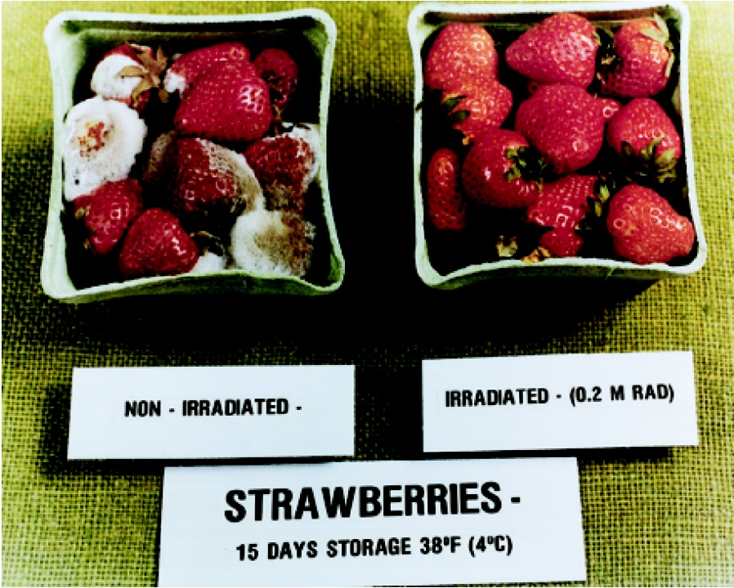
Chemistry In Action: Food Irradiation

