Slide 1
More Basics in Exercise Physiology

Slide 2
Exercise Physiology:
Terms and Concepts
Energy Systems
Lactate Threshold
Aerobic vs. Anaerobic Power
Exercise Intensity Domains
Principles of Training
Maximal Aerobic Power
Anaerobic Power
Miscellaneous Concepts

Slide 3
Energy Systems for Exercise
Energy Systems | Mole of ATP/min | Time to Fatigue
Immediate: Phosphagen (Phosphocreatine and ATP) | 4 | 5 to 10 sec
Short Term: Glycolysis (Glycogen-Lactic Acid) | 2.5 | 1.0 to 1.6 min
Long Term: Aerobic | 1 | Unlimited time

Slide 4
Anaerobic vs Aerobic
Energy Systems
Anaerobic
  ATP-PCR : ≤ 10 sec.
  Glycolysis: < 3 minutes
Aerobic
  Krebs cycle
  Electron Transport Chain
  ß-Oxidation
2 minutes +

Slide 5
Energy Transfer Systems and Exercise
100%
% Capacity of Energy System
Glycolysis
Aerobic
Phosphagen (ATP-PCR)
10 sec
30 sec
2 min
5 min +

Slide 6
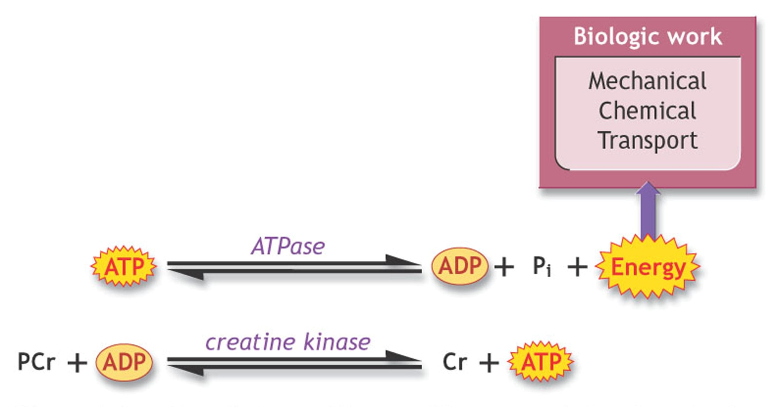
The Phosphagen System

Slide 7
Aerobic and Anaerobic
ATP Production
Glycogen
Glucose
Amino acids
Fatty acids
Immediate
Short-term
Long-term
ATP-stores
ATP-production
ATP
PCR
Glycolysis
Anaerobic Glycolysis
  aerobic
Aerobic Glycolysis
ß-oxidation
system
Substrate level phosphorylation
TCA-Cycle
Oxidative Phosphorylation

Slide 8
Comparison of Aerobic and Anaerobic ATP production
ATP/PCR
Anaerobic Glycolysis
Aerobic Glycolysis
ß-oxidation
Limiting Factors
Velocity of supply
+ +
+
-
- -
Rate of supply
+ +
+
-
- -
Stores
-
+
+
+ +
Efficiency
?
- -
+
+ +
Aerobic glucose degradation yields 18-19 more ATP
than anaerobic, but velocity and rate are lower!

Slide 9
Lactic Acid
Formed from reduction of pyruvate in recycling of NAD or when insufficient O₂ is available for pyruvate to enter TCA cycle.
If NADH + H+ can’t pass H+ to mitochondria, H+ is passed to pyruvate to form lactate.
Regeneration of NAD+
sustains continued
operation of glycolysis.
NAD+
NADH + H+
NADH
Glucose 6-P ←→ G-3-P ←→ Pyruvate
NAD+
Acetyl-CoA
Lactate

Slide 10
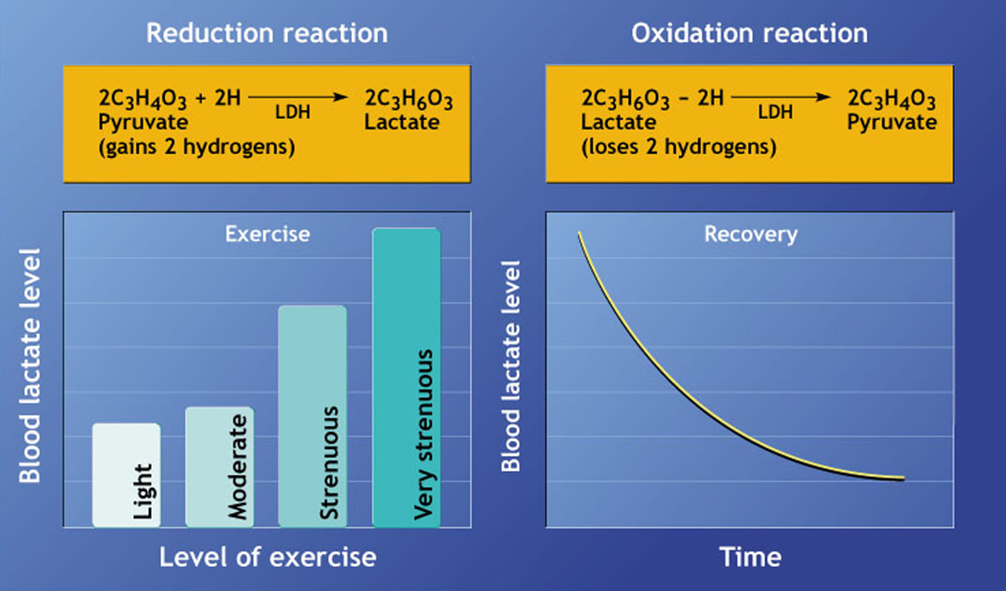
Pyruvate:Lactate

Slide 11
Exercise Intensity Domains
Moderate Exercise
  All work rates below LT
Heavy Exercise:
  Lower boundary: Work rate at LT
  Upper boundary: highest work rate at which blood lactate can be stabilized (Maximum lactate steady state)
Severe Exercise:
  Neither O₂ or lactate can be stabilized

Slide 12
Oxygen Uptake and
Exercise Domains
I
N
C
R
E
M
E
N
T
A
L
C
O
N
S
T
A
N
T
L
O
A
D
T_{Lac}
W
a
Severe
4
4
Heavy
VO₂ (l/min)
Severe
2
2
Moderate
Heavy
Moderate
0
150
300
0
12
24
Work Rate (Watts)
Time (minutes)

Slide 13
Lactate and Exercise Domains

Slide 14
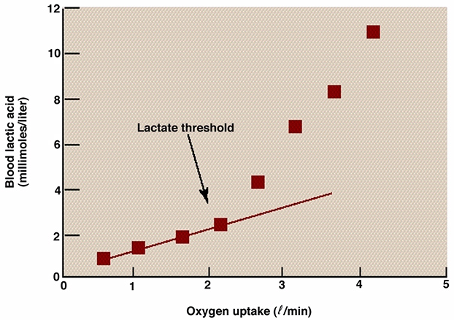
Lactate Threshold

Slide 15
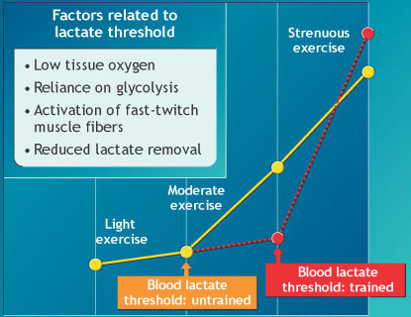
Blood Lactate as a Function of Training
Blood Lactate (mM)
25
50
75
100
Percent of VO_{2max}

Slide 16
Lactate Threshold
LT as a % of VO_{2max} or workload
  Sedentary individual→ 40-60% VO_{2max}
  Endurance-trained→ > 70% VO_{2max}
LT: Maximal lactate at Steady State exercise
  Max intensity SS-exercise can be maintained
  Prescribe intensity as % of LT

Slide 17
Other Lactate Threshold Terminology
Anaerobic threshold or AT
  first used in 1964
  based on ↑ blood La- being associated with hypoxia
    Should not be used
Onset of blood lactate accumulation (OBLA)
  maximal steady state blood lactate concentration
    Can vary between 3 to 7 mmol/L
    Usually assumed to be around 4 mmol/L

Slide 18
What is the Lactate Threshold (LT)?
Point La- production exceeds removal in blood
  La- rises in a non-linear fashion
  Rest [La-]→ 1 mmol/L blood (max 12-15 mmol)
LT represents ↑ metabolism
  ↑ glycogenolysis and glycolytic metabolism
  ↑ recruitment of fast-twitch motor units
  Mitochondrial capacity for pyruvate is exceeded
    Pyruvate converted to lactate to maintain NAD+
  ↓ Redox potential (NAD+/NADH)

Slide 19
Mechanisms to Explain LT
Blood Catechols
Lactate Threshold
La- Production
Reduced Removal of Lactate
Low
Muscle O₂
Mitochon Capacity for Pyruvate Exceeded
Redox Potential
Accelerated Glycolysis
Recruitment of Type II Fibers

Slide 20
Formation of Lactate is Critical to Cellular Function
Does not cause acidosis related to fatigue
  pH in body too high for Lactic Acid to be formed
Assists in regenerating NAD+ (oxidizing power)
  No NAD+, no glycolysis, no ATP
Removes H+ when it leaves cell: proton consumer
  Helps maintain pH in muscle
Can be converted to glucose/glycogen in liver via Cori cycle

Slide 21

Ventilatory Threshold
3 methods used in research:
  Minute ventilation vs VO₂, Work or HR
  V-slope (VO₂ & VCO₂)
  Ventilatory equivalents (V_{E}/VO₂ & V_{E}/VCO₂)
Relation of VT & LT
  highly related (r = .93)
  30 second difference between thresholds

Slide 22
Ventilatory Threshold
During incremental exercise:
  Increased acidosis (H+ concentration)
  Buffered by bicarbonate (HCO₃⁻)
H⁺ + HCO₃⁻ → H₂CO₃ → H₂O + CO₂
Muscle
RBC
Lung
Marked by increased ventilation
  Hyperventilation

Slide 23
V-Slope Ventilatory Threshold
By V Slope Method

Slide 24
V_{E} Ventilatory Threshold
200
By Minute Ventilation Method
150
VE (L/min)
100
50
0
80
100
120
140
160
180
Heart Rate

Slide 25
Oxygen Deficit and Debt
Oxygen deficit = difference between the total oxygen used during exercise and the total that would have been used if if use had achieved steady state immediately
Oxygen debt = total oxygen used during the recovery period

Slide 26
Recovery VO_{2 or} Excess Post-exercise O₂ Consumption (EPOC)
Fast component (Alactacid debt) = when prior exercise was primarily aerobic; repaid within 30 to 90 sec; restoration of ATP and CP depleted during exercise.
Slow component (Lactacid debt) = reflects strenuous exercise; may take up to several hours to repay; may represent reconversion of lactate to glycogen and restoration of core temperature.

Slide 27
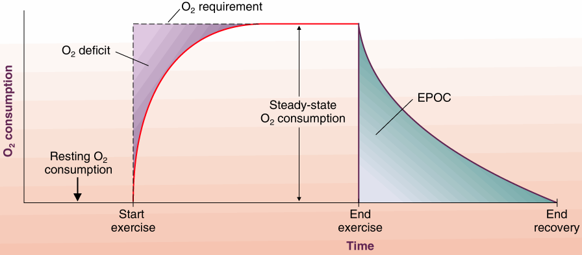
Oxygen Deficit and Debt

Slide 28
Respiratory Exchange Ratio/Quotient
Respiratory Exchange Ratio (RER): CO₂ expired/O₂ consumed
Respiratory Quotient (RQ): CO₂ produced/O₂ consumed at cellular level
RQ indicates type of substrate (fat vs. carbohydrate) being metabolized:
  0.7 when fatty acids are main source of energy.
  1.0 when CHO are primary energy source.
Can exceed 1.0 during heavy non-steady state, maximal exercise due to increased respiratory and metabolic CO₂.

Slide 29
Energy from RER (No table)
(RER + 4) x (L/O₂ consumed per minute) = kcal/minute
For example:
  RER determined from gas analysis =0.75
  4.0 + 0.75 = 4.75
  L of O₂ per minute = 3 liters
  4.75 x 3 = 14.25 kcal/min
  If exercised for 30 minutes = 427.5 kcals

Slide 30
Estimating Energy Expenditure
From RER: (RER + 4) x (L/O₂ per minute) = kcal/minute
  RER = 0.75
  4.0 + 0.75 = 4.75
  L of O₂ per minute = 3 liters
  4.75 x 3 = 14.25 kcal/min
From VO2: 1 L/min of O₂ is ~ 5 kcal/L
  VO₂ (L/min) = 3
  3 * 5 kcal/L = 15 kcal/min

Slide 31
MET: Metabolic Energy Equivalent
Expression of energy cost in METS
  1 MET = energy cost at rest
  1 MET = 3.5 ml/kg/min.
  3 MET = 10.5 ml/kg/min
  8 MET = 28 ml/kg/min

Slide 32
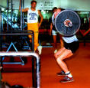
Basic Training Principles
Individuality
  Consider specific needs/ abilities of individual.
Specificity - SAID
  Stress physiological systems critical for specific sport.
FITT
  Frequency, Intensity, Time, Type
Progressive Overload
  Increase training stimulus as body adapts.

Slide 33
Basic Training Principles
Periodization
  Cycle specificity, intensity, and volume of training.
Hard/Easy
  Alternate high with low intensity workouts.
Reversibility
  When training is stopped, the training effect is quickly lost

Slide 34
SAID Principle
Specific Adaptations to Imposed Demands
  Specific exercise elicits specific adaptations to elicit specific training effects.
  E.g. swimmers who swam 1 hr/day, 3x/wk for 10 weeks showed almost no improvement in running VO2 max.
    Swimming VO2 increase – 11%
    Running VO2 increase – 1.5%

Slide 35
Reversibility
0
%Decline in VO_{2max}
1.4 - 0.85 X Days;
r = - 0.73
Training effects gained through aerobic training are reversible through detraining.
-10
% Decline in VO_{2max}
-20
-30
-40
0
10
20
30
40
Days of Bedrest
Data from VA Convertino MSSE 1997

Slide 36
Response to Training
High vs. low responders
  Bouchard et. al. research on twins
  People respond differently to training
    Genetics - strong influence
    Differences in aerobic capacity increases varied from 0 – 43% over a 9 -12 month training period.
    “Choose your parents wisely”

Slide 37
Determinants of
Endurance Performance
Endurance
O₂ Delivery
Maximal SS
Other
VO_{2max}
Lactate Threshold
Economy
Performance measure?
Performance measure?

Slide 38
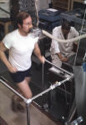
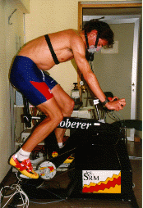
Testing for Maximal Aerobic Power or VO_{2max}

Slide 39
Requirements for
VO_{2max} Testing
Minimal Requirements
  Work must involve large muscle groups.
  Rate of work must be measurable and reproducible.
  Test conditions should be standardized.
  Test should be tolerated by most people.
Desirable Requirements
  Motivation not a factor.
  Skill not required.

Slide 40
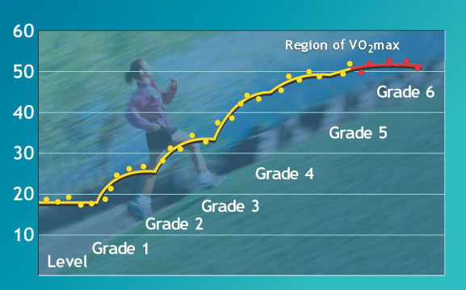
Graded “Exercise” Testing

Slide 41
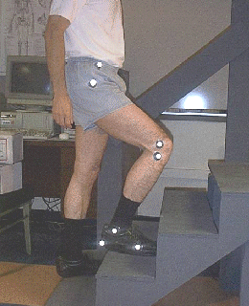
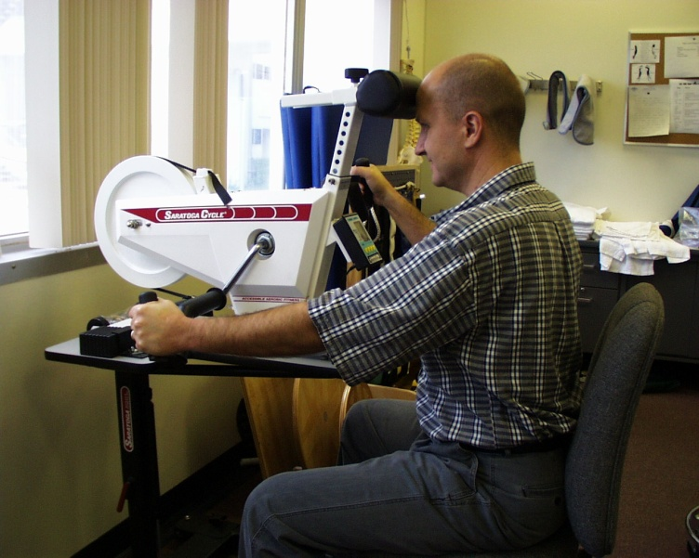

Typical Ways to Measure Maximal Aerobic Power
Treadmill Walking/Running
Cycle Ergometry
Arm Ergometry
Step Tests

Slide 42
Maximal Values Achieved During Various Exercise Tests
Types of Exercise
Uphill Running
Horizontal Running
Upright Cycling
Supine Cycling
Arm Cranking
Arms and Legs
Step Test
% of VO2max
100%
95 - 98%
93 - 96%
82 - 85%
65 - 70%
100 - 104%
97%

Slide 43
Types of Maximal Treadmill/ Cycle Ergometer Protocols
Constant Speed with Grade Changes
  Naughton: 2 mph and 3.5% grade increases
  Balke: 3 mph and 2% grade increases
  HPL: 5 - 8 mph and 2.5% grade increases
Constant Grade with Speed Increases
Changing Grades and Speeds
  Bruce and Modified Bruce
Cycle Ergometer: 1 to 3 minute stages with 25 to 60 step increments in Watts

Slide 44
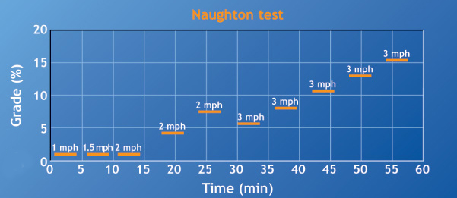
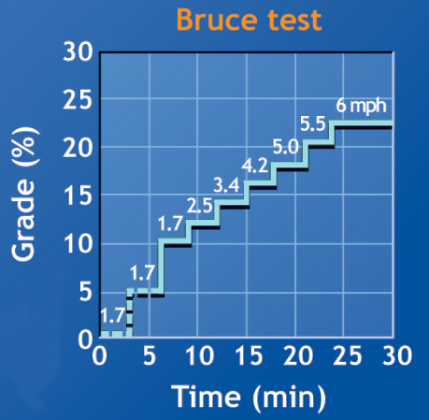
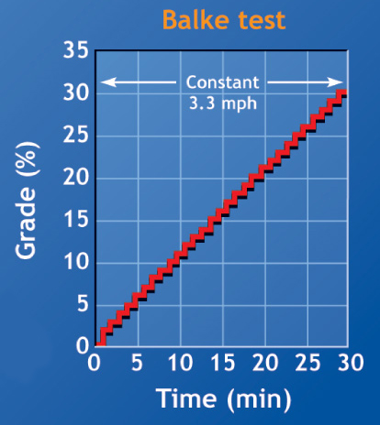
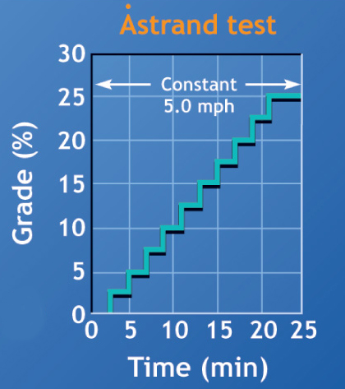

Slide 45
Criteria Used to Document Maximal Oxygen Uptake
Primary Criteria
  < 2.1 ml/kg/min (150 ml/min) increase with 2.5% grade increase
Secondary Criteria
  Blood lactate ≥ 8 mmol/L
  RER ≥ 1.15
  ↑ in HR to estimated max for age ± 10 bpm
  Borg Scale ≥ 17

Slide 46
VO_{2max} Classification for Men (ml/kg/min)
Age (yrs)
20 - 29
30 - 39
40 - 49
50 - 59
60 - 69
Low
<25
<23
<20
<18
<16
Fair
25 - 33
23 - 30
20 - 26
18 - 24
16 - 22
Average
34 - 42
31 - 38
27 - 35
25 - 33
23 - 30
Good
43 - 52
39 - 48
36 - 44
34 - 42
31 - 40
High
53+
49+
45+
43+
41+

Slide 47
VO_{2max} Classification for Women (ml/kg/min)
Age (yrs)
20 - 29
30 - 39
40 - 49
50 - 59
60 - 69
Low
<24
<20
<17
<15
<13
Fair
24 - 30
20 - 27
17 - 23
15 - 20
13 - 17
Average
31 - 37
28 - 33
24 - 30
21 - 27
18 - 23
Good
38 - 48
34 - 44
31 - 41
28 - 37
24 - 34
High
49+
45+
42+
38+
35+

Slide 48
VO₂max
HR_{max}
SV_{max}
a-vO₂ diff.
Training Duration

Slide 49
Training to Improve
Aerobic Power
Goals:
  Increase VO_{2max}
  Raise lactate threshold
Three methods
  Interval training
  Long, slow distance
  High-intensity, continuous exercise
Intensity appears to be the most important factor in improving VO_{2max}

Slide 50
Absolute vs Relative
Work Rate
John:
VO
= 54.0 ml/kg/min
2max
Mark:
VO
= 35.0 ml/kg/min
2max
Absolute W
ork Rate:
32.0 ml/kg/min
John:
Relative W
ork Rate
= 60% of
VO
2max
Mark:
Relative W
ork Rate
= 90% of
VO
2max

Slide 51
Monitoring Exercise Intensity
Heart rate
  Straight heart rate percentage method
    60-90% of Hr max)
  Heart rate reserve method (Karvonen)
Pace
Perceived exertion
Blood lactate

Slide 52
Estimating Maximal
Heart Rate
Standard Formula: 220 - Age in years
Other Formulas
  210 - 0.65 X Age in years
  New: 208 - 0.7 X Age in years
  New formula may be more accurate for older persons and is independent of gender and habitual physical activity
Estimated maximal heart rate may be 5 to 10%
(10 to 20 bpm) > or < actual value.
Maximal heart rate differs for various activities: influenced by body position and amount of muscle mass involved.

Slide 53
Heart Rate and VO_{2max}
100
90
80
70
% of Maximal Heart Rate
60
50
40
30
0
20
40
60
80
100
% of VO_{2max}

Slide 54
Rating of Perceived Exertion: RPE/Borg Scale
6
7
Very, very light
8
9
Very light
10
11
Fairly
light
Lactate Threshold
12
13
Somewhat hard
14
2.0 mM Lactate
15
H
ard
16
2.5 mM Lactate
17
Very
hard
4
.0 mM Lactate
18
19
Very, very hard

Slide 55
Interval Training for VO_{2max}
Repeated exercise bouts (Intensity 80 - 110% VO_{2max}) separated by recovery periods of light activity, such as walking
VO_{2max} is more likely to be reached within an interval workout when work intervals are intensified and recovery intervals abbreviated.

Slide 56
Types of Interval Training
Broad-intensity or variable-paced interval training
Long interval training: work intervals lasting 3 min at 90-92% vVO2max with complete rest between intervals.
High-intensity intermittent training: short bouts of all-out activity separated by rest periods of between 20 s and 5 min.
  Low-volume strategy for producing gains in aerobic power and endurance normally associated with longer training bouts.

Slide 57
Guidelines for
Interval Training
Energy System | ATP-PC | Lactate | Aerobic
Work (sec) | 10 - 30 | 30 - 120 | 120 - 300
Recovery (sec) | 30 - 90 | 60 - 240 | 120 - 310
W:R | 1:3 | 1:2 | 1:1
Reps | 25 - 30 | 10 - 20 | 3 - 5

Slide 58
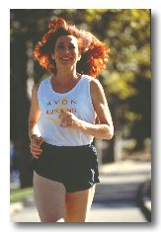
Long, Slow Distance
Low-intensity exercise
  57% VO_{2max} or 70% HR_{max}
Duration > than expected in competition
Based on idea that training improvements are based on volume of training

Slide 59
High-Intensity,
Continuous Exercise
May be the best method for increasing VO_{2max} and lactate threshold
High-intensity exercise
  80-90% HR_{max}
  At or slightly above lactate threshold
Duration of 25-50 min
  Depending on individual fitness level

Slide 60
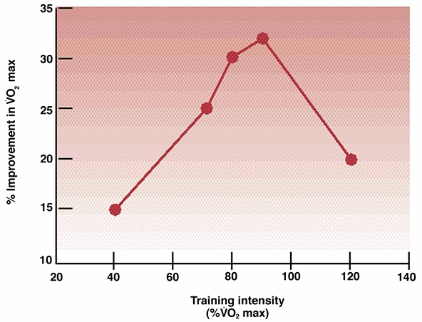
Training Intensity and Improvement in VO_{2max}

Slide 61
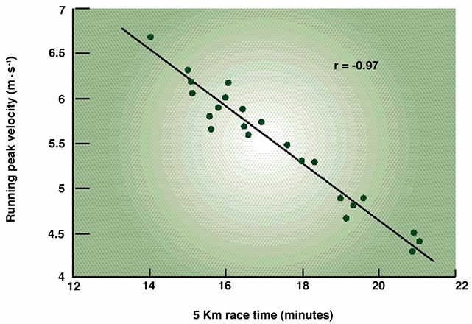
Predicting Performance From Peak Running Velocity

Slide 62
Factors Affecting Maximal Aerobic Power
Intrinsic
Genetic
Gender
Body Composition
Muscle mass
Age
Pathologies
Extrinsic
Activity Levels
Time of Day
Sleep Deprivation
Dietary Intake
Nutritional Status
Environment

Slide 63
Adaptations to Aerobic Training
↑ Oxidative enzymes
↓ Glycolytic enzymes
↑ Size and number of mitochondria
↑ Slow contractile and regulatory proteins
↓ Fast-fiber area
↑ Capillary density
↑ Blood volume, cardiac output and O₂ diffusion

Slide 64
Physiological Basis for Differences in VO_{2max}
 | VO_{2max} = | (HR_{max}) x | (SV_{max}) x |  | (a-v)O₂ diff
Athletes: | 6,250 ml/min = | (190 b/min) x | (205 ml/b) X | (.16 ml/ml blood)
Normally Active: | 3,500 ml/min = | (195 b/min) x | (112 ml/b) X | (.16 ml/ml blood)
Cardiac Patients: | 1,400 ml/min = | (190 b/min) x | (43 ml/b) X | (.17 ml/ml blood)

Slide 65
Succinate Dehydrogenase Activity
in Response to Training and Detraining
Fitness Level | Range of VO_{2max} (ml/kg/min) | Type I | Type IIa | Type IIb
Deconditioned | 30-40 | 5.0 | 4.0 | 3.5
Sedentary | 40-50 | 9.2 | 5.8 | 4.9
Conditioned (months) | 45-55 | 12.1 | 10.2 | 5.5
Endurance Athletes | >70 | 23.2 | 22.1 | 22.0

Slide 66
Influence of Gender, Initial Fitness Level, and Genetics
Men and women respond similarly to training programs
Training improvement is always greater in individuals with lower initial fitness
Genetics plays an important role in how an individual responds to training

Slide 67
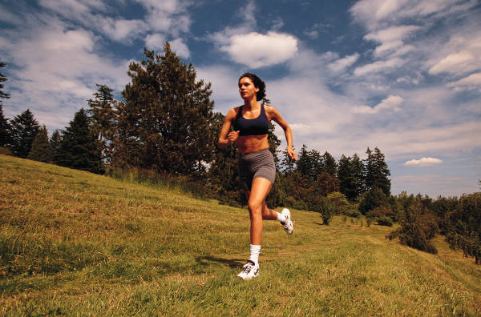
Anaerobic Power
Depends on ATP-PC energy reserves and maximal rate at which energy can be produced by ATP-PCR system.
Maximal effort
Cyclists and speed skaters highest.
Power = Force x Distance
  Time

Slide 68

Adaptations to
Anaerobic Training
↑ Wet mass of muscle
↑ Muscle fiber cross sectional area
↑ Protein and RNA content
↑ Capacity to generate force

Slide 69
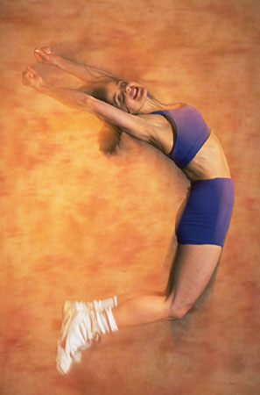
Anaerobic Power Tests
Margaria-Kalamen Test
Quebec 10 s Test
Standing broad jump
Vertical jump
40 yd. sprints
Wingate Test

Slide 70
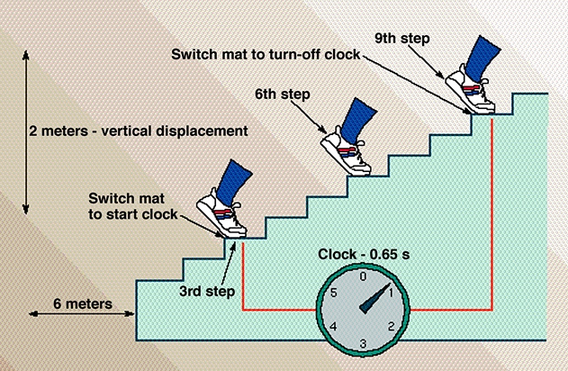
The Margaria Power Test

Slide 71
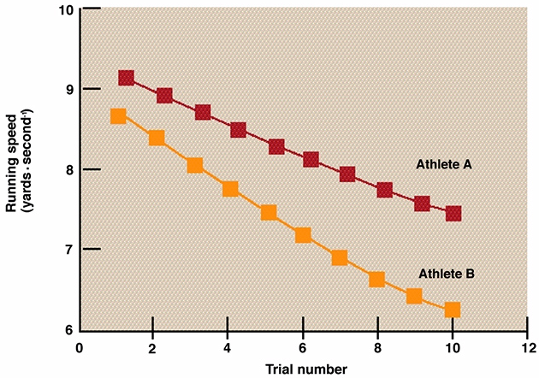
Series of 40-yard Dashes to Quantify Anaerobic Power

Slide 72
Wingate Test for
Anaerobic Power
30 sec cycle ergometer test
Count pedal revolutions
Calculate peak power output, anaerobic fatigue, and
anaerobic capacity

Slide 73
Training for Improved Anaerobic Power
ATP-PC system
  Short (5-10 seconds), high-intensity work intervals
  30-60 second rest intervals
Glycolytic system
  Short (20-60 seconds), high-intensity work intervals

Slide 74
Other Anaerobic
Training Methods
Intervals
Sprints
Accelerations
Speed Play (Fartlek)
Hill tempos

Slide 75
Strength-Endurance Continuum
Olympic lifting
High
Strength
Strength
Power lifting
High Power
⬆
⬅Rowing➔
⬇
Throwing
Hypertrophy
Football
Rugby
⬆
⬅Decathalon➔
⬇
100m
Bodybuilding
400m
Soccer
⬅Basketball➔
High
Capillarity
Endurance
Mile Run
10K
⬆
⬅Swimming➔
⬇
High VO_{2max}
Marathon
Aerobic Power
High Mitochondria
10 sec
5 min
> 2hrs

Slide 76
Concurrent Strength and Endurance Training
Hickson et al. 1980.

Slide 78
Factors Influencing Exercise Efficiency
Exercise work rate
  Efficiency decreases as work rate increases
Speed of movement
  Optimum speed of movement and any deviation reduces efficiency
Fiber composition of muscles
  Higher efficiency in muscles with greater percentage of slow fibers

Slide 79
Velocity at Maximal Heart Rate and Oxygen Uptake
Velocity at VO_{2max}
or vVO_{2max}

Slide 80
Velocity at Maximal
Aerobic Power or vVO_{2max}
Running speed which elicits VO_{2max}
Used by coaches to set training velocity.
Different methodologies used to establish:
  Ratio of VO_{2max} to Economy
  Extrapolation from treadmill test
  Derived from track runs
Higher in endurance runners than sprinters.
Improved by endurance training

Slide 81
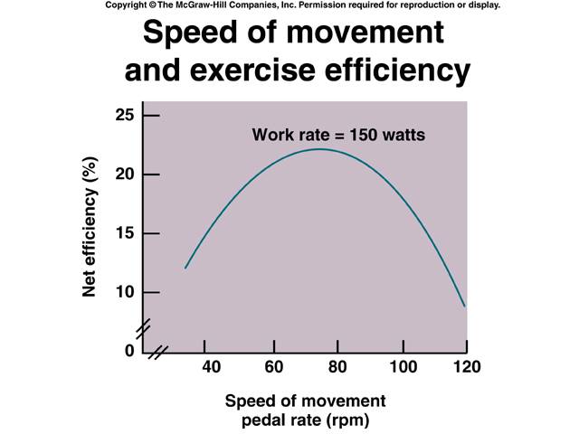
Speed of Movement and Efficiency

Slide 82
Running Economy
Not possible to calculate net efficiency of horizontal running
Running economy
  Oxygen cost of running at given speed
Gender difference in running economy
  No difference at slow speeds
  At race pace, males may be more economical than females

Slide 83
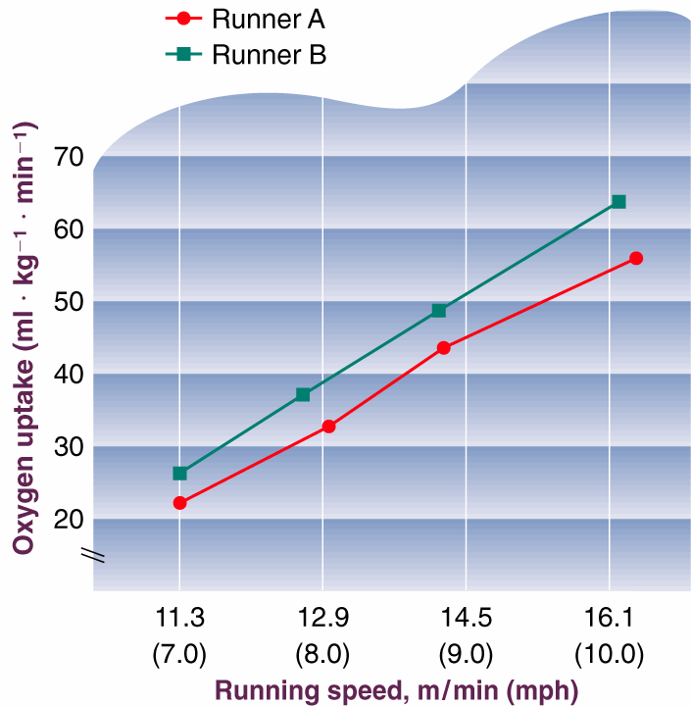
Economy of Two Runners
Cycling:
  Seat height
  Pedal cadence
  Shoes
  Wind resistance
Running:
  Stride length
  Shoes
  Wind resistance

Slide 84
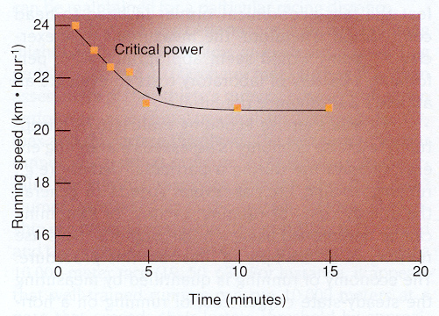
Critical Power

Slide 85
Relation Between Speed, Grade, and Oxygen Uptake

Slide 86
Energy, Work and Power
Work: when a Force (1 N) acts though a Distance of 1 meter
  Measured in joules
  Work = Force x Distance
Force (N) = mass x acceleration
Power: Work/per unit of time
  Measured in j/s or Watts (W)

Slide 87
Work & Power
Example: Moved 50 kg 1 m in 1 sec
Work
  Force x Distance
  50 kg x 1 m
  50 kgm
Power
  Force x Distance
  Time
  50 kg x 1 m
  1 sec
  50 kgm/sec
  8.2 Watts

Slide 88
Work Units
Kgm (kilogram meters)
j (joules) or kj (kilojoules)
  1 kgm = 9.8 j
Kcal (kilocalories)
  1 kcal = 426.85 kgm = 4.18 kj

Slide 89
Power Units
Kgm/min.
Ft-lb/min.
Watts
Kj/min.
Horsepower

Slide 90
Converting Work/Power Units
UNITS | kJ/min | kcal/min | kg-m/min | Watts (j/sec)
kJ/min | 1.0 | 0.2389 | 0.000102 | 16.667
kcal/min | 4.186 | 1.0 | 426.85 | 0.000
kg-m/min | 6.16 | 0.00234 | 1.0 | 0.163
Watts (j/sec) | 0.060 | 0.01433 | 6.118 | 1.0

Slide 91
Cycle Ergometry
Work = resistance (kg) x rev/min. x flywheel distance (m) x min.
  Example: 80 kg male cycles 60 rpm against 3 kg load for 20 min. D = 6 m
    3 kg*60rpm*6 m/rev *20 min. = 21,600 kgm
    21,600 kgm * 9.8 = 211,680 Joules
    211,680 J = 212 kj
POWER: Work/time
  211,680 J/(20*60) = 176 Watts (J/sec)

Slide 92
Stair-Stepping
Work = body weight (kg) x distance/step x steps/min. x min.
  Example: 70 kg male steps 65/min
  up 0.25m stairs carrying 22 kg.
    (70+22)*0.25*65 = 1,333 kgm
    1,333 kgm * 9.8 = 13,059 Joules
    13,059 Joules = 13 kj
POWER: Work/time
  13,059 J/60 = 217 Watts (J/sec)

Slide 93
Treadmill Work Made Simple
Work = mass (kg)*speed* grade*min
  Example: 70 kg man runs 4.5 mph for 90 min.,15% grade
  70*9.8*120*0.15*90 =
  1,111,320 Joules or 1,111 kj
Power = Work/min
  1,111,320/(90*60) = 206 Watts

Slide 94

Arm Ergometry
Work = resistance (kg) x rev/min. x flywheel distance (m) x min.
  Example: 80 kg male cranks 40 rpm against 3 kg load for 10 min. Flywheel = 3 m
    3 kg*40rpm*3 m/rev *10 min. = 3,600 kgm
    3,600 kgm * 9.8 = 35,280 Joules
    35,280 J = 35 kj
POWER: Work/time
  35,280/(10*60) = 59 Watts

Slide 95
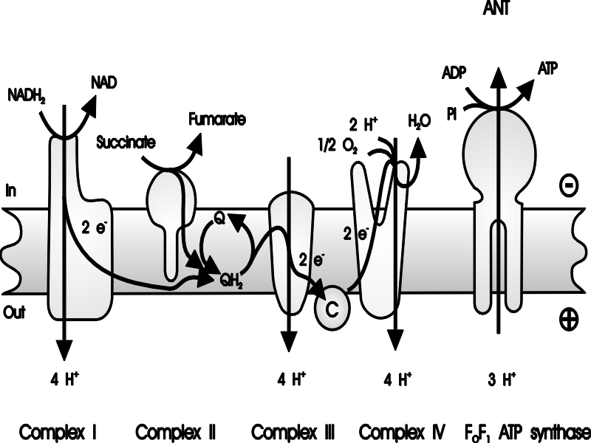
Aerobic and Anaerobic
ATP Production
Glycolysis
ß-Oxidation
Pyruvate
Ox-Dep.
Lactate
Acetyl-CoA
ATP
TCA Cycle
FADH₂
NADH+H⁺
ATP

