Slide 1
AN INTRODUCTION OF COST ESTIMATION COURSE
By: Sativa
Civil and Planning Education Department
Engineering Faculty
Yogyakarta State University

Slide 2
Earthquake, 26th May 2006

Slide 3
Why there were so many damaged buildings?

Slide 4
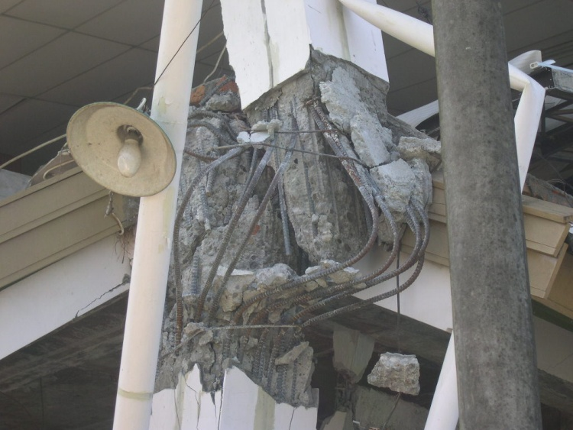
The causes of the damage
-The strength of the earthquake
-The age of the old buildings
- The weakness of the
building construction
/ Unqualified building
construction

Slide 5
WHY THERE ARE SO MANY UNQUALIFIED BUILDING CONSTRUCTION ?
MISSPLANNED CONSTRUCTION
UNPLANED CONSTRUCTION
BOTH OF THEM, SOMETIMES DUE TO MINIMIZING THE COST WITHOUT CONSIDERING THE STRENGHT

Slide 6
SO, IT IS IMPORTANT TO STUDY
THE COST ESTIMATION
OF COSTRUCTION PROJECT

Slide 7
WHAT IS COST ESTIMATION SUBJECT?
DISCUSSING THE VARIETY OF COST ESTIMATION IN CONSTRUCTION PROJECT
EXPLAINING THE PROCESS OF COST CALCULATION IN A CONSTRUCTION PROJECT
BESIDE THAT, ALSO STUDYING PROJECT RESOURCES AND RELATED ASPECTS,DUE TO THEIR ROLES IN ESTIMATING THE COST OF CONSTRUCTION PROJECT

Slide 8
WHAT KIND OF COST?
the cost for the planner
The cost for the constructor
The cost for the supervisor
Global cost estimation
Engineer’s & Owner’s Estimation
Cost Budget /RAP
Cost Estimate / RAB

Slide 9
REFERENCES
Construction Project Cost Management – Asiyanto
Rencana dan Estimate Real of Cost – Bachtiar Ibrahim
Pedoman Standarisasi dan Pedoman Operasional Penyelenggaraan Pembangunan Gedung Negara – Dirjen Cipta Karya. Dep Kimpraswil

Slide 10
FINAL SCORE ASPECTS
ATTENDANCE
PERSONAL PERFORMANCE
ASSIGNMENT & PRESENTATION
MIDTERM EXAMINATION
FINAL EXAMINATION

