Slide 1
Pertemuan 3
Menghitung:
Nilai rata-rata (mean)
Modus
Median
Simpangan (deviasi)
varians

Slide 2
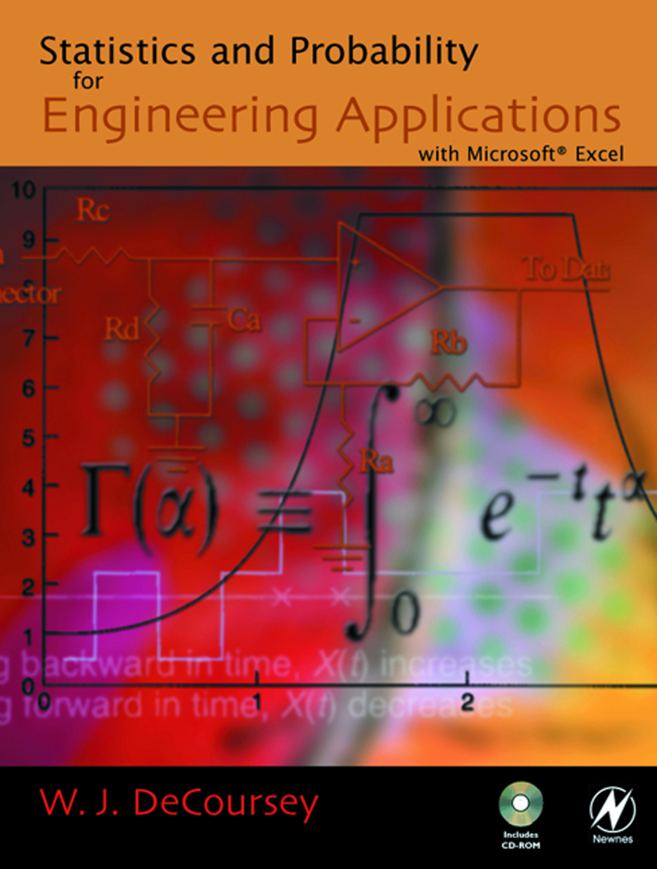
www.4shared.com statistics and free ebook

Slide 3
Nilai Rata-rata
Nilai rata-rata (hitung/aritmetika) adalah jumlah hasil pengukuran dibagi dengan jumlah pengukuran. $\overline{x}$ adalah simbol nilai rata-rata sampel. µ adalah simbol nilai rata-rata populasi.
dimana n = jumlah pengukuran
$\sum{x_{i}}$=Jumlah hasil pengukuran

Slide 4
Contoh
Hasil penghitungan kehadiran mhs:
Senin=2, Selasa=9, Rabu=11, Kamis=5, dan Jum’at = 6

Slide 5
Nilai Rata-rata (lanjutan)
Jika masing-masing pengukuran dilakukan beberapa kali (frekuensi) maka rumus berubah menjadi seperti berikut.
dimana n = jumlah pengukuran
$\sum{x_{i}}$=Jumlah hasil pengukuran
ƒ_{i}= jumlah frekuensi

Slide 6
Contoh (Sudjana: 69)
X_{i} (%) | f_{i} | f_{i}X_{i}
96 | 100 | 96
46 | 200 | 92
75 | 160 | 80
75 | 80 | 60
Jumlah | 540 | 328

Slide 7
= 60,07 %

Slide 8
Nilai Rata-rata (lanjutan)
Nilai rata-rata harmonik. Perhatikan, jika kecepatan rata-rata berangkat sebesar 10 km/jam dan kecepatan rata-rata pulang sebesar 20 km/jam. Berapakah keceptn rata-rata pulang-pergi?
$\frac{1}{2}$ (10+20) km/jam = 15 km/jam (?)
Jika panjang jalan 100 km, mk berangkat perlu 10 jam, pulang perlu 5 jam. Pulang –pergi perlu 15 jam, jadi rata-rata keceptnnya menjadi:
$\frac{200}{15}$ km/jam = 13 $\frac{1}{3}$ km/jam

Slide 9
Modus
Modus adalah fenomena/kejadian yang paling banyak terjadi, juga untuk menentukan “rata-rata” dari data kualitatif.
a. Data tak berkelompok : Modus (Mo) dilihat dari data yang memiliki frekuensi terbanyak
The set: 2, 4, 9, 8, 8, 5, 3
The mode is 8, which occurs twice
The set: 2, 2, 9, 8, 8, 5, 3
There are two modes—8 and 2 (bimodal)
The set: 2, 4, 9, 8, 5, 3
There is no mode (each value is unique).

Slide 10
Median
Median adalah ukuran tengah dari hasil pengukuran yang disusun dan terkecil hingga terbesar.
Me = 0,5$\left(n+1\right)$

Slide 11
Contoh:
The set: 2, 4, 9, 8, 6, 5, 3 n = 7
Sort: 2, 3, 4, 5, 6, 8, 9
Position: .5(n + 1) = .5(7 + 1) = 4th
Median = 4th measurement
The set: 2, 4, 9, 8, 6, 5 n = 6
Sort: 2, 4, 5, 6, 8, 9
Position: .5(n + 1) = .5(6 + 1) = 3.5th
Median = (5 + 6)/2 = 5.5 — average of the 3rd and 4th measurements

Slide 12
Simpangan (Deviasi)
1. Rata-rata simpangan:

Slide 13
Simpangan
2. Simpangan baku (deviasi standar) diberi simbol s untuk sampel dan σ (sigma) untuk populasi :
atau

Slide 14
Standard Deviation
Calculate the mean .
Subtract the mean from each value.
Square each difference.
Sum all squared differences.
Divide the summation by the number of values in the array minus 1.
Calculate the square root of the product.
Notes:
Note that this is the formula for the “sample standard deviation”, which statisticians distinguish from the “population standard deviation”. In practice, only the sample standard deviation can be measured, and therefore is more useful for applications.

Slide 15
Standard Deviation
Calculate the standard deviation for the data array.
2, 5, 48, 49, 55, 58, 59, 60, 62, 63, 63
1.
2.
2 - 47.64 = -45.64
5 - 47.64 = -42.64
48 - 47.64 = 0.36
49 - 47.64 = 1.36
55 - 47.64 = 7.36
58 - 47.64 = 10.36
59 - 47.64 = 11.36
60 - 47.64 = 12.36
62 - 47.64 = 14.36
63 - 47.64 = 15.36
63 - 47.64 = 15.36

Slide 16
Standard Deviation
Calculate the standard deviation for the data array.
2, 5, 48, 49, 55, 58, 59, 60, 62, 63, 63
3.
-45.64² = 2083.01
-42.64² = 1818.17
0.36² = 0.13
1.36² = 1.85
7.36² = 54.17
10.36² = 107.33
11.36² = 129.05
12.36² = 152.77
14.36² = 206.21
15.36² = 235.93
15.36² = 235.93

Slide 17
Standard Deviation
Calculate the standard deviation for the data array.
2, 5, 48, 49, 55, 58, 59, 60, 62, 63, 63
4.
2083.01 + 1818.17 + 0.13 + 1.85 + 54.17 + 107.33 + 129.05 + 152.77 + 206.21 + 235.93 + 235.93
= 5,024.55
7.
5.
11-1 = 10
6.
S = 22.42

Slide 18
Coba hitung dg rumus

Slide 19
Variance
Average of the square of the deviations
Calculate the mean.
Subtract the mean from each value.
Square each difference.
Sum all squared differences.
Divide the summation by the number of values in the array minus 1.
Notes:
This is the sample variance (the square of the sample standard deviation). Note that we don’t need this formula- we just found S, and the variance is S^2, so we can find this directly.

Slide 20
Variance
Calculate the variance for the data array.
2, 5, 48, 49, 55, 58, 59, 60, 62, 63, 63

Slide 21
Coba carilah nilai rata-rata, modus, mean, rata-rata simpangan , simpangan baku dan variansnya dari data berikut:
26, 29, 27, 28, 25, dan 30

Slide 22
Pekan depan
Pokok Bahasan:
Peluang (probability)

