Slide 1

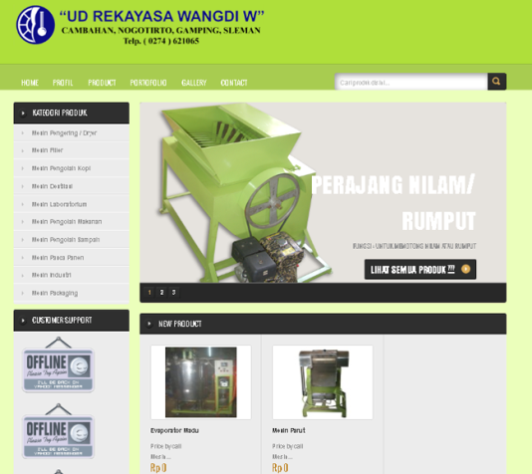
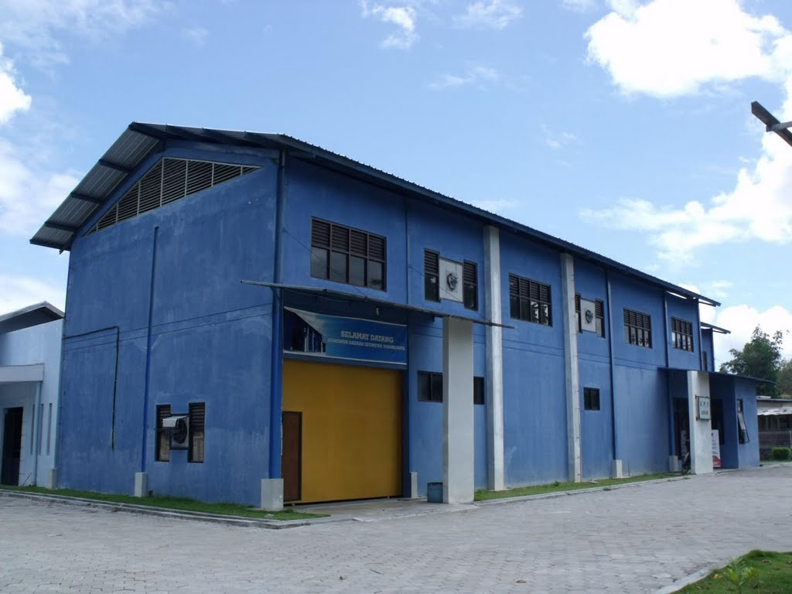
INDUSTRY INTERNSHIP IN LOCAL INDUSTRIES TO IMPROVE ENGINEERING DESIGN COMPETENCIES OF UNDERGRADUATE ENGINEERING STUDENTS
SUDIYATNO
sudiyatno@uny.ac.id
3rd International Conference on VET
May 14, 2014
EASTPARC HOTEL YOGYAKARTA

Slide 2
Presentation structure
Intoduction
Internship stages
Local Industries
Engineering Design Competencies
Products of Design
Results
Conclusion

Slide 3
INTRODUCTION
Industry internship is “a bridge” between academic world and real world
Industry internship gives students for having a real experience
Four internship stages: pre-placement, initiation, working and termination
Time internship spent is two months

Slide 4
Internship Stages
Pre-placement: process of identifying, investigating, interviewing and determining an internship placement site
Initiation : orientation and observation
Working : accomplish tasks and to reach the internship goals
Termination : to complete the jobs, to reflect on his/her performance, as well as professional and personal lessons learned.

Slide 5
Local Industries in Yogyakarta
Characteristics:
  Low educated workers
  Low to middle technology
  Simple products
Two Local Industries involved:
  UPT LOGAM Yogyakarta
  BENGKEL REKAYASA WANGDI Sleman
  Three design products: Cutter Machine, Slondok Moulding Machine and Sifter machine

Slide 6
Engineering Design Competences
No. | Type | Description
1 | General knowledge | To understand a phenomenon, a situation, a problem, a process, etc.
2 | Specific knowledge in a professional environment | To know the technologies, the rules, the standards, the culture, etc.
3 | Knowledge of procedures | To know the procedures, the methods, the processes, etc.
4 | Operational skills | To know how to use the procedures, the methods, the technologies, etc.
5 | Experiential skills | To know how to use tacit knowledge
6 | Social/Personal skills | To know how to listen, to cooperate, to work in team, etc.
 |  | Initiative, thorough, curious, etc.
 |  | To manage life (personal and professional), to feel (intuition, perception, etc.)
7 | Cognitive skills | To solve problem, to design, to manage a project, to take decisions, etc.

Slide 7
Assessment of
Engineering Design Competences
No. | Aspect | Objectives | Method and Instrument
1 | Knowledge of procedures | To know the procedures, the methods, the processes, etc. | Verbal examination
2 | Operational skills | To know how to use the procedures, the methods, the technologies, etc. | Observation and check list
3 | Social/Personal skills | To know how to listen, to cooperate, to work in team, etc. | Observation and check list
4 | Cognitive skills | To solve problem, to design, to manage a project, to take decisions, etc. | Presentation and check list
5 | Product | To examine the machine performance | Presentation (running test)

Slide 8
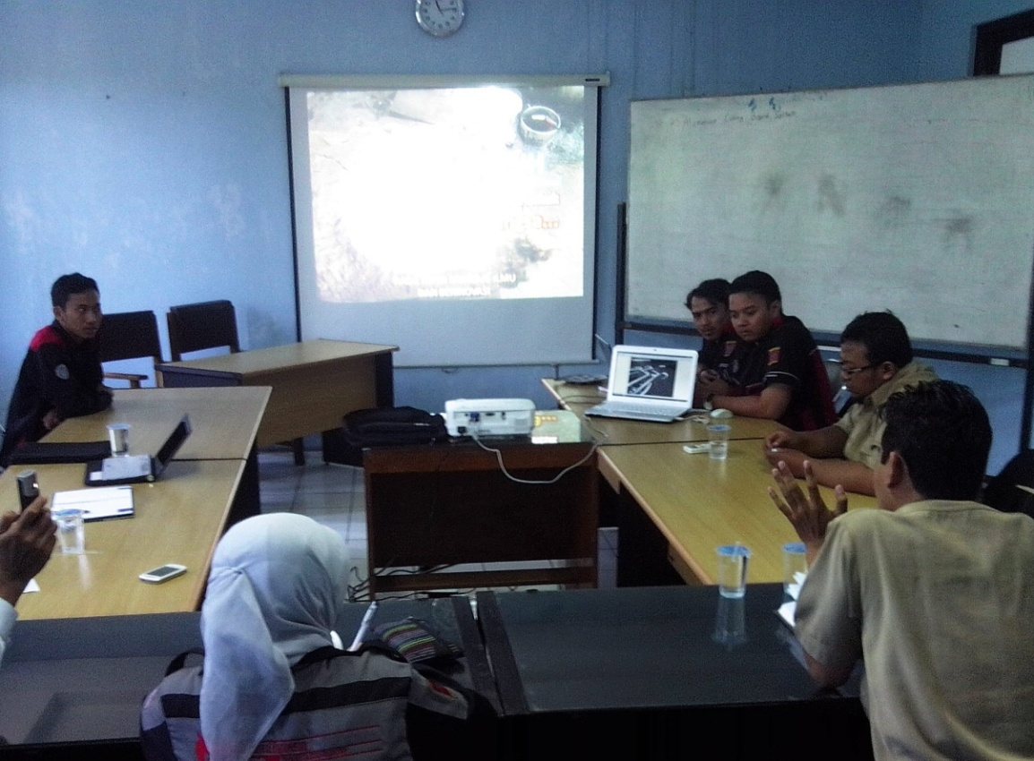
Design Presentation
Attendants :
  Internship students
  Industry supervisors
  Faculty supervisors

Slide 9
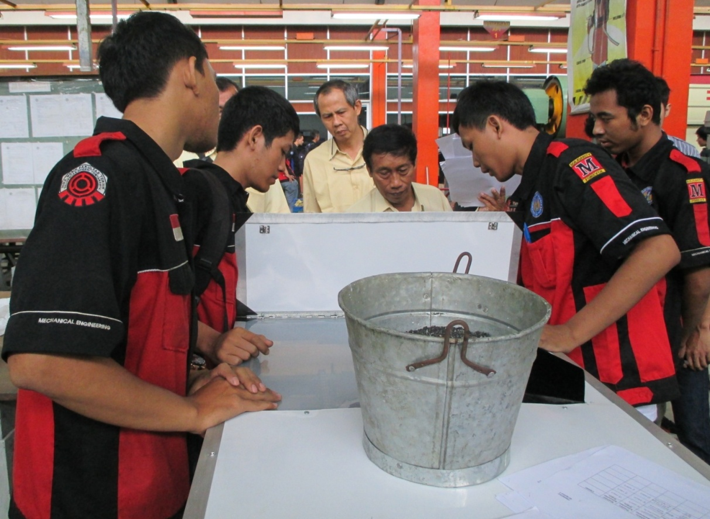
Product Performance Test
Attendants :
  Internship students
  Faculty examiners

Slide 10
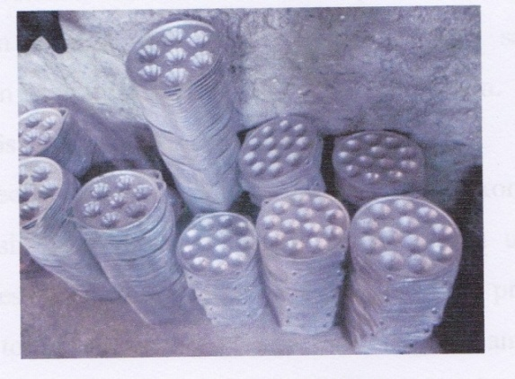
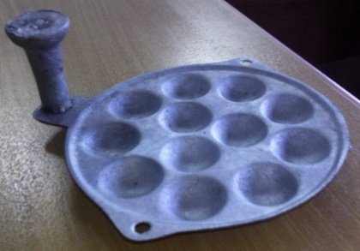
Products of Design
Cutter Machine
Handsaw
Cutter

Slide 11
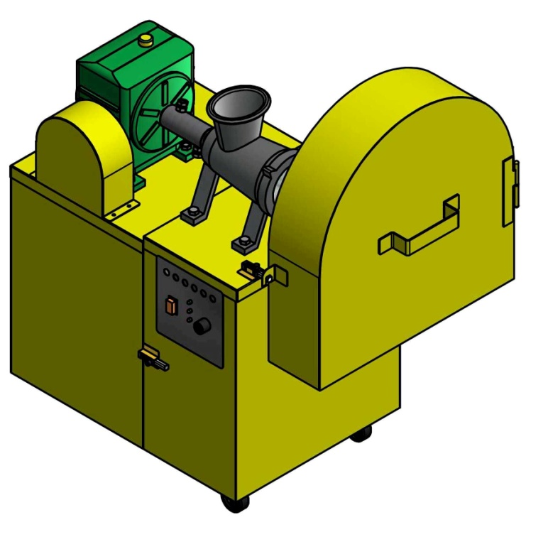
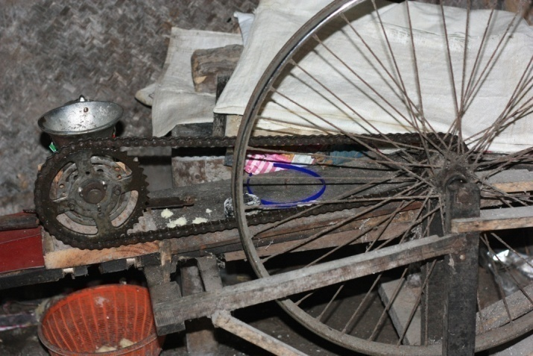
Products of Design
Slondok Moulding Machine
Manual
Automatic

Slide 12
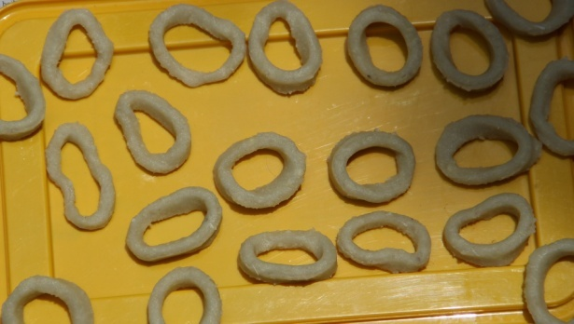
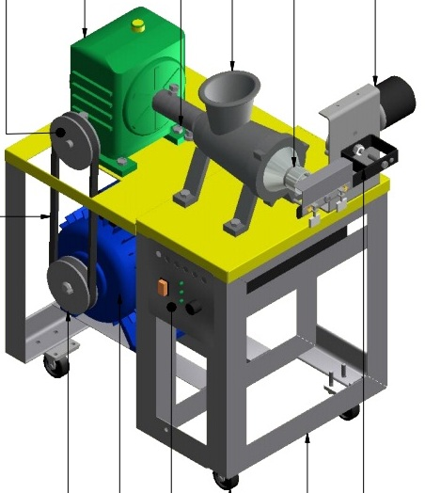
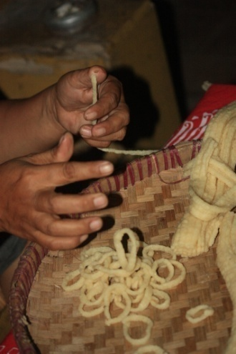
Products of Design
Not uniform
Uniform
Slondok Moulding Machine

Slide 13
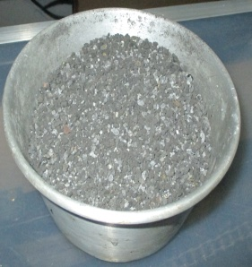
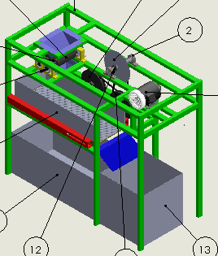
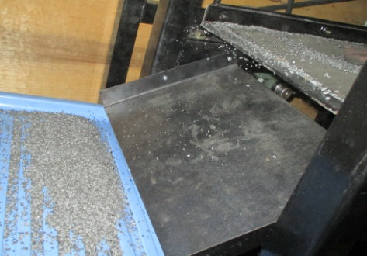
Products of Design
Sifter Machine
Aluminum and sands
Aluminum taped-shape

Slide 14
results
The integrated internship model showed that :
in all attributes of the competence (knowledge of procedures, operational skills, social skills and cognitive skills of the students) were better than those of students taking conventional industry internship.
the product performance test showed that the machines produced by the students taking the program had worked well.

Slide 15
conclusion
The students who took internship program in local industries were capable in designing machines.
All machines worked well.
It showed that by doing internship program in local industries the students could increase their design competencies.

Slide 16

Thank you

