Slide 1
13 Independent Clauses
Section 2: Structure & Written Expression
TOEFL Preparation
© Yosa A. Alzuhdy, M.Hum.
yosa@uny.ac.id
English Literature Study Program
State University of Yogyakarta

Slide 2
SIMPLE Sentences
Remember that all sentences consist of one or more clauses.
A SIMPLE SENTENCE consists of one clause (→ Subj+Verb).
China is changing.
S Vb
Developers are welcomed.
S Vb
People need vitamins.
S Vb Obj
Her mother is a senior surgeon in this hospital.
S Vb C: Noun Adv
My friends and I always play football and go swimming every weekend.
S Vb-phrase Adv
The followings are not (correct) sentences:
Behind his house near the tree on the corner
Always looking at me with her lovely eyes
The children playing hide-and-seek outside the room

Slide 3
SIMPLE Sentence
Independent Clause → Simple Sentence :
Subject + Verb → The VERB must be in accordance with SUBJECT,
TIME, TENSE, and ASPECT
For example:
Her father and sister are waiting for her coming at the airport.
We will have the mid semester exam in a few days.
A collection of books has been stolen from the library.
She didn’t follow the interview yesterday.
My girlfriend is in Jakarta right now.
Both of her brother and sister are students of this faculty.

Slide 4
Kinds of Sentences
The combination of clauses forming various types of sentences.
1. A SIMPLE SENTENCE consists of one independent clause ONLY.
The man bought a magazine in Gramedia bookstore last week.
2. A COMPOUND SENTENCE is two or more independent clauses joined together.
I enjoy tennis a lot, and I usually play it once a week.
3. A COMPLEX SENTENCE contains one independent clause and one (or more) dependent clause(s).
Here, one idea is more important (the MAIN Clause) than the other
(the SUBORDINATE clause).
Although the professor has retired since two years ago, he still teaches in several private universities.
4. A COMPOUND COMPLEX SENTENCE is a combination of two or more independent clauses and one (or more) dependent clauses.
I want to get married soon after I graduate from this university; however, my parents want me to get a job first.

Slide 5
Combining 2 or more Sentences
Practically, two simple sentences (clauses) can be joined using a:
> Coordinate Connector → Compound Sentence
> Subordinate Connector → Complex Sentence
> Sentence Connector → Compound Sentence
> semicolon (;) → Compound Sentence
He is sick. He stays at home.
He is sick, so he stays at home.
Because he is sick, he stays at home.
He stays at home because he is sick.
He is sick; therefore, he stays at home.
He is sick; he stays at home.
The girl is very clever. Nobody likes her.
The girl is very clever, but nobody likes her.
The girl is very clever, and nobody likes her.
The girl is very clever because nobody likes her.
Because the girl is very clever, nobody likes her.

Slide 6
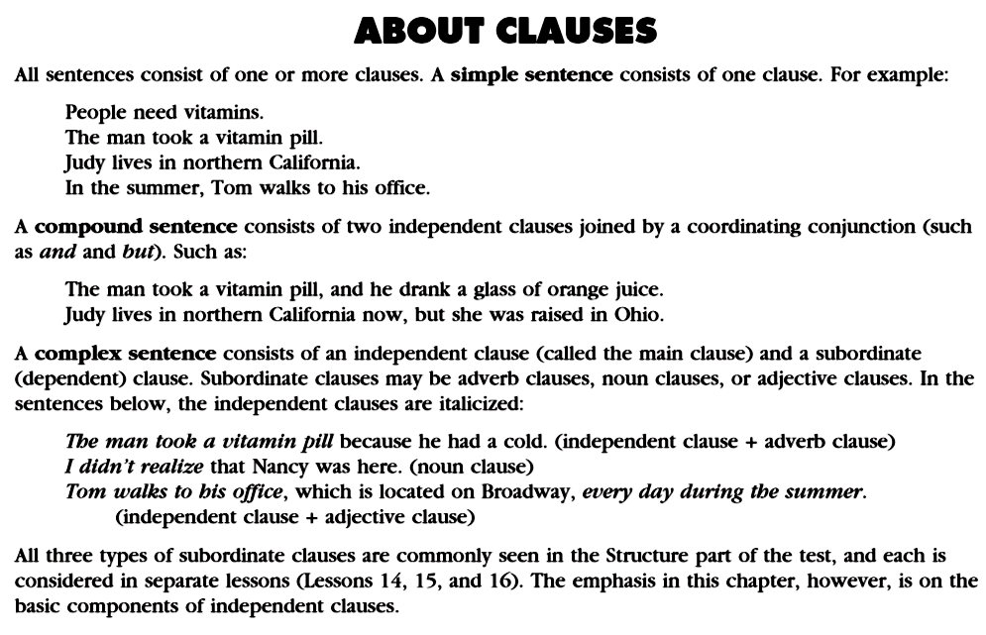
Independent Clauses
Because the man had a cold, he took a vitamin pill. (adverb clause + independent clause)

Slide 7
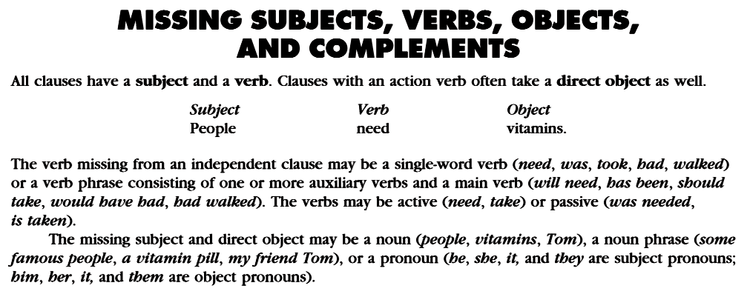

Slide 8
Examples

Slide 10
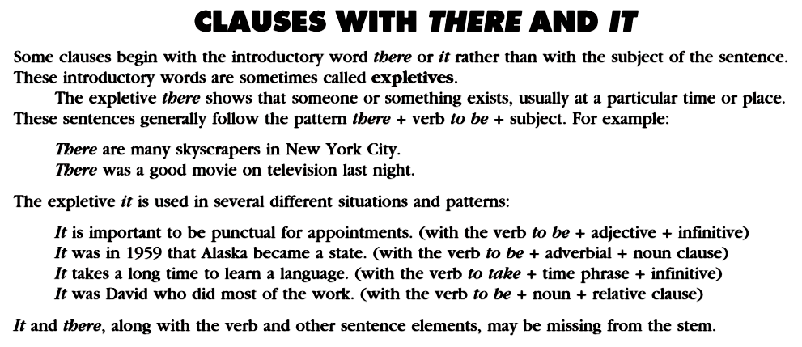
Clauses with There and It

Slide 11
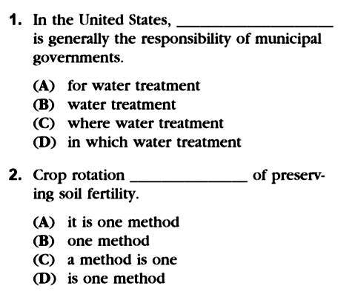
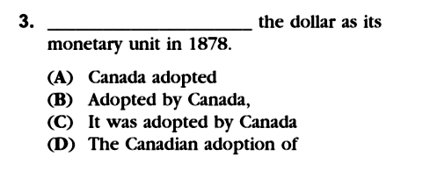
p.50 Exercise 13
Adv of place, + … + predicate (to be) →
(missing subject)
Subject: NOUN / Pronoun / Noun phrase
Noun phrase → Subject … (missing Verb)
… of preserving…
→ preposition : NOUN + of + NOUN/gerund
→ missing Subject + Verb
→ Subj+Verb, tenses: Past
→ Adverb
→ Subj+Vb, tdk cocok kelanjutannya
→ Tidak ada Verb

Slide 12
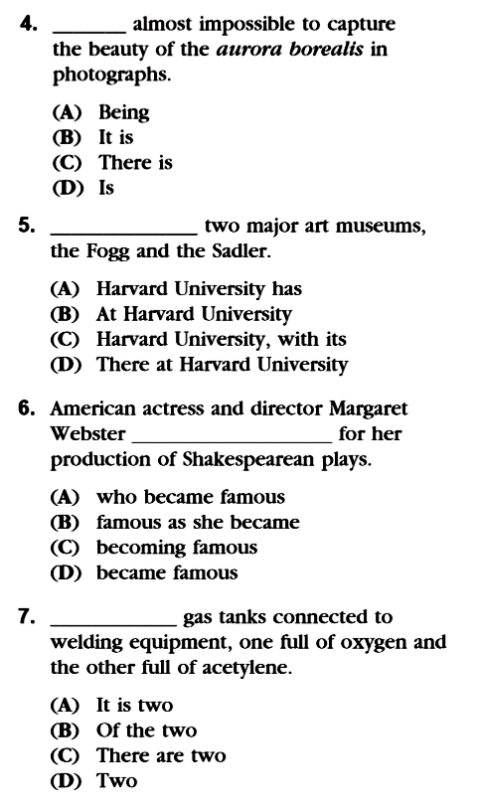
p. 51
… + adjective + to infinitive… → Impersonal IT
as subject
… missing Subj+Vb
Do the rest (plus additional)
for your exercise ONLINE.

Slide 13
Please review again at home,
and
do the quiz/exercise online.
See you next time…

