Slide 1
14 Adjective Clauses
Section 2: Structure & Written Expression
TOEFL Preparation
© Yosa A. Alzuhdy, M.Hum.
yosa@uny.ac.id
English Literature Study Program
State University of Yogyakarta

Slide 2
Adjective Clauses
Clause → contains Subj+Verb
Adjective Clause: a clause that functions like an adjective.
Adjective → functions to modify NOUN.
He is a clever student. → clever (adj) modifies student (N)
The young man is clever. → young and clever modifies man.
The man is my English teacher. I sent the man a long letter.
The man whom I sent a long letter is my English teacher.
→ Adj.clause (whom I sent a long letter) modifies the man.
I sent the man, who is my English teacher, a long letter.
→ Adj.clause (who is my English teacher) modifies the man.

Slide 3
Adjective Clause Connectors
:Dependent clause yg berfungsi sbg ADJECTIVE→ modifies noun/pronoun
Adjective clause menggunakan RELATIVE PRONOUN (kata ganti yang menghubungkan Adj.Clause dengan kata yang diterangkannya).
Catatan : Bila Relative Pronoun menggantikan OBJECT, atau sebagai pengganti SUBJECT + TOBE, maka bisa dihilangkan dari kalimat tsb.
Relative Pronoun | Menggantikan… | Posisi yg diganti: | Diterjemahkan
WHO | Orang | Subject | Yang
WHOM | Orang | Object | Yang
WHICH | Benda | Subject/object | Yang
THAT | Orang/benda | Subject/object | Yang
WHOSE | Possessive Adj. | Kepunyaan | Yang …nya
WHEN | Ket. Waktu | Adverb | Ketika, Waktu
WHERE | Ket. Tempat | Adverb | Tempat
WHY | Ket. Alasan | Adverb | Kenapa, Mengapa

Slide 4
Adjective Clauses
who | orang subj
whom | orang obj
which | benda subj/obj
that | org/bnd: sub/obj
whose | kepemilikan
(1) The man is a lecturer.
(2) He is standing in the corner.
(1-2) → The man who is standing in the corner is a lecturer.
→ The man that is standing in the corner is a lecturer.
(1)+(3) He was awarded a Nobel Prize yesterday.
(1-3) → The man who was awarded a Nobel Prize yesterday is a lecturer.
→ The man that was awarded a Nobel Prize yesterday is a lecturer.
(1)+(4) I met him in the party yesterday.
(1-4) → The man whom I met in the party yesterday is a lecturer.
→ The man that I met in the party yesterday is a lecturer.
(1)+(5) His car was stolen last week.
(1-5) → The man whose car was stolen last week is a lecturer.
(1)+(6) My friend is married to the man.
(1-6) → The man whom my friend is married to is a lecturer.
→ The man that my friend is married to is a lecturer.
→ The man to whom my friend is married is a lecturer.
→ The man to that my friend is married is a lecturer.
Preposition can be
placed before marker.
If preceded by
preposition, that
cannot be used.

Slide 5
Reduced Adj.Clause
Connector as OBJECT or as SUBJECT+TO BE → can be omitted:
(1-2) The man who is standing in the corner is a lecturer.
= The man that is standing in the corner is a lecturer.
= The man standing in the corner is a lecturer. (standing→Adjective)
(1-3) The man who was awarded a Nobel Prize yesterday is a lecturer.
= The man that was awarded a Nobel Prize yesterday is a lecturer.
= The man awarded a Nobel Prize yesterday is a lecturer.(awarded→Adj)
(1-4) The man whom I met in the party yesterday is a lecturer.
= The man that I met in the party yesterday is a lecturer.
= The man I met in the party yesterday is a lecturer.
(1-5) The man whose car was stolen last week is a lecturer. (no change!)
(1-6) The man whom my friend is married to is a lecturer.
= The man that my friend is married to is a lecturer.
= The man my friend is married to is a lecturer.
→ The man to whom my friend is married is a lecturer. (no change!)
~ to whom cannot be replaced by to that, and cannot be omitted.

Slide 6
Other Examples of Adj Clause
(1) This is the house. (2) I want to buy the house.
(1-2) → This is the house that I want to buy.
(1-2) → This is the house which I want to buy.
(1-2) → This is the house I want to buy.
(3) The house is on Jalan Solo. (2) I want to buy the house.
(3-2) →The house that I want to buy is on Jalan Solo.
(3-2) →The house which I want to buy is on Jalan Solo.
(3-2) →The house I want to buy is on Jalan Solo.
(4) We’ll build a house. (5) The house is large enough for 6 people.
(1-4) → We’ll build a house that is large enough for 6 people.
(1-4) → We’ll build a house which is large enough for 6 people.
(6) The house is red. (5) The house is large enough for 6 people.
(5-6) The house that is large enough for 6 people is red.
(5-6) The house which is large enough for 6 people is red.
The job _____ started yesterday was rather difficult.
(A) when
(B) was
(C) after
(D) that he
Reduced Adj.Clause :
= The job he started yesterday was rather difficult.
_____ just dropped off a package for you is my sister.
(A) The woman
(B) The woman who
(C) Because the woman
(D) With the woman
Reduced Adj.Clause: → Adjective Phrase
= The woman just dropping off a package for you
is my sister.

Slide 7
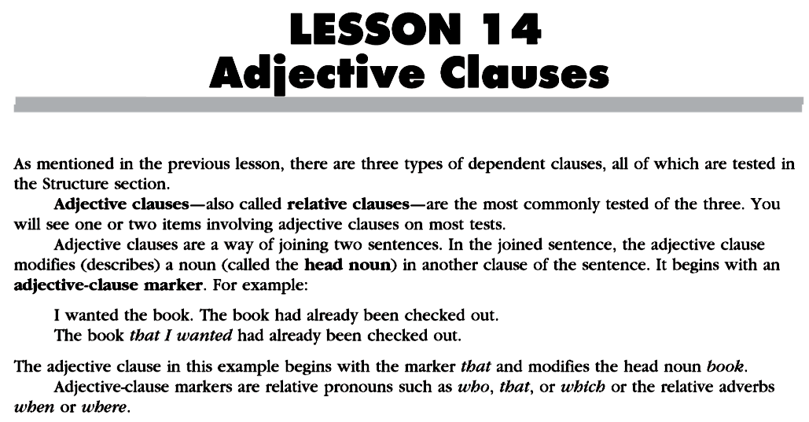
p.52 Adjective Clauses
which ✓

Slide 8
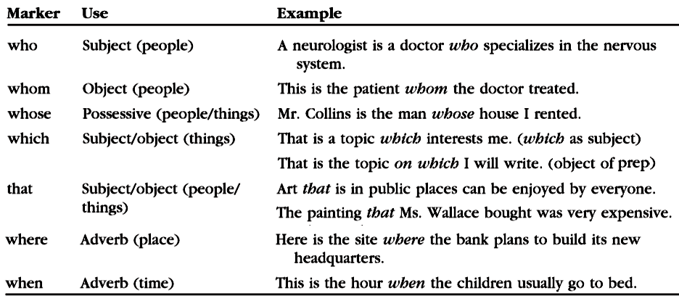

Slide 9
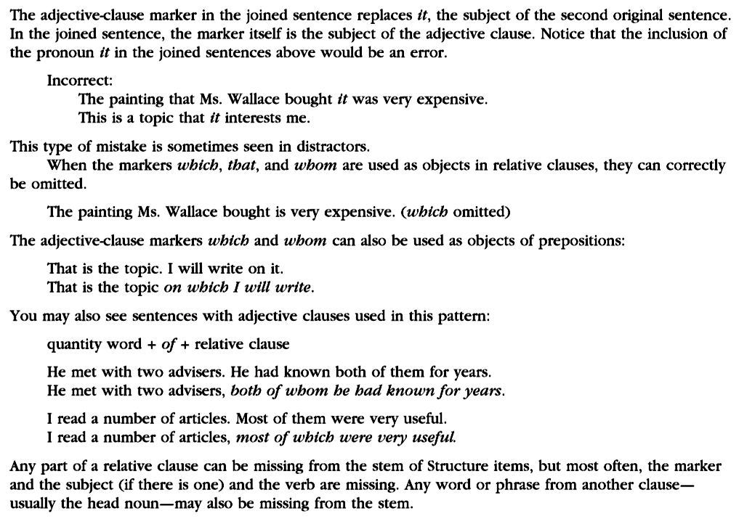
The painting which Ms Wallace bought is very expensive.
→ That is the topic which I will write on.
= That is the topic that I will write on.
on that
both of that
most of that

Slide 10
Restrictive – Non-restrictive Clause
Adj.clause can be restrictive (membatasi dari yang banyak) → tidak diapit oleh tanda koma, atau non-restrictive (tidak membatasi, memang hanya ada satu) → diapit oleh koma. Perhatikan:
My brother who works as a driver has two children.
→ Implicitly, it means that I have more than one brother, and in this sentence I am talking about one of them.
The painting which Ms. Wallace bought was very expensive.
→ Ada banyak lukisan, dan yang yang mahal adalah yg dibeli Ms Wallace.
→ Pada restrictive clause, who/whom/which bisa diganti dengan that.
Compare:
My sister, who lives in Sidempuan, has one child.
→ It means that I only have one sister, and she lives in Sidempuan. So, I just give extra information about my only sister in the adjective clause.
The painting, which Ms. Wallace bought, was very expensive.
→ Kita hanya membicarakan satu lukisan yang mahal harganya, dan kita sudah tahu bahwa lukisan itu dibeli oleh Ms Wallace.
→ Jika non-restrictive, who/whom/which tidak bisa diganti dengan that.
that ✓
that ✓
dan bisa dihilangkan / direduksi.
that
that
dan tidak bisa direduksi.

Slide 11
Examples

Slide 12
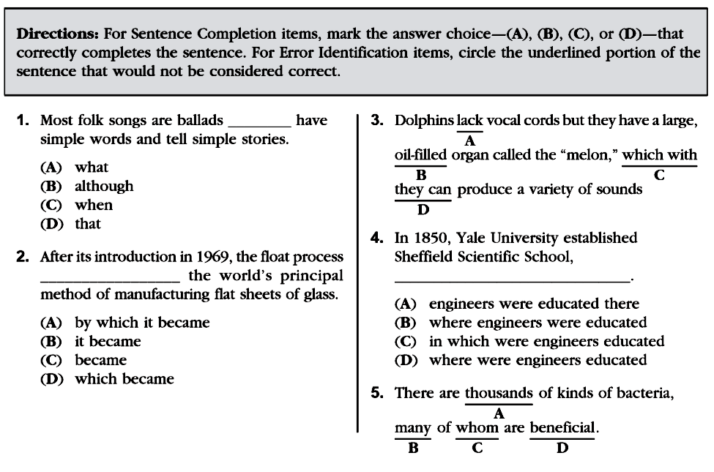
p. 54 Exercise 14
with which
Do the rest (plus additional)
for your exercise ONLINE.
Simple Sentence!
…School. Engineers were educated in the school.
/ Engineers were educated there.
➔…School, which engineers were educated in.
= …School, in which engineers were educated.
= …School, where engineers were educated.
thing: which. that? No! (after prep. of)

Slide 13
Please review again at home,
and
do the quiz/exercise online.
See you next time…

