Slide 1
16 Noun Clauses
Section 2: Structure & Written Expression
TOEFL Preparation
© Yosa A. Alzuhdy, M.Hum.
yosa@uny.ac.id
English Literature Study Program
State University of Yogyakarta

Slide 2
p. 61 Noun Clauses
Statement: Subject + Vb / Subj + auxiliary
Question: Auxiliary + Subject
(Auxiliary): to be / have,has,had /
modals / do,does,did

Slide 3
NOUN CLAUSES
➔Dependent clause sebagai NOUN: Subject, Object atau Complement
Menggunakan Subordinators:
Asal kalimat | Subordinator yg digunakan | Diterjemahkan:
Statement | (That) | Bahwa
Wh-Questions | Who | Siapa
 | Which | Yang mana
 | What | Apa
 | When | Kapan
 | Where | Di mana / ke mana
 | Why | Kenapa
 | Whoever, Whatever, etc | Siapapun / siapa saja
 | How much/many/often etc | Berapa banyak/sering
Yes/No Questions | If | Jika / apakah
 | Whether | Jika / apakah

Slide 4
NOUN CLAUSES
Perhatikan perubahan dari kalimat simpel menjadi NOUN CLAUSE.
Learning English needs patience and lots of practice. [statement]
That learning English needs patience and lots of practice is true.
Noun Clause as Subject Vb C:Adj
I know that learning English needs patience and lots of practice.
S Vb Noun Clause as Object
Where did she go last night? [Wh-Question]
Where she went last night is still a mystery.
Noun Clause as Subject Vb C:Adj
They want to know where she went last night.
S Vb Noun Clause as Object
What have you put into this food? [Wh-Question]
What you have put into this food makes me sick.
Noun Clause as Subject Vb Obj Adj
They are investigating what you have put into this food.
S Vb Noun Clause as Object

Slide 5
How did she put the sugar into the cake? [Wh-Question]
How she put the sugar into the cake made people confused.
Noun Clause as Subject Vb Obj Adj
They often asked her how she put the sugar into the cake.
S advb Vb O1 Noun Clause as Object2
Why can’t the government eradicate corruption? [Wh-Question]
Why the government can’t eradicate corruption is a big question.
Noun Clause as Subject Vb C:Noun
Our question is why the government can’t eradicate corruption.
S Vb Noun Clause as Complement
Do you understand this explanation? [Yes-No Question]
Whether you understand this explanation is very important.
Noun Clause as Subject Vb C:Adj
I need to know whether you understand this explanation.
S Vb Noun Clause as Object
Have you done the Quiz on Tenses in BeSmart? [Yes-No Question]
Whether you’ve done the Quiz on Tenses in BeSmart is my concern.
Noun Clause as Subject Vb C:Noun
She wonders if you have done the Quiz on Tenses in BeSmart.
S Vb Noun Clause as Object

Slide 6
NOUN CLAUSES
Once again, like the NOUN, Content Clauses (= Noun Clauses) can be as Subject, Object (Direct, Indirect, after Preposition), or Complement.
Subject Who finishes first will get a present.
What goes up must come down.
Direct Obj. They think that the test is on the next day.
You may decide what time you want to go.
Indirect Obj. She asked whoever comes into the room a lot of questions.
The man gave whoever he knew a great sum of money.
Obj. of Prep We talked about what seemed to be the right solution.
You can speak to whoever you meet first.
Complement Love is what you can give.
What you see is what you get. = wysiwyg

Slide 7
Check the FORMAT:
1. Noun Clause dan Adjective Clause: membentuk Kalimat Kompleks.
2. Noun Clause: sebagai Noun; Adjective Clause: sebagai Adjective.
3. Sebagian Noun Clause terlihat SAMA atau MIRIP dg Ajective Clause,
terutama yang menggunakan kata penghubung yang sama:
WHO, WHICH, THAT, WHEN, WHERE, dan WHY.
Bagaimana membedakannya?
Perhatikan FORMATnya: Noun clauses (CLAUSE as NOUN) functions
as Subject (diikuti oleh VERB), Direct/Indirect Object (setelah VERB), Object of Preposition (setelah PREPOSITION), or as Complement (setelah TO BE or LINKING VERB).
Adjective clauses (as ADJECTIVE) functions as Modifier of NOUN. FORMAT: ditempatkan setelah NOUN (NOUN dulu baru Adj.Clause).
Who can answer all the questions will get A+. → Subj → Noun Clause.
Students who can answer all the questions will get A+. → stlh N → Adj Cl.
I don’t believe that he bought hats in the market. → stlh Verb: Obj: Noun Cl.
I like the hats that he bought in the market. → stlh Noun → Adj Cl.
We will discuss about when the raise in oil price will be on. → Obj.Prep: N Cl.
July is the time when we usually conduct the SBMPTN. → stlh Noun →Adj Cl.

Slide 8
= It
= it
= it

Slide 9
Examples
1. _____ was caused by breathing impure air was once a common belief.
A. Malaria B. That malaria C. Why malaria D. Because malaria
Perhatikan kalimatnya: ada dua VERB, berarti ada 2 Clause (:kal.kompleks)
(A) salah, karena tidak membentuk kalimat kompleks.
(D) salah, karena conj. because di awal kalimat, berarti main-clause (S+V) ada di akhir kal dan harus dipisahkan dengan tanda koma dari anak kal.
(B) → menunjukkan Noun clause yg berasal dari Statement.
(C) → menunjukkan Noun clause yg berasal dari WH-Question.
Kalimat soal menunjukkan bhw Noun clause-nya adalah sesuatu yg dulu dipercayai orang (a common belief), berarti itu adalah suatu pernyataan, BUKAN pertanyaan. Berarti jawabannya adalah: (B).
Terjemahannya: Bahwa penyakit malaria disebabkan oleh udara yang kotor merupakan hal yang dahulu dipercayai orang secara umum.
Atau bisa juga: Orang-orang dulu banyak yang percaya bahwa malaria disebabkan oleh udara yang tercemar.

Slide 10
2. One basic question psychologists have tried to answer is _____.
A. people learn C. people learn how
B. how do people learn D. how people learn
Perhatikan kalimatnya: ada dua VERB, berarti ada 2 Clause (:kal.kompleks)
Di sini, main clause One basic question is… diikuti oleh Adjective Clause psychologists have tried to answer (perhatikan posisinya setelah NOUN).
Main clause: Verb-nya to be, berarti diikuti Complement.→ Semua jawaban terdiri dari S+V → Noun Clause. Lihat Main Clause: tentang question.
(A) salah, bukan berasal dari Question. (B) salah, format: question form.
(C) juga salah, karena susunannya bukan format statement.
(D) benar, Noun clause dari WH-Question, & formatnya berupa Statement.
Terjemahannya: Salah satu pertanyaan dasar yang dicoba dijawab oleh para ahli psikologi adalah bagaimana orang belajar.
Atau bisa juga: Salah satu pertanyaan dasar yang para ahli psikologi coba menjawabnya adalah bagaimana orang mempelajari sesuatu.

Slide 11
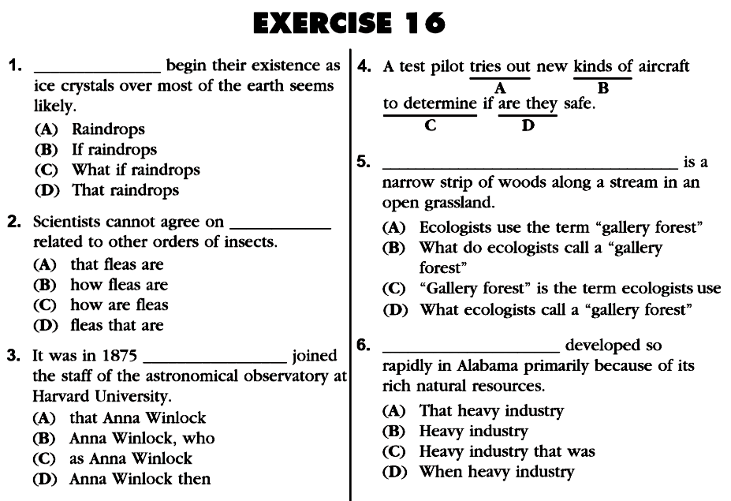
p. 62
statement form: they are
Do the rest (plus additional)
for your exercise ONLINE.

Slide 12
Please review again at home,
and
do the quiz/exercise online.
See you next time…

