Slide 1
18 Word Forms
Section 2: Structure & Written Expression
TOEFL Preparation
© Yosa A. Alzuhdy, M.Hum.
yosa@uny.ac.id
English Literature Study Program
State University of Yogyakarta

Slide 2
p. 67 Word Forms

Slide 3
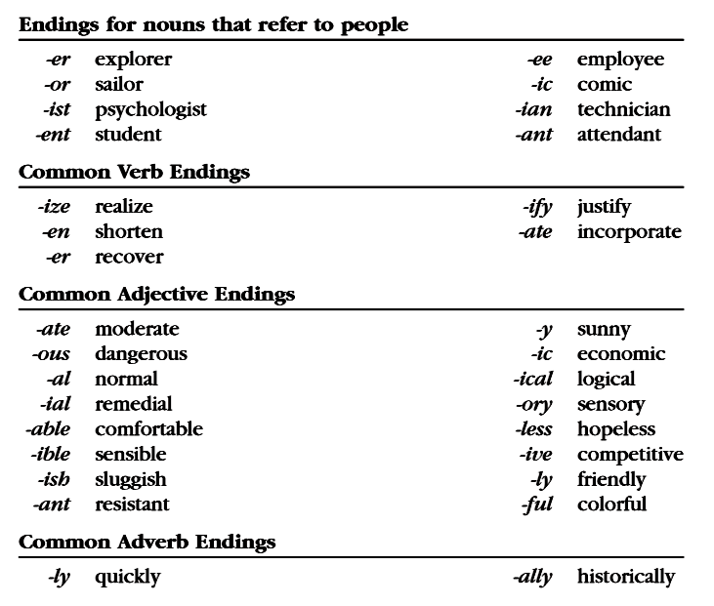

Slide 5
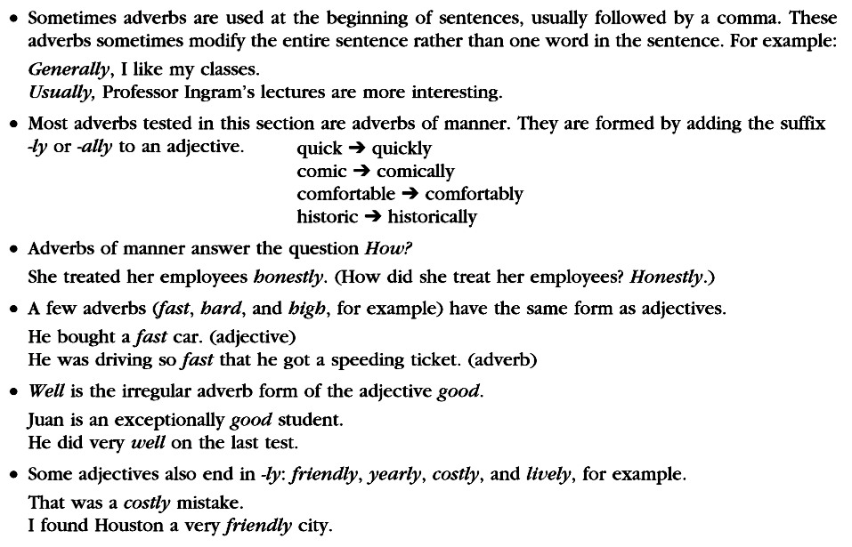

Slide 6
adjective+Noun(phrase)
adverb+Adjective (number)
Parallel→profession+and+profession

Slide 7
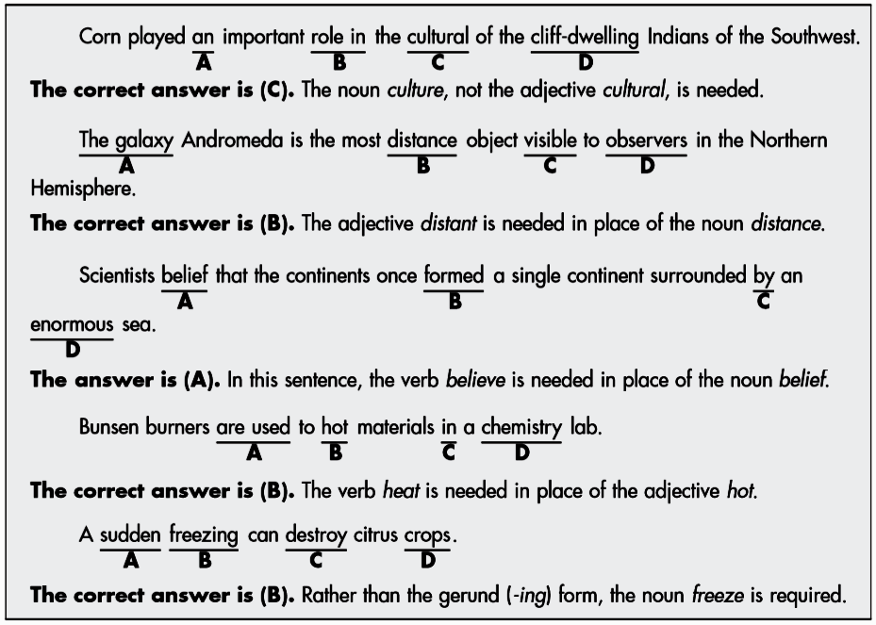
Other word form problems
the/a/an+Noun(phrase) // Noun+of+Noun
the most+adjective (comparison)
Subject+Verb (predicate)
be used to + Verb →heat
Subject: Noun(phrase) // Gerund→Noun (the process)

Slide 8
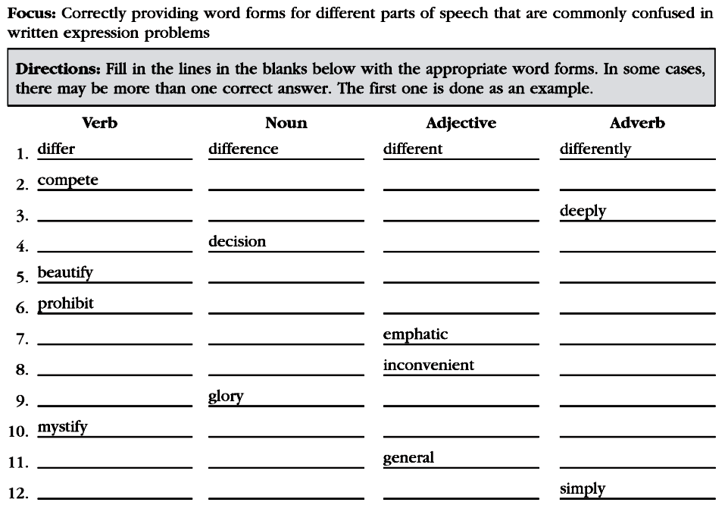
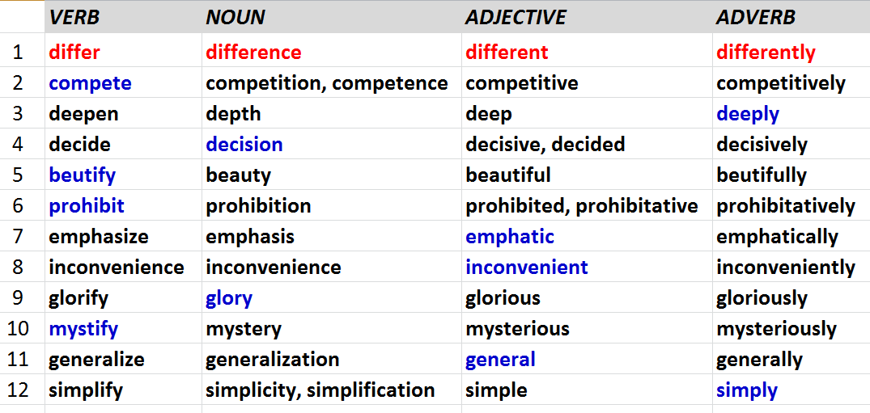
p.74 Exc.18.1

Slide 9
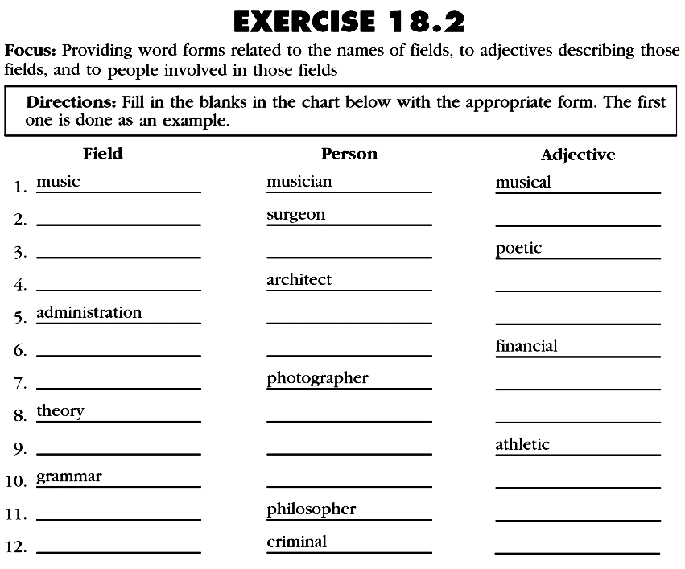
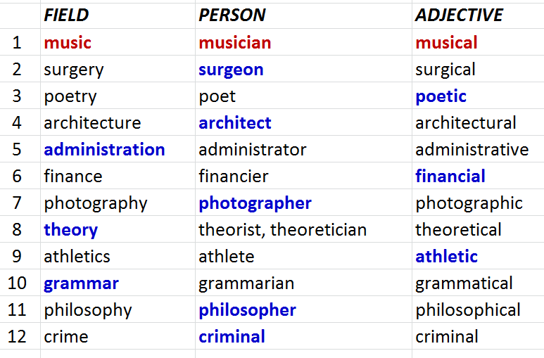

Slide 10
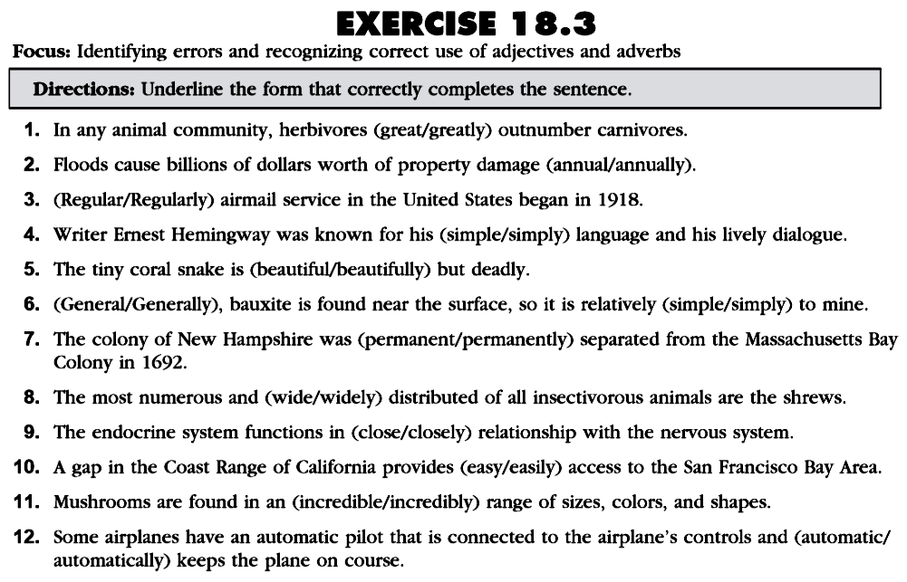
Do the rest (+additional questions)
for your exercise as a quiz ONLINE.

Slide 11
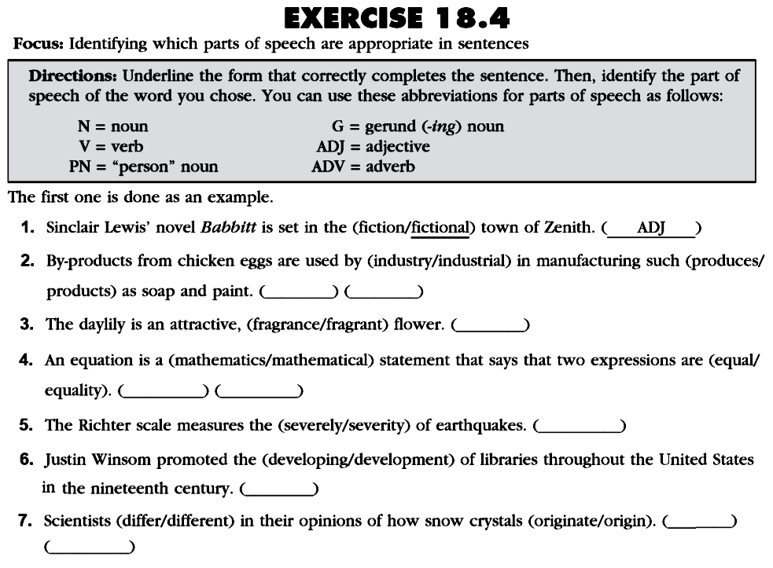
Do the rest (+additional questions)
for your exercise as a quiz ONLINE.

Slide 12
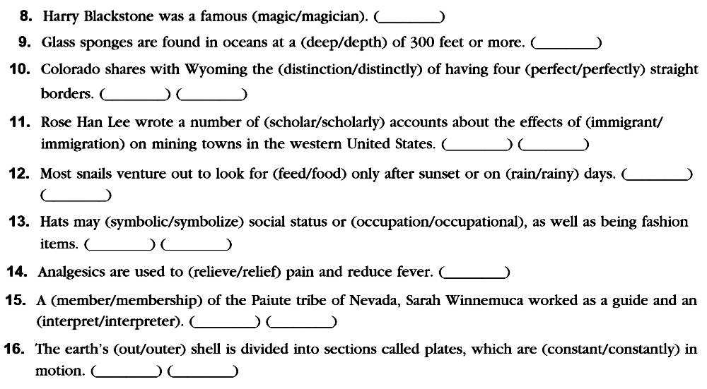

Slide 13
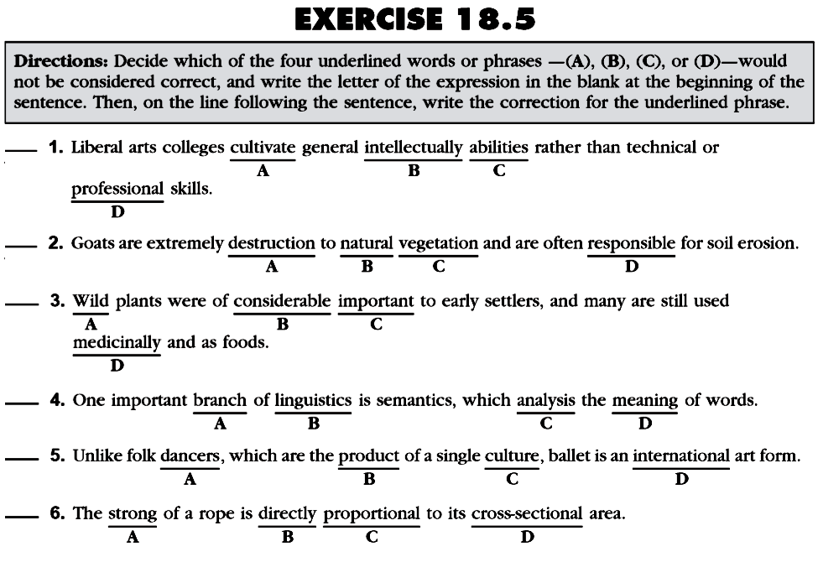
intellectual (Adj+Noun)
Adj: destructive
Adj+Noun: importance
which[Subj]+Vb: analyzes
compare w/ ballet
→ Noun: dances
Do the rest (+additional questions)
for your exercise as a quiz ONLINE.

Slide 14
Please review again at home,
and
do the quiz/exercise online.
See you next time…

Slide 15
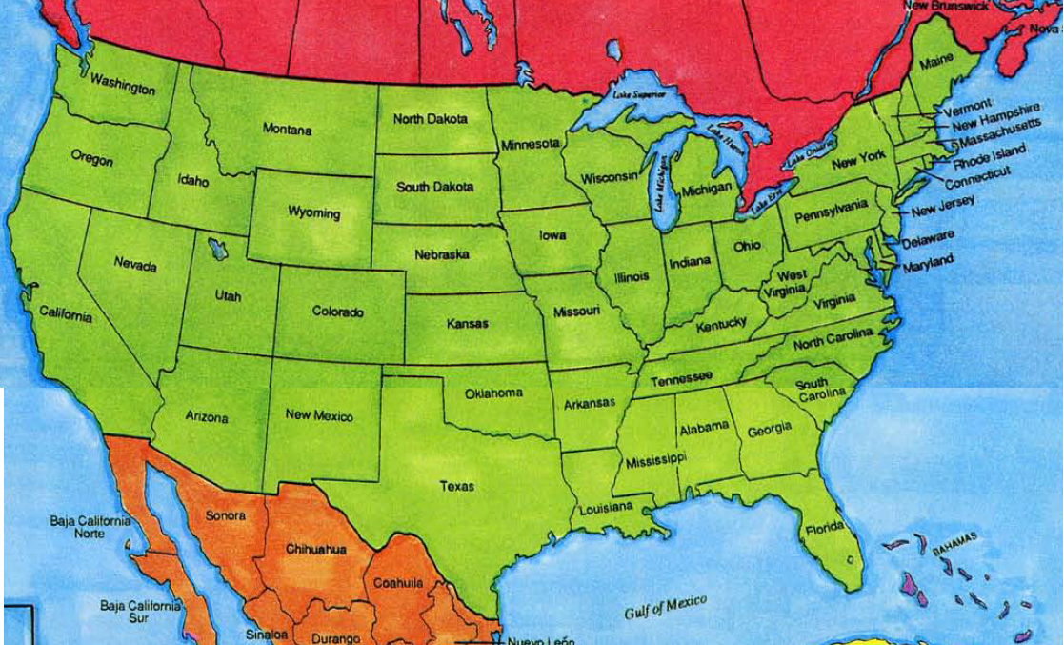
The U.S. Map

