Slide 1
19 Word Choice
Section 2: Structure & Written Expression
TOEFL Preparation
© Yosa A. Alzuhdy, M.Hum.
yosa@uny.ac.id
English Literature Study Program
State University of Yogyakarta

Slide 2
p. 80
Try to remember all these expressions. Use them regularly in your own sentences.

Slide 3
Examples
contextual meaning: is made from (terbuat dari…)
Check the form: do business with (not: make business)

Slide 4
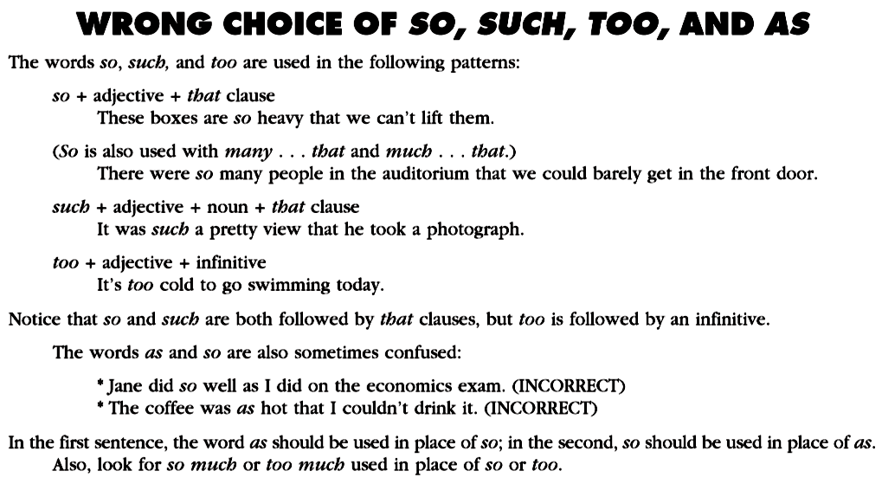
so, such, too, as
as well as
(comparison)
so hot that

Slide 5
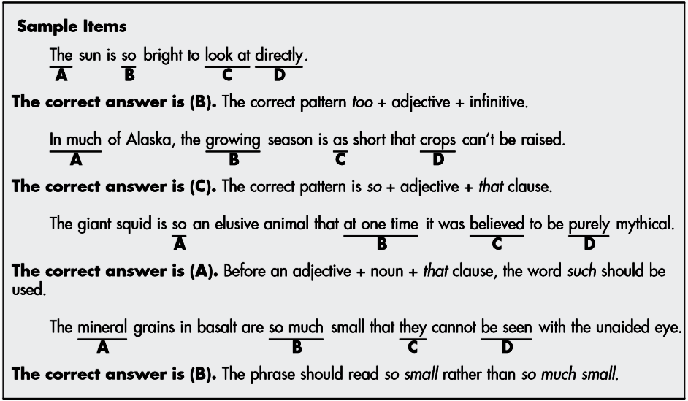
too+adj+infinitive
so+adj+that clause
such+noun(phrase)+that clause
so+adj+that clause

Slide 6
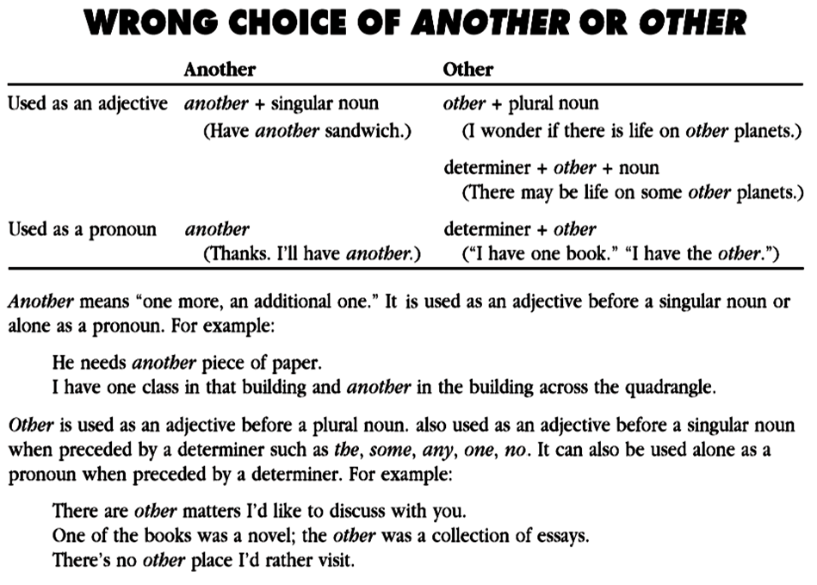
another is never used
after a determiner

Slide 7
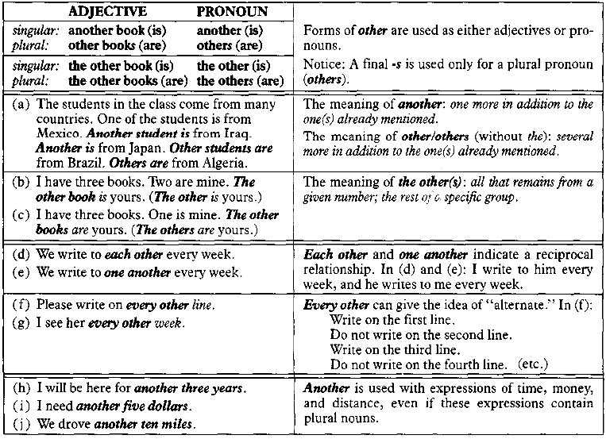
OTHER, OTHERS & ANOTHER
others is never followed by a noun
other + plural noun
another + singular noun

Slide 8
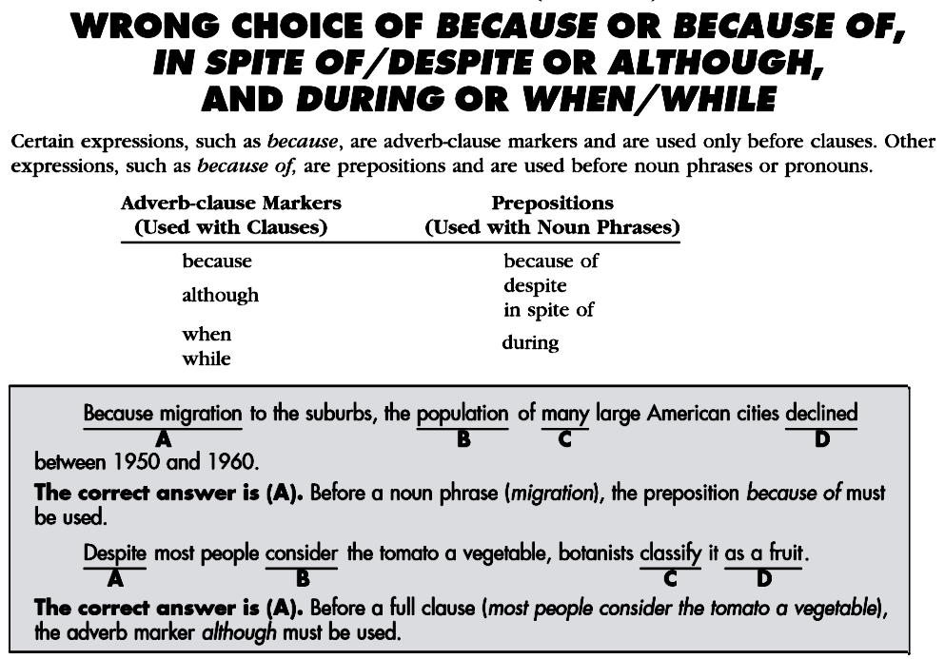
Conjuction:
+ Subj+Vb
Preposition:
+ Noun(phrase)
Because of+ Noun(phrase)
Although+Clause

Slide 9
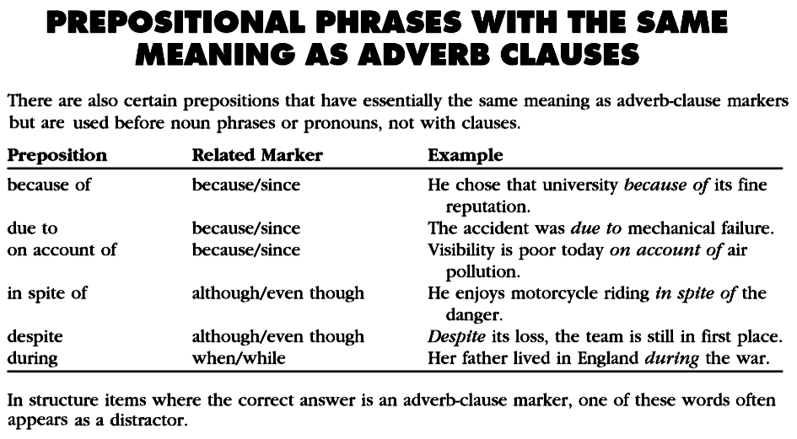
See page 57 (Adverb Clause)
/as
/as
/as
= due to /on account of
…because it has fine reputation
…because there is air pollution
/
though
…although it is dangerous
when the war occurred

Slide 10
Because (of)
BECAUSE : followed by Subject + Verb
1.He cannot come today because he is sick.
2.Because her mother is going to Bali, she must stay at home for 3 days.
3.Some students have to take a remedial class because they failed the test.
4.Because it was raining hard, we didn’t go playing football.
BECAUSE OF : followed by Noun / N.Phrase / N.Clause
1.He cannot come today because of his sickness.
2.Because of her mother’s trip to Bali, she must stay at home for 3 days.
3.Some students have to take a remedial class because of their failure.
4.Because of the rain, we didn’t go playing football.
DUE TO + NOUN… DUE TO the fact that + Subj+Verb
1.He cannot come today due to his sickness.
= He cannot come today due to the fact that he is sick.
2.Due to her mother’s trip to Bali, she must stay at home for 3 days.
= Due to the fact that her mother is going to Bali, she must stay at home.
3.… due to their failure. =… due to the fact that they failed the test.

Slide 11
Expressions of Quantity
Count Noun
many
few / fewer
a few
a / an
number
Count & Noncount Noun
most none of
some any
a lot of no
all
Noncount Noun
much
little / less
a little
amount
Many students have submitted their assignments.
Much of the news on television is not reliable.
Some students are absent in today’s lecture.
Some advice is impossible to be carried out in this situation.
Most of the backyard was covered by the leaves.
Most of the chairs in this room are occupied.
Most of ocean water near the factory is polluted.
Although a number of students have quitted since an amount of bad information spread out, the total number of students is increasing.

Slide 12
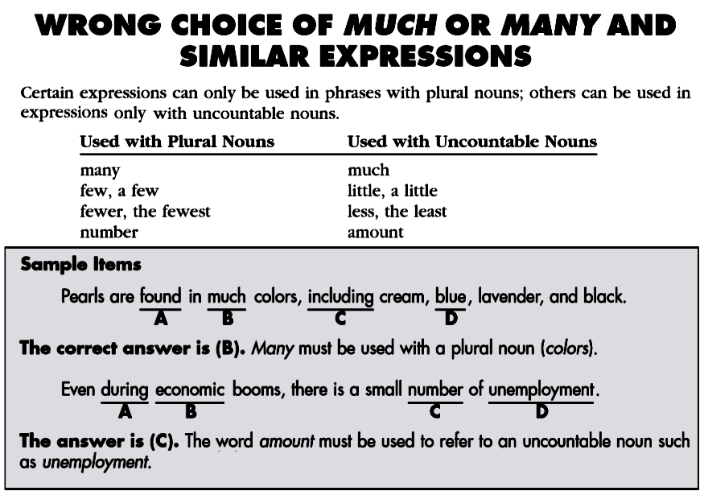
I want to have many cars.✓
I want to have a lot of cars.✓
I want to have much money.✓
I want to have a lot of money.✓
There are a few students here.✓
There are some students here.✓
There is a little water inside.✓
There is some water inside.✓
many+plural Noun
amount+uncountable Noun

Slide 13
Other Word Problems
No
not
no
most
most
almost
I have twice as much money as he does.
I have twice more money than he does.
twice+comparison
verb
======
twice
has doubled

Slide 14
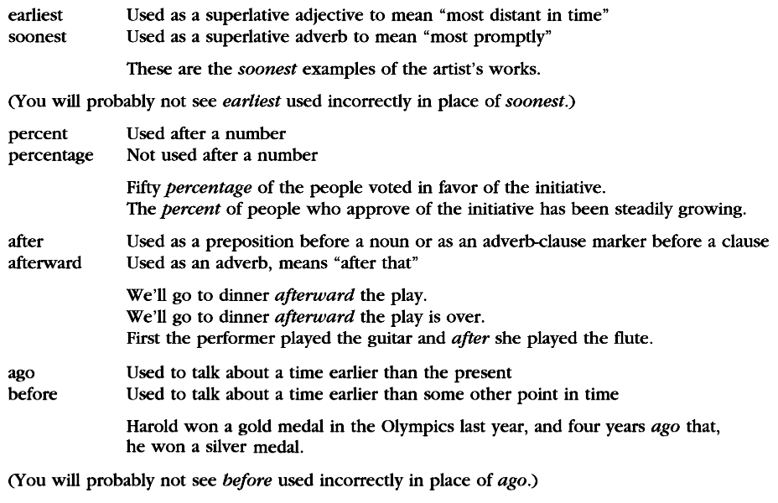
yg paling awal
yg paling cepat
earliest
percent
percentage
after
after
afterward
…yg lalu
sebelum(nya)
before

Slide 15
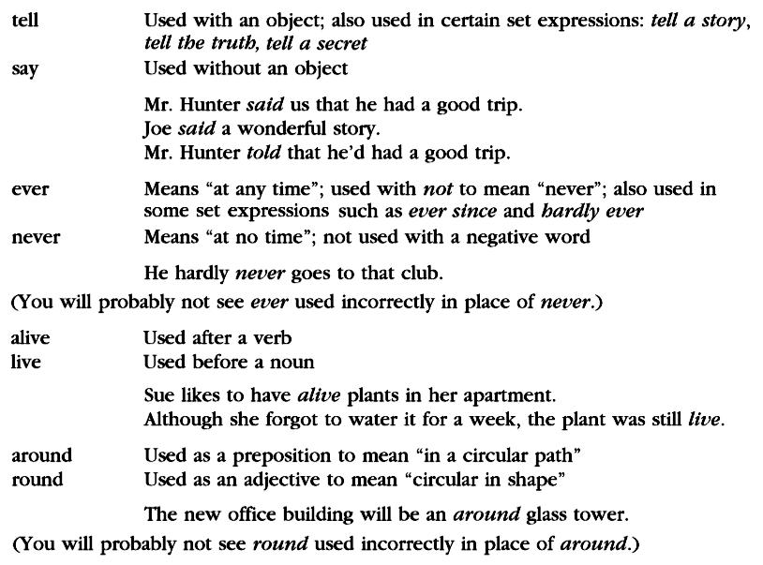
told
told
said
ever
I ever went to Singapore. ✗
I once went to Singapore. ✓
→ cannot be followed by Noun
live
alive
→the route/direction
→the shape/form
a round

Slide 16
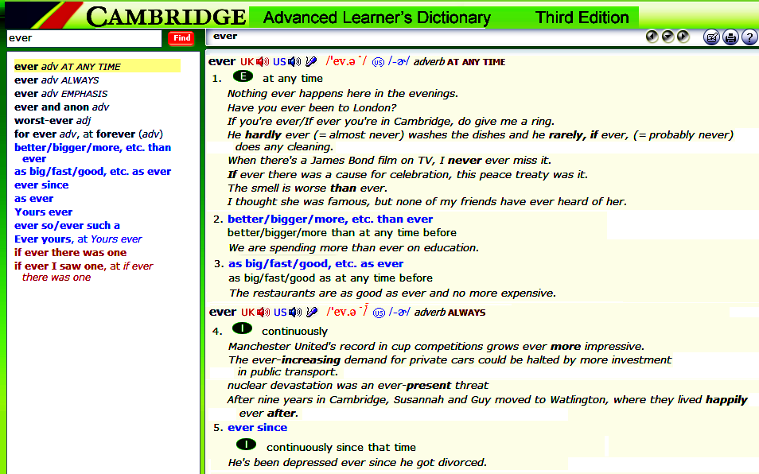
Look it up at Cambridge Dictionary

Slide 18
Live or alive, like or alike?
live
like
unlike
side
new
alive
alike
not alike
aside
anew
without Noun
(end of clause or
phrase)
+ Noun
She likes to have live plants in her house.
Although I didn’t water the plants for a week, they’re still alive.
The old man behaved like a child when he saw the show.
I don’t know which is Ani and which is Ana. They looks alike.
The man, unlike his children, prefers coffee to tea.
Although they are twins, Anita and Atina are not alike.
Take the side walk if you want to enter the house.
If you don’t want to read these magazines now, just put it aside.
My children want new bicycles as the present for their success.
To start anew, the company should refresh all the managers.

Slide 19
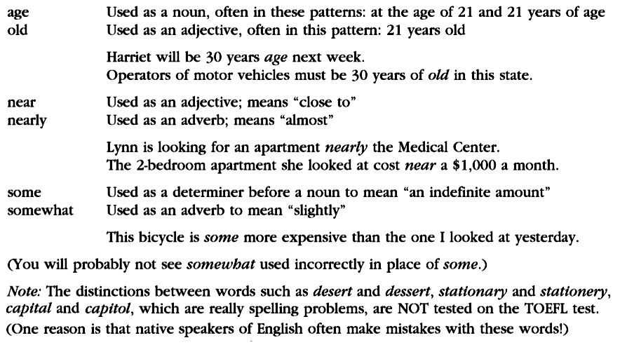
old
age
The pipe is 30 cm long.
= It is 30 cm in length.
The hole is 100 m deep.
= It is 100 m in depth.
near
nearly
somewhat

Slide 20
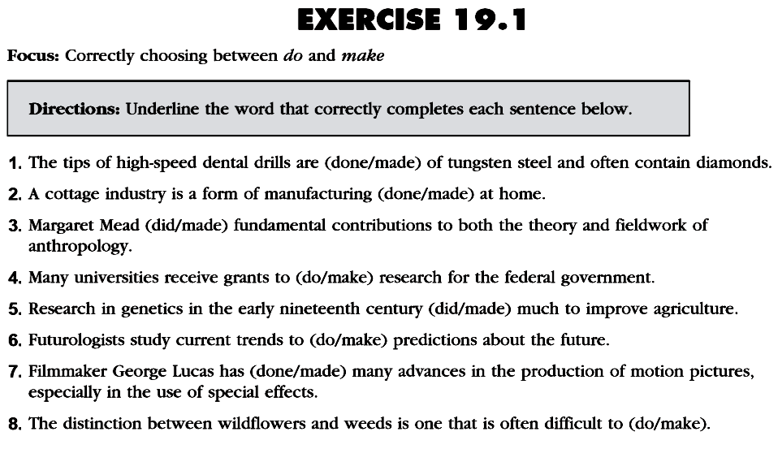
p. 86
do + certain nouns
make + certain nouns

Slide 21
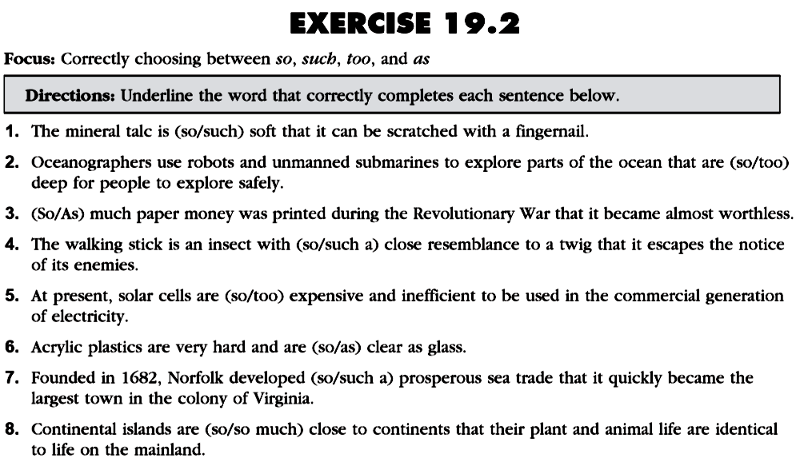
so+adjective+that clause
such+Noun(phrase)+that clause
too+adjective+infinitive
as+adjective+as (comparison)

Slide 22
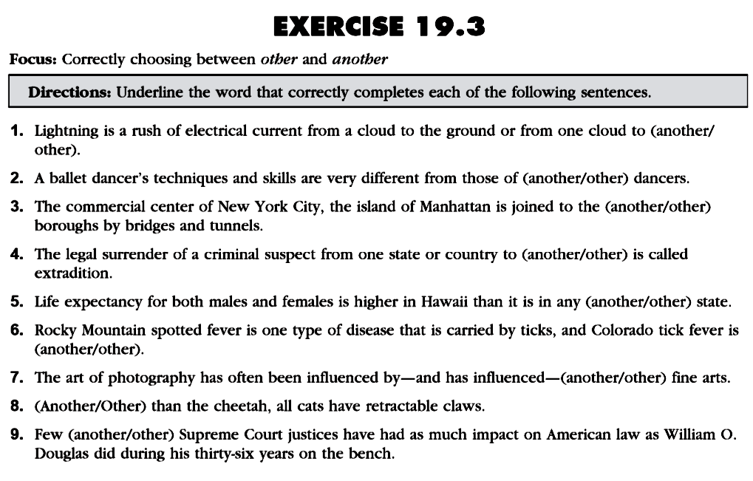
another+singular noun
other+plural noun
determiner+other+sg/pl noun

Slide 23
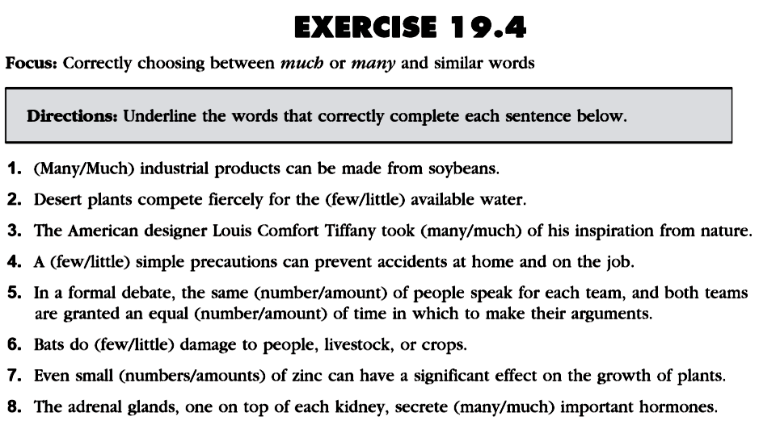
many/(a) few/number
→plural countable noun
much/(a) little/amount
→uncountable noun

Slide 24
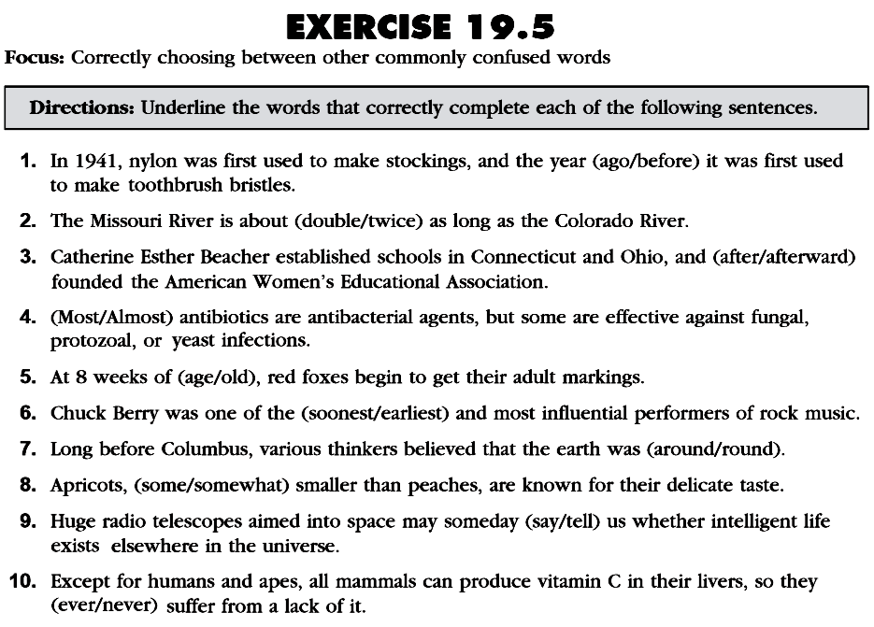

Slide 25
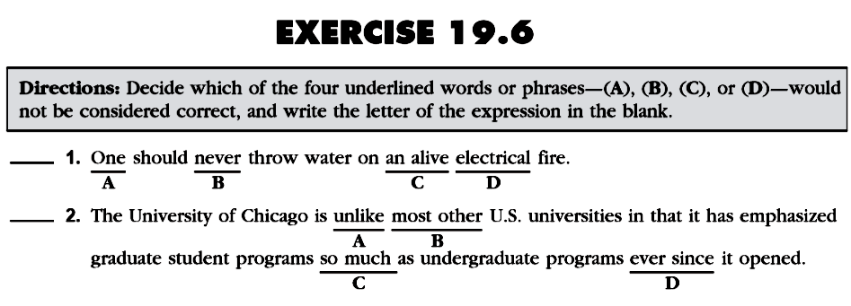
Page 89
a live
= not like
as much as
nearly
Do the rest (+additional questions)
for your exercise as a quiz ONLINE.

Slide 26
Please review again at home,
and
do the quiz/exercise online.
See you next time…

