Slide 1
2b. HOW and WHY of RESEARCH
Quantitative Research
© Yosa A. Alzuhdy, M.Hum.
yosa@uny.ac.id
English Language and Literature Study Program
Yogyakarta State University

Slide 2
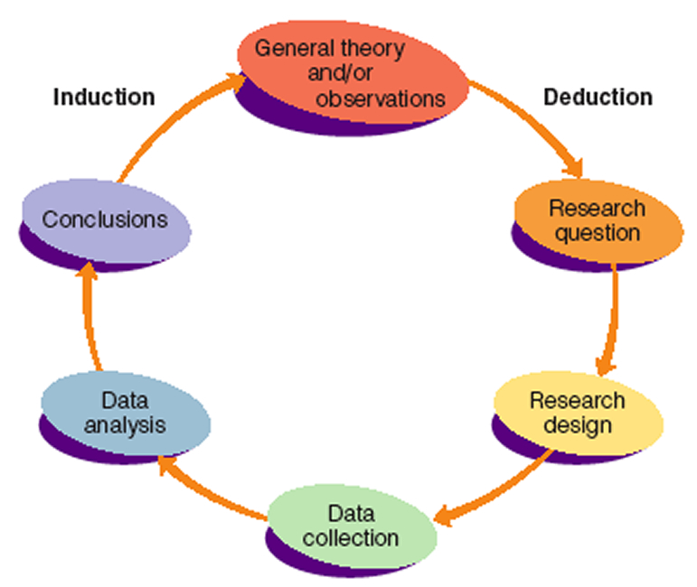
Research Process

Slide 3
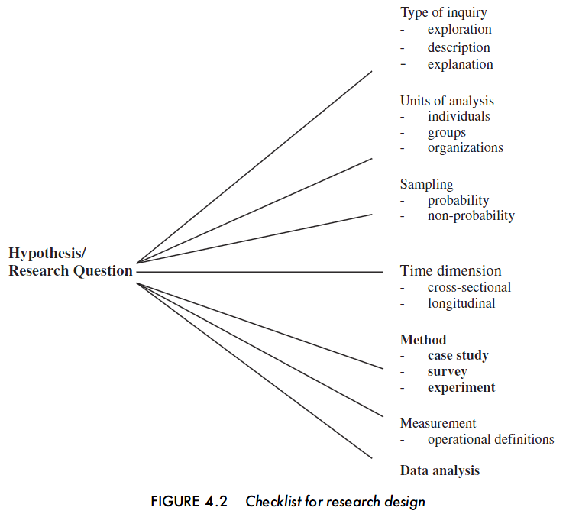
Checklist for Research Design

Slide 4
HOW? Research Strategy
QUANTITATIVE RESEARCH STRATEGY
  Experimental Research
  Descriptive and Correlational Research
  Survey Research
    One-Shot Design
    Longitudinal Design
    Cross Sectional Design
    Repeated Independent Samples Design

Slide 5
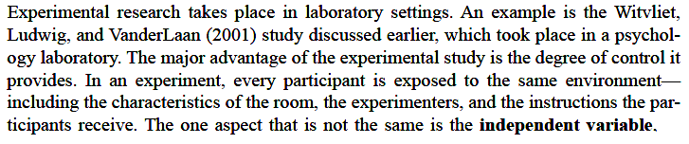
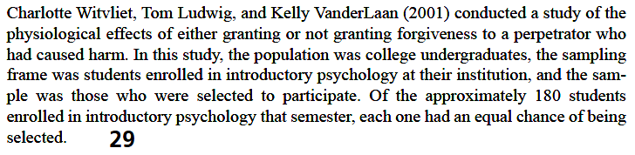
Experimental Research
Takes place in laboratory settings.

Slide 6
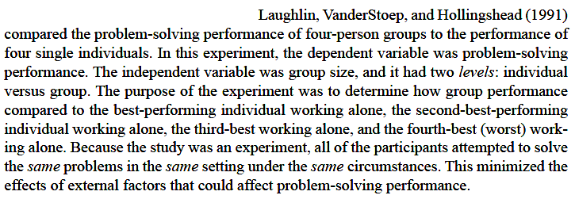
Experimental Research
Independent variable: the variable that is systematically controlled by the researcher to determine the effect of that variable.
Dependent variable: the outcome which the researcher is measuring. (the result)
e.g. How problem solving performance is different in groups of four people and in individuals.
Dependent: problem solving performance
Independent: group size: four-person and individuals

Slide 7
Experimental Research
Looks at cause-and-effect relationships
Highly controlled, objective, systematic studies
Involves the measurement of independent and dependent variables
Main characteristics:
  Controlled manipulation of at least one independent variable
  Uses experimental and control groups
  Random assignment of the sample to the experimental and control groups

Slide 8
Quantitative Research
Formal, objective, rigorous, systematic process for generating information
Describes new situations, events, or concepts
Examines relationships among variables
Determines the effectiveness of treatments
Descriptive
Correlational
Quasi-experimental
Experimental
Increased
control
with type
of study

Slide 9
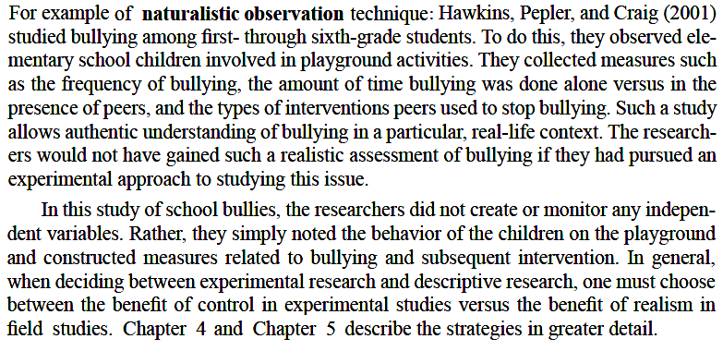
Descriptive Research
Describes attitudes & behaviors observed during investigation
Explore & describe phenomena in natural, real-life situations
Include Naturalistic observation: collecting data where people are ordinarily found
New meaning is likely to be discovered and the description of concepts is accomplished
Helps to identify relationships
In terms of control, Naturalistic Res >< Experimental Res
Quasi-Experiment falls somewhere in between: conducting an experiment, usually in real-life setting, without the benefit of random assignment of participants to conditions or other controls → correlational research identifying statistical relationships between two variables rather than causal relationships.

Slide 10
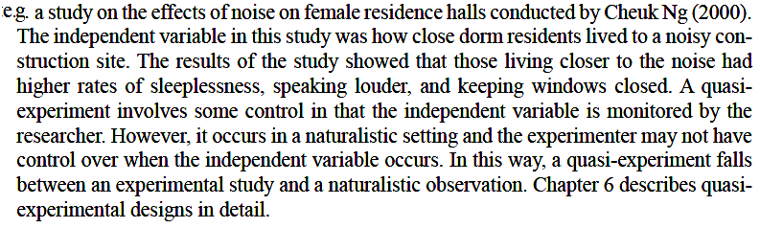
Quasi-experimental Research
Somewhat cause-and-effect relationships, but more on statistical relationships between two variables
Real life settings rather than laboratory settings
Less control by researcher than true experimental designs
Control over independent variable, no control over other factors in the environment
Samples are not randomly selected.

Slide 11
Correlational Research
Looks at the relationship between two or more variables
Determines the strength and type of relationships
Explains what is seen
No cause and effect

Slide 12
Control in Quant. Res
Type of Quant Research | Researcher Control | Research Setting
Descriptive | Uncontrolled | Natural or partially controlled
Correlational | Uncontrolled or partially controlled | Natural or partially controlled
Quasi-experimental | Partially controlled | Partially controlled
Experimental | Highly controlled | Laboratory

Slide 13
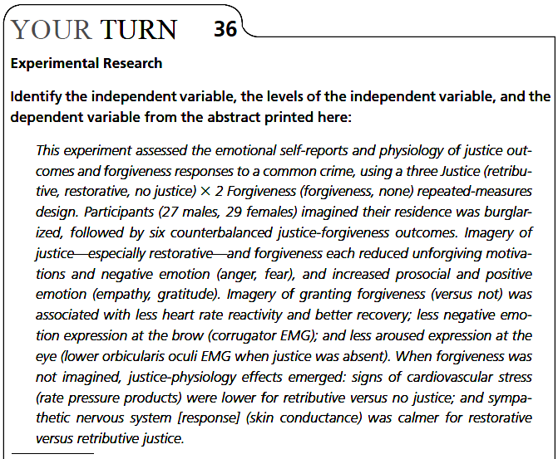
Assignment: page.36
Write your answer using MS-Word.
Use Task3-<YourName>.doc as the file name.
Upload via Be-Smart within 5 days.

Slide 14
Survey data
Collecting data from a large group of people
Data are obtained when individuals respond to questions asked by interviewers or when the individual responds to questions that he has read
May include quantitative and qualitative information
Census (all population) or sample
Sometimes use secondary data analyses: data analysis on previously collected data

Slide 15
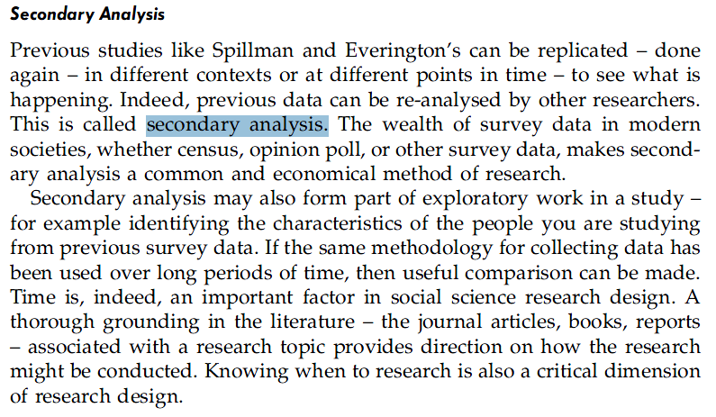
Secondary Analysis

Slide 16
Types of Designs
Concerning the frequency of data collections:
One-shot design
Longitudinal design
Cross-sectional design
Repeated-independent design

Slide 17
One-Shot Design
Take data from one group of participants only once.
Can be:
Surveys
Experiments
Field studies
Example of a one-shot longitudinal study: [p.38 below] Inman, McDonald, & Ruch (2004) asked participants to complete a creativity test; participants then were given one of three randomly assigned feedbacks about their creativity. In other words, the independent variable was type of feedback, and it had three levels.

Slide 18
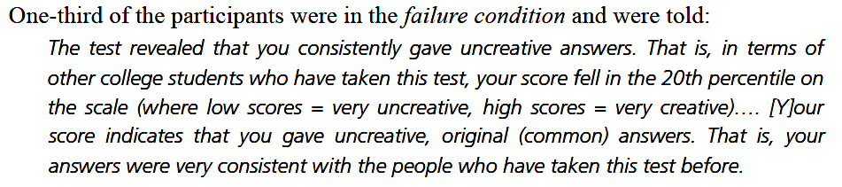
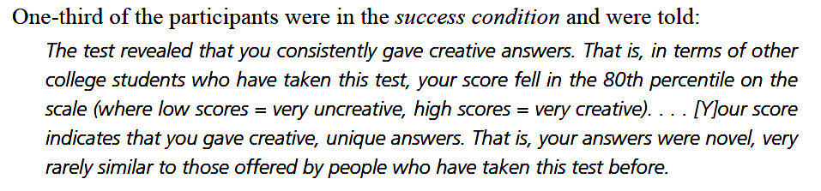
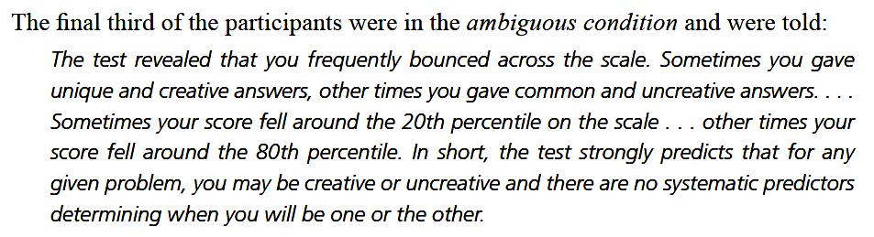

Slide 19
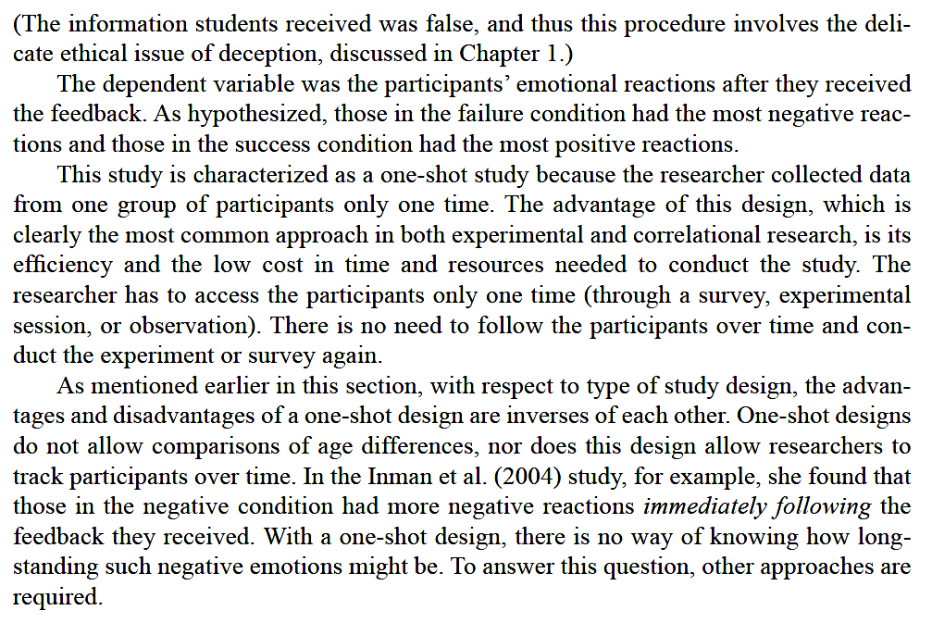

Slide 20
Longitudinal Design
Studies the same people over multiple data-collection periods.
Attrition: the dropping out of participants over time in a longitudinal study.
Using the same people over time → can be quite confident that the independent variable is at least partly causal on the dependent variable.
Require immense cost in terms of time and money.

Slide 21
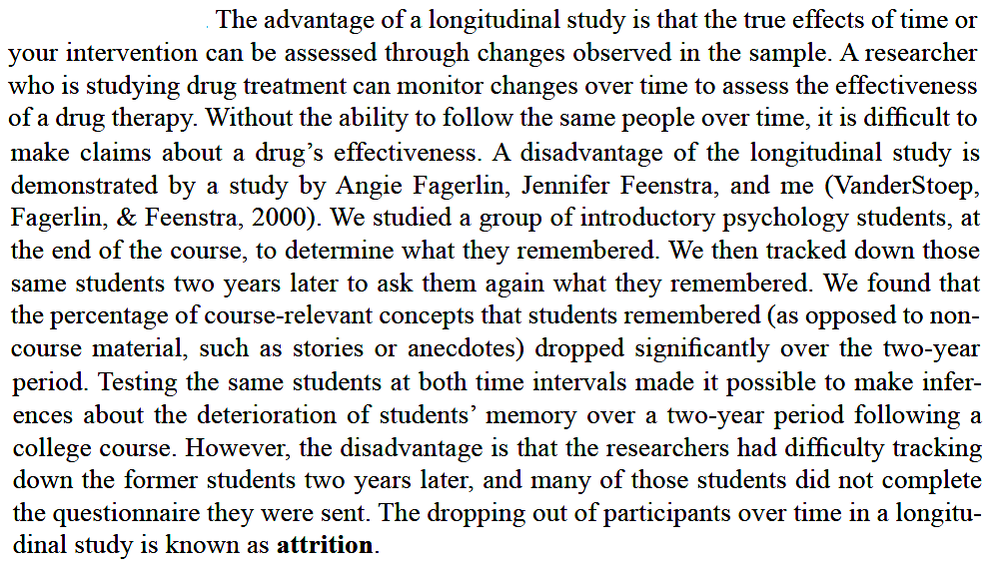

Slide 22
Cross-Sectional Design
Studies several different groups of people of different ages to compare whether age differences exist in the behavior or attitude being studied.
The most effective way to identify the age at which certain social and psychological factors occur.
Cohort effects, and not maturation, may cause the differentiation.
A cohort effect arises when the finding that is thought to be due to the independent variable is in fact due to some generational differences in the sample. (p.40)

Slide 23
Repeated-Independent Design
Investigates a different sample of people over repeated trials to track changes in behavior or attitudes.
Better to employ repeated samples to track changes over time.
Can get a type of longitudinal data without keeping track of all the original research participants, so may eliminate the risk of attrition.
Does not track the same people over time.

Slide 24
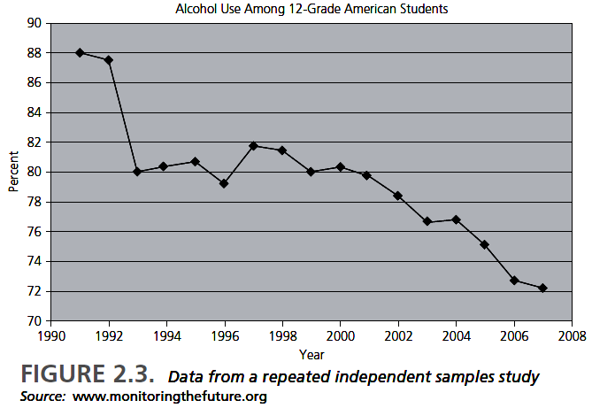
p.42

Slide 25
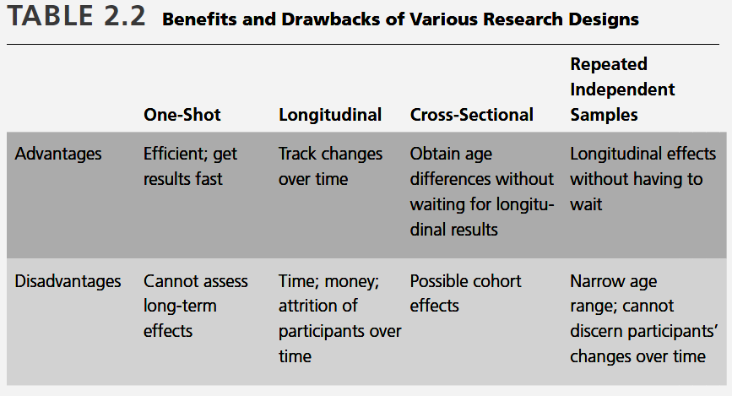
Survey types compared

Slide 26
QUALITY, WHY?
Research that makes a difference
  Basic Research: Inform Future Development
  Why should others be interested in this topic?
  Applied Research: Inform Policy and Planning
  How the outcome of research will differently influence the decision taken by and practice of a certain institution/ organization.

Slide 27
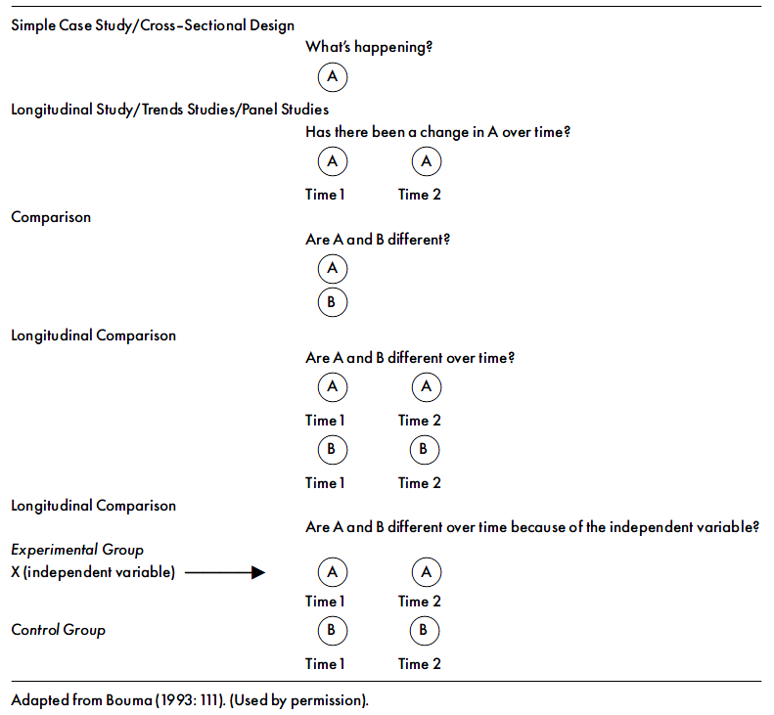
Time and Research Design

Slide 28
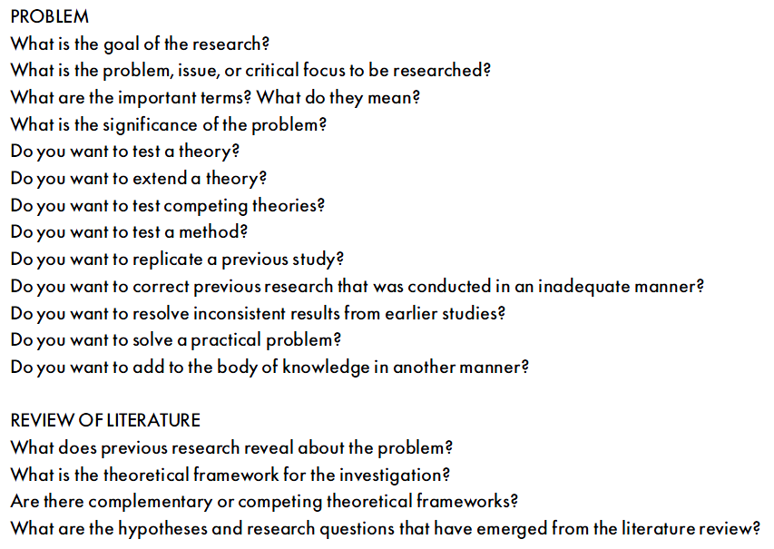
Organizing a Qnt. Res. Study -1

Slide 29
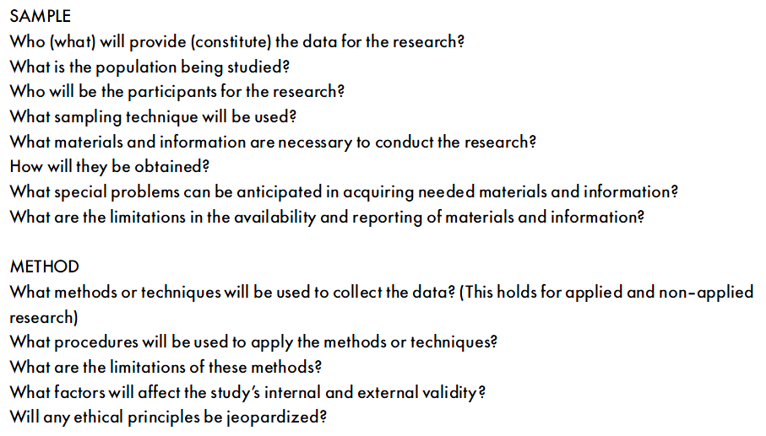
Organizing a Qnt. Res. Study -2

Slide 30
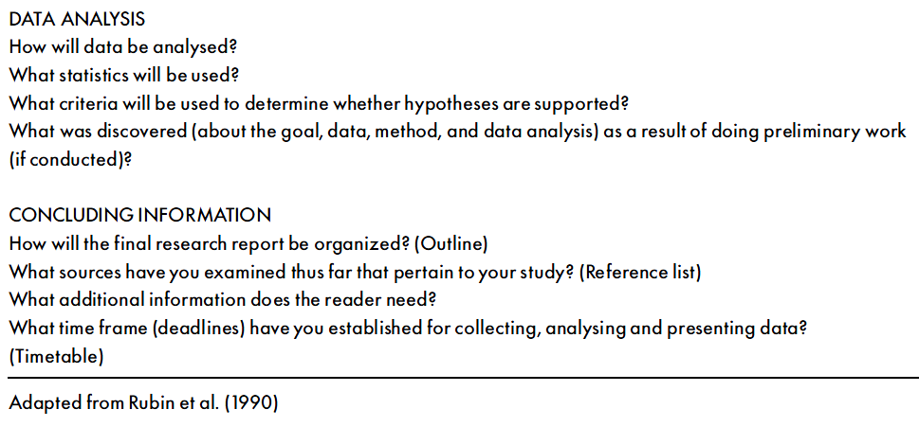
Organizing a Qnt. Res. Study -3

