Slide 1
Subject + Verb
Basic English Sentences
© Yosa A. Alzuhdy, M.Hum.
Introductory Course
Yogyakarta State University
yosa@uny.ac.id

Slide 2
Sentence Main Elements:
Auxiliary Verbs
(+do, does, did)
Various types of Verbs
Simple Present Tense
Past Tense (sama untuk seluruh Subject)
Vb+complement:
Kalimat Nominal
(non-action)
Optional:
+ Objects
+ Adverbs
Frequency
Manner
Place
Time
Purpose
Reason
Degree
Sequence
etc
Continuous/sedang berlangsung
Passive (Subj dikenai tindakan)
Keharusan/kepastian/fungsi
Verb dalam
bentuk dasar
Simple Present/Past (mempunyai)
Perfect tenses (sudah)
Keharusan/kewajiban

Slide 3
1: SUBJECTS and VERBS
All sentences must have Subject + Verb as the basic elements.
Some of the information is incorrect.
Members of our parliament support the RUU.
The bus arriving from Bali was 2 hours late.
He always comes on time to every meeting.
They didn’t like the busy schedule.
Subject and Verb CANNOT BE DOUBLED in a sentence.
The old man he went to Medan.
The train was running fast came towards them.
Except in compound or complex sentences:
The man and his three children were running towards her.
She phoned me and cried but didn’t say anything at all.
Return

Slide 4
Changes of VERBS
Stem Vb
STUDY
OPEN
WRITE
GO
HAVE
COME
CUT
BE
Infinitive Vb+s/es Vb-ing Vb2 Vb3
to study studies studying studied studied
to open opens opening opened opened
to write writes writing wrote written
to go goes going went gone
to have has having had had
to come comes coming came come
to cut cuts cutting cut cut
to be is/am/are being was/were been
Return

Slide 5
Simple Present Tense
SUBJECT+ Vb1
I You We They + Stem Verb ; He She It + Vb+s/es
All of the students like to come home earlier.
Budi really wants to attend the meeting.
This machine works well to all appliances.
He always goes to campus on foot.
She doesn’t understand this lesson at all.
She go. He is go. He is goes. We goes. They are go.
They to go. She going. He cans go. She always go.
Return

Slide 6
Simple Past Tense
SUBJECT+ Vb2
I You We They He She It + Vb2
All of the students enjoyed swimming.
Budi wanted to join the Students Club.
This machine worked well to all appliances.
He usually went to campus on foot.
She didn’t understand the previous lesson at all.
They didn’t went. She doesn’t goes. I didn’t to go.
Return

Slide 7
Nominal Sentences
Subject + Verb + Complement
Verb → to be : is, am, are, was, were, must be, has been …
or Linking Verbs : become, look, seem, appear, taste, smell
sound, feel, get…
The VERBS are STATIVE, showing situation/condition, NOT activities.
Complement: Adjective, Noun, Adverb
She is an architect.
––––––– ––– –––––––––-––––––––––––
Subj Vb Compl (Noun)
The student seemed upset all day long.
–––––––––––––––––---–––– ––––––––––-––– –––––––––– ––––––––––––––––––––
Subject Verb Comp (Adj) Adverb
Our rector is from the Faculty of Education.
–––––––––––––––––––– ––– –––––––––––––––––––––––––––––––––––––––––––––––––––––––––
Subject Vb Compl (Adverb/Prepositional Phrase)
The boys are new students of Yogyakarta State University.
–––––––––––––––– ––––––– –––––––––––––––––––––––––––––––––––––––––––––––––––––––––––––––––––––––––––––––––
Subject Verb Complement (Noun Phrase)
The soup tastes hot and salty.
–––––––––––––––––– ––-------––––– –––––––––––––––––––––––––
Subject Verb Comp (Adjective)
He works in this office.
S Vb Adv
He is in this office.
S V C:Adv
.✓
…???
… ???
Return

Slide 8
Continuous
To Be + Vb-ing
penekanan pada kejadian yang SEDANG BERLANGSUNG
We are studying English. (Present Continuous)
The student is writing on her book. (Present Cont.)
She was watching TV at 10 last night. (Past Cont.)
They were talking about World Cup. (Past Cont.)
I will not be studying at 10 tonight. (Future Cont.)
He going to Bali. I am study in YSU.
The lecturer was taught us English yesterday.
Return

Slide 9
Passive Structures
TO BE + Vb 3 = Kalimat Pasif
Subject dikenai suatu tindakan (oleh seseorang yang lain)
The news is broadcasted through all channels.
These facilities are provided by the faculty.
Some students weren’t invited to the party.
The letter was written by the Maria.
The children are being scolded for playing truant.
The minister might be reexamined by “Pansus”.
Our assignment won’t be scored before two weeks.
The LCD projector has been turned on by him.
Return

Slide 10
BE + INFINITIVE
TO BE + TO INFINITIVE
Keharusan / Rencana / Fungsi
The champions are to meet the committee.
Mr. Bambang was to go to Bali yesterday.
The assignment is to be submitted by Friday.
This big knife is to cut off the bones.
She was went to Bali. They are study English.
He is feels sleepy. We are bought some fruit.
Return

Slide 11
Modals and Verbs
MODALS + STEM VERB
Harus diikuti bentuk dasar Verb, tidak boleh jenis kata lain.
I will sleep right after this class has finished.
Mahmud can finish the assignment easily.
She must be happy to hear this information.
The girl will be taken into the hospital.
He might not be listening to the music.
You should have submitted your self-identity.
She must crazy. He can going. I would went.
Return

Slide 12
Have-Has-Had = Vb1 / Vb2
HAVE + Noun/Object → sebagai FULL VERB
Disesuaikan dengan Subject (singular/plural) dan Tenses.
That handsome boy has five girlfriends.
The student doesn’t have any pen to write.
We have rice, salad and fried fish for dinner.
She is having lunch at the café.
They were having fun at the party last night.
My brother will have another baby this month.
I had two meetings at the same time yesterday.
He didn’t have anything to pay his debt.
Return

Slide 13
Perfect Tenses
HAVE/HAS/HAD + Vb3 (Past Participle)
Perfect Tenses: sudah selesai (:tidak boleh ada ket.waktu lampau)
We have learned Basic English Sentences.
She has submitted her assignment via BeSmart.
They had not arrived home when I came.
The girl has been waiting here for 3 hours.
Her sister has been in Paris since last year.
His motorcycle has been sold to pay his debt.
The boy must have studied hard to do the task.
The boy studied hard to do it last night.
Return

Slide 14
HAVE TO = MUST
Have to = Must // Don’t have to ≠ Mustn’t
Keharusan / Keyakinan / Kepastian
She has to come home tomorrow.= She must come..
We have to wait for him. = We must wait …
They had to sign up for BeSmart last week.
You should have to be able to access it by now.
She doesn’t have to come home now. (optional)
She can come now, or tomorrow, or at another time.
≠ She mustn’t come home now. (prohibition)
She cannot come home now. She may come another time.
Return

Slide 15
SUBJECT and VERBS
See the example :
Notice immediately the VERB: … was ringing …
but there is NO SUBJECT.
Subject: NOUN, PRONOUN, NOUN PHRASE/CLAUSE, VERB-ING, TO-INF.
The verb starts with a singular to be: WAS, so the Subject must be SINGULAR
→ The answer is C: The phone (singular noun).
_______ was ringing continuously for hours.
(A) Loudly
(B) In the morning
(C) The phone
(D) The bells

Slide 16
OTHER EXAMPLES
Missing VERB…
The only verb in options is B: are delivered (in the passive form).
Missing Predicate… Remember that Verb-ing cannot be Predicate directly, but should be preceded with TO BE → Continuous.
A: double subject; B: double subject; C: double Verb-ing D: Correct (future)
Newspapers _______ every morning and every evening.
(A) delivery
(B) are delivered
(C) on time
(D) regularly
The plane _______ landing at the airport in five minutes.
(A) it is
(B) it really is
(C) is descending
(D) will be

Slide 17
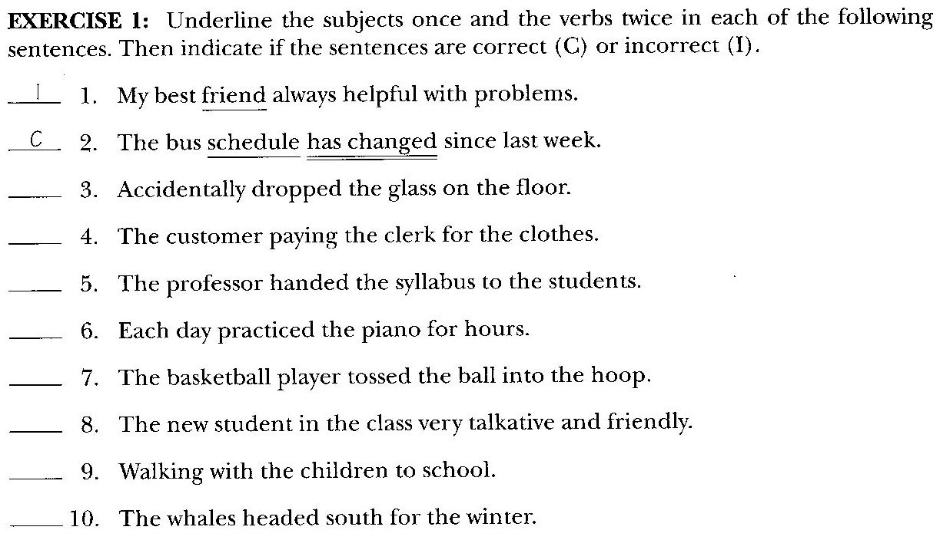
missing Verb: is; has always been; etc.
I
missing Subject: He
I
missing verb: paying → was paying; paid; must pay; etc
C
I
missing Subject: she; he; etc
C
I
missing Verb: is; was; seems; might be; etc.
I
missing Subj+Vb: He is; We are; etc. Or: Add Vb: Walking..is fun, is exhausting, etc.
C
Return

Slide 18
OBJECTS of PREPOSITIONS
Objects of prepositions are adverbs or complements of the sentences, and CANNOT function as SUBJECTS, although it contains Nouns.
For more than ten years she has been expecting her husband’s return.
Under the table lies the missing book. = There lies the missing book.
The missing book lies under the table. / The missing book lies there.
Example:
Notice that To Mike cannot be subject because it is preceded by to → Object of Preposition; functions as adverb.
There is a Verb (was a big surprise), so we should find SUBJECT.
Subject: NOUN, PRONOUN, NOUN PHRASE/CLAUSE, VERB-ING, TO-INF.
Answer → B: the party.
To Mike _______ was a big surprise.
(A) really
(B) the party
(C) funny
(D) when

Slide 19
OTHER EXAMPLES
There is a subject (Homo Sapiens), but there is NO VERB.
There is a verb/predicate (replaced), but NO SUBJECT.
Homo Sapiens _______ about 40,000 years ago.
(A) their first appearance
(B) first appeared
(C) first appearing
(D) they first appeared
_______ replaced the Franklin half dollar in 1964.
(A) The Kennedy half dollar
(B) The half dollar featured Kennedy
(C) On the Kennedy half dollar
(D) The Kennedy half dollar that
With his friend _______ found the movie theater.
(A) has
(B) when
(C) later
(D) he

Slide 20
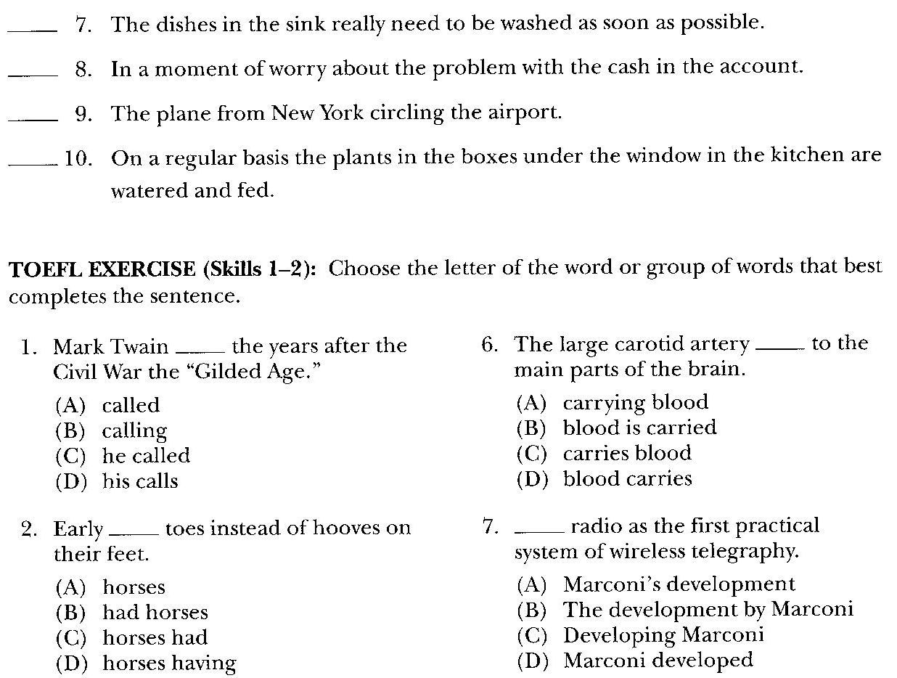
C
I
missing Subject+Verb: e.g. She was thinking
I
Missing Verb: is; was; might be; should not be; etc
C

Slide 21
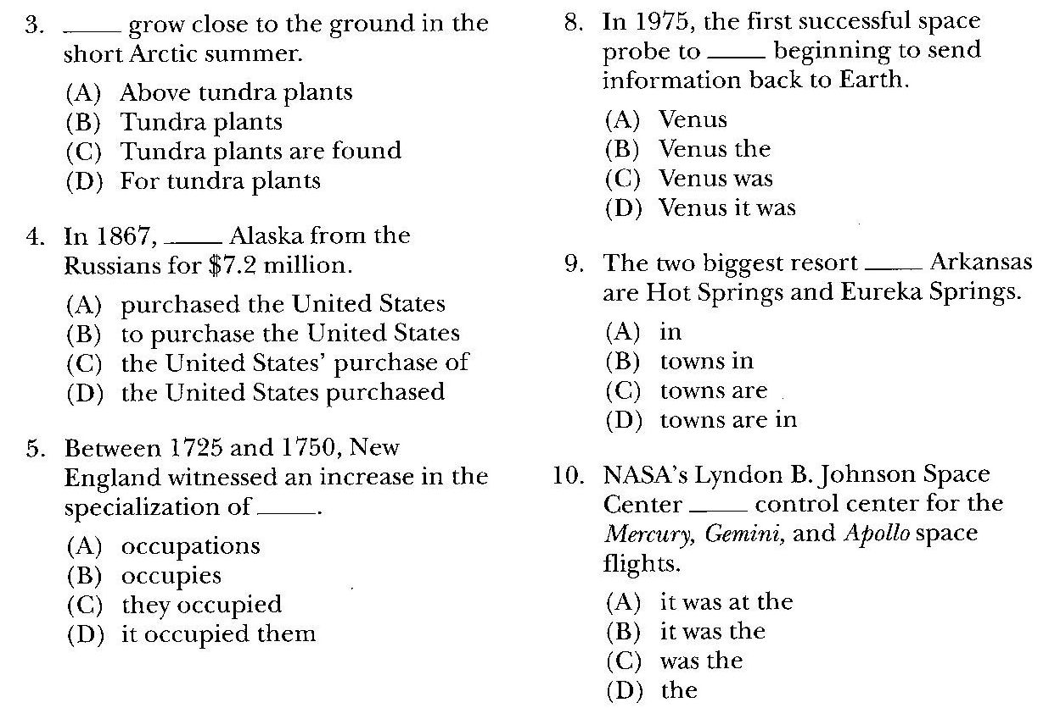

Slide 22
Thank you!
PRACTICE AGAIN
the exercises in the book
at home…

