Slide 1
Stress & Intonation
Listening I
© Yosa A. Alzuhdy, M.Hum.
yosa@uny.ac.id
English Language and Literature Study Program
Yogyakarta State University

Slide 2
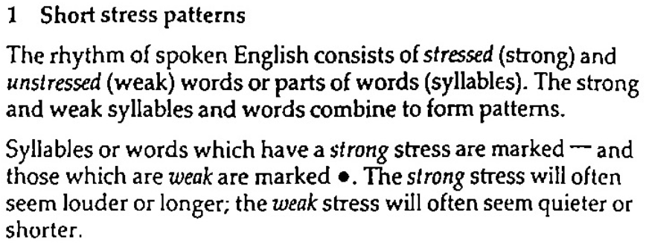
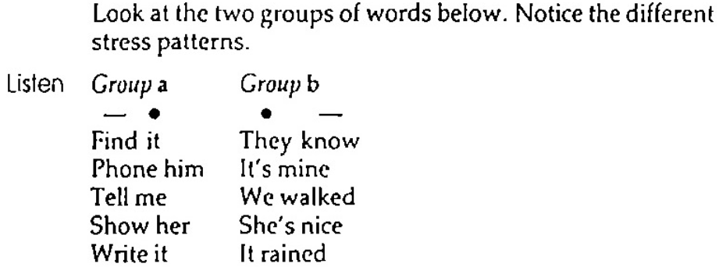
p.17 Stress and Intonation

Slide 3
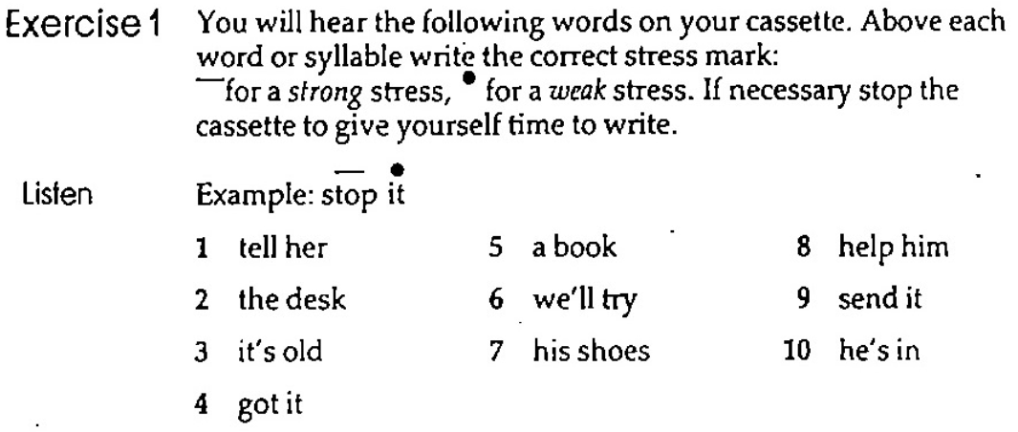
p.17 Short Stress Patterns
― ●
● ―
― ●
● ―
● ―
― ●
● ―
● ―
● ―
― ●

Slide 4
p.17-18 Short Stress Patterns
a
― ●
b
● ―
sell it
they walk
______________________ _______________________
______________________ _______________________
______________________ _______________________
read them
she‘s out
he knows

Slide 5
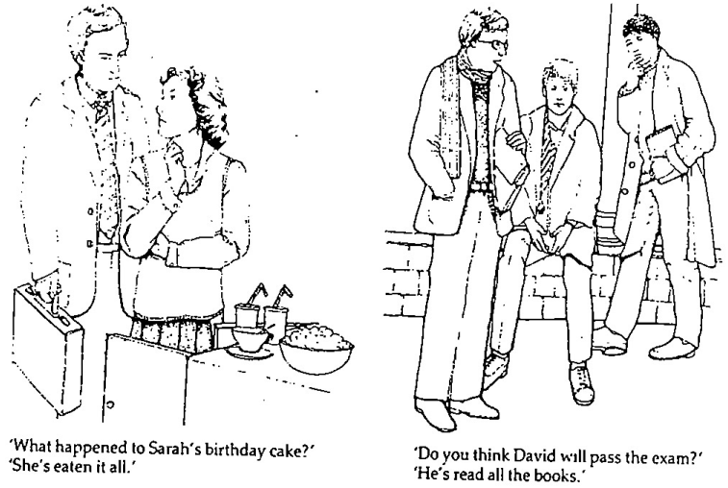
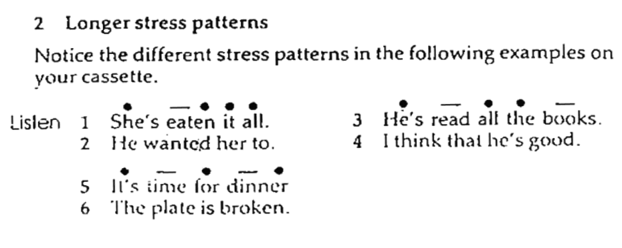
p.18 Longer Stress Patterns

Slide 6
p.19 Longer Stress Patterns
―
―
―
―
―
―
―
―
―
―
―

Slide 7
p.19 Noun Stress

Slide 8
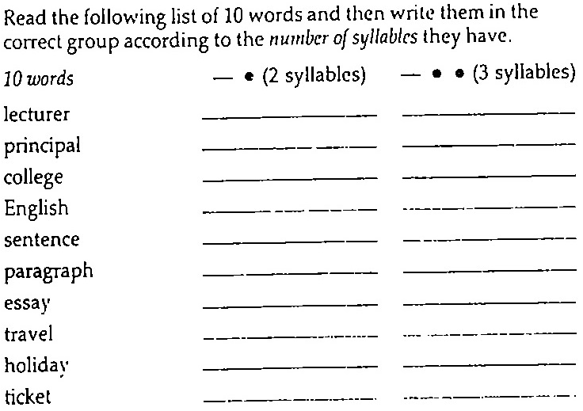
p.19 Exercise 4
lecturer
principal
college
English
sentence
paragraph
essay
travel
holiday
ticket

Slide 9
4. Variable Stress
a. The strong stress may be on the other syllables, not always on the first syllable.

Slide 10
b. When the words of related meaning (derivational words) change their grammatical form (e.g.: Noun to Adjective) , the stress pattern may change.

Slide 11
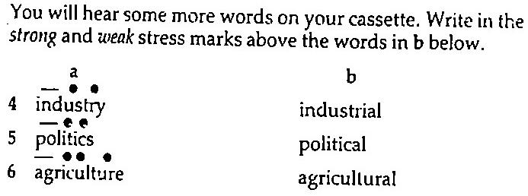
Exercise 5
● ― ● ●
● ― ● ●
● ● ― ● ●

Slide 12
5. Verb Stress

Slide 13
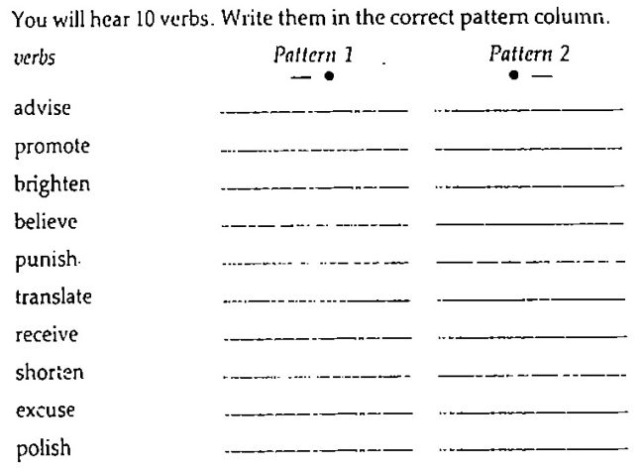
Exercise 6
advise
promote
brighten
believe
punish
translate
receive
shorten
excuse
polish

Slide 14
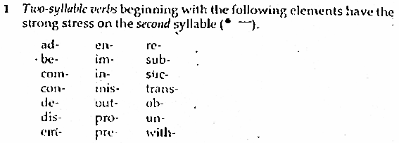
Note on Stress

Slide 15
6. Noun and Verb Stress

Slide 16
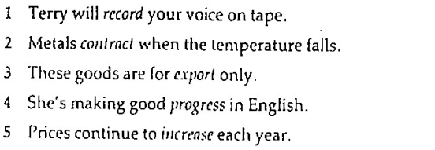
6. Noun and Verb Stress
―
→Verb
―
→Verb
―
→Noun
―
→Noun
―
→Verb
―
―
―
―
―
―
―
―
―
―

Slide 17
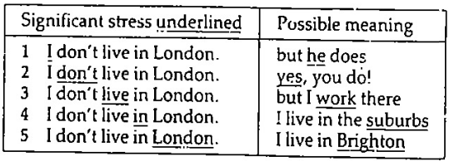
7. Significant Stress

Slide 18
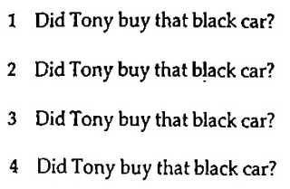
Exercise 9
___
___
__
__

Slide 19
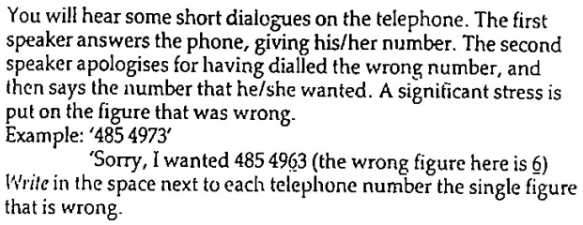
Exercise 10a
8
5
1
2
4
0

Slide 20
Exercise 10b
804 1213
372 4061
507982
a. ___________ b. ___________ c. __________
d. ___________ e. ___________ f. __________
435 7957
760 0846
193 5274

Slide 21
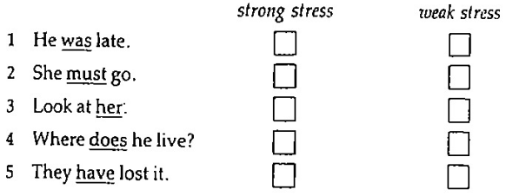
8. Essential Weak Stress Forms
Exercise 11
✓
✓
✓
✓
✓

Slide 22
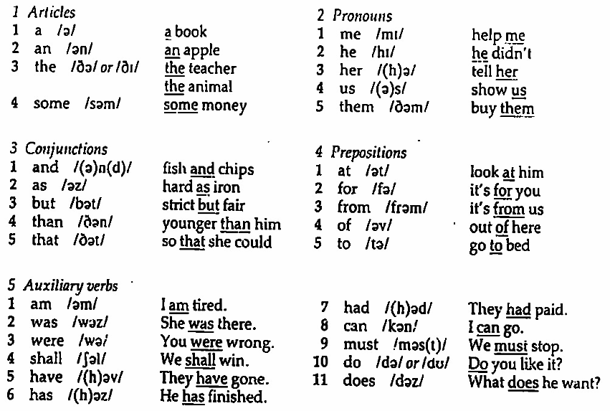
8. Essential Weak Stress Forms

Slide 23
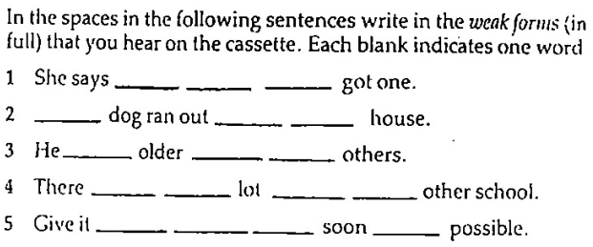
Exercise 12
that
he
has
A
of
the
was
than
the
were
a
from
the
to
them
as
as

Slide 24
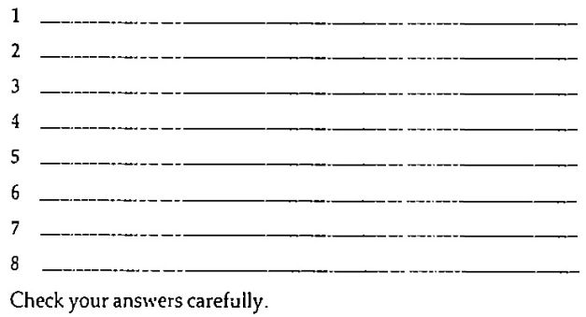
Exc.13 Revision: Dictation
_
__
Where has he gone?
__
__
They are brother and sister.
___
_
_
Give them another week to finish.
_
__
_
___
I asked her to buy me some bread.
__
_
He said that he can do it.
__
_
What have they got to do?
_
__
_
When can she call for a new one?
__
__
He was away from work last week.

Slide 25
That’s all for today…
See you next week!

Slide 26
9. Intonation Patterns
Exercise 14

