Slide 1
Sentence Elements: Some PARTS of SPEECH
Basic English Sentences
© Yosa A. Alzuhdy, M.Hum.
Introductory Course
Yogyakarta State University
yosa@uny.ac.id

Slide 2
NOUNS
Noun : Kata benda → merunjuk pada sesuatu atau seseorang.
Noun phrase → dua kata atau lebih berfungsi sebagai noun
Noun clause → bagian kalimat (mengandung subject dan verb),
yang berfungsi sebagai noun.
Noun/Noun Phrase/Noun Clause digunakan utk :
Subject → Cars are very expensive nowadays.
One of my brothers sent me the telegram a week ago.
What she gave to the counselor will be kept confidential.
Object → They will send money as soon as possible.
The security guard himself caught the naughty boys.
She recorded whatever you said in the meeting.
Complement → My mother is a housewife.
We are new students in YSU School of Graduate Studies.
After preposition → one of my brothers…, said to the manager
You can rely on anybody chosen in the general election.

Slide 3
VERBS
Verb : kata kerja→ kegiatan, tindakan, aktivitas fisik, atau mental.
Verb sebagai PREDIKAT harus SESUAI dg SUBJECT: singular/plural
Atau bila ada keterangan waktu tertentu → harus SESUAI dg TENSES
Jk tak ada verb yang menunjukkan activity, PREDIKAT → TO BE (is/am/are/was/were, etc.)
Bila Subject Noun Phrase, cari INTI Phrase tsb untuk Predikat.
My father and mother usually go to work together.
The young, lovely, and talkative woman has just finished her undergraduate study.
One of my friends in Jakarta is coming to our dorm tomorrow.
The collection of the books is moved from the reference section.
Some books in the library are not allowed to be taken out.

Slide 4
S-V Agreements
1. One of the sick children ______ taken to Sarjito Hospital.
2. The woman _____ is reading a magazine in the corner.
3. There ______ absent in today’s class.
4. Seldom in history _______ the election without any jealousy.
5. Each of the students ______ in the classroom.
6. Singing the country songs ______ happy.
is, was, can be, has already been, should have been
who gave me flowers, wearing a red hat, he married
is a student, are some boys, might be several girls
has a newcomer won, have two candidates won
is busy writing, has prepared a surprise gift, might be
always makes her, will make us all, can’t make him
[can bring happy feeling, may give you happyiness]

Slide 5
Beberapa ketentuan untuk VERB
 TO BE + Vb-ing → progressive (sedang melakukan kegiatan)
She was reading the weekly report when the boss called her.
I will be watching Super Deal on ANTV tomorrow at 7.30 pm.
 TO BE + Vb3 → Passive meaning (di- atau ter-)
The victims were taken to the hospital soon after the accident.
 TO BE + to-infinitive → keharusan, kewajiban, atau rencana
The secretary is to meet the director immediately.
➔ TO BE tidak bisa diikuti bentuk Verb yg lain (Vb2, Vbs/es)
* My children are go to picnic tomorrow. → will go / are going
* The students were went to Bali before the earthquake. → went
* The man is visits the counselor twice a week. → visits
Usahakan menguasai perubahan Irregular Verb
see – sees – seeing – saw – seen
go – goes – going – went – gone etc.

Slide 6
Beberapa ketentuan untuk VERB
 Modal auxiliary harus diikuti Vb infinitive/be → bentuk dasar
→ can, could, may, might, shall, should, will, would, must
I will be watching Super Deal on ANTV tomorrow at 7.30 pm.
They might agree to finance this project if you bring the data.
 have/has/had + Vb3/been → menyatakan sudah terjadi
Our plan has been approved by the Marketing Director. (pasif)
 PREPOSITION harus diikuti oleh Noun atau Verb-ing.
I am not interested in world history.
I am always interested in going to new places.
 Verb TIDAK sebagai Predikat bisa banyak variasinya.
He needs to get more assistance due to the natural disaster.
My father enjoys watching the cartoon on TV with his children.
She always helps me solve the problems that I have at school.

Slide 7
PRONOUNS
A PRONOUN is a word used to replace a noun or noun phrase.
PERSONAL PRONOUNS:
Subject | Object | Possess. Adj. | Possess. Pron. | Emphatic / Reflexive
I You We They He She It | Me You Us Them Him Her It | My Your Our Their His Her Its | Mine Yours Ours Theirs His Hers - | Myself Yourself / yourselves Ourselves Themselves Himself Herself itself
*Me and my friend are taking a trip. → My friend and I …
*Our neighbors will go to the zoo with you and I. → … you and me.
*I can see the reflection of you and me in the mirror.→…you and myself.
*The students turned in theirs papers. → … their papers.
*I would like to borrow your. → … borrow your book / yours.
*The cookies are for you, so please take it. → … take them.
*Each person has to sign their application form. → … his / his or her …

Slide 8
ADJECTIVES
Adjective : kata sifat → memberi penjelasan pd noun.
Posisi Adjective:
1. adjective + noun → noun phrase
a beautiful scenery some old, expensive bicycles
I have a new watch.
2. Subj + tobe + Adjective → nominal sentence
The weather is hot. This class is clean and cool.
Noun phrase → Noun + Noun a bank manager
adjective some spider tattoos
The young children enjoyed visiting the toy factory.
He was a handsome, rich, easygoing, multi-talented person.
The English lesson is really useful.
The little, smart girl always makes him surprised but happy.
The young children enjoyed visiting the toy factory.

Slide 9
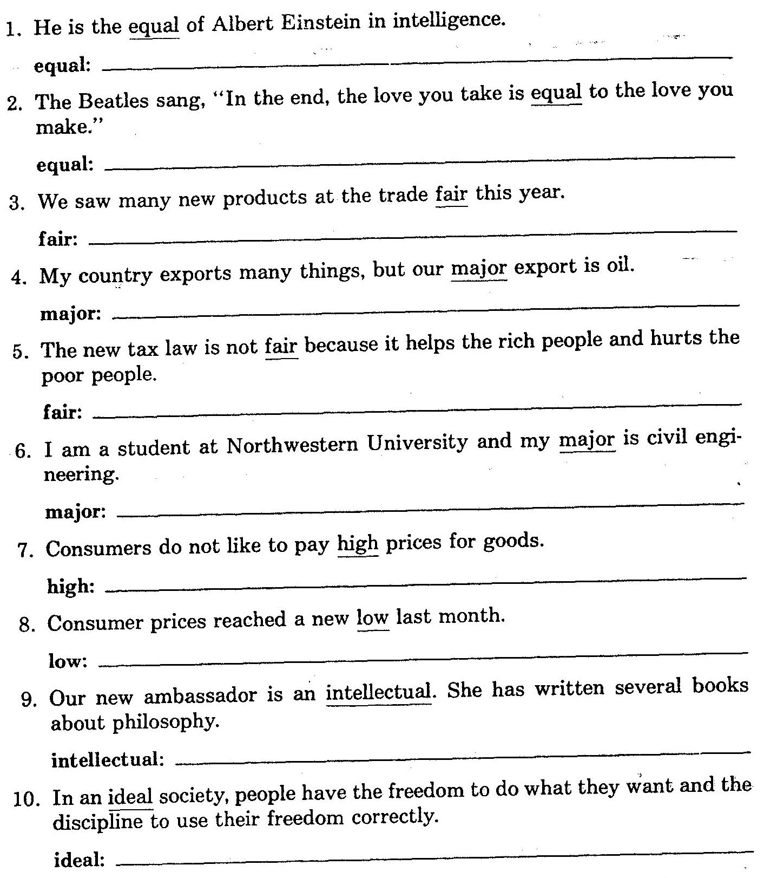
Noun or Acjective? What is the meaning?
[noun] orang yang sebanding
[adjective] setara; sebanding; sama
Noun
or
Adjective?
[noun] pameran
[adjective] utama
[adjective] adil
[noun] jurusan; konsentrasi
[adjective] tinggi
[noun] posisi terendah
[noun] orang yang cerdas; akademisi
[adjective] ideal; sesuai keinginan/harapan

Slide 10
ADVERBS
Adverb : keterangan → menjelaskan verb, adjective, adverb,
Sebagian besar Adverb = Adjective+ly
She is a careful student. →menjelaskan bagaimana ia sbg student)
She always does the exercises carefully. → menjelaskan bagaimana cara dia mengerjakan latihan tsb.
It was an extreme situation. (situasinya yang ekstrim)
Last night the weather was extremely cold. (dinginnya yg ekstrim)
It is really a beautiful bridge. (jembatannya sangat indah)
It’s really a beautifully constructed bridge.(jembatan yg dibangun dengan sangat indah→ hasil membangunnya sangat indah, hebat)
Adverb lain: adv.of frequency, adv.manner, adv.place, adv.time,
They always practice the move carefully behind the stage at night.
frequency Manner Place Time

Slide 11
Adverbs: modify Vb/Adj/Adv
Adverb of Time : when something happens/happened
Adverb of Frequency : how frequently something happens/happened
Adverb of Place : where/in what direction an action occurs/occurred
Adverb of Degree : to what extent an action occurs/occurred
Adverb of Manner : how something is/was done
Adverb of Sequence : in what order things occur/occurred
Adverb of Result : the result or effect of an action
Adverb of Contrast : an idea which is either in contrast to a preceding
one or different from the expected one
Adverb of Reason : the reason or cause of an action
Sebagian Adverb = Adjective+ly (: adverb of manner)
bad- badly interesting-interestingly quick-quickly
slow-slowly happy-happily true-truly
She is a careful student. All of her assignments are always carefully done.
The bad singer is singing the really extremely slow song badly and quickly.
The man looks strange. He always looks at the people around him strangely.
The interesting topic was presented interestingly to the interested audience.

Slide 12
Adverbs of Frequency
Adverb of Frequency (AF): seberapa sering sesuatu dilakukan
Definite AF – di awal kalimat (dg koma) atau akhir kalimat (langsung).
once a week, every month, twice a year, every other day…
Every Tuesday afternoon, they went to the library.
They went to the library every Tuesday afternoon.
Indefinite AF – letaknya: setelah auxiliary yang pertama.
bila tidak ada auxiliary, di antara Subject dan Verb.
always, usually, sometimes, often, seldom, rarely, never…
They should always read the contract before they start the project.
She is often late on Mondays.
My boss will usually be in the office before 7 o’clock.
The report must always have been signed by the manager.
His father sometimes arrives home after midnight.

Slide 13
Comparison of Adjective/Adverb
Positive: as … as (se… / sama …nya dengan)
He runs as fast as the wind. Ia berlari secepat angin.
She writes the report as neatly as the computer.
The manager is as popular as a movie star.
Negative: not as … as (tidak se… / tidak sama …nya dengan)
not so … as (tidak se… / tidak sama …nya dengan)
They cannot do the project as quickly as I expected.
They cannot do the project so quickly as I expected.
My office is not as far as / so far as hers.
His face isn’t as handsome as / so handsome as his picture.
The girl can pay twice as much money as the man.
The girl can pay twice as much money as the man will.
The girl can pay twice as much money as will the man.

Slide 14
Comparison of Adj/Advb
*My house is bigger than you. (incorrect)
My house is bigger than your house.
My house is bigger than yours.
My house is much bigger than that of the young man.
The spirit of the students is often much better than that of the teacher.
The variations in animals is not more complicated than those in plants.
Anita is the cleverest student in our class.
Between Anita and Andy, Anita is cleverer. (not: *the cleverest)
Special format: The (comparative), the (comparative)
The sooner you finish, the better.
The more sophisticated the technology, the more expensive it will be.
The higher the mountain, the harder it is to climb.

Slide 15
Comparison of Adj/Advb
Positive (Normal) | Comparative (lebih…) | Superlative (Paling…)
1-2 suku kata hot, easy, high | Adj/Adv + er … than hotter, easier, higher | the + Adj/Adv + est hottest, easiest, highest
3 suku kata atau lebih difficult/expensive/ carefully | more + adj/adv than more difficult/ expensive/carefully | the most + adj/adv the most difficult/ expensive/ carefully
But: handsome more handsome the most handsome
stupid, polite,
Irregular Comparison:
Good/Well better than the best
Bad/badly worse than the worst
Many/Much more than the most
Little less than the least
Far farther than the farthest (distance)
further than the furthest (progress)
much, far, extremely, a bit, a little, slightly → much prettier, a bit harder, etc…

Slide 16
Some CONJUNCTIONS
Conjunction/Preposition | Function | Possible Translation
therefore, consequently, so, so that, hence | effect/result | oleh karena itu, makanya, jadi, sehingga
because, as, since, for | cause | karena, sebab, lantaran
moreover, besides, furthermore, in addition | addition | selain itu, terlebih lagi, di samping itu
although, even though, though, despite, in spite of | concession, contrast | walau, meski, kendati walaupun, meskipun, kendatipun
however, but, nevertheless, yet, still, howbeit | contrast | namun, (akan) tetapi, meski(pun) begitu, meski(pun) demikian
when, while, as | time relation | ketika, pada saat, sementara
instead, instead of | contrast | sebagai ganti, bukan(nya)
so (adj/adv) that, such…that | cause-effect | [dengan] begitu (…..)nya sehingga
otherwise, or | alternative | atau, kalau tidak
unless, if not | condition | kalau…tidak, bila…tidak, kecuali

Slide 17
ARTICLES
GENERIC NOUNS: A/An or ∅
A cat is a domestic animal.
Cats are domestic animals.
An unexpected gift always brings happiness.
Unexpected gifts always bring happiness.
Fruit is good for our health.
INDEFINITE NOUNS: A/An or Some
She bought a new car last month.
He only ate an apple for today’s breakfast.
I have some friends in Jakarta.
We will tell you some good news.
DEFINITE NOUNS: The
The car she bought was a Jaguar.
The apple was very big.
Thanks a lot for the news.
If you step on an empty can, the can will be ruined.
A generic noun represents a whole class of things, not a specific, real, concrete thing, but more as a symbol of the whole group in general.
Indefinite nouns are actual things (not symbols), but they are not specifically identified, not necessarily referring to “this thing” or “that thing”.
A noun is definite when the speaker and the listener are thinking about the same specific thing, not another thing of the same group, not a different thing.

Slide 18
Expressions of Quantity
Count Noun
many
few / fewer
a few
a / an
number
Count & Noncount Noun
most none of
some any
a lot of no
all
Noncount Noun
much
little / less
a little
amount
Many students have submitted their assignments.
Much of the news on television is not reliable.
Some students are absent in today’s lecture.
Some advice is impossible to be carried out in this situation.
Most of the backyard was covered by the leaves.
Most of the chairs in this room are occupied.
Most of ocean water near the factory is polluted.
Although a number of students have quitted since an amount of wrong information spread out, the total number of our students is increasing.

Slide 19
Expressions of Singular Noun
anybody
everybody
somebody
nobody
anyone
everyone
someone
no one
anything
everything
something
nothing
each + N (sg)
each of +N (pl)
every + N (sg)
Every student is expected to do their own assignments.
Somebody has to clean the whiteboard every morning.
Each room in this building is equipped with an LCD projector.
Each of the LCD projectors has been checked and registered.
Nothing in this world can take me away from her.
Everybody knows the rule but somebody has just broken it.
Each student is suggested to have an account on BeSmart.

Slide 20
Thank you…
Do practice a lot

