Slide 1
Intermediate Structure Determiners
Special Semester 2015-2016
© Yosa A. Alzuhdy, M.Hum.
0815 7887 1437 | 0811 2545 567
yosa@uny.ac.id
English Language and Literature Study Program
English Department
State University of Yogyakarta

Slide 2
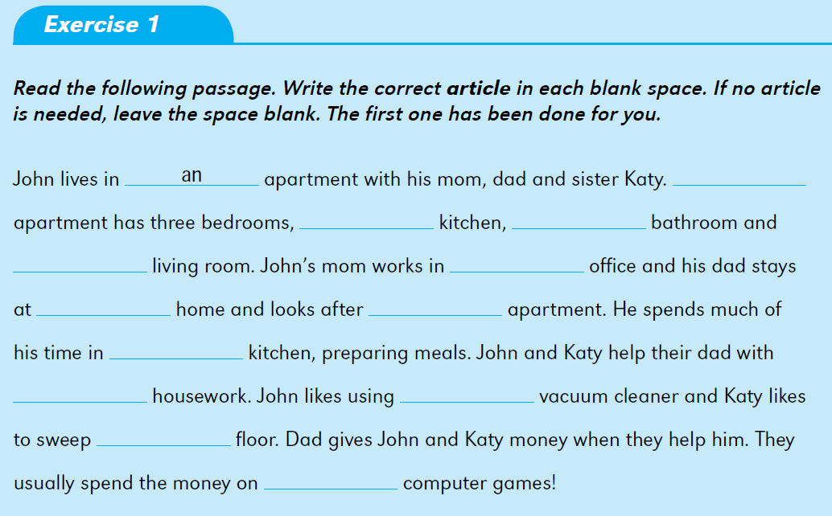
The
a
a
a
an
-
the
the
the
the
the
-

Slide 3
P
Q
P
P
N
P
P
P
D
P

Slide 4
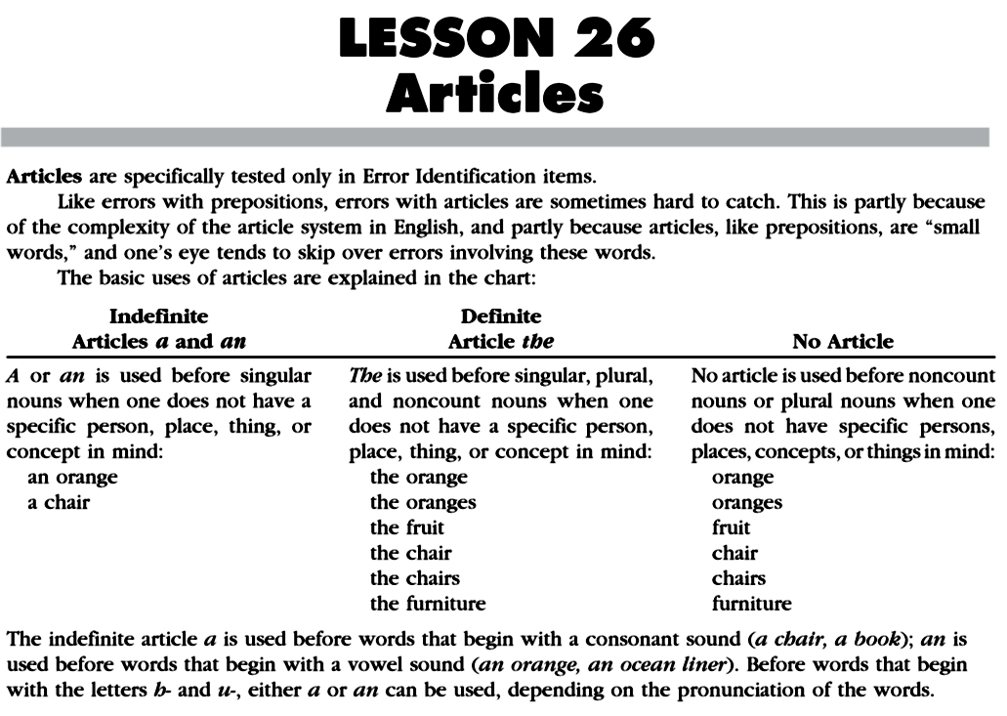
Page 125

Slide 5
ARTICLES
GENERIC NOUNS: A/An or ∅
A cat is a domestic animal.
Cats are domestic animals.
An unexpected gift always brings happiness.
Unexpected gifts always bring happiness.
Fruit is good for our health.
INDEFINITE NOUNS: A/An or Some
She bought a new car last month.
He only ate an apple for today’s breakfast.
I have some friends in Jakarta.
We will tell you some good news.
DEFINITE NOUNS: The
The car she bought was a Jaguar.
The apple was very big.
Thanks a lot for the news.
If you step on an empty can, the can will be ruined.
A generic noun represents a whole class of things, not a specific, real, concrete thing, but more as a symbol of the whole group in general.
Indefinite nouns are actual things (not symbols), but they are not specifically identified, not necessarily referring to “this thing” or “that thing”.
A noun is definite when the speaker and the listener are thinking about the same specific thing, not another thing of the same group, not a different thing.

Slide 6
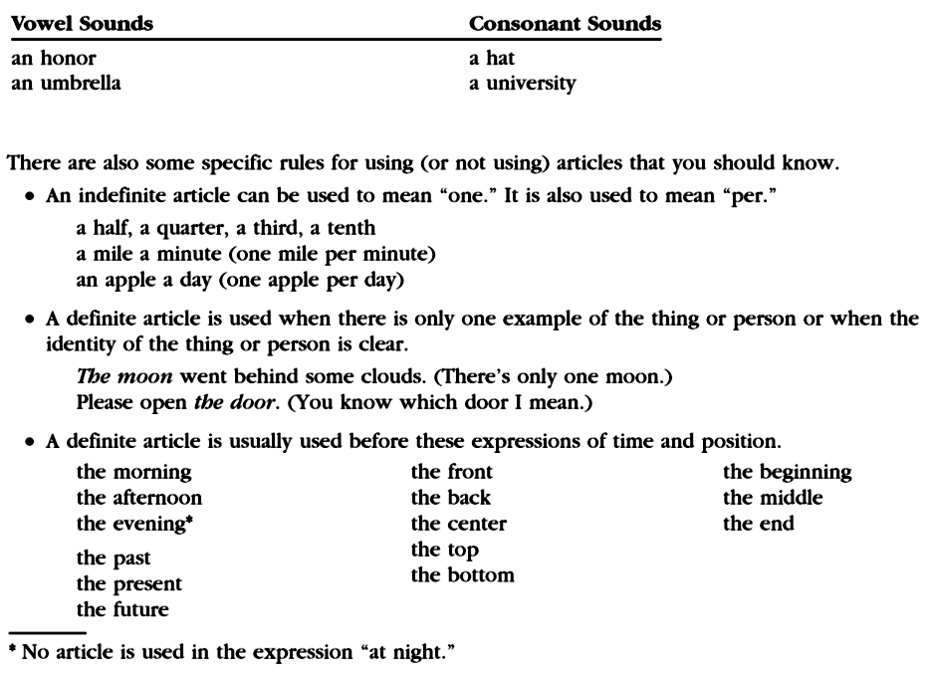
an apple
an imbecile person
an indefinite article
an honest woman
a hotel room
an hour ago
a high building

Slide 7
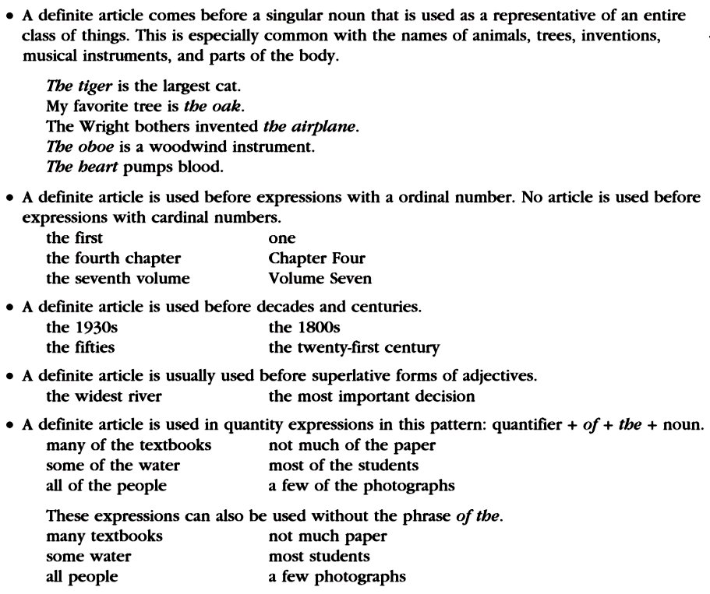

Slide 8
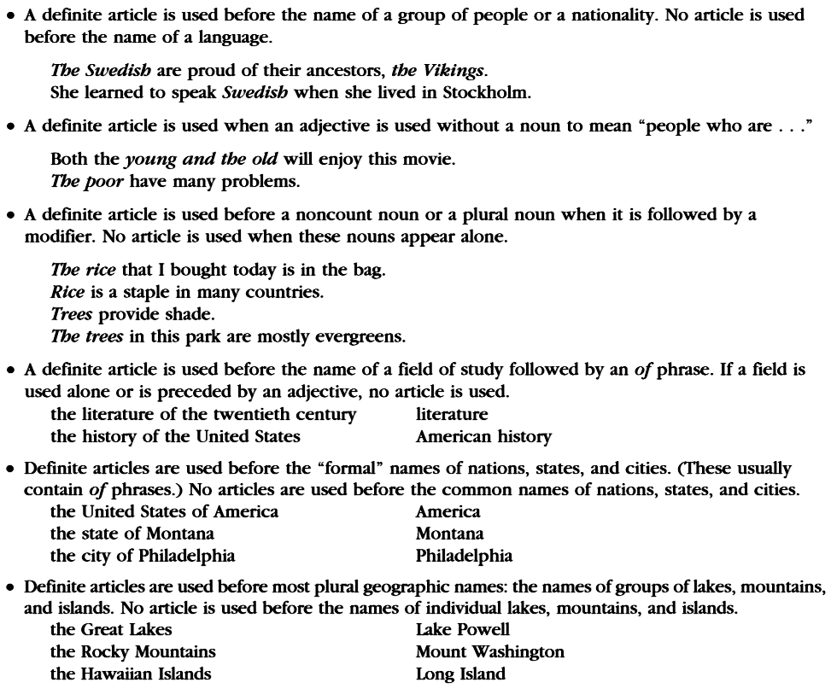

Slide 9
An
the
+the
===
their

Slide 10
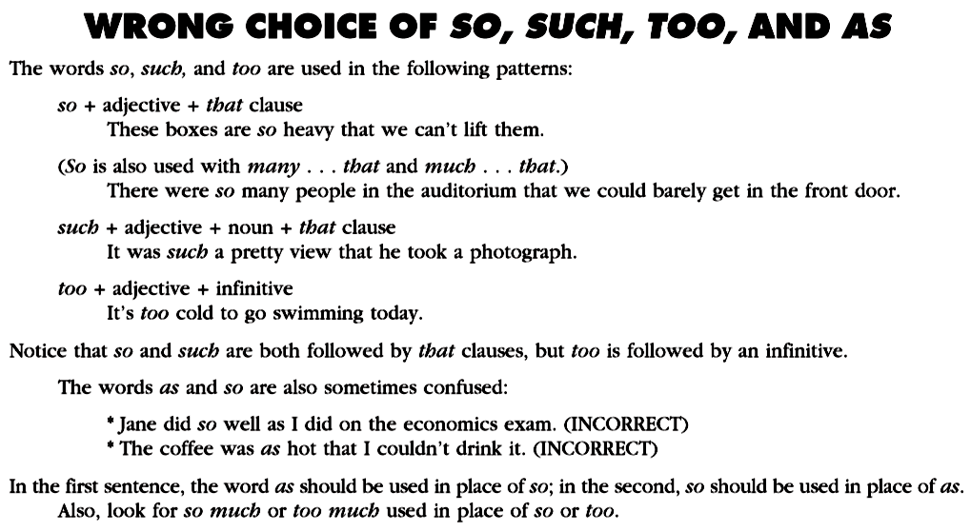
so, such, too, as
as well as
(comparison)
so hot that

Slide 11
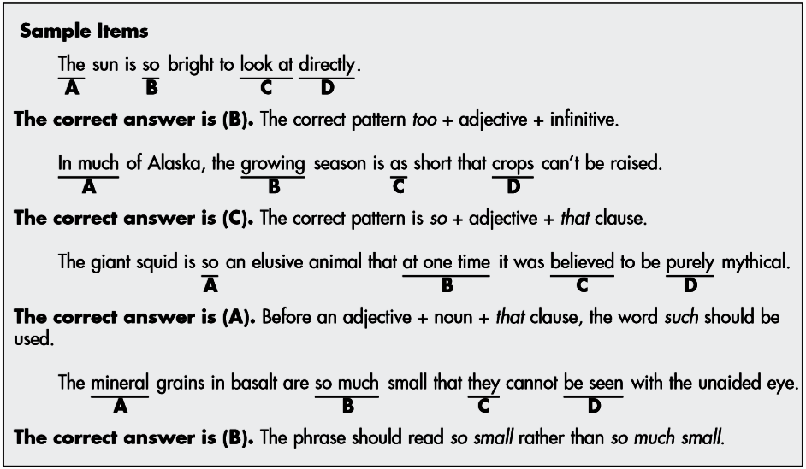
too+adj+infinitive
so+adj+that clause
such+noun(phrase)+that clause
so+adj+that clause

Slide 12
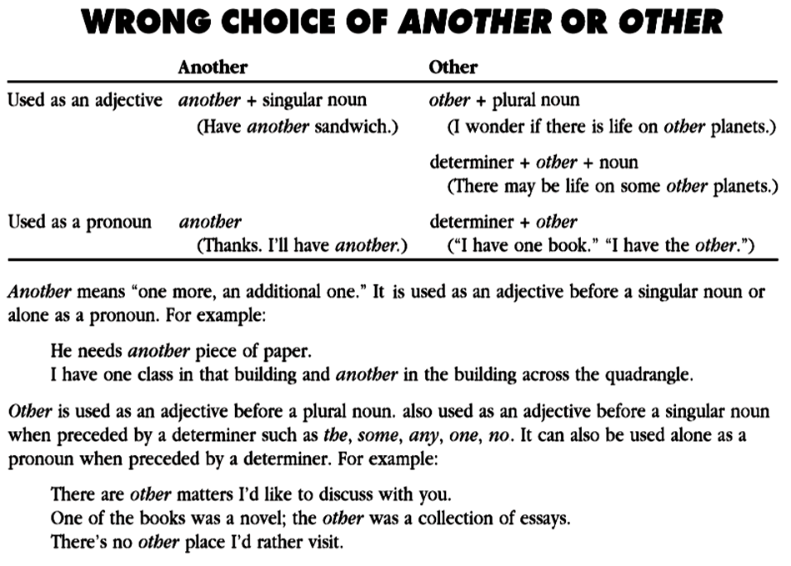
another is never used
after a determiner

Slide 13
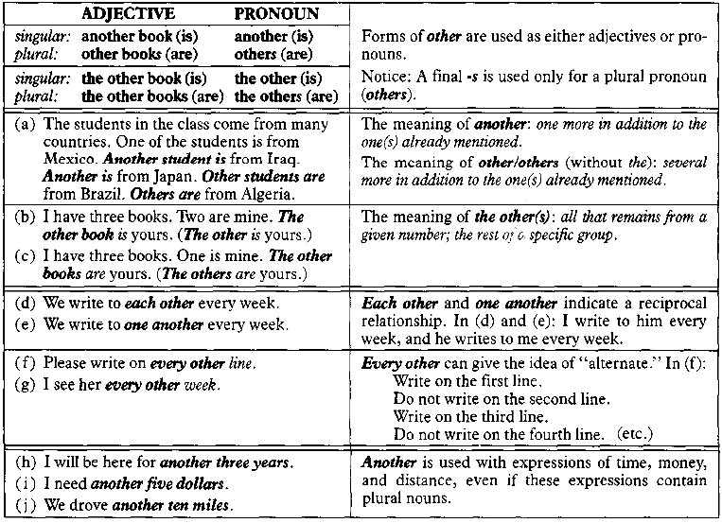
OTHER, OTHERS & ANOTHER
others is never followed by a noun
other + plural noun
another + singular noun

Slide 14
Expressions of Quantity
Count Noun
many
few / fewer
a few
a / an
number
Count & Noncount Noun
most none of
some any
a lot of no
all
Noncount Noun
much
little / less
a little
amount
Many students have submitted their assignments.
Much of the news on television is not reliable.
Some students are absent in today’s lecture.
Some advice is impossible to be carried out in this situation.
Most of the backyard was covered by the leaves.
Most of the chairs in this room are occupied.
Most of ocean water near the factory is polluted.
Although a number of students have quitted since an amount of bad information spread out, the total number of students is increasing.

Slide 15
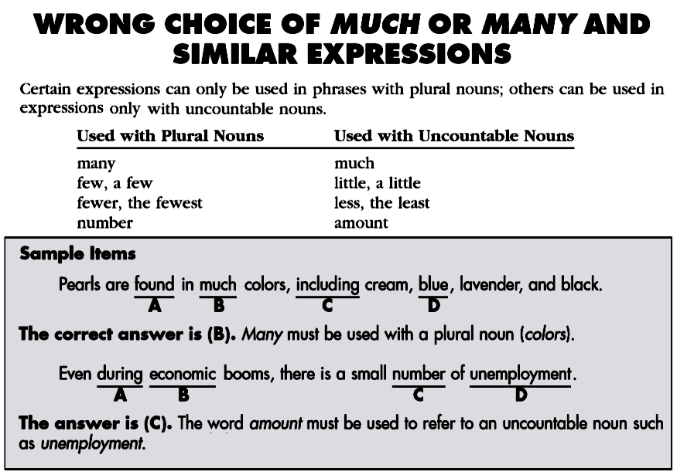
I want to have many cars.✓
I want to have a lot of cars.✓
I want to have much money.✓
I want to have a lot of money.✓
There are a few students here.✓
There are some students here.✓
There is a little water inside.✓
There is some water inside.✓
many+plural Noun
amount+uncountable Noun

Slide 16
Other Word Problems
No
not
no
most
most
almost
I have twice as much money as he does.
I have twice more money than he does.
twice+comparison
verb
======
twice
has doubled

Slide 17
Live or alive, like or alike?
live
like
unlike
side
new
alive
alike
not alike
aside
anew
without Noun
(end of clause or
phrase)
+ Noun
She likes to have live plants in her house.
Although I didn’t water the plants for a week, they’re still alive.
The old man behaved like a child when he saw the show.
I don’t know which is Ani and which is Ana. They looks alike.
The man, unlike his children, prefers coffee to tea.
Although they are twins, Anita and Atina are not alike.
Take the side walk if you want to enter the house.
If you don’t want to read these magazines now, just put it aside.
My children want new bicycles as the present for their success.
To start anew, the company should refresh all the managers.

Slide 18
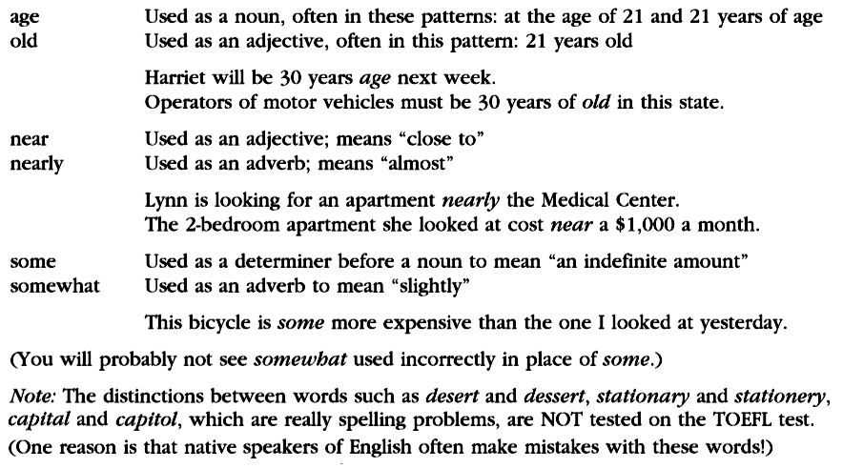
old
age
The pipe is 30 cm long.
= It is 30 cm in length.
The hole is 100 m deep.
= It is 100 m in depth.
near
nearly
somewhat

Slide 19
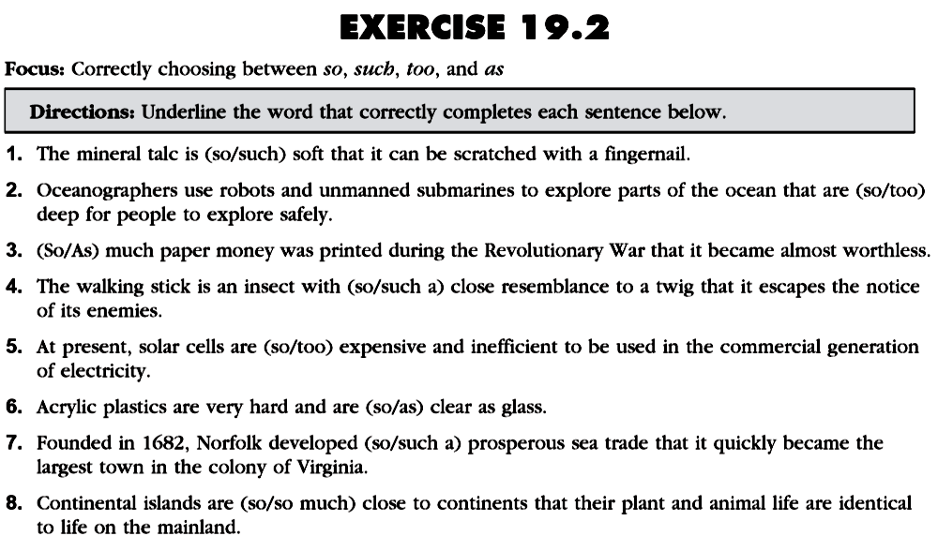
so+adjective+that clause
such+Noun(phrase)+that clause
too+adjective+infinitive
as+adjective+as (comparison)

Slide 20
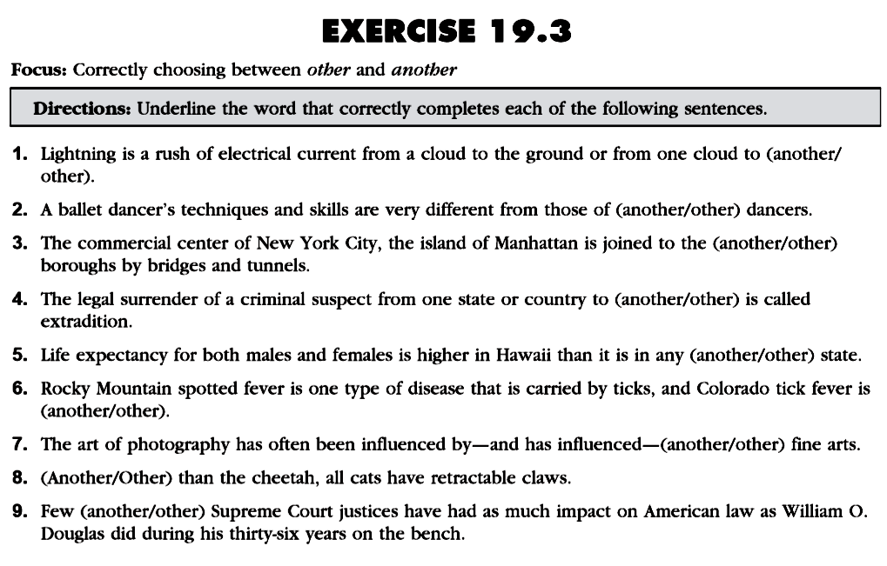
another+singular noun
other+plural noun
determiner+other+sg/pl noun

Slide 21
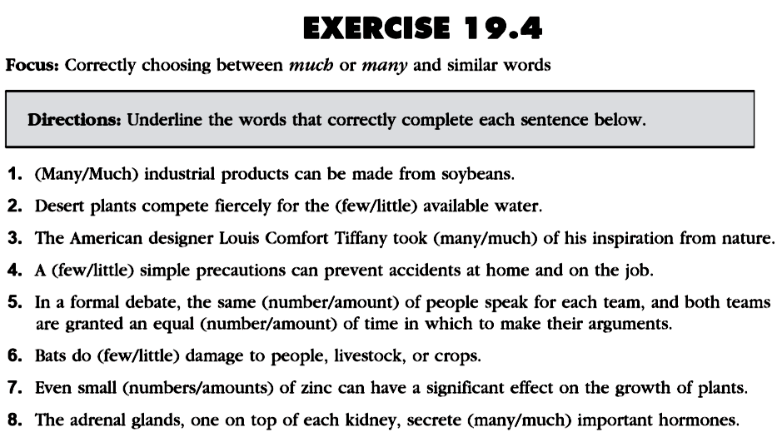
many/(a) few/number
→plural countable noun
much/(a) little/amount
→uncountable noun

Slide 22
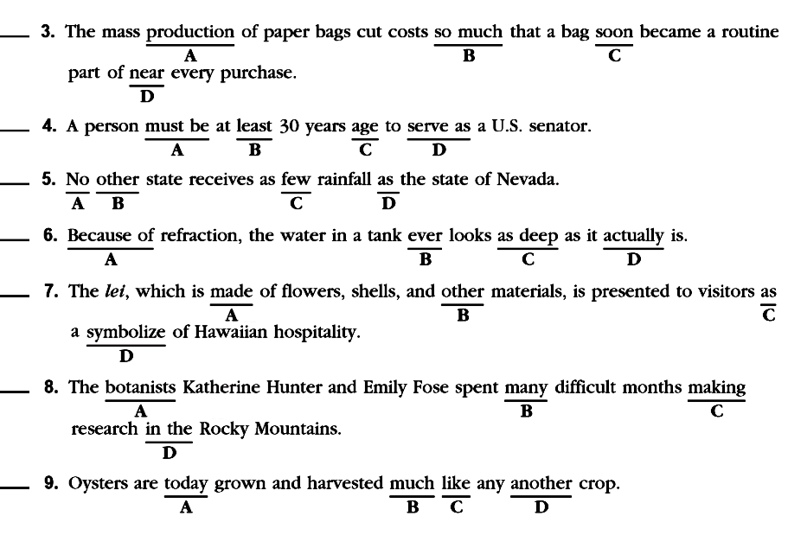
nearly
old/of age
little
never
symbol
doing
other

Slide 23
PRACTICE
makes
PERFECT
PERFECT
✔
✔
So, repeat (perfectly) again at your leisure time several times

Slide 24
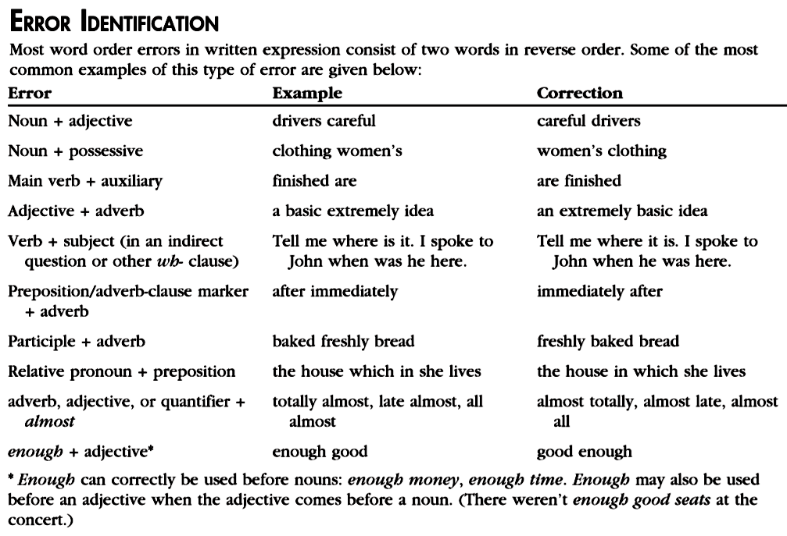
fresh flowers
it is
= quite good

Slide 25
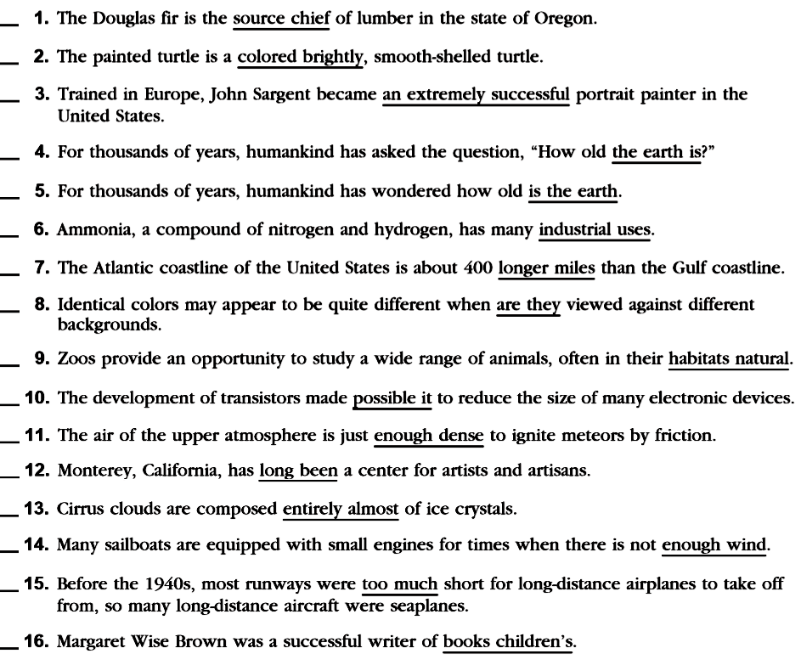
Exc. 27.1
X
chief source
X
brightly colored
C
X
is the earth
X
the earth is
C
X
X
miles longer
they are
X
natural habitats
X
X
it possible
C
dense enough
X
C
almost entirely
X
much too
X
children’s books

Slide 27
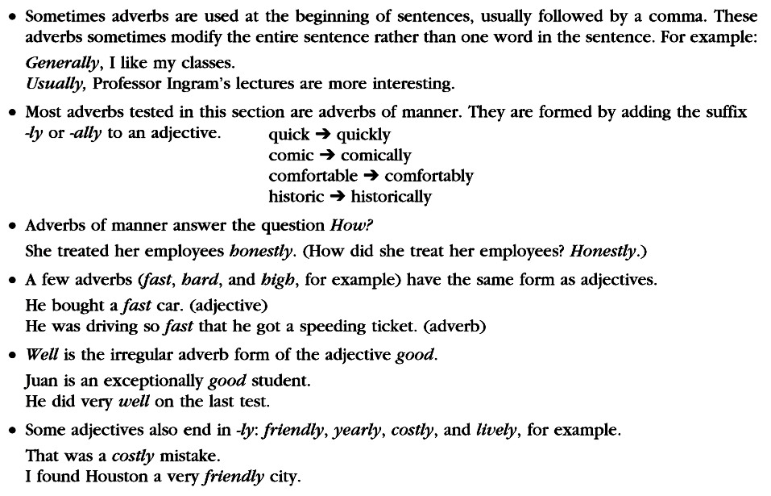

Slide 28
adjective+Noun(phrase)
adverb+Adjective (number)
Parallel→profession+and+profession

Slide 29
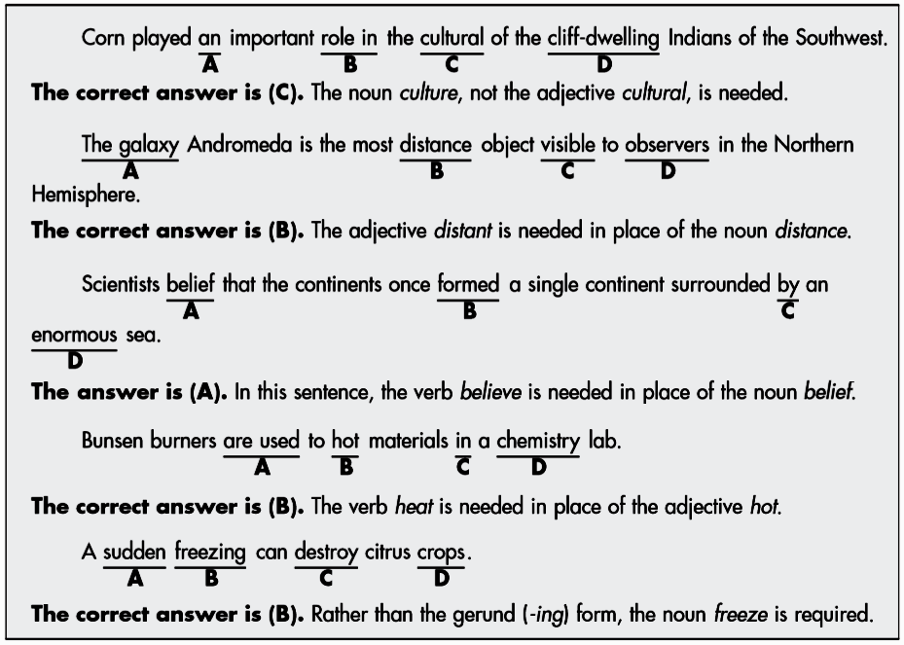
Other word form problems
the/a/an+Noun(phrase) // Noun+of+Noun
the most+adjective (comparison)
Subject+Verb (predicate)
be used to + Verb →heat
Subject: Noun(phrase) // Gerund→Noun (the process)

Slide 30
