Slide 1
2a. WHO of RESEARCH
Quantitative Research
© Yosa A. Alzuhdy, M.Hum.
yosa@uny.ac.id
English Language and Literature Study Program
Yogyakarta State University

Slide 2
Research Process

Slide 3
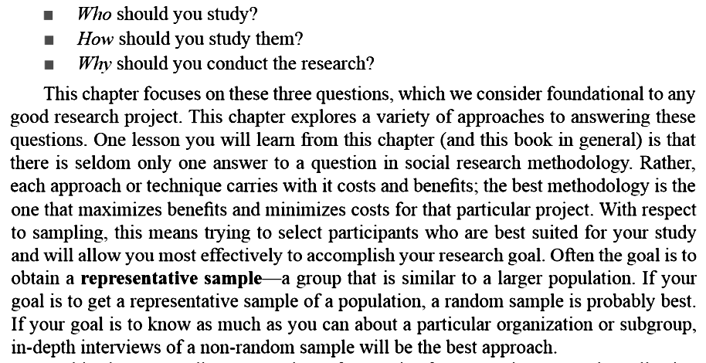
Three questions to begin:

Slide 4
WHO? Sampling
Often the groups sociologists want to study are so large or so dispersed that research on the whole group is impossible.
To construct a picture of the entire group, they take data from a subset of the.
A sample is any subset of a population.
A population is a relatively large collection of people, the universe of the people, that a researcher studies and about which generalizations are made.

Slide 5
Sampling
Many situations where not possible to study the entire population
A sample is a finite part of a population whose properties are studied to gain information about the whole.
Subset of population can be used to make generalizations
Must be representative of total population
See all characteristics of total population in same relationship
Microcosm of total population

Slide 6
Sampling Strategy
The degree to which your sample mirrors the population from which it comes will depend to a large extent on your sampling strategy.
The sampling strategy is the way in which you select units from the population for inclusion into your study.
Why is this important?

Slide 7
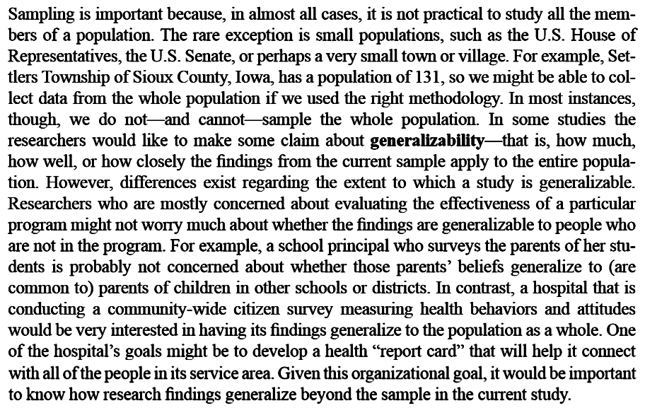
Why is sampling important?

Slide 8
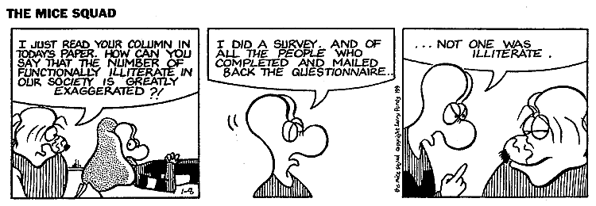

Slide 9
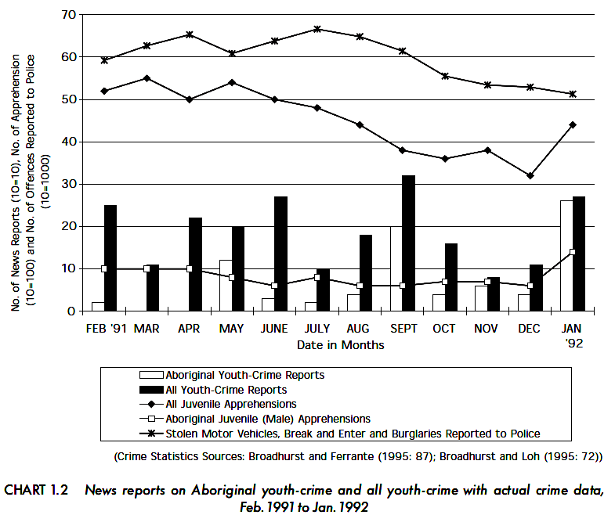
Sample Quant. Research

Slide 10
Sampling Frame
Sampling Frame: A list of all the individuals (units) in the population from which the sample is taken; the actual list of sampling units (or elements).
Examples of Sampling Frames:
Students of Yogyakarta State University
List of businesses registered with the Chamber of Commerce
The phone book
List of students served by the ILLC
List of labor migrants registered with authorities in a particular city

Slide 11
Sampling Techniques
NON-RANDOM SAMPLING (Non-Probability): each member of the sampling frame does not have an equal chance of being selected as a participant in the study.
Convenience Sampling
Snowball Sampling
Purposive Sampling
Quota Sampling
Self-Selected/Voluntary
RANDOM SAMPLING (Probability): each member of the sampling frame has an equal chance of being selected.
Simple Random Sampling
Stratified Random Sampling
Systematic Sampling
Cluster Sampling

Slide 12
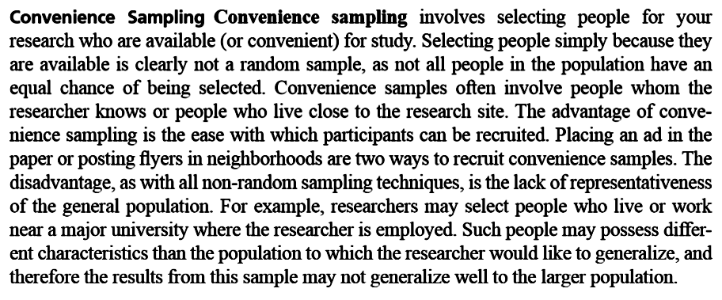
Convenience Sampling

Slide 13
Snowball Sampling
Typically used in qualitative research
When members of a population are difficult to locate, for covert sub-populations, non-cooperative groups
Recruit one respondent, who identifies others, who identify still others,….
Primarily used for exploratory purposes

Slide 14
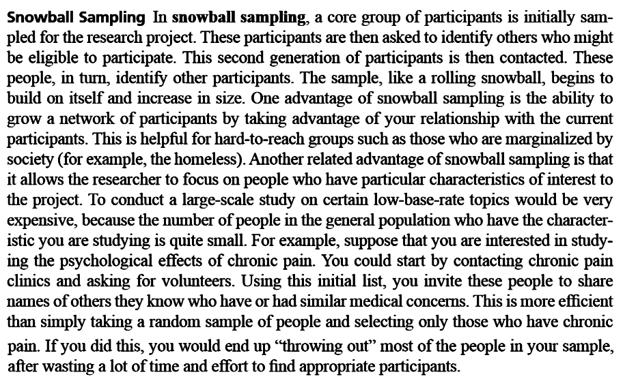
Snowball Sampling

Slide 15
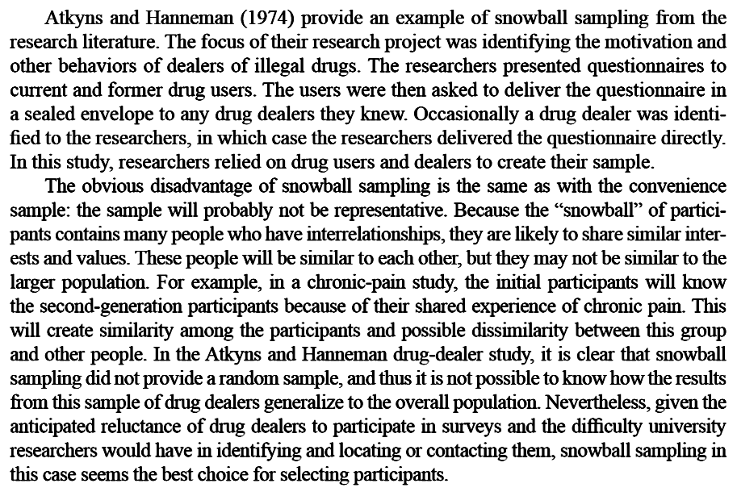
Why Snowball Sampling?

Slide 16
Other Non-Probability Sampling
PURPOSIVE SAMPLING
Select the sample on the basis of knowledge of the population: suitability with the purpose, or use expert judges to identify candidates to select
Typically used for very rare populations, such as deviant cases
SELF-SELECTED/VOLUNTARY SAMPLING
Give the candidates opportunity to voluntarily participate in a survey
Provide questionnaires to be self-completed

Slide 17
Quota Sampling
A stratified convenience sampling strategy
Begins with a table that describes the characteristics of the target population
e.g. the composition of postgraduate students at UNY in terms of faculty, race, and gender
Then select on a convenience basis, postgraduate students in the same proportions regarding faculty, race, and gender than in the population
Of course, the quota frame (the proportions in the table) must be accurate
And biases may be introduced when selecting elements to study

Slide 18
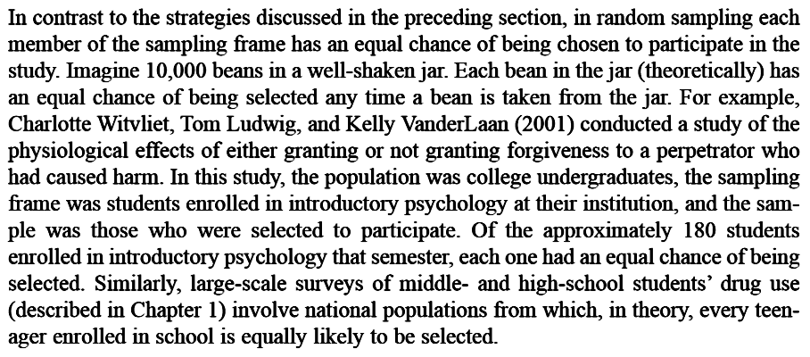
Simple Random Sampling

Slide 19
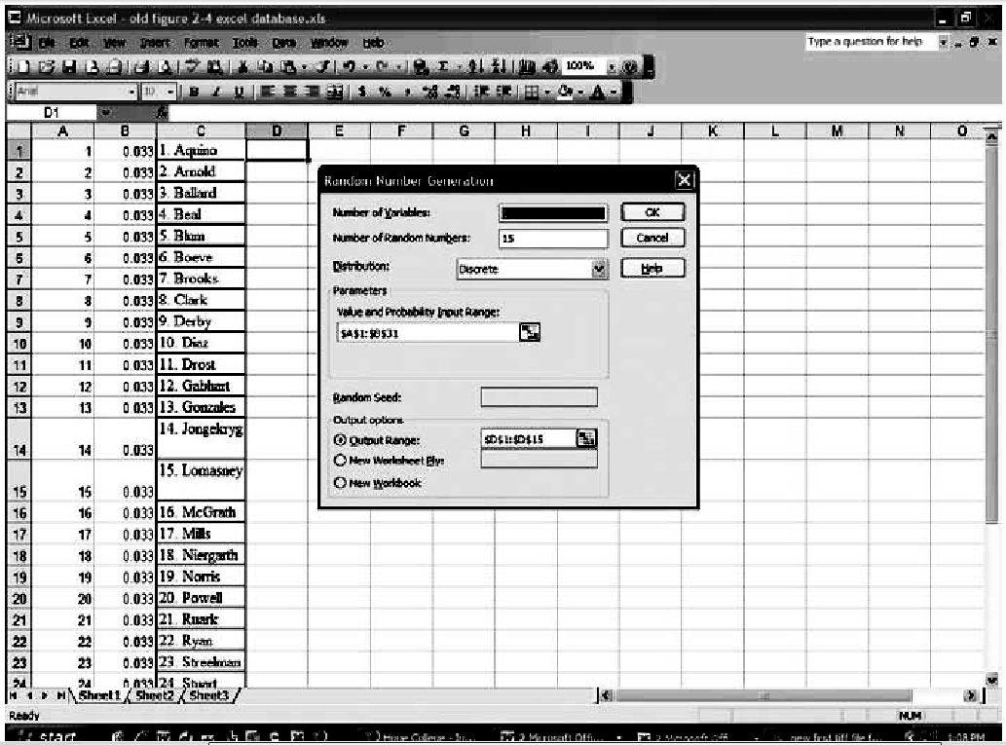
Selecting Simple Random Sample-MS Excel

Slide 20
Selecting Simple Random Sample - SPSS

Slide 21
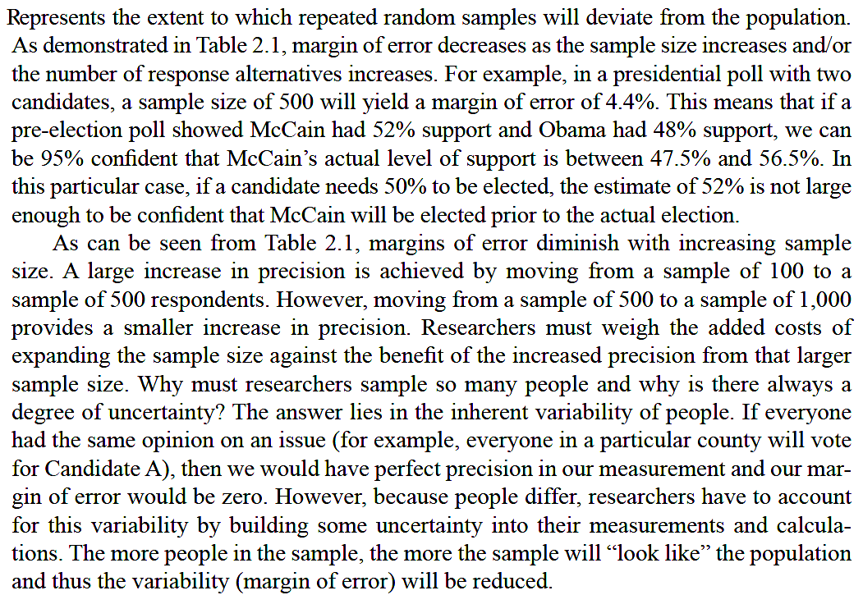
Margin of Error

Slide 22
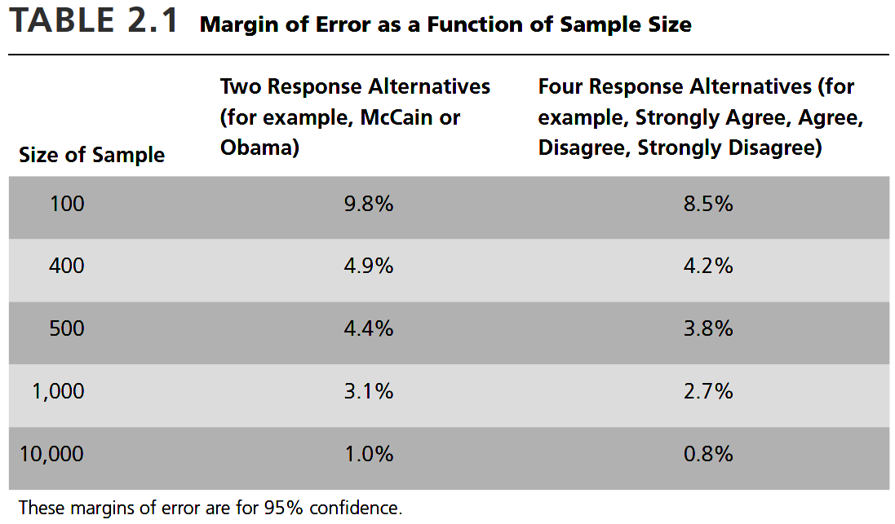
Margin of Error

Slide 23
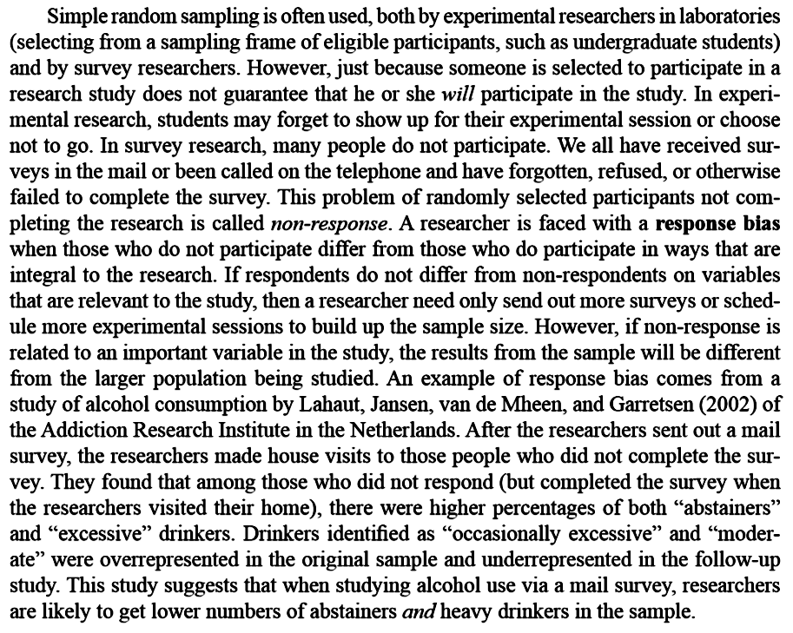

Slide 24
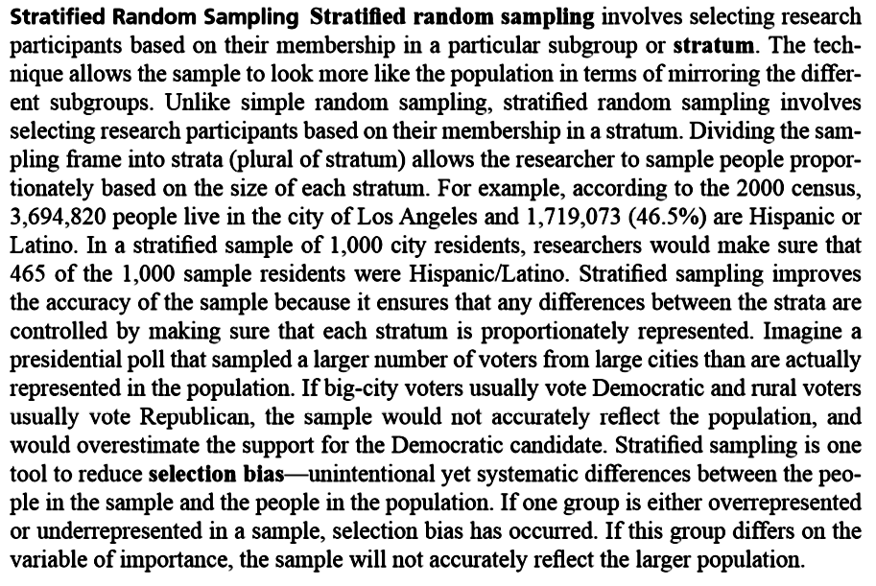
Stratified Random Sampling

Slide 25
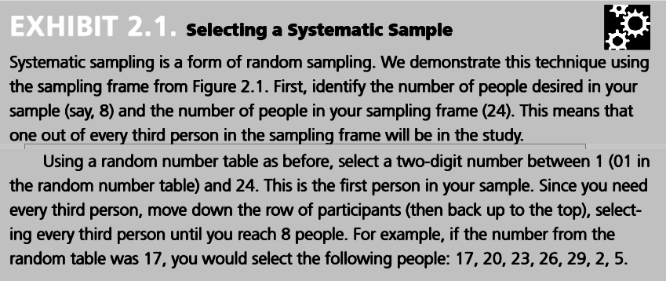
Systematic Sampling

Slide 26
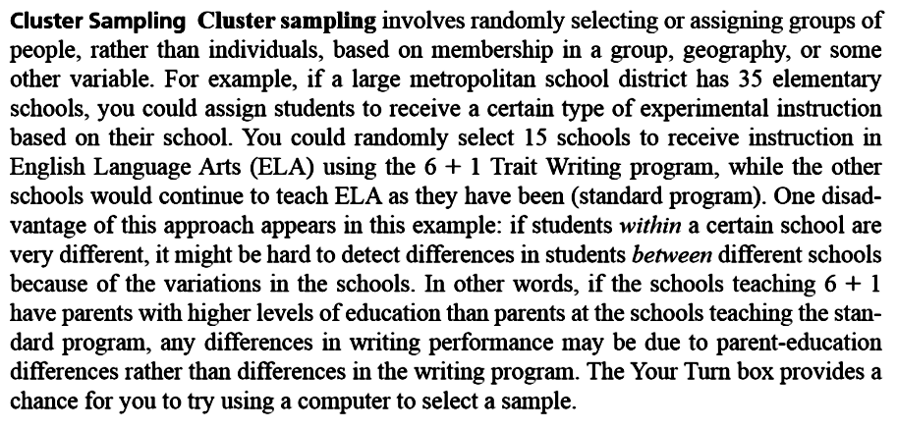
Cluster Sampling

Slide 27
Generating a Random Sample

Slide 28
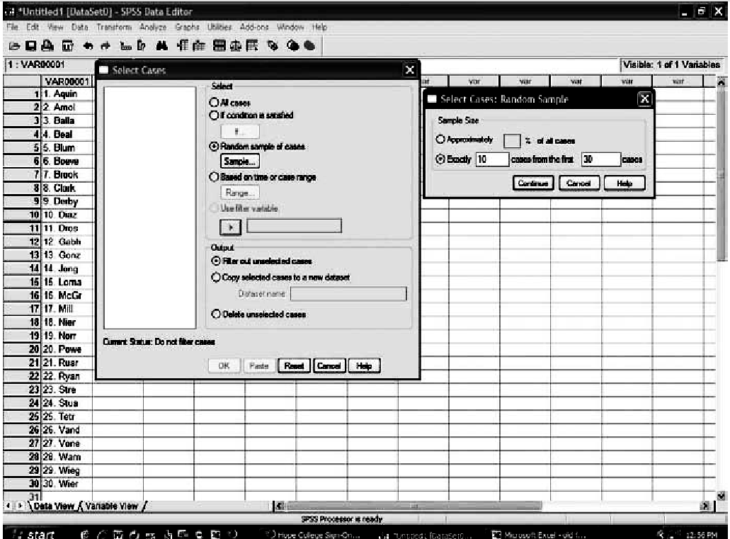
Generating Random Number

Slide 29
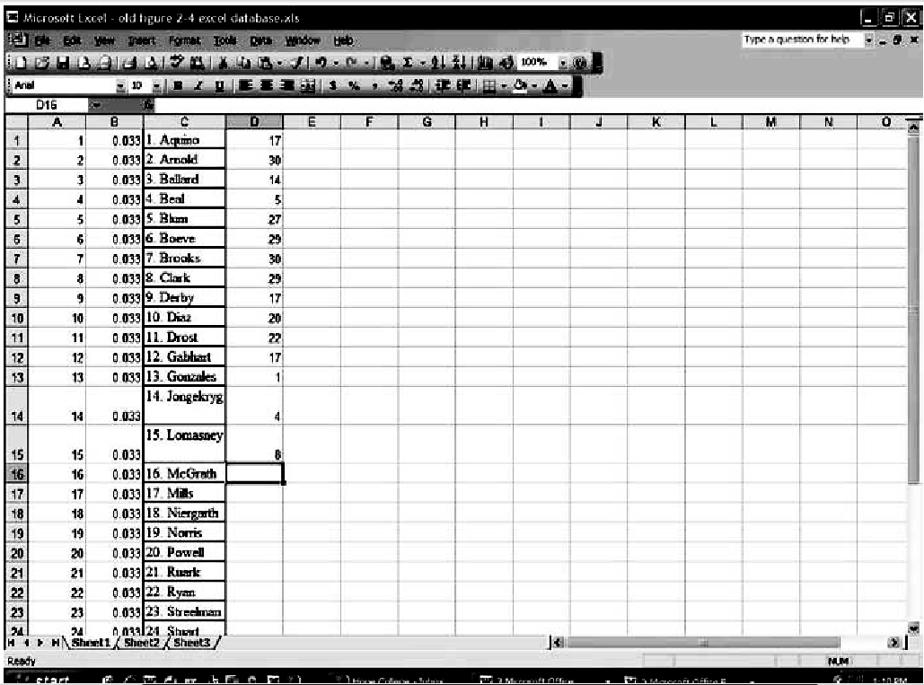

Slide 30
Sampling Error (Bias)
The reliability and internal validity of your research can be effected by:
Sampling errors (Bias)
Non-sampling errors
Sampling error occurs when an abnormally large number of units with unusual characteristics are chosen from a given population.
Influence disturbing randomness of sample population
Sample selection
Response rate

Slide 31
Sampling Error (Bias)
Most often the result of:
Flawed sampling frame
Poor sampling strategy
Small sample size
Protecting against sampling error:
Use a large sample size
Probability sampling
Most representative sampling frame available

Slide 32
Sample Size
Quantitative Research:
A function of the variability or variance one expects to find in the population (standard deviation), and the statistical level of confidence (usually 95%) one wishes to use.
Qualitative Research:
As big as possible
No definite rules to be followed

Slide 33
Sample Size
The larger the sample, the better
Guidelines (for professional research):
< 100 survey entire population
~ 500 survey 50% of population
~ 1,500 survey 20% of population
> 5,000 survey 400
Larger sample may be necessary for heterogeneous population
For undergrad: approx.30 or more samples

Slide 34
That’s all for today
…
Prepare for the next material:
How and Why of the Research

