Slide 1
Aspects on Teaching and Learning

Slide 2
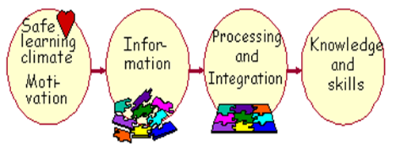
Basic teaching for learning

Slide 3
A good teacher should:
subject knowledge and enthusiasm to share it
ability to structure the topic and relate it to students' background and experience
commitment and ability to stimulate student learning and development of skills
social competence and good contact with students, and
a personal philosophy on learning and teaching

Slide 4
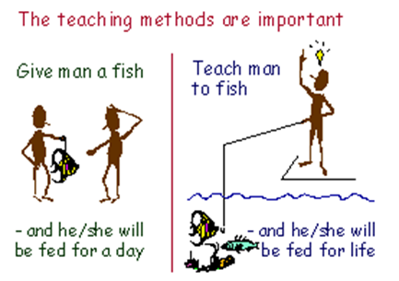
Teaching Methods

Slide 5
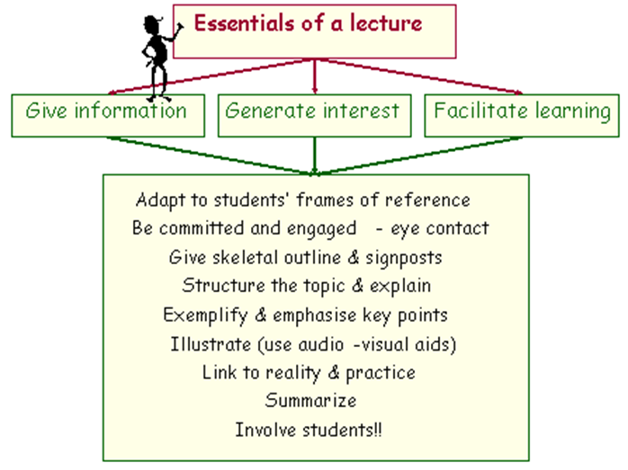
1. Lecture

Slide 6
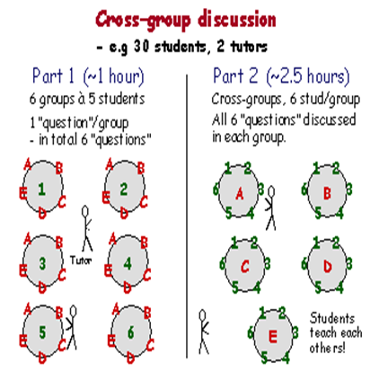
2. Group Work and Discussion

Slide 7
Why discussion?
communication and discussion skills
co-operative ability
self-confidence
responsibility for learning.

Slide 8
3. Exercises & assignment

Slide 9
4. Field work, Internship, Field Visits

Slide 10
5. Project, Literature review, Research Task

