Slide 1
Introducing Visuals

Slide 3
Types of charts and graphs

Slide 4
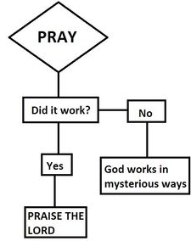
Flow chart

Slide 7
Commenting on visuals

Slide 10
Suggested expressions

