Slide 1
Cell Structure and Function evy yulianti evy_yulianti@uny.ac.id

Slide 2
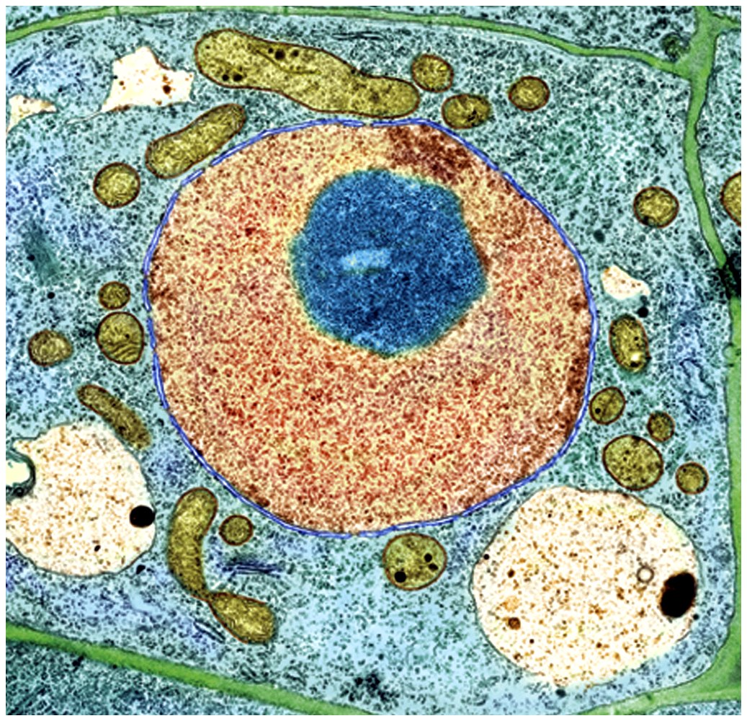
Cell Types
Prokaryotic
Eukaryotic

Slide 3
Eukaryotic cells have internal membranes that compartmentalize their functions
The basic structural and functional unit of every organism is one of two types of cells: prokaryotic or eukaryotic
Only organisms of the domains Bacteria and Archaea consist of prokaryotic cells
Protists, fungi, animals, and plants all consist of eukaryotic cells

Slide 4
Cell Structure
All Cells have:
an outermost plasma membrane
genetic material in the form of DNA
cytoplasm with ribosomes

Slide 5
Cell Structure
All Cells have:
an outermost plasma membrane……
Structure – phospholipid bilayer with embedded proteins
Function – isolates cell contents, controls what gets in and out of the cell, receives signals

Slide 6
Cell Structure
All Cells have:
genetic material in the form of DNA
Eukaryotes – DNA is within a membrane (nucleus)
Prokaryotes – no membrane around the DNA (DNA region called nucleoid)

Slide 7
Cell Structure
All Cells have:
cytoplasm with ribosomes……
Cytoplasm – fluid area inside outer plasma membrane and outside DNA region
Ribosome – site of protein synthesis

Slide 8
Why Are Cells So Small?
Cells need sufficient surface area to allow adequate transport of nutrients in and wastes out.
As cell volume increases, so does the need for the transporting of nutrients and wastes.

Slide 9
Why Are Cells So Small?
However, as cell volume increases the surface area of the cell does not expand as quickly.
If the cell gets too large a volume it cannot transport enough wastes out or nutrients in.
Thus, surface area limits cell volume/size.

Slide 10
Comparing Prokaryotic and Eukaryotic Cells
Basic features of all cells:
Plasma membrane
Semifluid substance called the cytosol
Chromosomes (carry genes)
Ribosomes (make proteins)

Slide 11
Prokaryotic cells have no nucleus
In a prokaryotic cell, DNA is in an unbound region called the nucleoid
Prokaryotic cells lack membrane-bound organelles

Slide 12
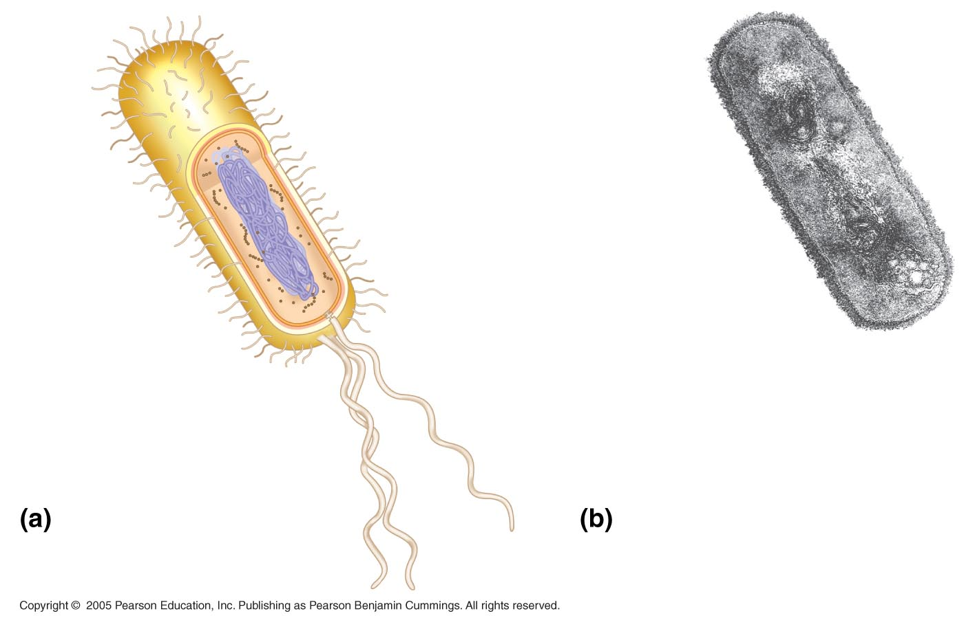
Pili
Nucleoid
Ribosomes
Plasma
membrane
Bacterial
chromosome
Cell wall
Capsule
0.5 µm
Flagella
A typical
rod-shaped
bacterium
A thin section through the
bacterium Bacillus
coagulans (TEM)

Slide 13
Eukaryotic cells have DNA in a nucleus that is bounded by a membranous nuclear envelope
Eukaryotic cells have membrane-bound organelles
Eukaryotic cells are generally much larger than prokaryotic cells
The logistics of carrying out cellular metabolism sets limits on the size of cells

Slide 14
Prokaryotic Cell Structure
Prokaryotic Cells are smaller and simpler in structure than eukaryotic cells.
Typical prokaryotic cell is ________
Prokaryotic cells do NOT have:
Nucleus
Membrane bound organelles

Slide 15
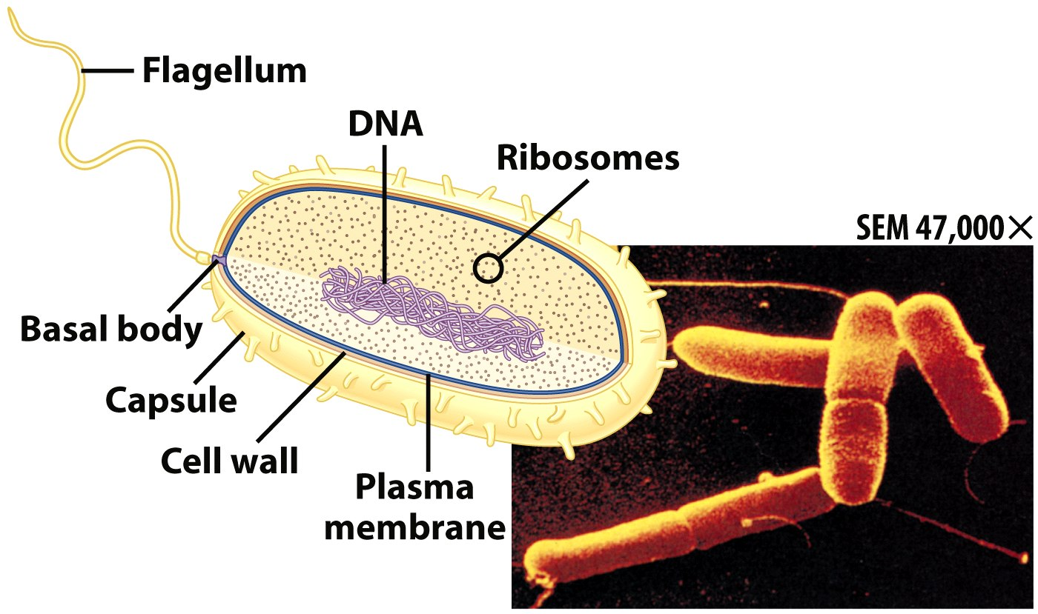
Prokaryotic Cells
No membrane bound nucleus
Nucleoid = region of DNA concentration
Organelles not bound by membranes

Slide 17
Prokaryotic Cell Structure
Structures
Plasma membrane
Cell wall
Cytoplasm with ribosomes
Nucleoid
Capsule
Flagella and pili

Slide 18
Eukaryotic Cells
Structures in all eukaryotic cells
Nucleus
Ribosomes
Cytomembrane System
Endoplasmic reticulum
Golgi body
Vesicles
Mitochondria
Cytoskeleton

Slide 19
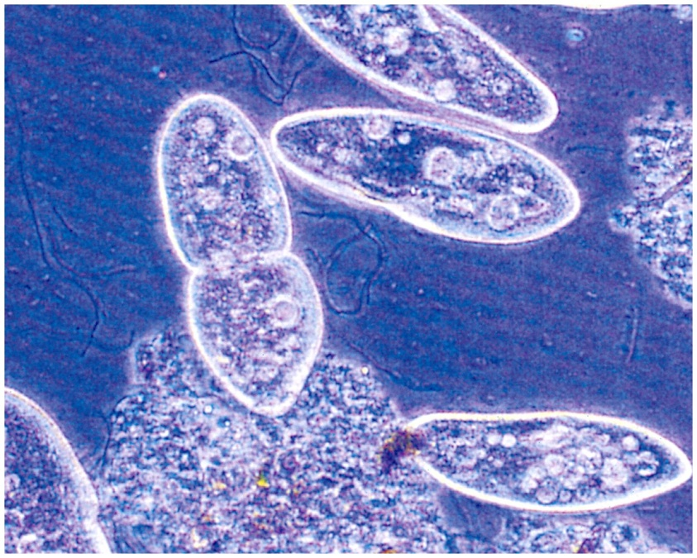
Eukaryotic Cells
Nucleus bound by membrane
Include fungi, protists, plant, and animal cells
Possess many organelles
Protozoan

Slide 20
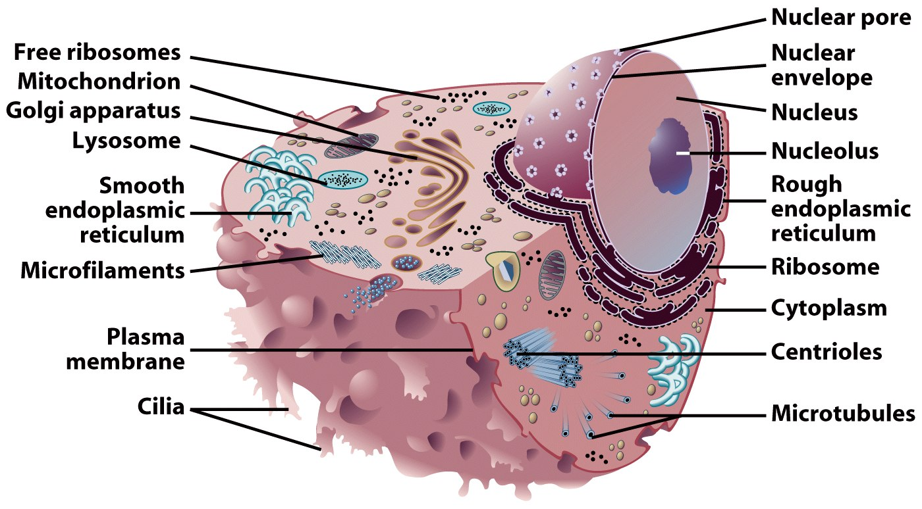
Representative Animal Cell

Slide 21
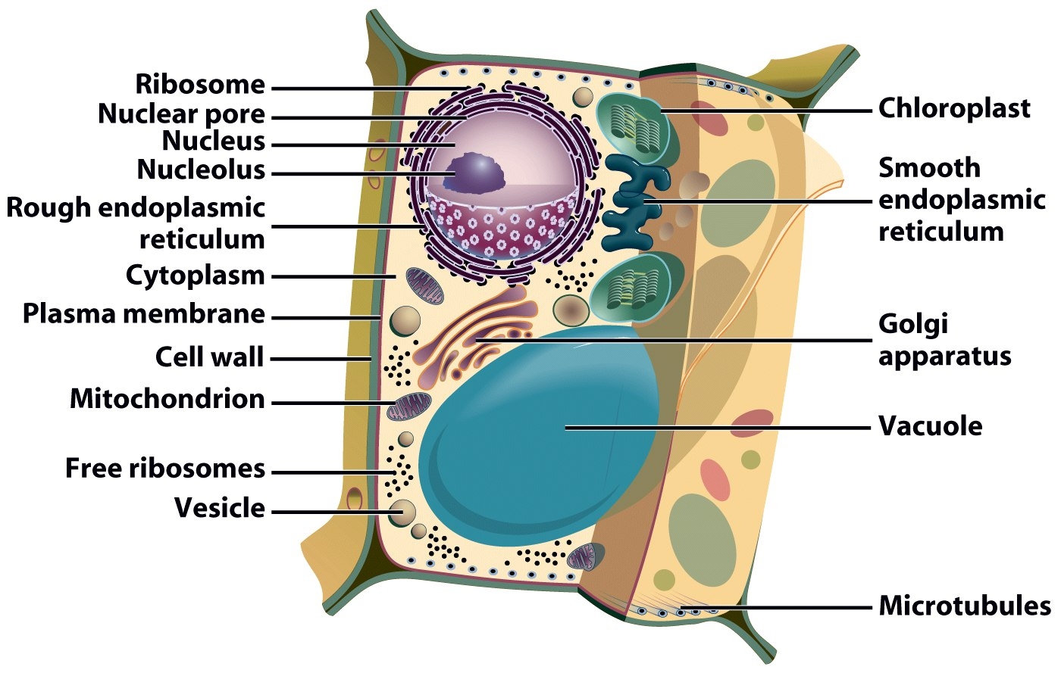
Representative Plant Cell

Slide 22
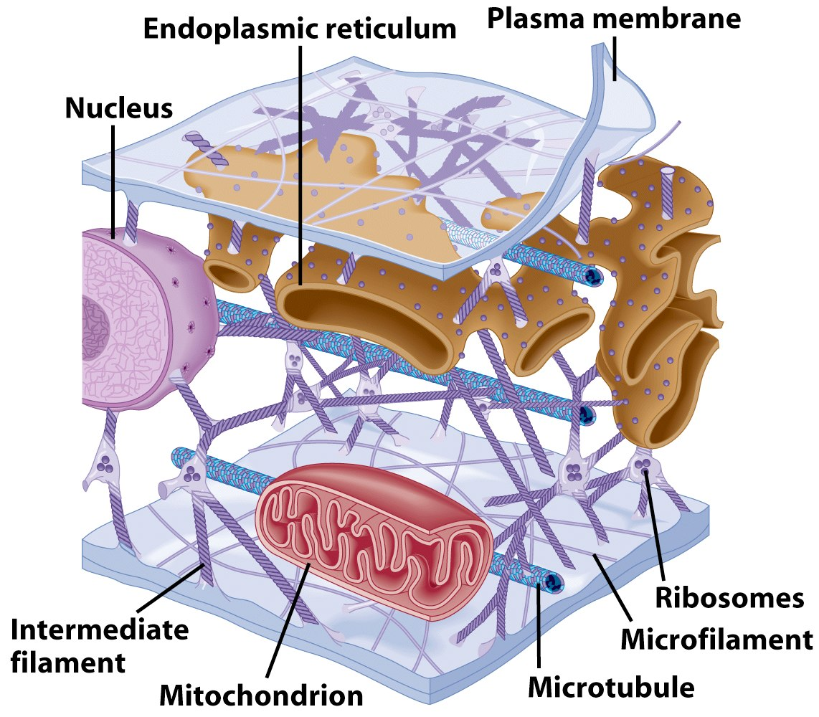
Cytoplasm
Viscous fluid containing organelles
components of cytoplasm
Interconnected filaments & fibers
Fluid = cytosol
Organelles (not nucleus)
storage substances

Slide 23
Organelles
Cellular machinery
Two general kinds
Derived from membranes
Bacteria-like organelles

Slide 24
Bacteria-Like Organelles
Derived from symbiotic bacteria
Ancient association
Endosymbiotic theory
Evolution of modern cells from cells & symbiotic bacteria

Slide 25
Membranous Organelles
Functional components within cytoplasm
Bound by membranes

Slide 26
Nucleus
Function – isolates DNA, controls movement of substances in/out of nucleus
Structure
Nuclear envelope
Two Phospholipid bilayers with protein lined pores ……
Nucleoplasm – fluid of the nucleus

Slide 27
Nucleus
Structure, continued
Nucleolus
Area of condensed DNA
Where ribosomes are made

Slide 28
The eukaryotic cell’s genetic instructions are housed in the nucleus and carried out by the ribosomes
The nucleus contains most of the DNA in a eukaryotic cell
Ribosomes use the information from the DNA to make proteins

Slide 29
The Nucleus: Genetic Library of the Cell
The nucleus contains most of the cell’s genes and is usually the most conspicuous organelle
The nuclear envelope encloses the nucleus, separating it from the cytoplasm

Slide 30
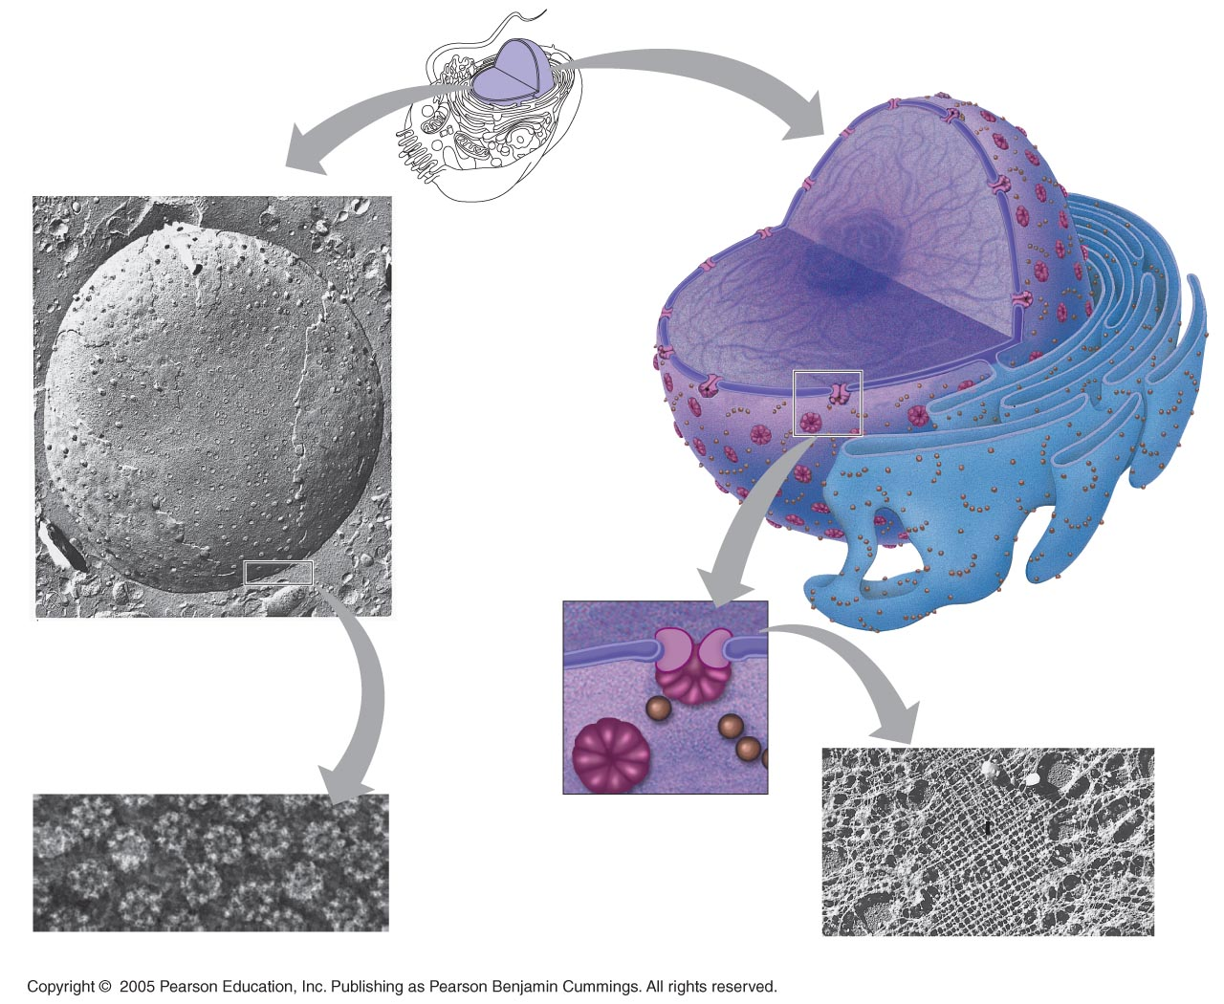
Nucleus
Nucleus
1 µm
Nucleolus
Chromatin
Nuclear envelope:
Inner membrane
Outer membrane
Nuclear pore
Pore
complex
Rough ER
Surface of nuclear envelope
Ribosome
1 µm
0.25 µm
Close-up of nuclear
envelope
Pore complexes (TEM)
Nuclear lamina (TEM)

Slide 31
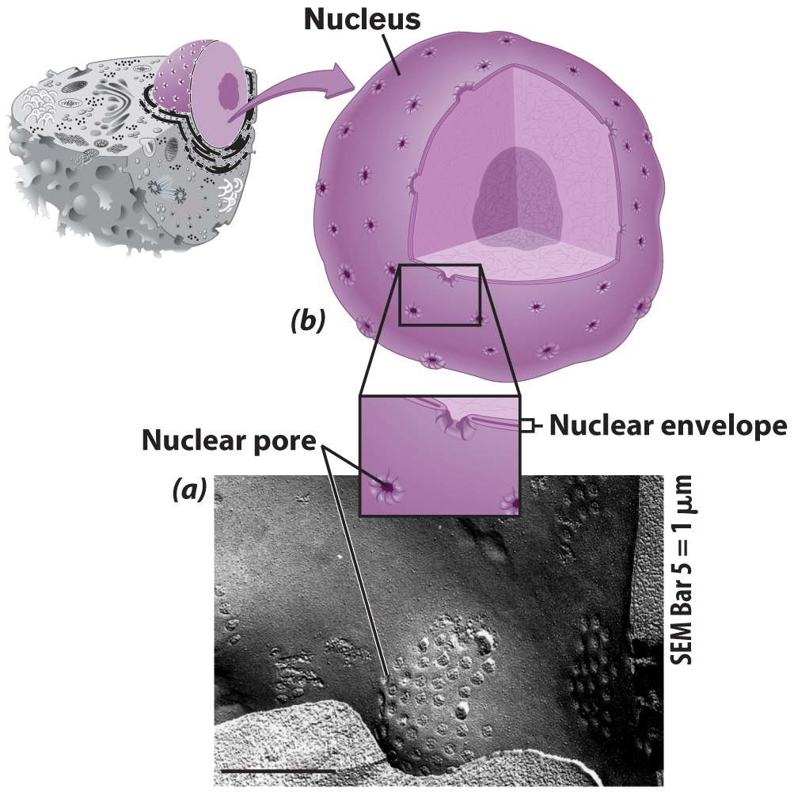
Nucleus
Control center of cell
Double membrane
Contains
Chromosomes
Nucleolus

Slide 32
Nuclear Envelope
Separates nucleus from rest of cell
Double membrane
Has pores

Slide 33
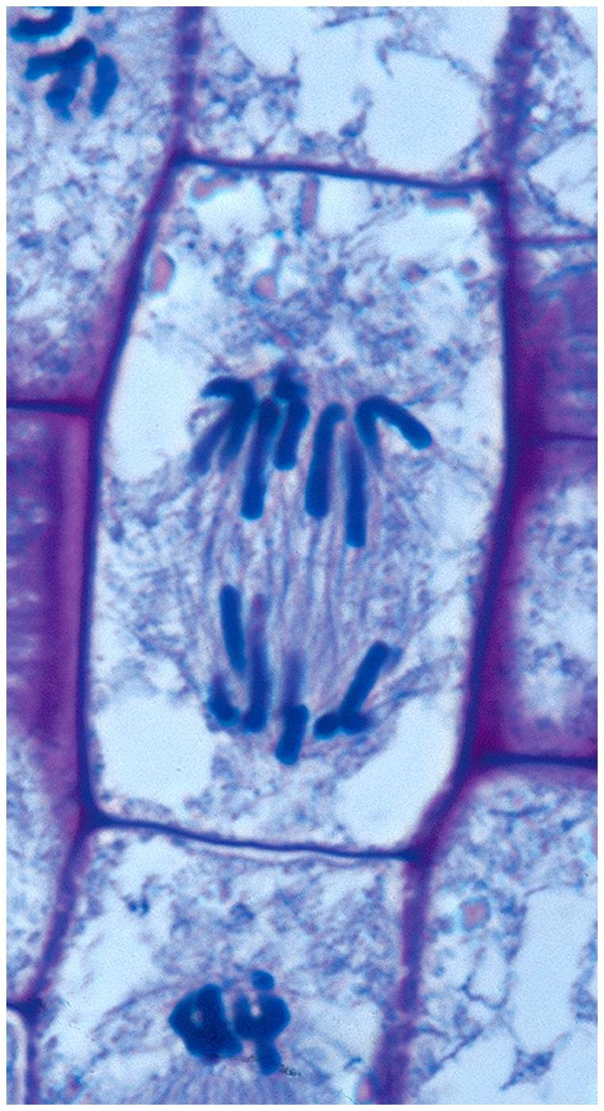
DNA
Hereditary material
Chromosomes
DNA
Protiens
Form for cell division
Chromatin

Slide 34
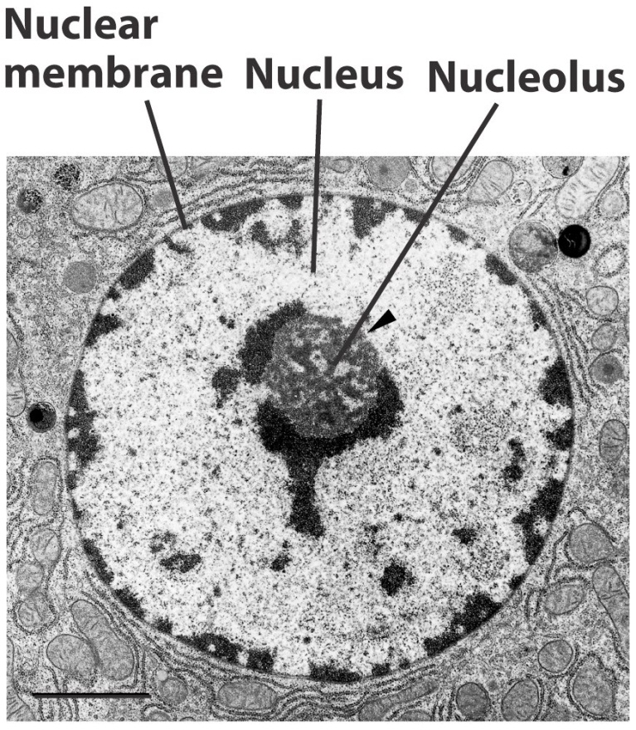
Nucleolus
Most cells have 2 or more
Directs synthesis of RNA
Forms ribosomes

Slide 35
Nucleus
DNA arranged in chromosomes
Chromosome – single molecule of DNA and its associated proteins
Chromatin – all of the cell’s DNA and the associated proteins

Slide 36
Ribosomes: Protein Factories in the Cell
Ribosomes are particles made of ribosomal RNA and protein
Ribosomes carry out protein synthesis in two locations:
In the cytosol (free ribosomes)
On the outside of the endoplasmic reticulum (ER) or the nuclear envelope (bound ribosomes)

Slide 37
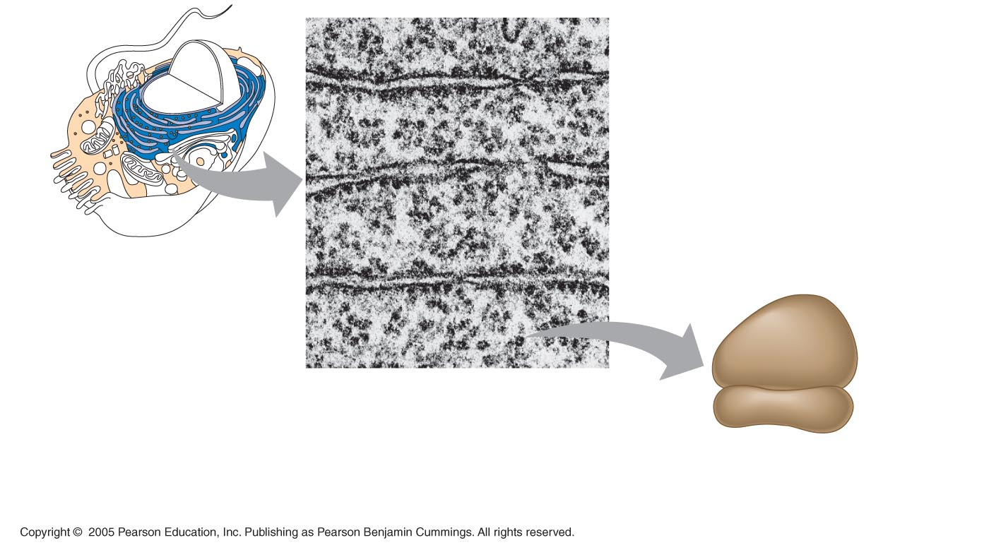
Ribosomes
ER
Cytosol
Endoplasmic
reticulum (ER)
Free ribosomes
Bound ribosomes
Large
subunit
0.5 µm
Small
subunit
TEM showing ER
and ribosomes
Diagram of
a ribosome

Slide 38
The Endomembrane System: A Review
The endomembrane system is a complex and dynamic player in the cell’s compartmental organization

Slide 39
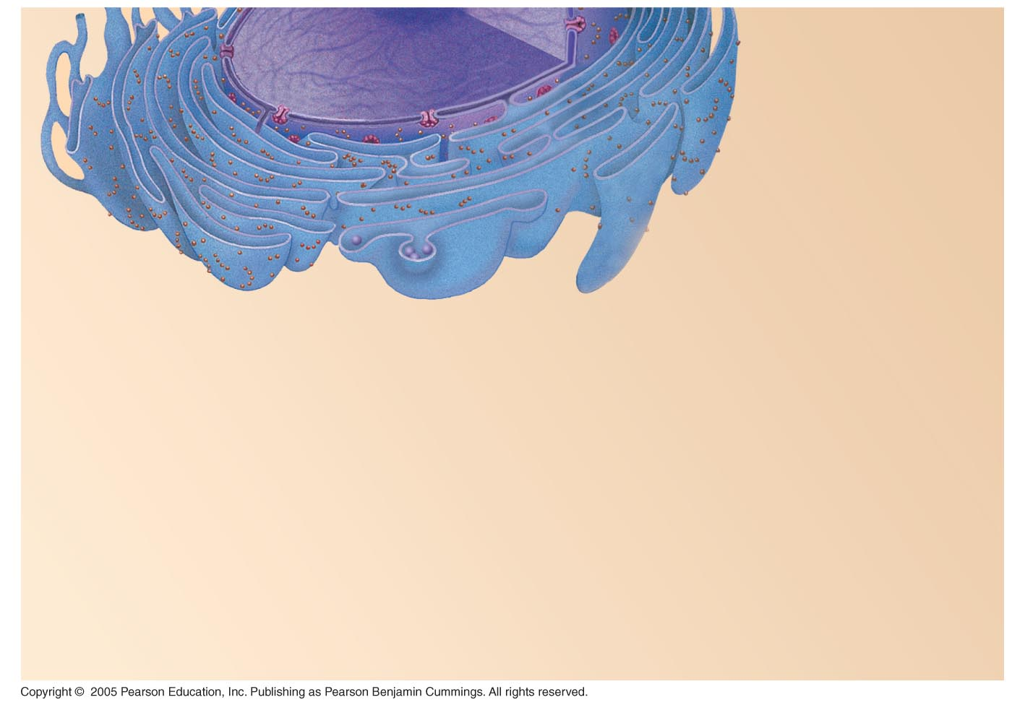
Nucleus
Rough ER
Smooth ER
Nuclear envelope

Slide 40
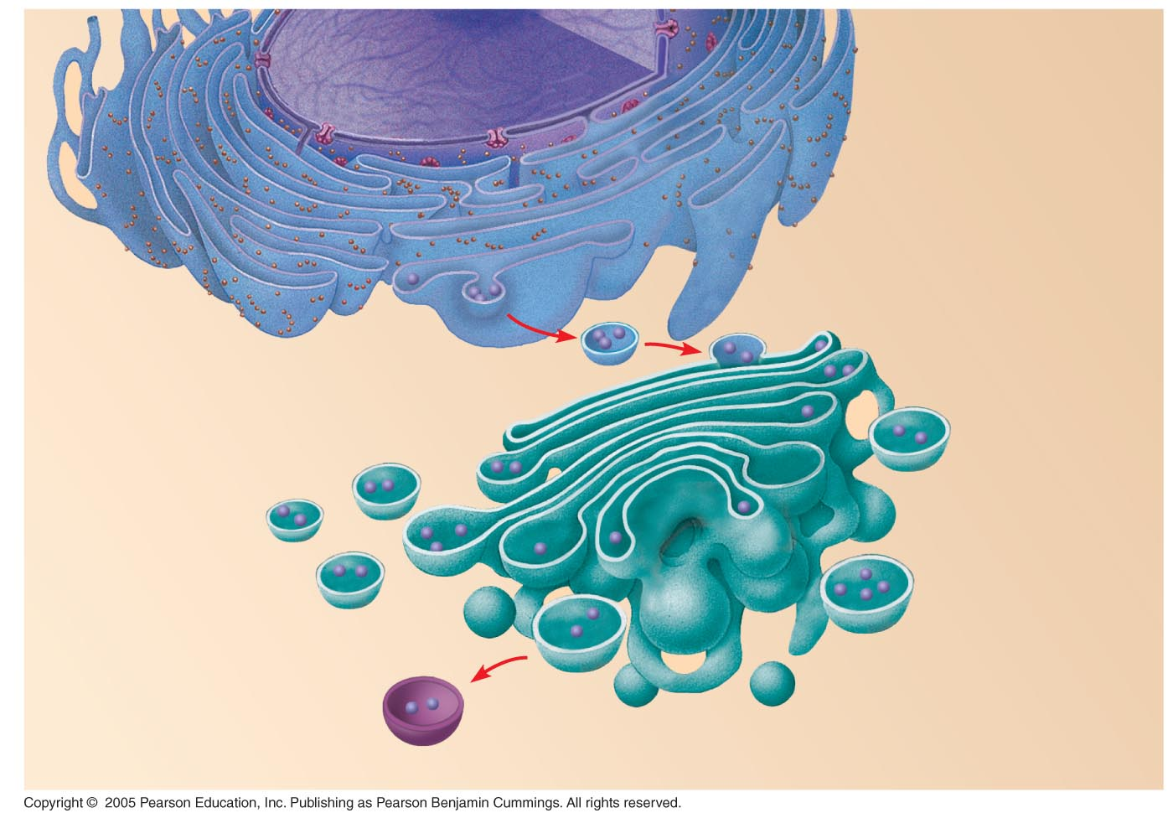
Nucleus
Rough ER
Smooth ER
Nuclear envelope
cis Golgi
Transport vesicle
trans Golgi

Slide 41
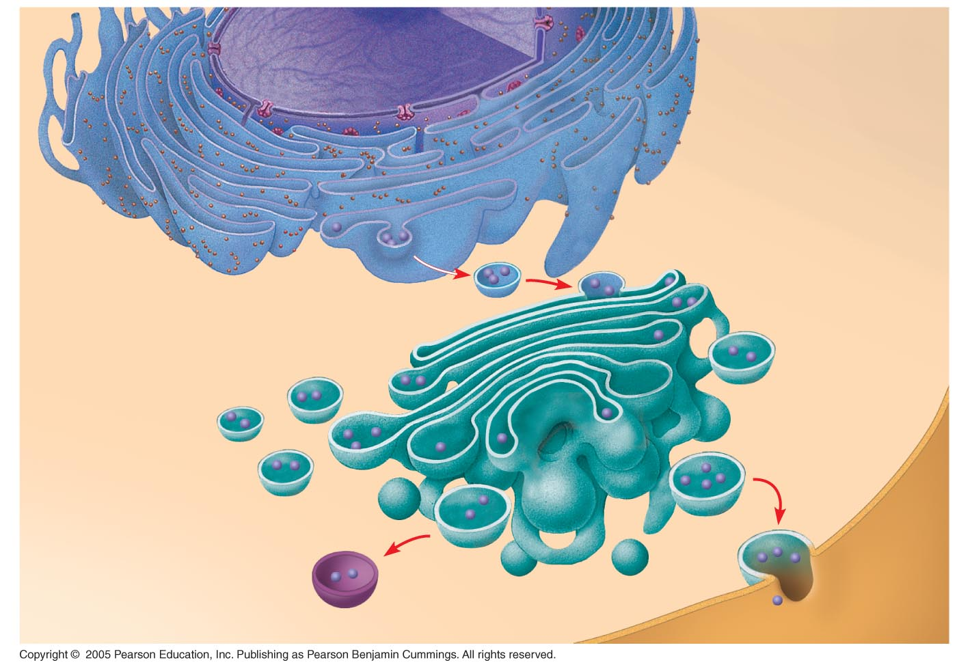
Nucleus
Rough ER
Smooth ER
Nuclear envelope
cis Golgi
Transport vesicle
Plasma
membrane
trans Golgi

Slide 42
The endomembrane system regulates protein traffic and performs metabolic functions in the cell
Components of the endomembrane system:
Nuclear envelope
Endoplasmic reticulum
Golgi apparatus
Lysosomes
Vacuoles
Plasma membrane
These components are either continuous or connected via transfer by vesicles

Slide 43
The Endoplasmic Reticulum: Biosynthetic Factory
The endoplasmic reticulum (ER) accounts for more than half of the total membrane in many eukaryotic cells
The ER membrane is continuous with the nuclear envelope
There are two distinct regions of ER:
Smooth ER, which lacks ribosomes
Rough ER, with ribosomes studding its surface

Slide 44
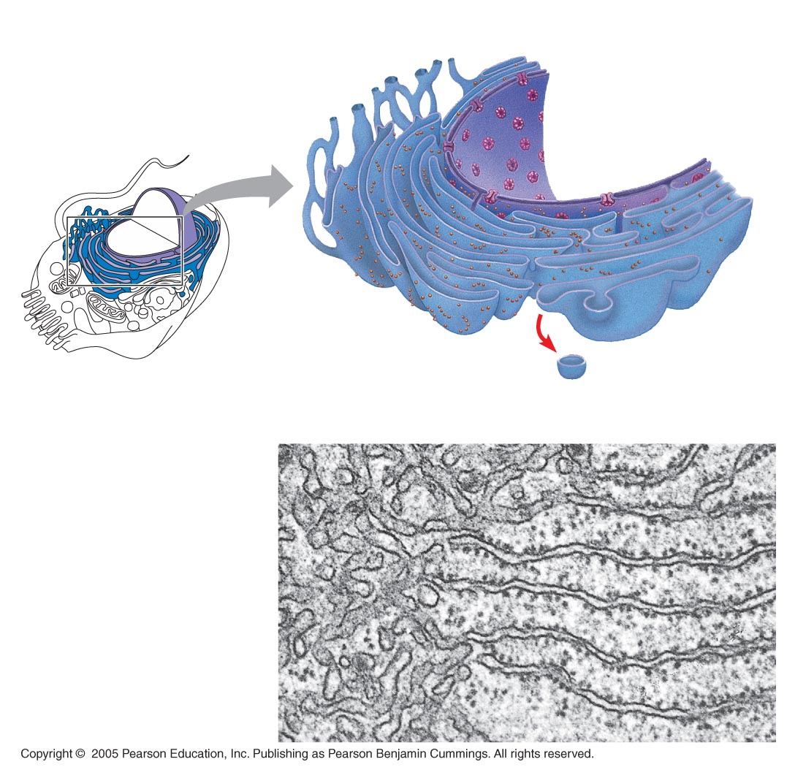
Smooth ER
Rough ER
Nuclear
envelope
ER lumen
Cisternae
Ribosomes
Transitional ER
Transport vesicle
Smooth ER
Rough ER
200 nm

Slide 45
Endo/Cytomembrane System
Series of organelles responsible for:
Modifying protein chains into their final form
Synthesis of lipids
Packaging fully processed proteins and lipids into vesicles

Slide 46
Endoplasmic Reticulum
Helps move substances within cells
Network of interconnected membranes
Two types
Rough endoplasmic reticulum
Smooth endoplasmic reticulum

Slide 47
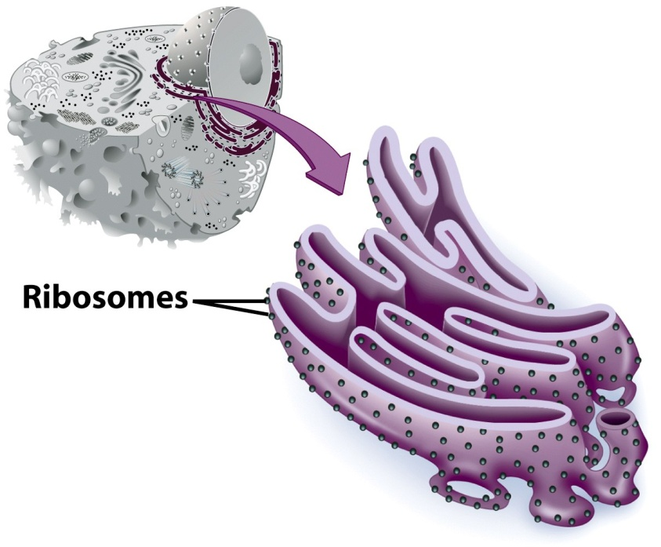
Rough Endoplasmic Reticulum
Ribosomes attached to surface
Manufacture protiens
Not all ribosomes attached to rough ER
May modify proteins from ribosomes

Slide 48
Endo/Cytomembrane System
Endoplasmic Reticulum (ER)
Rough ER (RER)
Flattened membrane sacs create a “maze”….
Many ribosomes attached to the outside
Where proteins are modified and packaged for transport to the Golgi body

Slide 49
Functions of Rough ER
The rough ER
Has bound ribosomes
Produces proteins and membranes, which are distributed by transport vesicles
Is a membrane factory for the cell

Slide 50
Smooth Endoplasmic Reticulum
No attached ribosomes
Has enzymes that help build molecules
Carbohydrates
Lipids

Slide 51
Endo/Cytomembrane System
Smooth ER (SER)
Tubular membrane structure
Often continuous with RER
No ribosomes attached
Where lipids are made and packaged for transport to the Golgi body

Slide 52
Functions of Smooth ER
The smooth ER
Synthesizes lipids
Metabolizes carbohydrates
Stores calcium
Detoxifies poison

Slide 53
Endo/Cytomembrane System
Golgi Body
Stack of flattened membrane sacs
Completes the processing of proteins and lipids
Sorts and packages fully processed proteins and lipids in vesicles

Slide 54
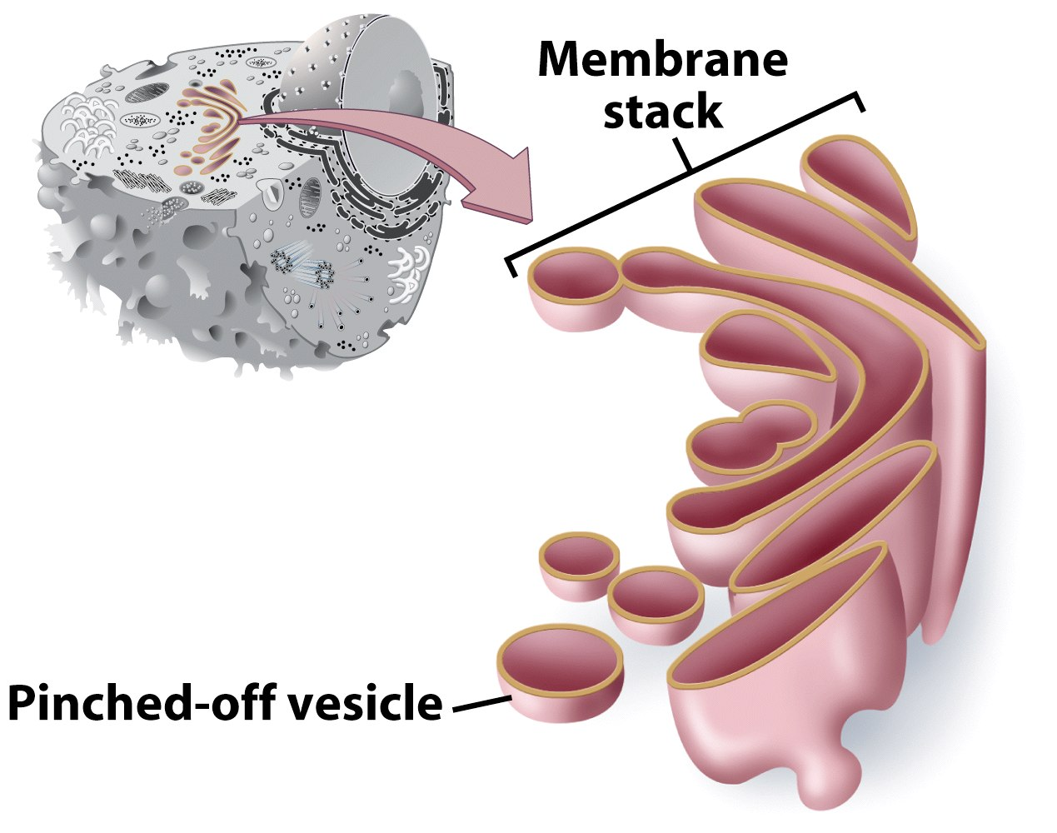
Golgi Apparatus
Involved in synthesis of plant cell wall
Packaging & shipping station of cell

Slide 55
Golgi Apparatus Function
1. Molecules come in vesicles
2. Vesicles fuse with Golgi membrane
3. Molecules may be modified by Golgi

Slide 56
Golgi Apparatus Function (Continued)
4. Molecules pinched-off in separate vesicle
5. Vesicle leaves Golgi apparatus
6. Vesicles may combine with plasma membrane to secrete contents

Slide 57
The Golgi Apparatus: Shipping and Receiving Center
The Golgi apparatus consists of flattened membranous sacs called cisternae
Functions of the Golgi apparatus:
Modifies products of the ER
Manufactures certain macromolecules
Sorts and packages materials into transport vesicles

Slide 58
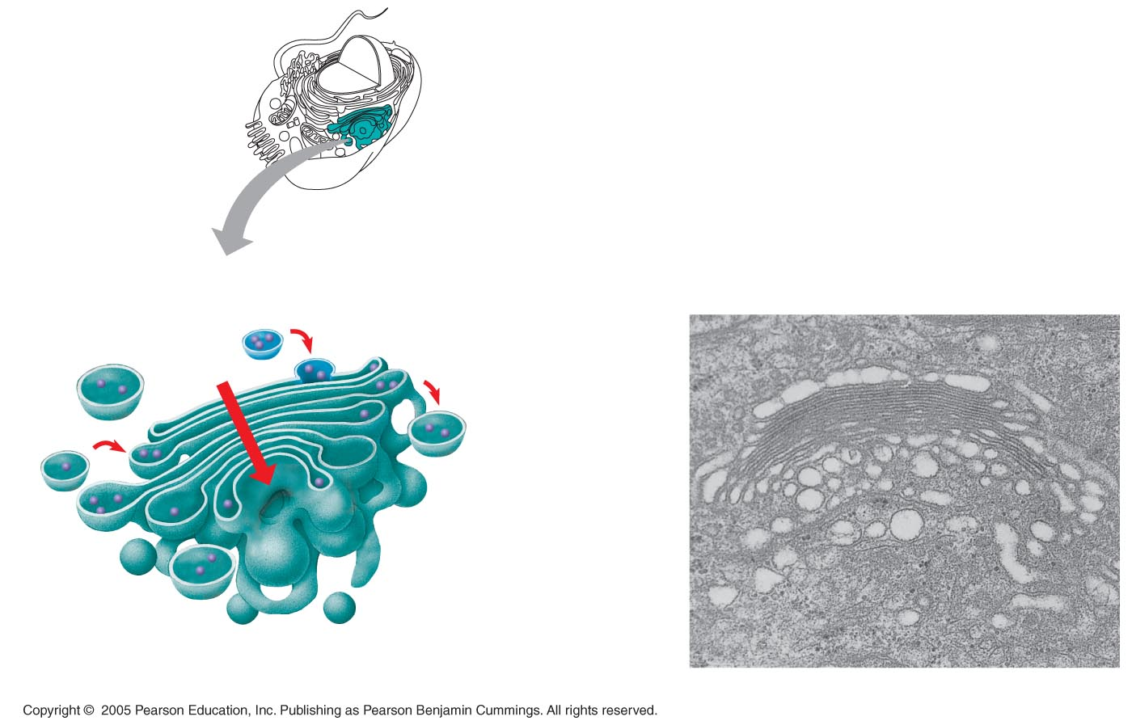
Golgi
apparatus
cis face
(“receiving” side of
Golgi apparatus)
Vesicles move
from ER to Golgi
Vesicles coalesce to
form new cis Golgi cisternae
0.1 µm
Vesicles also
transport certain
proteins back to ER
Cisternae
Cisternal
maturation:
Golgi cisternae
move in a cis-
to-trans
direction
Vesicles form and
leave Golgi, carrying
specific proteins to
other locations or to
the plasma mem-
brane for secretion
Vesicles transport specific
proteins backward to newer
Golgi cisternae
trans face
(“shipping” side of
Golgi apparatus)
TEM of Golgi apparatus

Slide 59
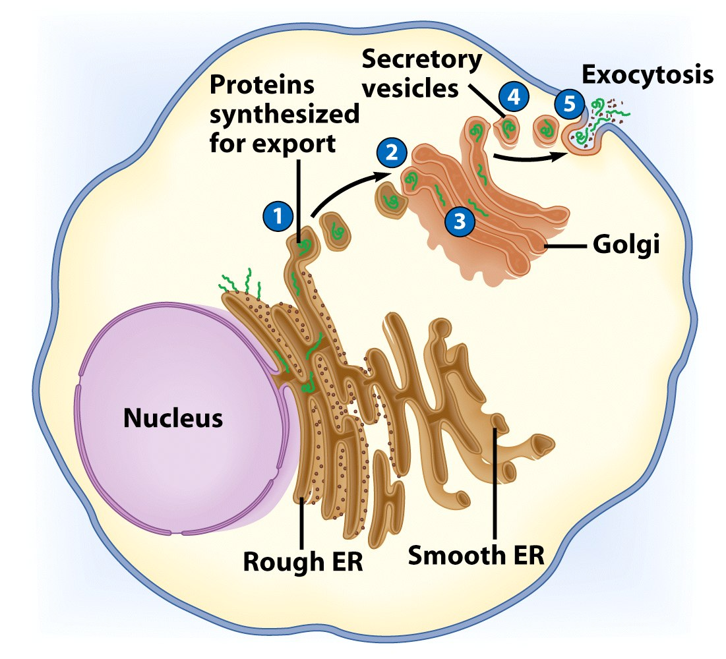

Slide 60
Endo/Cytomembrane System
Transport Vesicles
Vesicle = small membrane bound sac
Transport modified proteins and lipids from the ER to the Golgi body (and from Golgi to final destination)

Slide 61
Endo/Cytomembrane System
Putting it all together
DNA → RNA → nuclear pore → ribosome →
Protein made → protein with proper code enters RER → proteins modified in RER and lipids made in SER → proteins and lipids bud off in vesicles →

Slide 62
Cytomembrane System
Putting it all together
→ER vesicles merge with Golgi body → proteins and lipids enter Golgi → each is fully modified as it passes through layers of Golgi → modified products bud off in Golgi vesicles → …

Slide 63
Cytomembrane System
Putting it all together
→ Golgi vesicles either merge with the plasma membrane and release their contents OR remain in the cell and serve a purpose

Slide 64
Vesicles
Vesicles
Small membrane bound sacs
Examples
Golgi and ER transport vesicles
Lysosome
Peroxisome

Slide 65
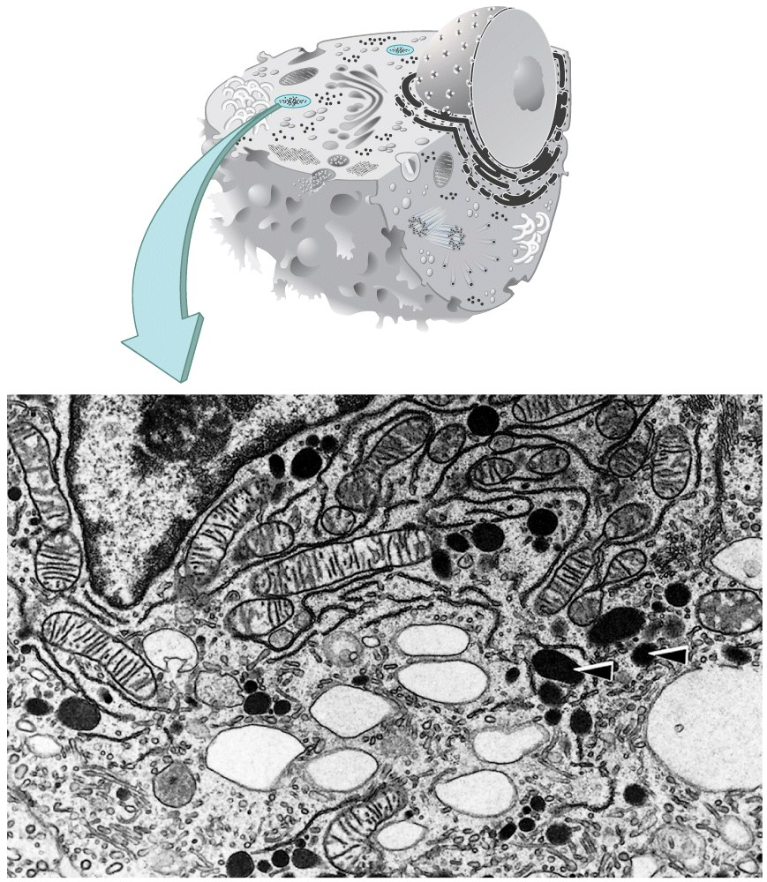
Lysosomes
Contain digestive enzymes
Functions
Aid in cell renewal
Break down old cell parts
Digests invaders

Slide 66
Lysosomes: Digestive Compartments
A lysosome is a membranous sac of hydrolytic enzymes
Lysosomal enzymes can hydrolyze proteins, fats, polysaccharides, and nucleic acids
Lysosomes also use enzymes to recycle organelles and macromolecules, a process called autophagy

Slide 67
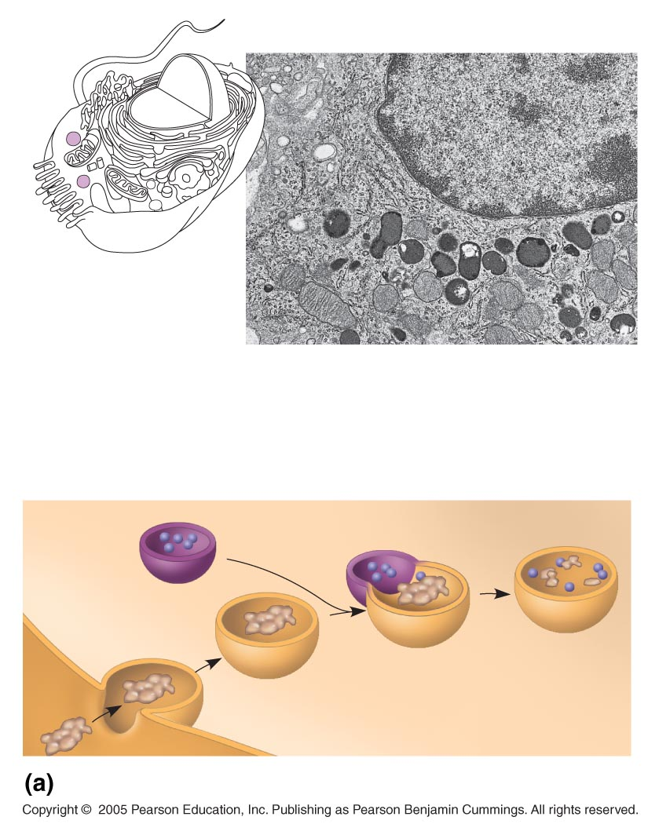
Nucleus
1 µm
Lysosome
Lysosome contains
active hydrolytic
enzymes
Food vacuole
fuses with
lysosome
Hydrolytic
enzymes digest
food particles
Plasma
membrane
Digestive
enzymes
Lysosome
Digestion
Food vacuole
Phagocytosis: lysosome digesting food

Slide 68
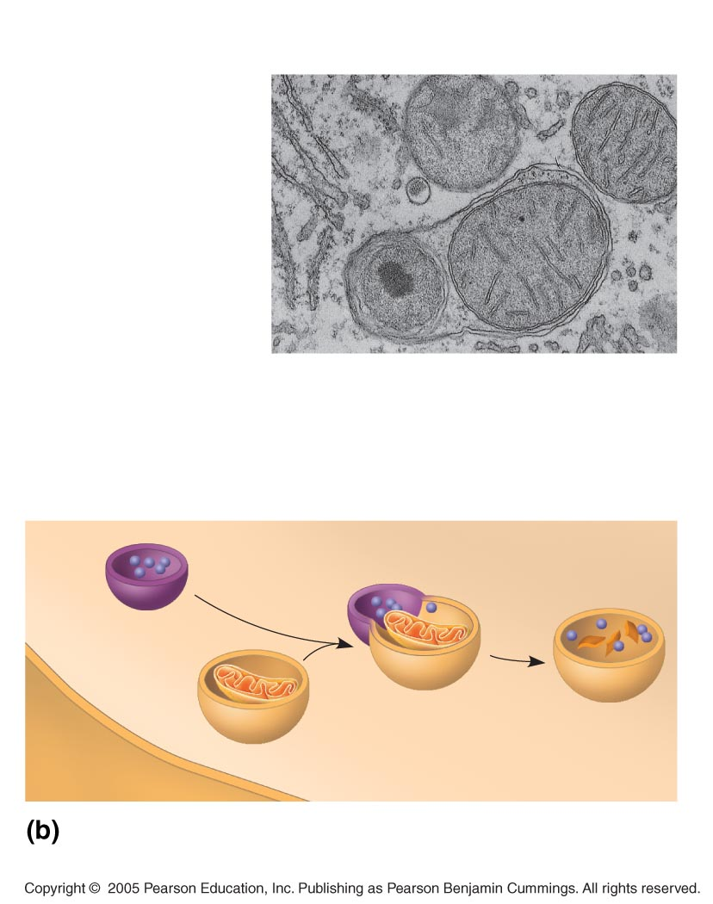
Lysosome containing
two damaged organelles
1 µm
Mitochondrion
fragment
Peroxisome
fragment
Lysosome fuses with
vesicle containing
damaged organelle
Hydrolytic enzymes
digest organelle
components
Lysosome
Digestion
Vesicle containing
damaged mitochondrion
Autophagy: lysosome breaking down
damaged organelle

Slide 69
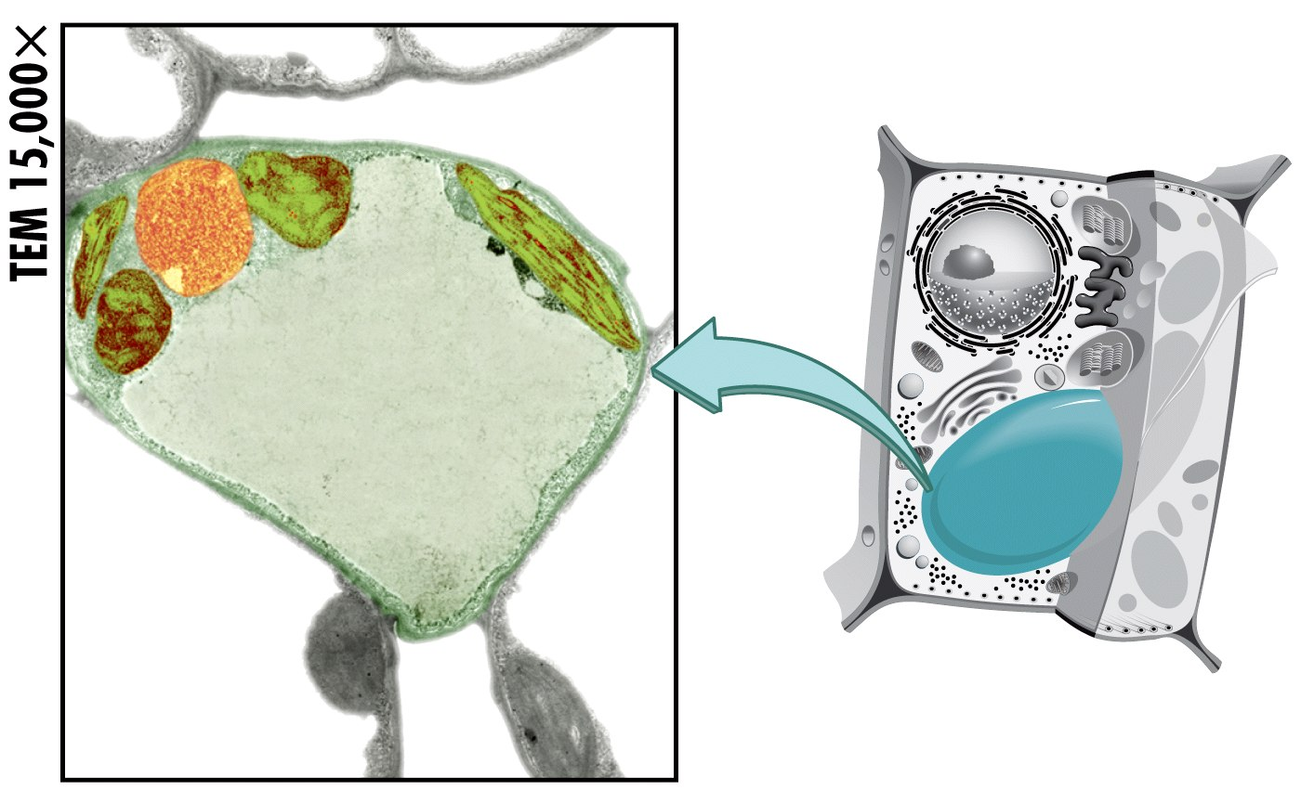
Vacuoles
Membrane bound storage sacs
More common in plants than animals
Contents
Water
Food
wastes

Slide 70
Vacuoles: Diverse Maintenance Compartments
Vesicles and vacuoles (larger versions of vacuoles) are membrane-bound sacs with varied functions
A plant cell or fungal cell may have one or several vacuoles

Slide 71
Food vacuoles are formed by phagocytosis
Contractile vacuoles, found in many freshwater protists, pump excess water out of cells
Central vacuoles, found in many mature plant cells, hold organic compounds and water

Slide 72
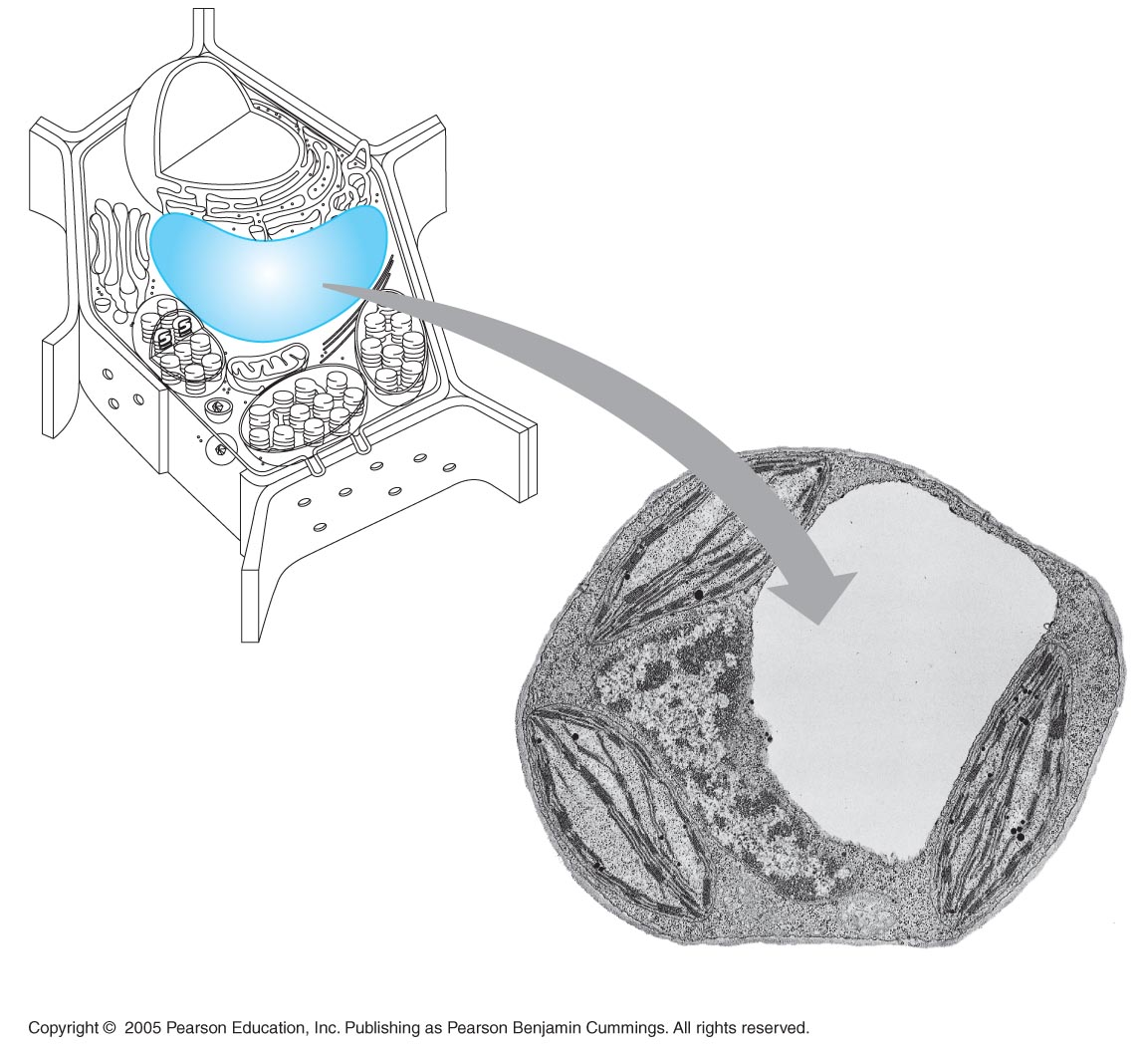
Central vacuole
Cytosol
Tonoplast
Nucleus
Central
vacuole
Cell wall
Chloroplast
5 µm

Slide 73
Central Vacuole
Function – storage area for water, sugars, ions, amino acids, and wastes

Slide 74
Central Vacuole
Structure
Large membrane bound sac
Occupies the majority of the volume of the plant cell
Increases cell’s surface area for transport of substances → cells can be larger

Slide 75
Plant Cell Structures
Structures found in plant, but not animal cells
Chloroplasts
Plastids
Central vacuole
Cell wall

Slide 76
Bacteria-Like Organelles
Release & store energy
Types
Mitochondria
(release energy)
Chloroplasts
(store energy)

Slide 77
Origin of Mitochondria and Chloroplasts
Both organelles are believed to have once been free-living bacteria that were engulfed by a larger cell.

Slide 78
Proposed Origin of Mitochondria and Chloroplasts
Evidence:
Each have their own DNA
Their ribosomes resemble bacterial ribosomes
Each can divide on its own
Mitochondria are same size as bacteria
Each have more than one membrane

Slide 79
Mitochondria and chloroplasts change energy from one form to another
Mitochondria are the sites of cellular respiration
Chloroplasts, found only in plants and algae, are the sites of photosynthesis
Mitochondria and chloroplasts are not part of the endomembrane system
Peroxisomes are oxidative organelles

Slide 80
Mitochondria: Chemical Energy Conversion
Mitochondria are in nearly all eukaryotic cells
They have a smooth outer membrane and an inner membrane folded into cristae
The inner membrane creates two compartments: intermembrane space and mitochondrial matrix
Some metabolic steps of cellular respiration are catalyzed in the mitochondrial matrix
Cristae present a large surface area for enzymes that synthesize ATP

Slide 81
Mitochondria
Function – synthesis of ATP
Structure:
~1-5 microns
Outer membrane
Inner membrane - Highly folded
Folds called cristae
Outer and inner compartment (or matrix)
DNA and ribosomes in matrix

Slide 82
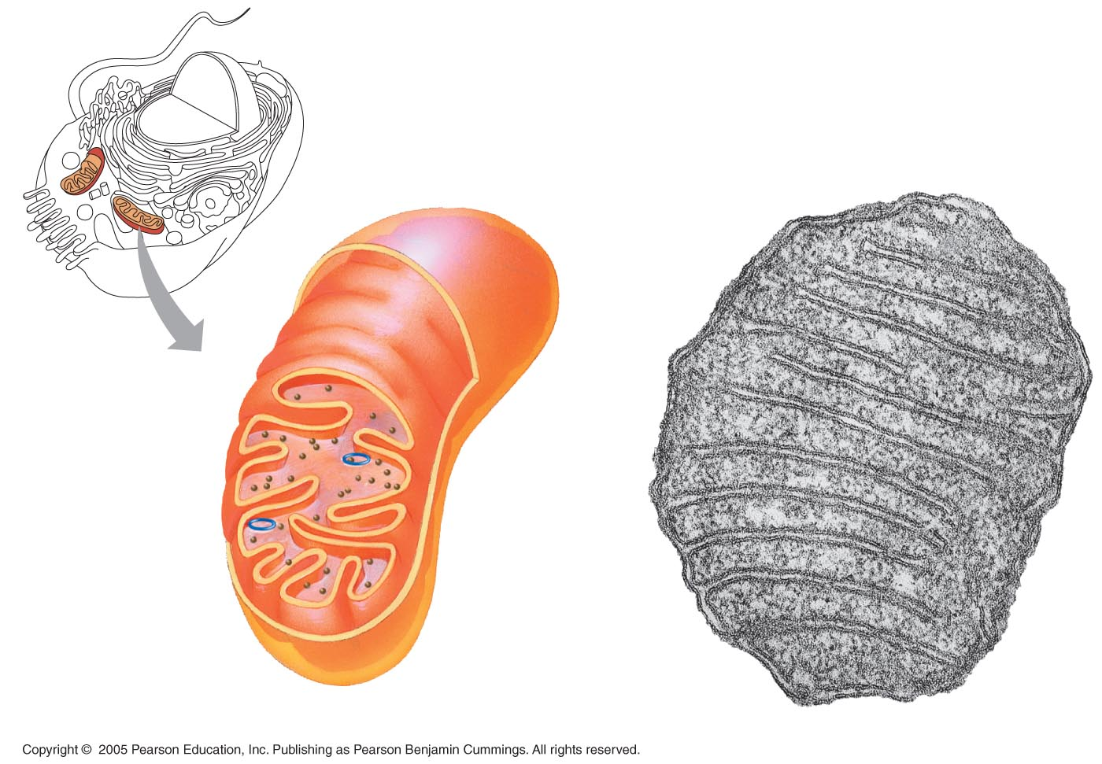
Mitochondrion
Intermembrane space
Outer
membrane
Free
ribosomes
in the
mitochondrial
matrix
Inner
membrane
Cristae
Matrix
Mitochondrial
DNA
100 nm

Slide 83
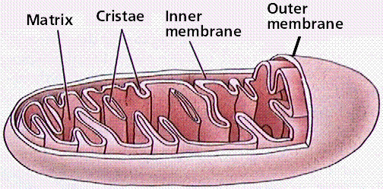
Mitochondria

Slide 84
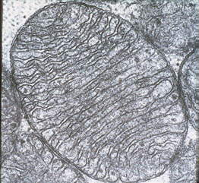
Mitochondria
TEM

Slide 85
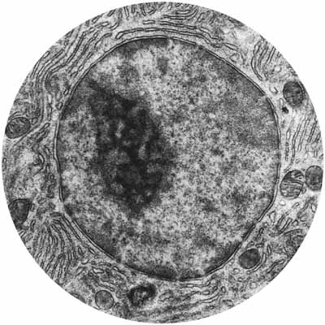

Slide 86
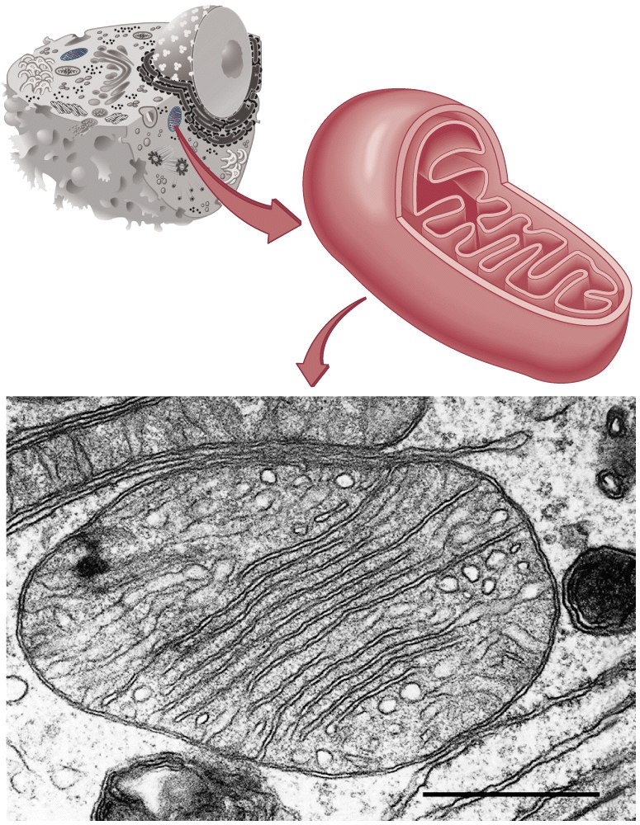
Mitochondria
Have their own DNA
Bound by double membrane

Slide 87
Mitochondria
Break down fuel molecules (cellular respiration)
Glucose
Fatty acids
Release energy
ATP

Slide 88
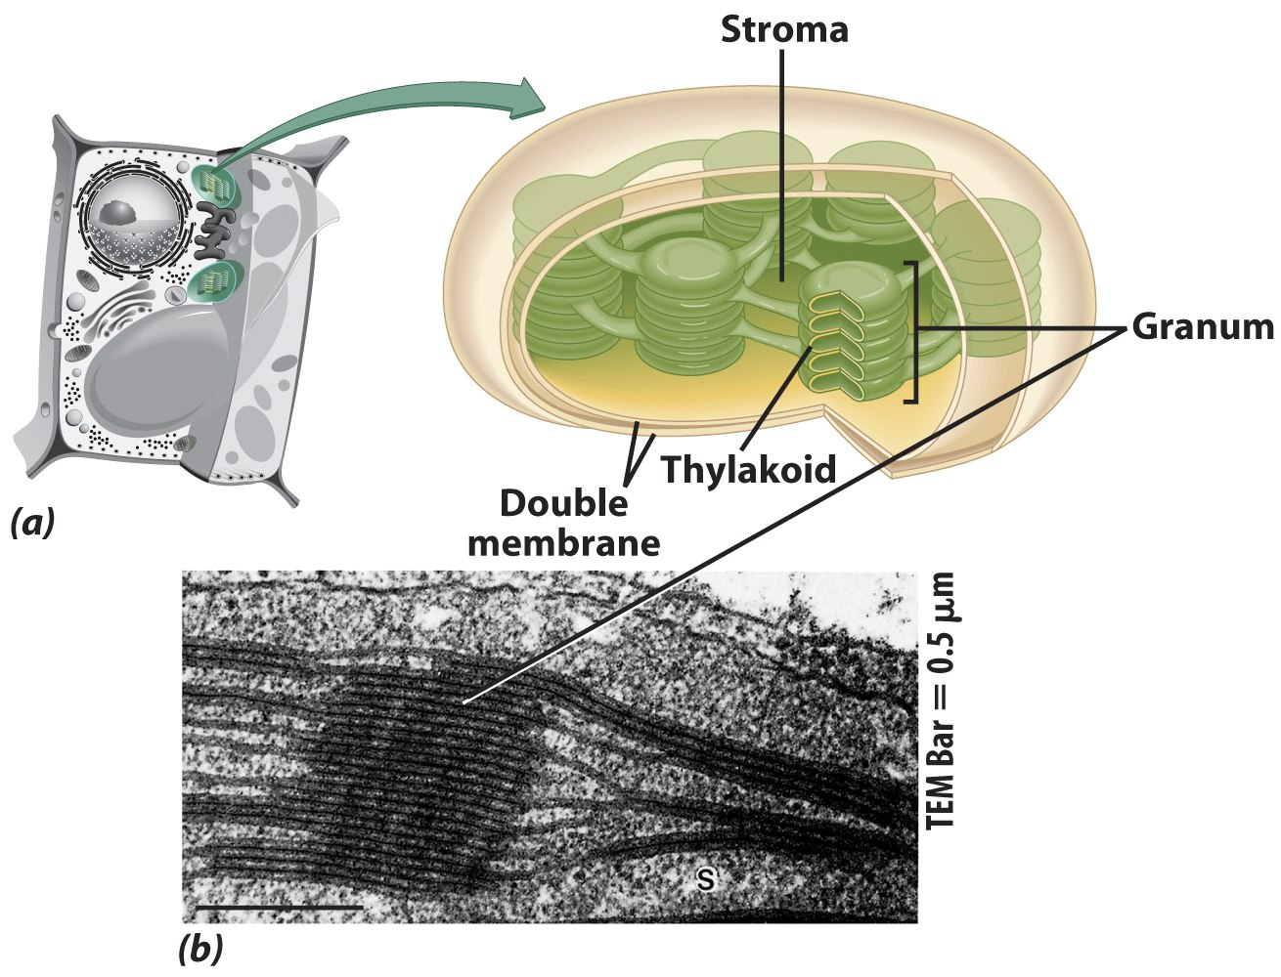
Chloroplasts
Derived form photosynthetic bacteria
Solar energy capturing organelle

Slide 89
Chloroplasts: Capture of Light Energy
The chloroplast is a member of a family of organelles called plastids
Chloroplasts contain the green pigment chlorophyll, as well as enzymes and other molecules that function in photosynthesis
Chloroplasts are found in leaves and other green organs of plants and in algae
Chloroplast structure includes:
Thylakoids, membranous sacs
Stroma, the internal fluid

Slide 90
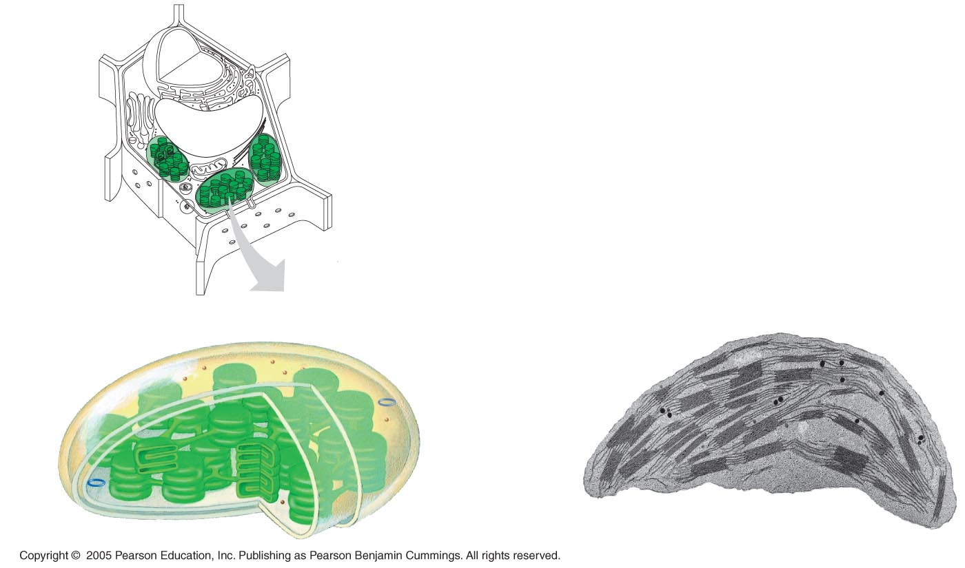
Chloroplast
Ribosomes
Stroma
Chloroplast
DNA
Inner and outer
membranes
Granum
1 µm
Thylakoid

Slide 91
Photosynthesis
Takes place in the chloroplast
Makes cellular food – glucose

Slide 92
Chloroplasts
Function – site of photosynthesis
Structure
2 outer membranes
Thylakoid membrane system
Stacked membrane sacs called granum
Chlorophyll in granum
Stroma
Fluid part of chloroplast

Slide 93
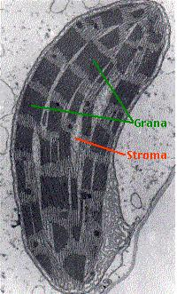

Slide 94
Plastids
Plastids are similar to vesicles
Examples
Chloroplasts
Chromoplasts – contain colored pigments
Pigments called carotenoids
Amyloplasts – store starch

Slide 95
Peroxisomes: Oxidation
Peroxisomes are specialized metabolic compartments bounded by a single membrane
Peroxisomes produce hydrogen peroxide and convert it to water

Slide 96
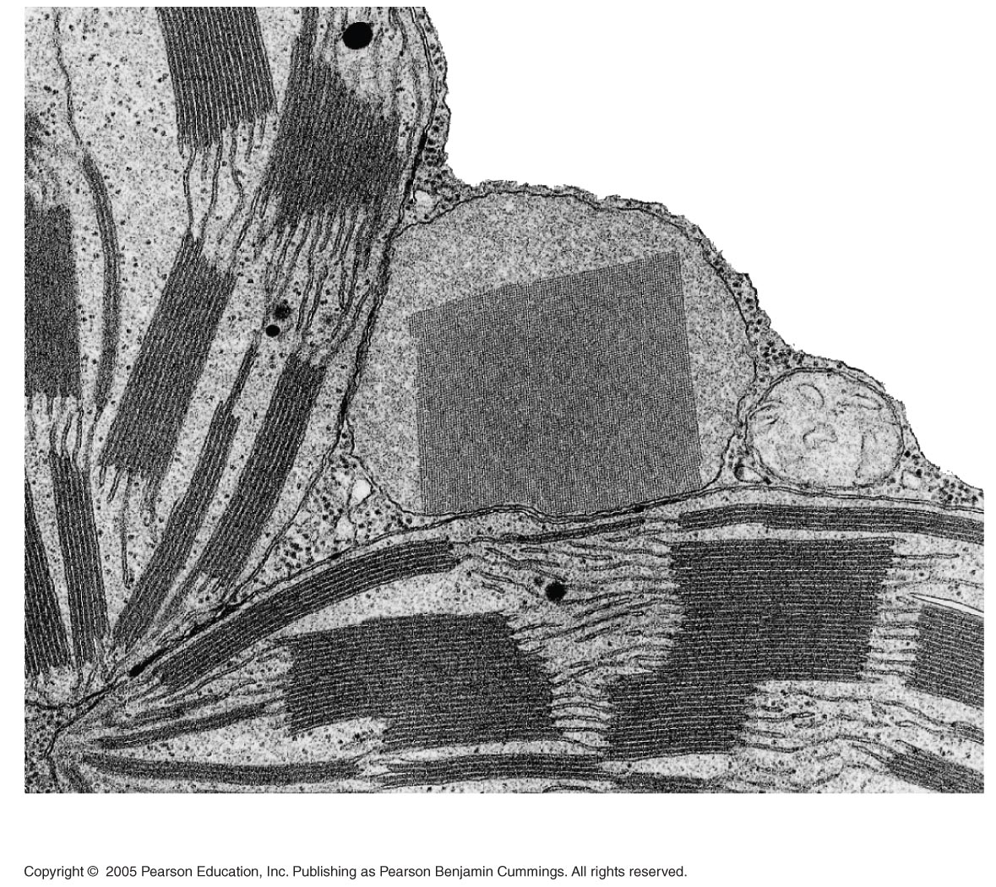
Chloroplast
Peroxisome
Mitochondrion
1 µm

Slide 97
The cytoskeleton is a network of fibers that organizes structures and activities in the cell
The cytoskeleton is a network of fibers extending throughout the cytoplasm
It organizes the cell’s structures and activities, anchoring many organelles
It is composed of three types of molecular structures:
Microtubules
Microfilaments
Intermediate filaments

Slide 98
Cytoskeleton
Function
gives cells internal organization, shape, and ability to move
Structure
Interconnected system of microtubules, microfilaments, and intermediate filaments (animal only)
All proteins

Slide 99
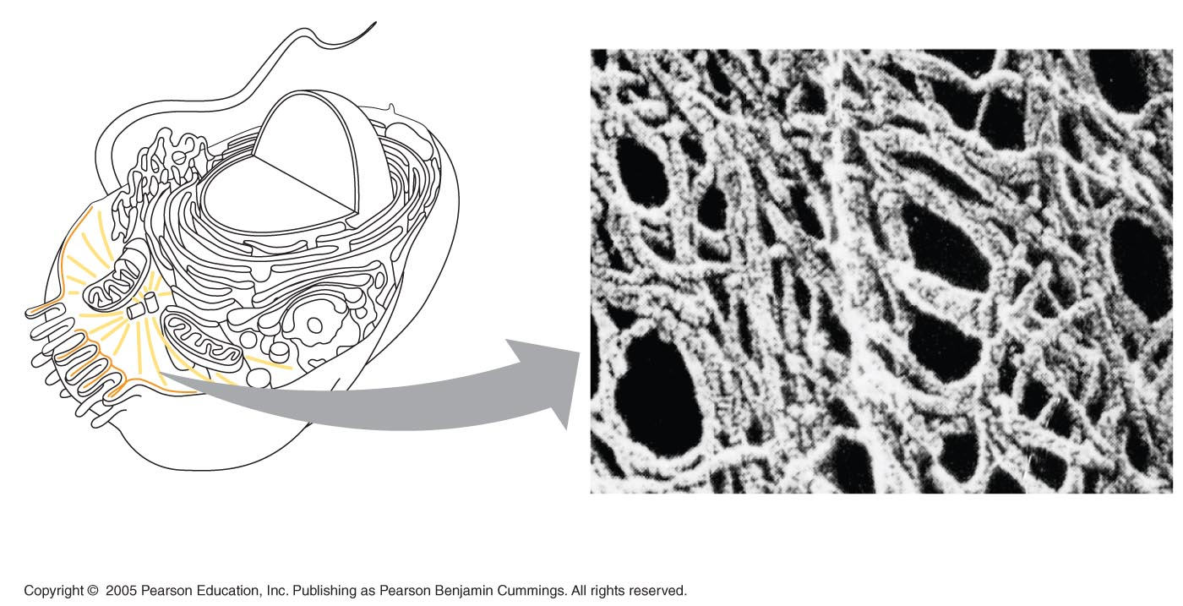
Microtubule
Microfilaments
0.25 µm

Slide 100
Roles of the Cytoskeleton: Support, Motility, and Regulation
The cytoskeleton helps to support the cell and maintain its shape
It interacts with motor proteins to produce motility
Inside the cell, vesicles can travel along “monorails” provided by the cytoskeleton
Recent evidence suggests that the cytoskeleton may help regulate biochemical activities

Slide 101
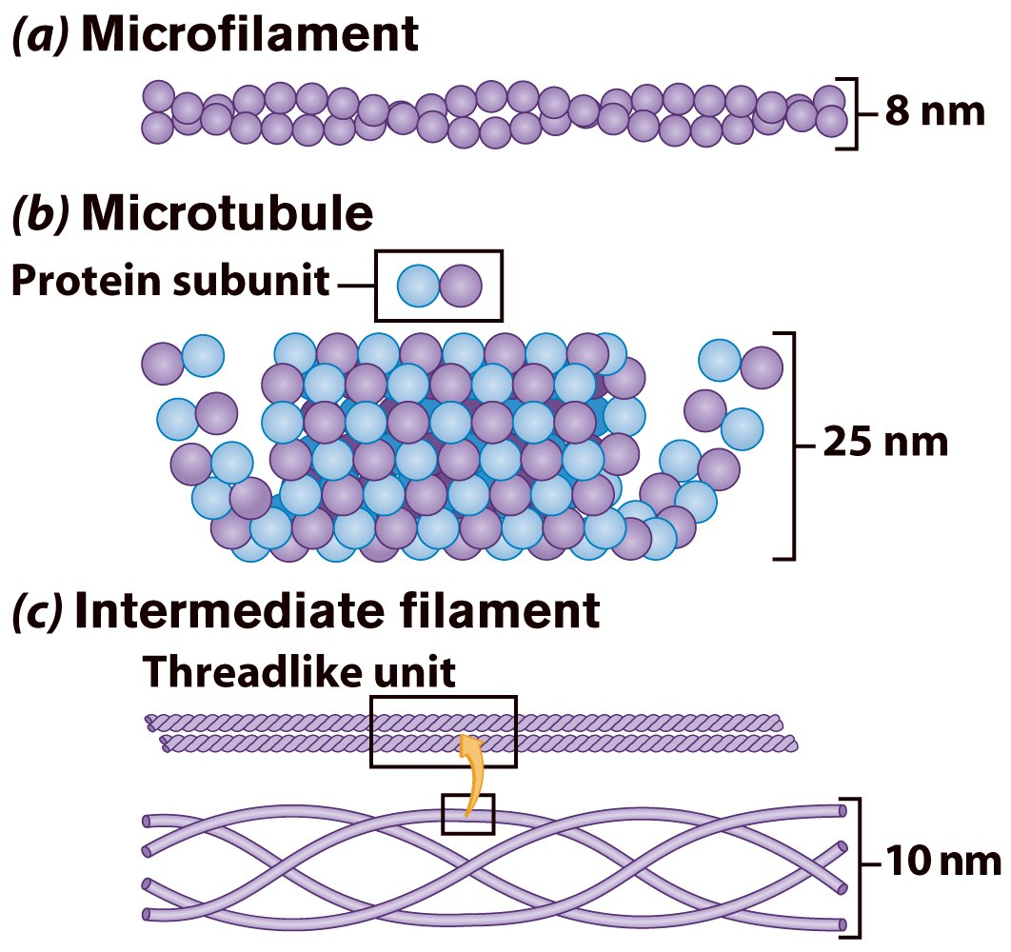
Cytoskeleton
Filaments & fibers
Made of 3 fiber types
Microfilaments
Microtubules
Intermediate filaments
3 functions:
mechanical support
anchor organelles
help move substances

Slide 102
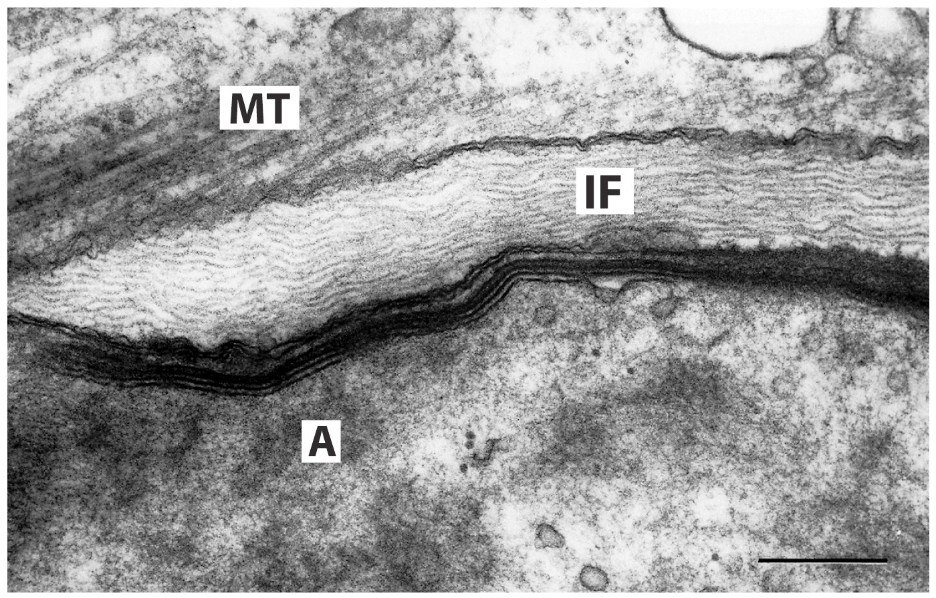
A = actin, IF = intermediate filament, MT = microtubule

Slide 103
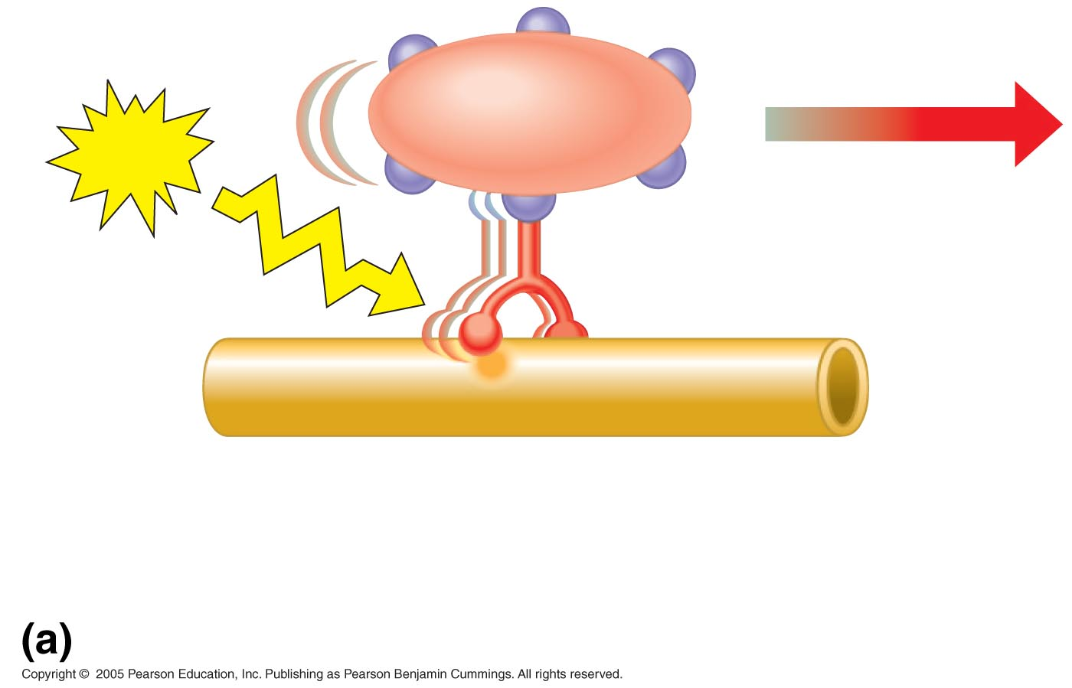
Vesicle
ATP
Receptor for
motor protein
Motor protein
(ATP powered)
Microtubule
of cytoskeleton

Slide 104
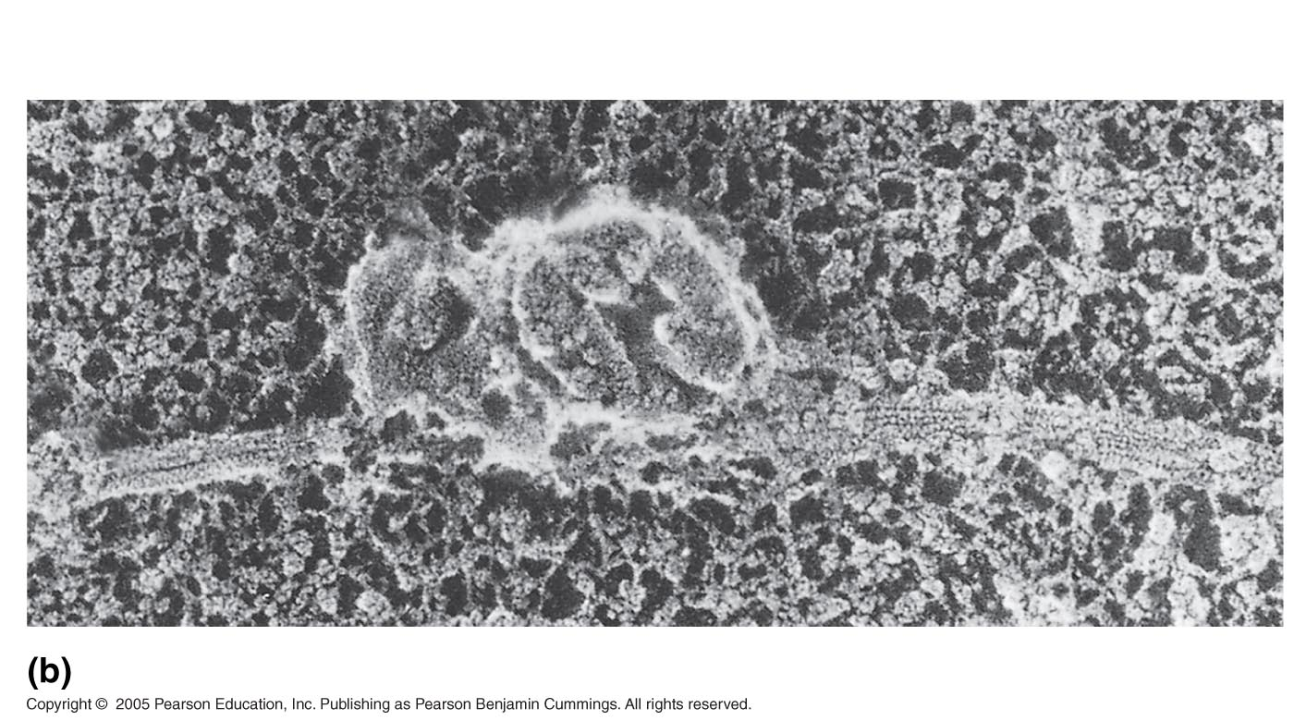
Microtubule
Vesicles
0.25 µm

Slide 105
Components of the Cytoskeleton
Microtubules are the thickest of the three components of the cytoskeleton
Microfilaments, also called actin filaments, are the thinnest components
Intermediate filaments are fibers with diameters in a middle range

Slide 109
Microtubules
Microtubules are hollow rods about 25 nm in diameter and about 200 nm to 25 microns long
Functions of microtubules:
Shaping the cell
Guiding movement of organelles
Separating chromosomes during cell division

Slide 110
Centrosomes and Centrioles
In many cells, microtubules grow out from a centrosome near the nucleus
The centrosome is a “microtubule-organizing center”
In animal cells, the centrosome has a pair of centrioles, each with nine triplets of microtubules arranged in a ring

Slide 111
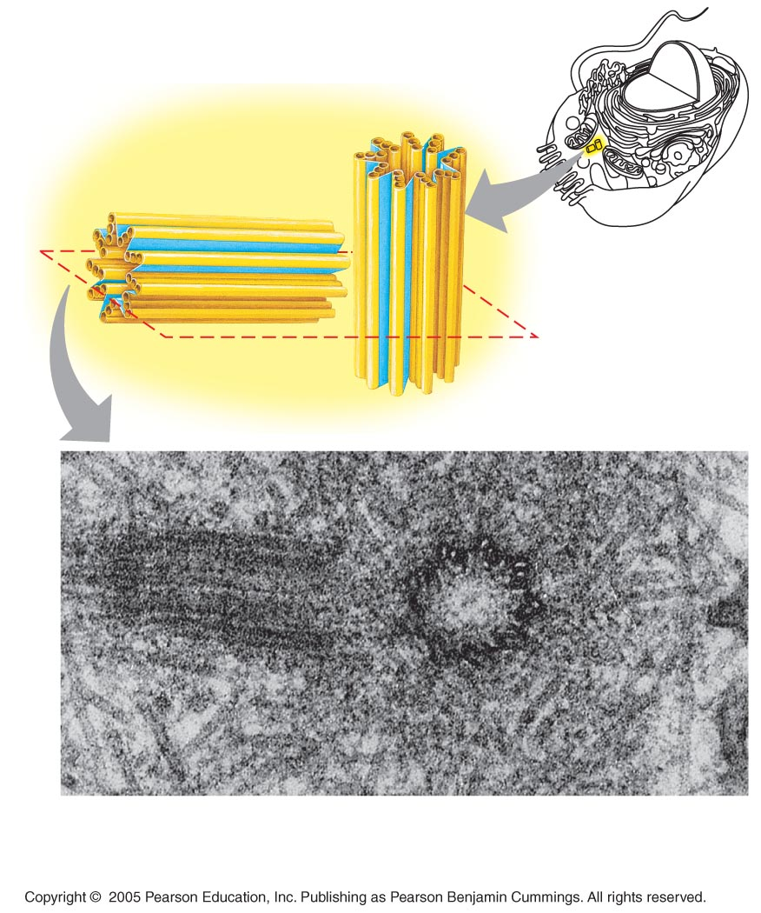
Centrosome
Microtubule
Centrioles
0.25 µm
Longitudinal section
of one centriole
Microtubules
Cross section
of the other centriole

Slide 112
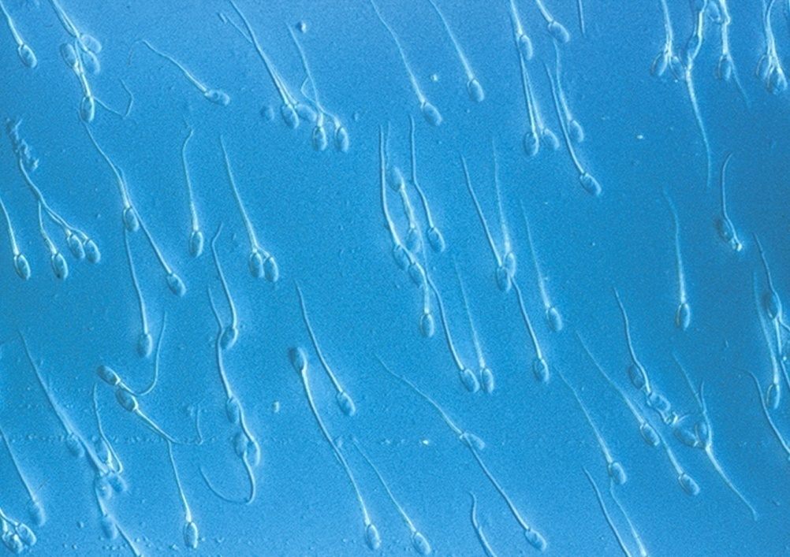
Cilia & Flagella
Provide motility
Cilia
Short
Used to move substances outside human cells
Flagella
Whip-like extensions
Found on sperm cells
Basal bodies like centrioles

Slide 113
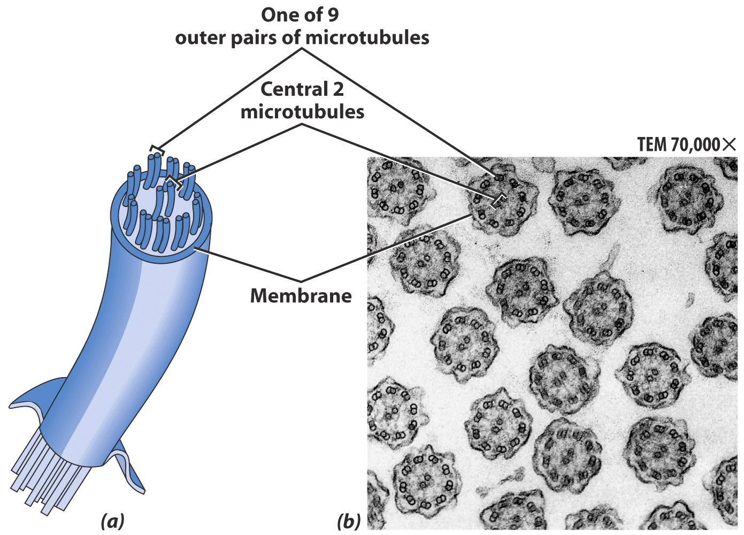
Cilia & Flagella Structure
Bundles of microtubules
With plasma membrane

Slide 114
Cilia and Flagella
Microtubules control the beating of cilia and flagella, locomotor appendages of some cells
Cilia and flagella differ in their beating patterns

Slide 115
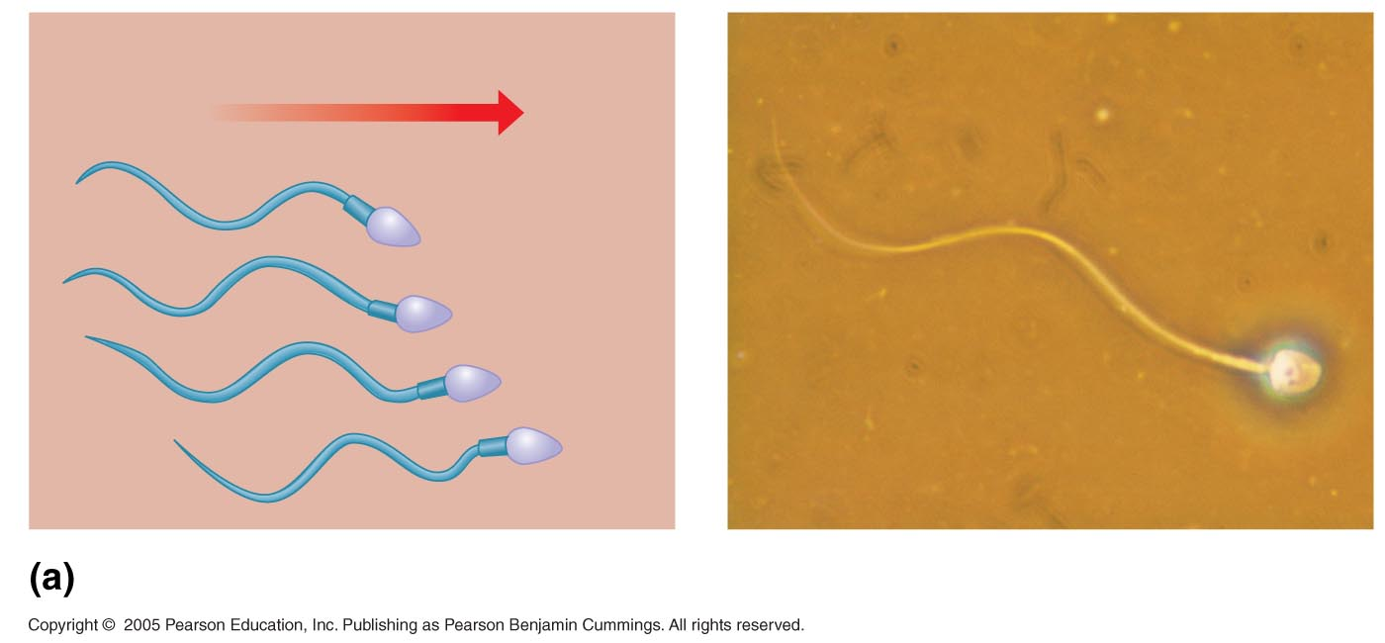
Direction of swimming
Motion of flagella
5 µm

Slide 116
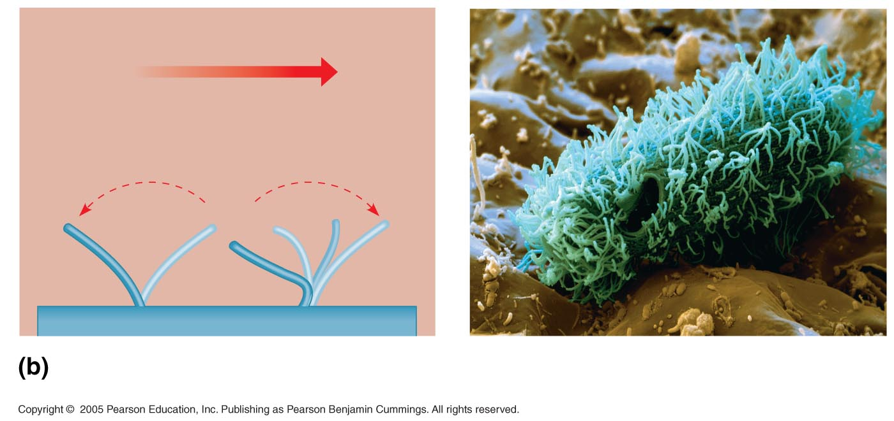
Direction of organism’s movement
Direction of
active stroke
Direction of
recovery stroke
Motion of cilia
15 µm

Slide 117
Cilia and flagella share a common ultrastructure:
A core of microtubules sheathed by the plasma membrane
A basal body that anchors the cilium or flagellum
A motor protein called dynein, which drives the bending movements of a cilium or flagellum

Slide 118
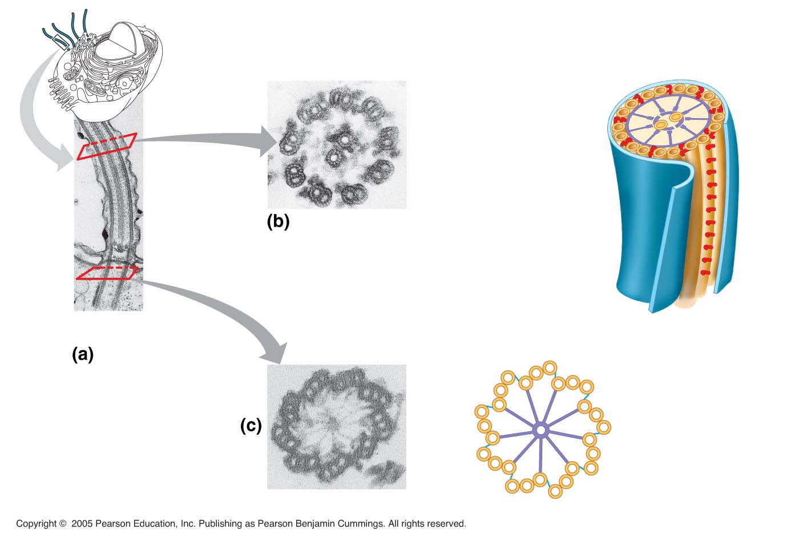
0.1 µm
Outer microtubule
doublet
Plasma
membrane
Dynein arms
Central
microtubule
Cross-linking
proteins inside
outer doublets
Microtubules
Plasma
membrane
Radial
spoke
Basal body
0.5 µm
0.1 µm
Triplet
Cross section of basal body

Slide 119
How dynein “walking” moves flagella and cilia:
Dynein arms alternately grab, move, and release the outer microtubules
Protein cross-links limit sliding
Forces exerted by dynein arms cause doublets to curve, bending the cilium or flagellum

Slide 120
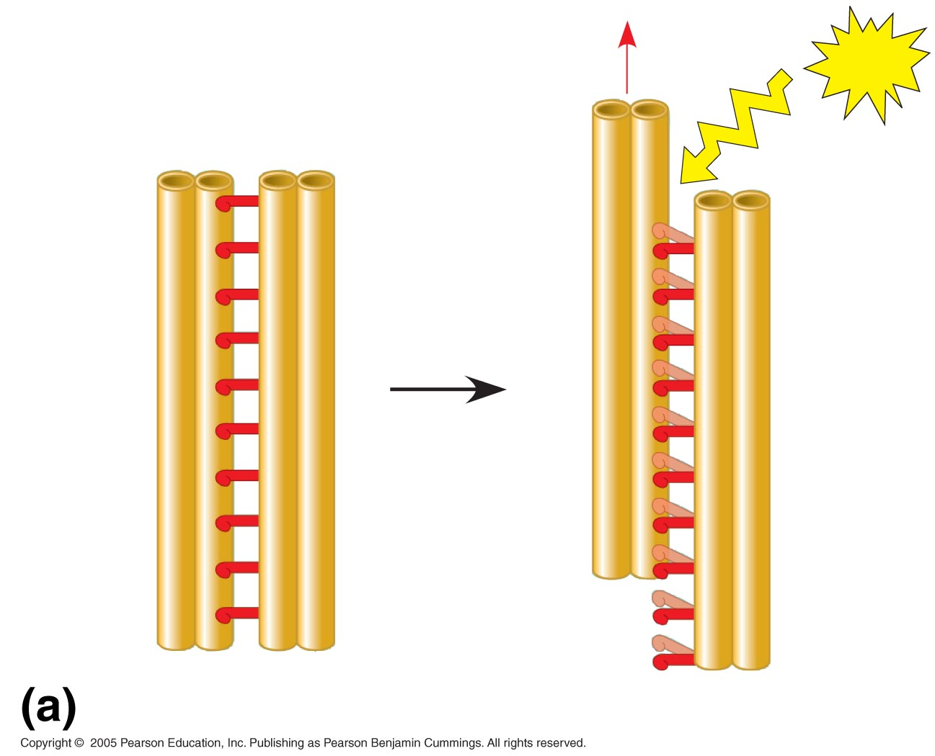
Microtubule
doublets
ATP
Dynein arm
Dynein “walking”

Slide 121
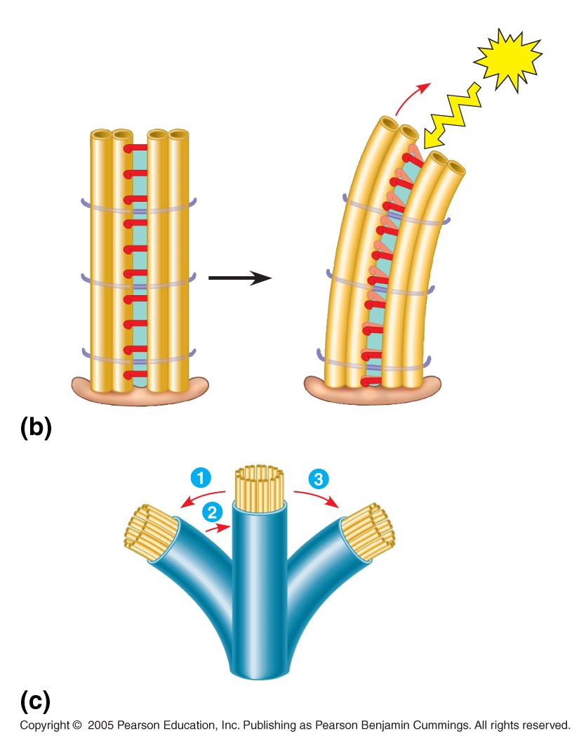
Cross-linking
proteins inside
outer doublets
ATP
Anchorage
in cell
Effect of cross-linking proteins
Wavelike motion

Slide 122
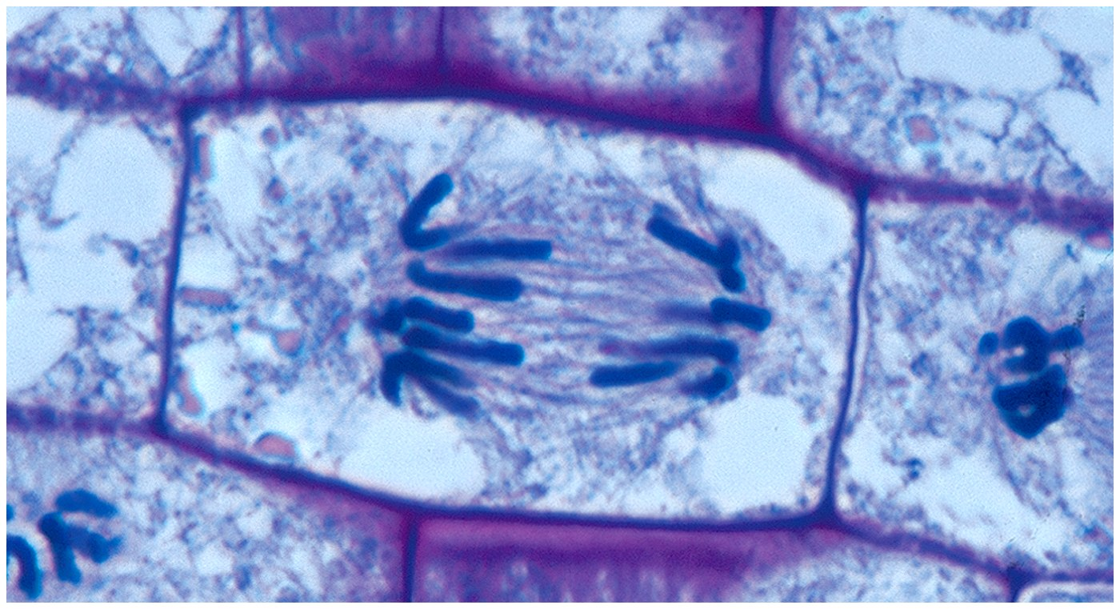
Centrioles
Pairs of microtubular structures
Play a role in cell division

Slide 123
Microfilaments (Actin Filaments)
Microfilaments are solid rods about 7 nm in diameter, built as a twisted double chain of actin subunits
The structural role of microfilaments is to bear tension, resisting pulling forces within the cell
They form a 3D network just inside the plasma membrane to help support the cell’s shape
Bundles of microfilaments make up the core of microvilli of intestinal cells

Slide 124
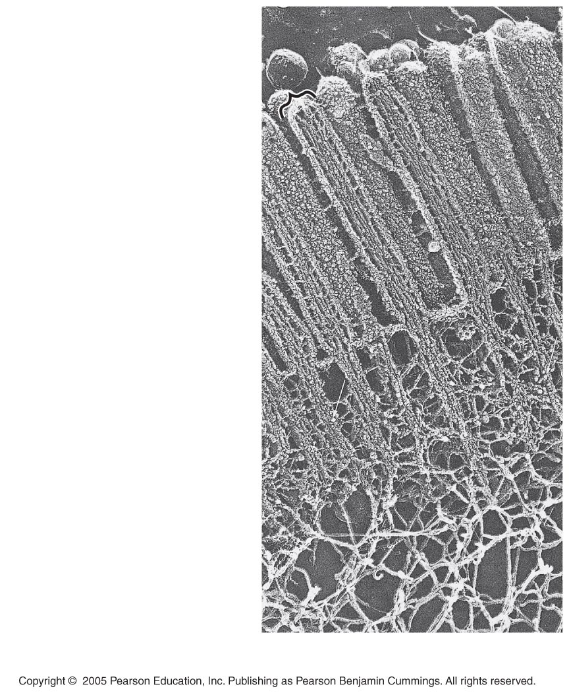
Microvillus
Plasma membrane
Microfilaments (actin
filaments)
Intermediate filaments
0.25 µm

Slide 125
Microfilaments that function in cellular motility contain the protein myosin in addition to actin
In muscle cells, thousands of actin filaments are arranged parallel to one another
Thicker filaments composed of myosin interdigitate with the thinner actin fibers

Slide 126
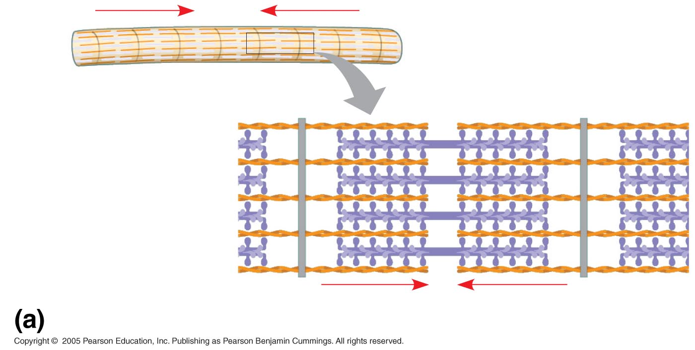
Muscle cell
Actin filament
Myosin filament
Myosin arm
Myosin motors in muscle cell contraction

Slide 127
Localized contraction brought about by actin and myosin also drives amoeboid movement
Pseudopodia (cellular extensions) extend and contract through the reversible assembly and contraction of actin subunits into microfilaments

Slide 128
Cortex (outer cytoplasm):
gel with actin network
Inner cytoplasm: sol
with actin subunits
Extending
pseudopodium
Amoeboid movement

Slide 129
Cytoplasmic streaming is a circular flow of cytoplasm within cells
This streaming speeds distribution of materials within the cell
In plant cells, actin-myosin interactions and sol-gel transformations drive cytoplasmic streaming

Slide 130
Nonmoving
cytoplasm (gel)
Chloroplast
Streaming
cytoplasm
(sol)
Vacuole
Parallel actin
filaments
Cell wall
Cytoplasmic streaming in plant cells

Slide 131
Intermediate Filaments
Intermediate filaments range in diameter from 8–12 nanometers, larger than microfilaments but smaller than microtubules
They support cell shape and fix organelles in place
Intermediate filaments are more permanent cytoskeleton fixtures than the other two classes

Slide 132
Plasma Membrane
Contains cell contents
Double layer of phospholipids & proteins

Slide 133
Phospholipids
Polar
Hydrophylic head
Hydrophobic tail
Interacts with water

Slide 134
Movement Across the Plasma Membrane
A few molecules move freely
Water, Carbon dioxide, Ammonia, Oxygen
Carrier proteins transport some molecules
Proteins embedded in lipid bilayer
Fluid mosaic model – describes fluid nature of a lipid bilayer with proteins

Slide 136
Membrane Proteins
1. Channels or transporters
Move molecules in one direction
2. Receptors
Recognize certain chemicals

Slide 137
Membrane Proteins
3. Glycoproteins
Identify cell type
4. Enzymes
Catalyze production of substances

Slide 138
Molecule Movement & Cells
Passive Transport
Active Transport
Endocytosis
(phagocytosis & pinocytosis)
Exocytosis

Slide 139
Passive Transport
No energy required
Move due to gradient
differences in concentration, pressure, charge
Move to equalize gradient
High moves toward low

Slide 140
Types of Passive Transport
1. Diffusion
2. Osmosis
3. Facilitated diffusion

Slide 141
Diffusion
Molecules move to equalize concentration

Slide 142
Osmosis
Special form of diffusion
Fluid flows from lower solute concentration
Often involves movement of water
Into cell
Out of cell

Slide 143
Solution Differences & Cells
solvent + solute = solution
Hypotonic
Solutes in cell more than outside
Outside solvent will flow into cell
Isotonic
Solutes equal inside & out of cell
Hypertonic
Solutes greater outside cell
Fluid will flow out of cell

Slide 145
Facilitated Diffusion
Differentially permeable membrane
Channels (are specific) help molecule or ions enter or leave the cell
Channels usually are transport proteins
(aquaporins facilitate the movement of water)
No energy is used

Slide 146
Process of Facilitated Transport
Protein binds with molecule
Shape of protein changes
Molecule moves across membrane

Slide 147
Active Transport
Molecular movement
Requires energy (against gradient)
Example is sodium-potassium pump

Slide 148
Endocytosis
Movement of large material
Particles
Organisms
Large molecules
Movement is into cells
Types of endocytosis
bulk-phase (nonspecific)
receptor-mediated (specific)

Slide 149
Process of Endocytosis
Plasma membrane surrounds material
Edges of membrane meet
Membranes fuse to form vesicle

Slide 150
Forms of Endocytosis
Phagocytosis – cell eating
Pinocytosis – cell drinking

Slide 151
Exocytosis
Reverse of endocytosis
Cell discharges material

Slide 152
Exocytosis
Vesicle moves to cell surface
Membrane of vesicle fuses
Materials expelled

Slide 153
Cell Walls
Found in plants, fungi, & many protists
Surrounds plasma membrane

Slide 154
Cell Wall Differences
Plants – mostly cellulose
Fungi – contain chitin

Slide 155
Cell Wall
Function – provides structure and protection
Never found in animal cells
Present in plant, bacterial, fungus, and protists (some)

Slide 156
Cell Wall
Structure
Made of cellulose and other polysaccharides
May be reinforced by pectin and lignin
Permeable

Slide 157
Extracellular components and connections between cells help coordinate cellular activities
Most cells synthesize and secrete materials that are external to the plasma membrane
These extracellular structures include:
Cell walls of plants
The extracellular matrix (ECM) of animal cells
Intercellular junctions

Slide 158
Cell Walls of Plants
The cell wall is an extracellular structure that distinguishes plant cells from animal cells
The cell wall protects the plant cell, maintains its shape, and prevents excessive uptake of water
Plant cell walls are made of cellulose fibers embedded in other polysaccharides and protein

Slide 159
Cell Walls of Plants
Plant cell walls may have multiple layers:
Primary cell wall: relatively thin and flexible
Middle lamella: thin layer between primary walls of adjacent cells
Secondary cell wall (in some cells): added between the plasma membrane and the primary cell wall
Plasmodesmata are channels between adjacent plant cells

Slide 160
Central
vacuole
of cell
Plasma
membrane
Secondary
cell wall
Primary
cell wall
Central
vacuole
of cell
Middle
lamella
1 µm
Central vacuole
Cytosol
Plasma membrane
Plant cell walls
Plasmodesmata

Slide 161
Plant Cell TEM

Slide 162
Typical Plant Cell

Slide 163
The Extracellular Matrix (ECM) of Animal Cells
Animal cells lack cell walls but are covered by an elaborate extracellular matrix (ECM)
The ECM is made up of glycoproteins and other macromolecules
Functions of the ECM:
Support
Adhesion
Movement
Regulation

Slide 164
EXTRACELLULAR FLUID
Proteoglycan
complex
Collagen
fiber
Fibronectin
Plasma
membrane
CYTOPLASM
Integrin
Micro-
filaments

Slide 165
Proteoglycan
complex
Polysaccharide
molecule
Carbo-
hydrates
Core
protein
Proteoglycan
molecule

Slide 166
Intercellular Junctions
Neighboring cells in tissues, organs, or organ systems often adhere, interact, and communicate through direct physical contact
Intercellular junctions facilitate this contact

Slide 167
Plants: Plasmodesmata
Plasmodesmata are channels that perforate plant cell walls
Through plasmodesmata, water and small solutes (and sometimes proteins and RNA) can pass from cell to cell

Slide 168
Cell walls
Interior
of cell
Interior
of cell
0.5 µm
Plasmodesmata
Plasma membranes

Slide 169
Animals: Tight Junctions, Desmosomes, and Gap Junctions
At tight junctions, membranes of neighboring cells are pressed together, preventing leakage of extracellular fluid
Desmosomes (anchoring junctions) fasten cells together into strong sheets
Gap junctions (communicating junctions) provide cytoplasmic channels between adjacent cells

Slide 170
Tight junctions prevent
fluid from moving
across a layer of cells
Tight junction
0.5 µm
Tight junction
Intermediate
filaments
Desmosome
1 µm
Gap
junctions
Space
between
cells
Plasma membranes
of adjacent cells
Gap junction
Extracellular
matrix
0.1 µm

Slide 171
The Cell: A Living Unit Greater Than the Sum of Its Parts
Cells rely on the integration of structures and organelles in order to function
For example, a macrophage’s ability to destroy bacteria involves the whole cell, coordinating components such as the cytoskeleton, lysosomes, and plasma membrane

Slide 172
Review of Eukaryotic Cells

Slide 173
Review of Eukaryotic Cells

