Slide 1
Tourism Products

Slide 2
Tourists activities → products
See
Do
Buy

Slide 3
Tourism products
the total tourist experience that meet its expectations, including experience with:
housing,
natural and cultural attractions,
entertainment,
transportation,
catering,
hosts etc.

Slide 4
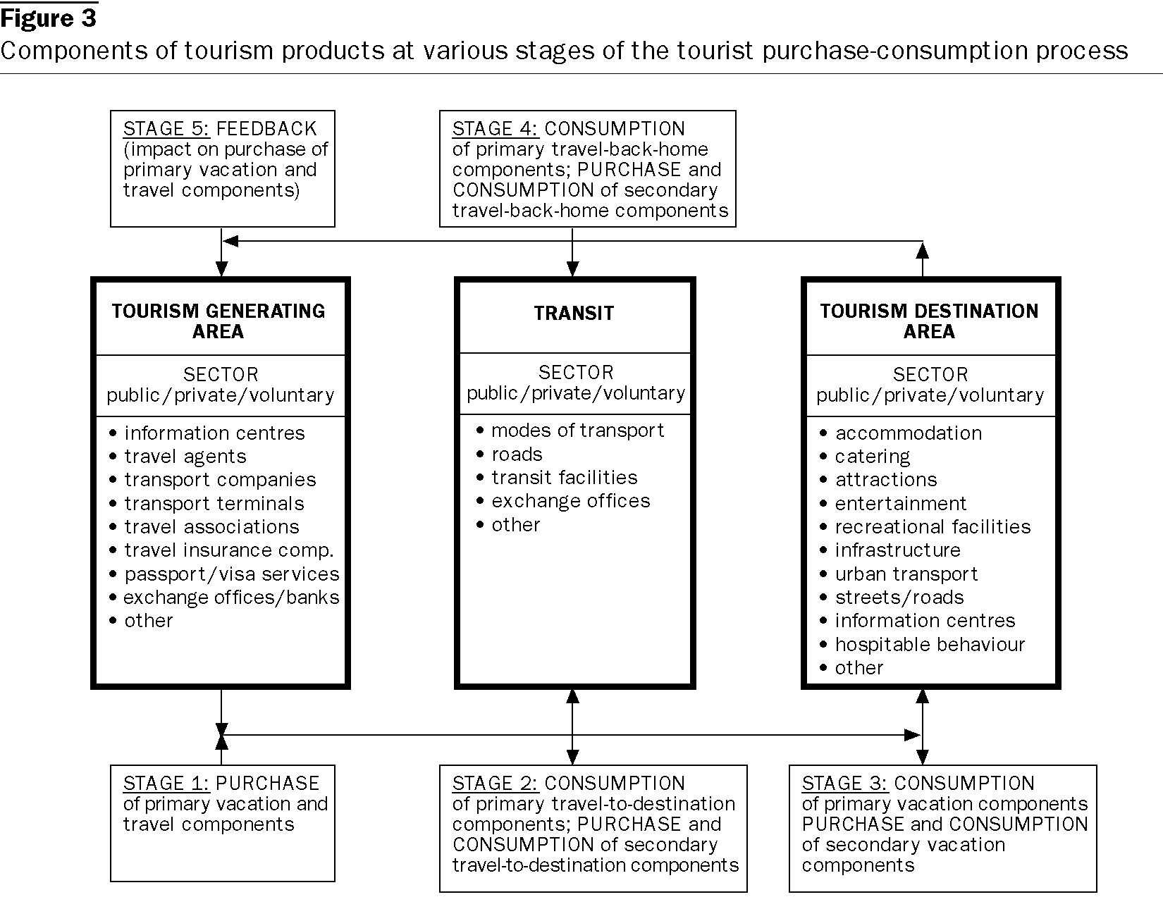

Slide 5
Tourism products: strategies
Bundling attractions
Wisata hutan bakau (mangrove forest)
Festivals, special events
Summer festival Thailand
Programming, packaging, and partnership
Ramayana Ballet

Slide 7
Develop tourism products
Understand your market: how many people, why visit, who are they, where do they come from, where do they stay,
Develop desired experiences
Connect with location: facilities, localities, the site itself
Example: RAIL JAVA TOUR

Slide 8
Group task
Pikirkan suatu produk: lokal, ditinggalkan, perlu dikembangkan, .....
Profil produk
SWOT analysis
Strategi pengembangan produk menjadi produk wisata: new tagline, new campaign, new usage, etc

Slide 9
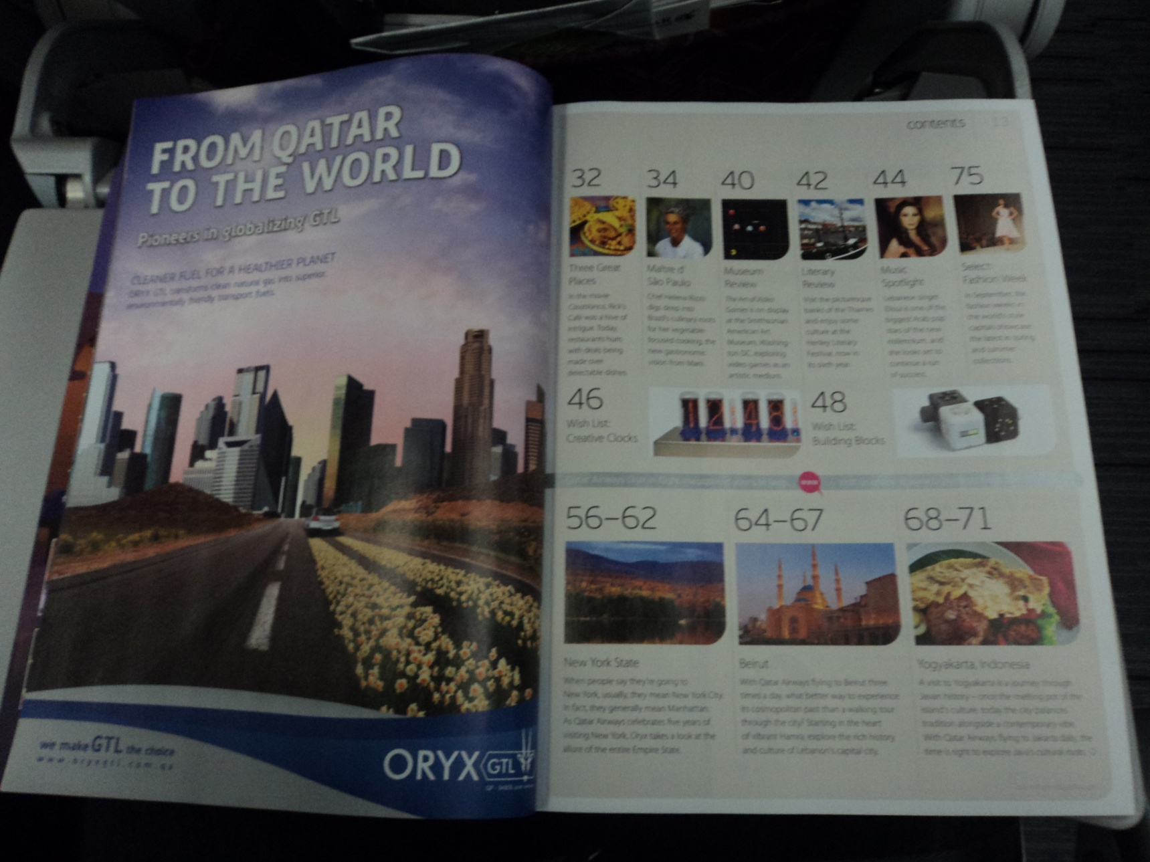
Rejuvenation

Slide 10
Rejuvenation

Slide 11
