Slide 1
People, process, physical evidence

Slide 2
People
Recruitment → sumber rekruitment?
Selection → cara seleksi?
Training → tujuan? Siapa saja?
Job specification
Job description
Motivating → reward dan punishment

Slide 3
Process
Input (raw materials) → output (goods and services)
Berhubungan dengan time of eating dan seat turnover
Berhubungan dengan perencanaan dapur
Harus efisien dan efektif → perhatikan alur konsumen masuk dan keluar

Slide 4
Physical Evidence
Konsep/tema harus jelas!
Vending
Family restaurant
Dinner house
Coffee shop
Cafetaria
Fast food
Luxury restaurant

Slide 5
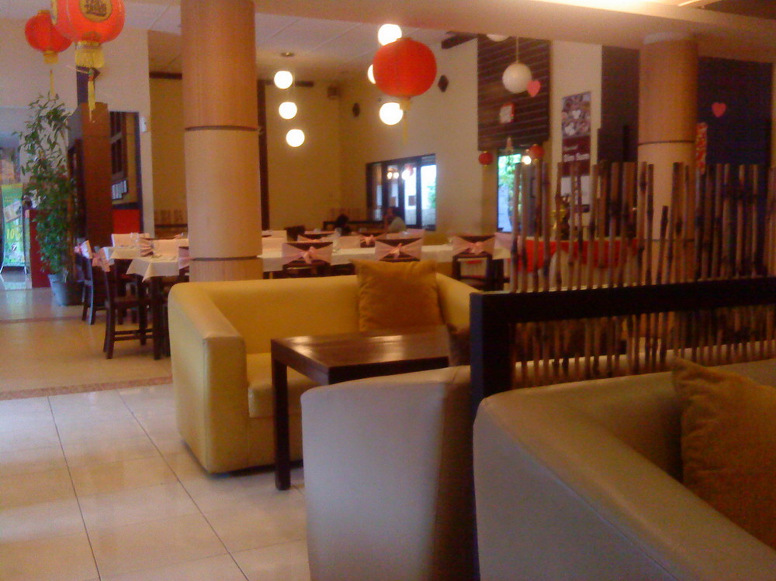

Slide 6
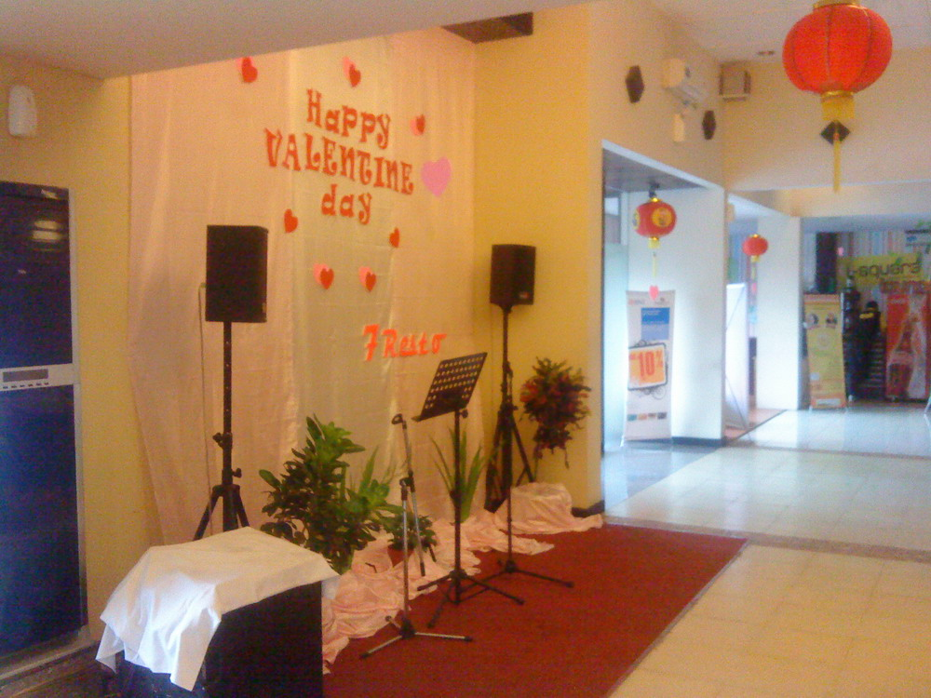

Slide 7
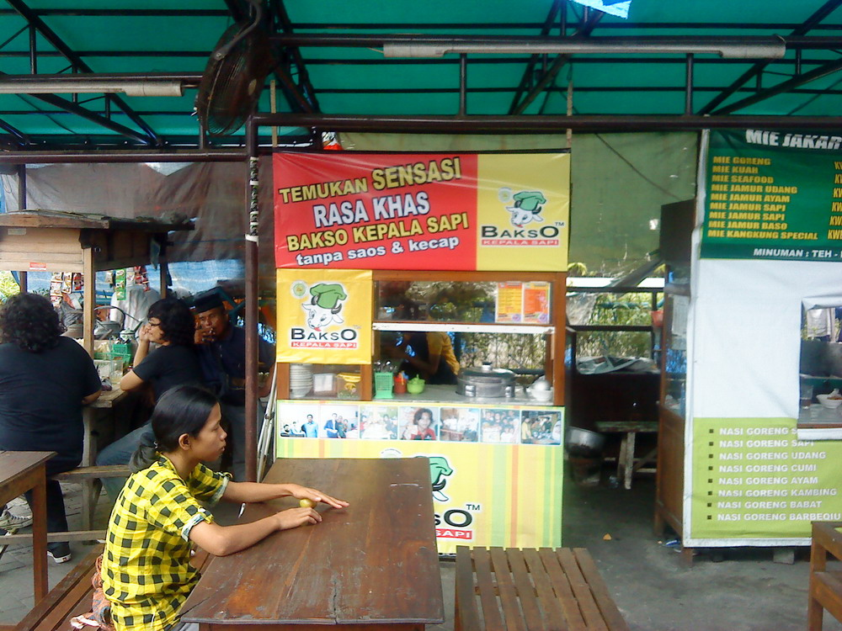

Slide 8
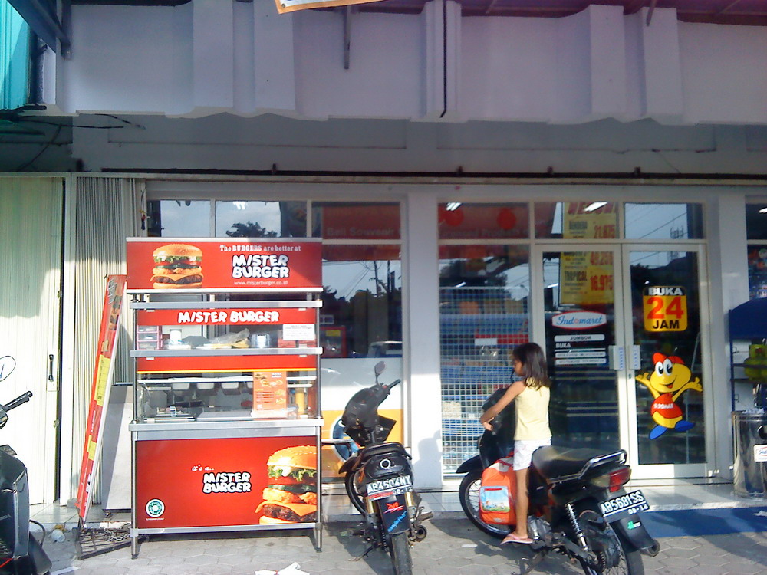

Slide 9
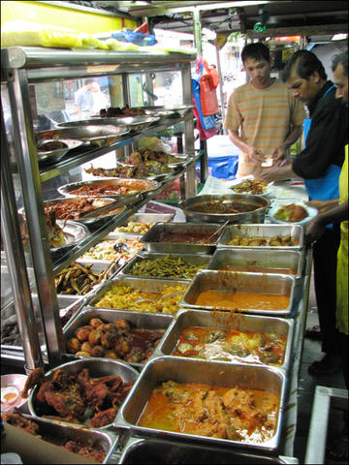

Slide 10
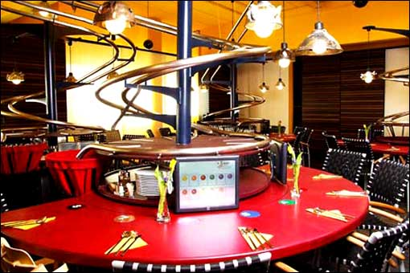

Slide 11
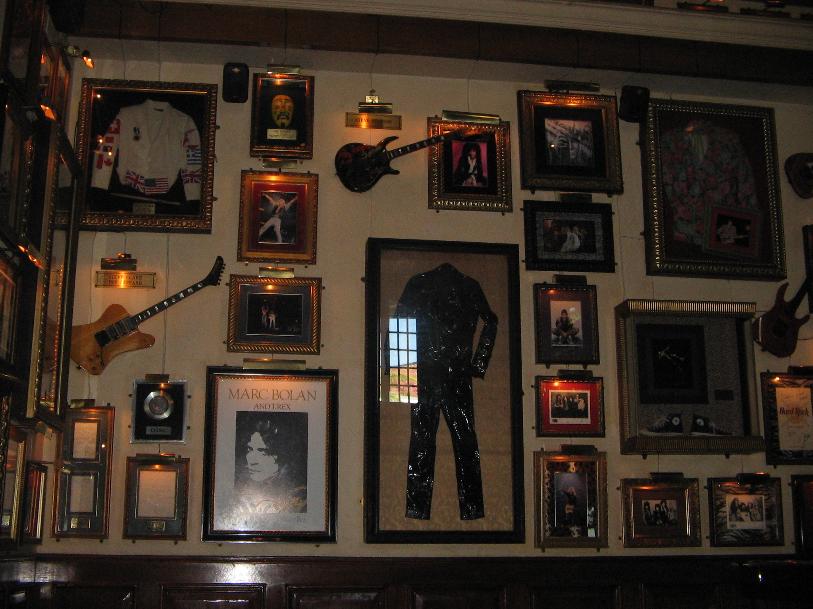

Slide 12
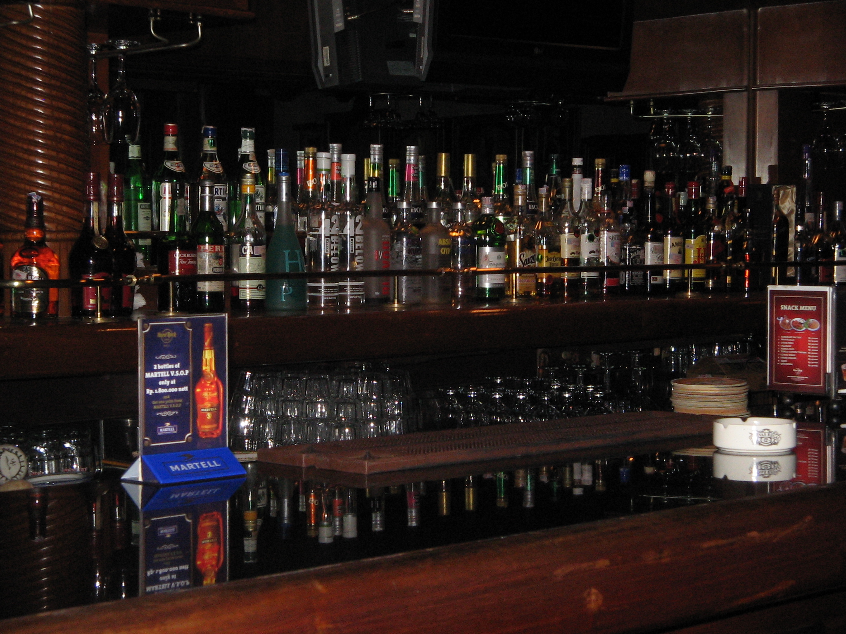

Slide 13
